Slide 1
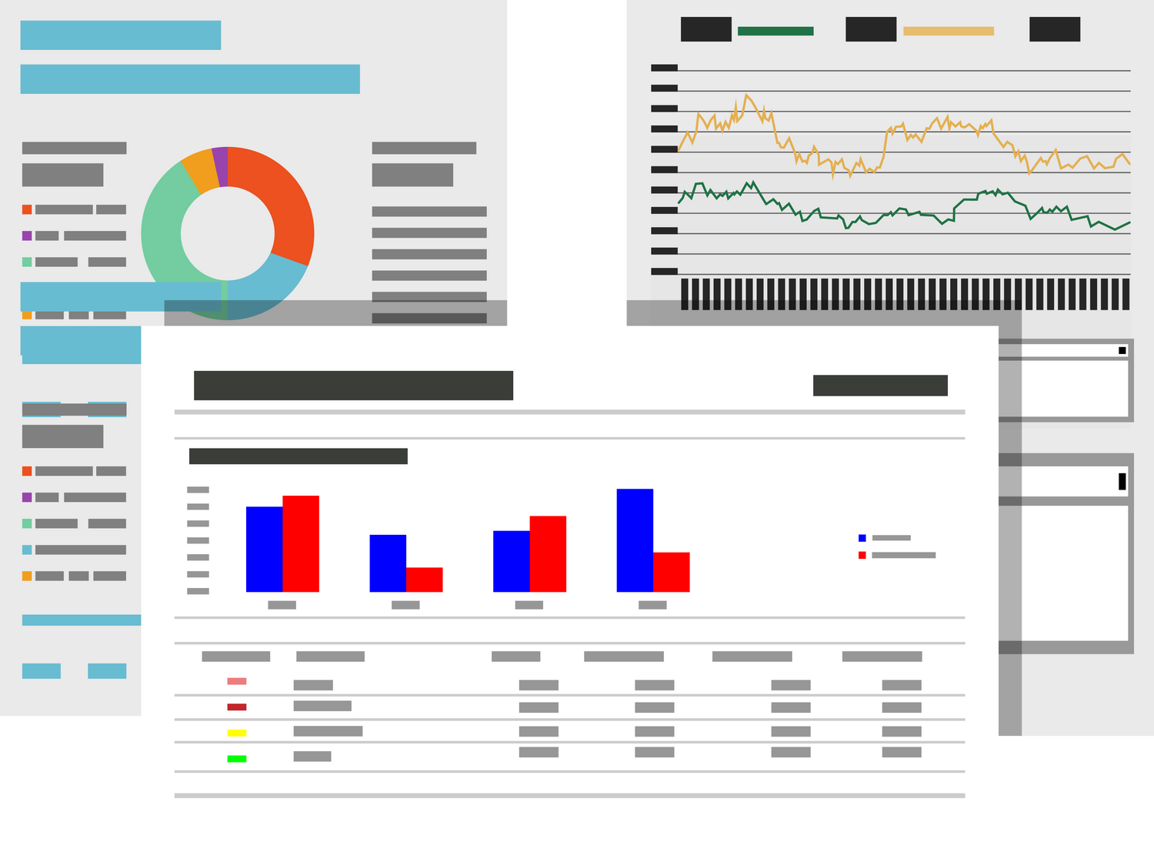

PREDICTIVE ANALYTICS
PROJECT REPORT

Slide 2
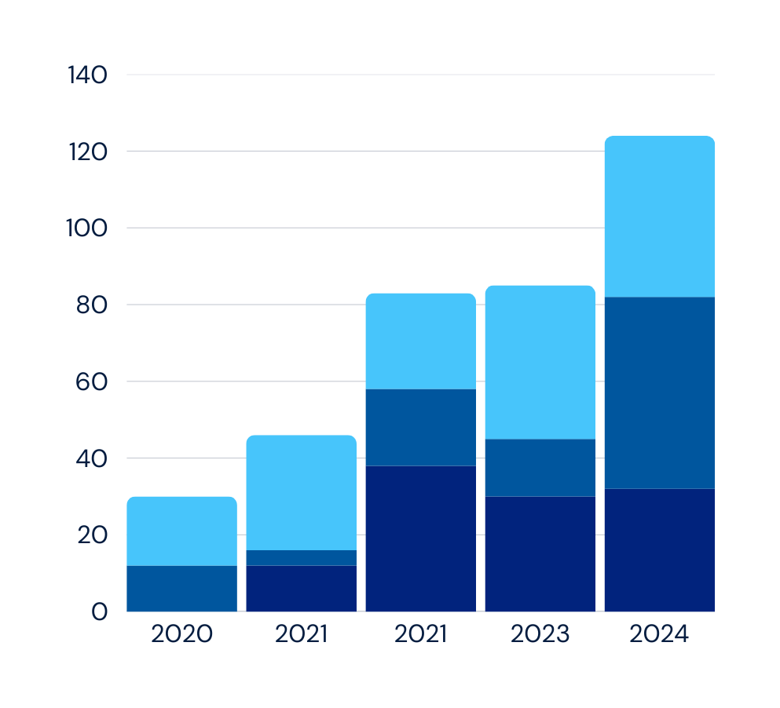

Overview
INTRODUCTION
CHALLENGES
DATA OVERVIEW
DATA CLEANING
PREDICTIVE MODELS
CONCLUSION

Slide 3
Introduction
This project aims to predict the likelihood of loan approval based on demographic, credit, and loan-related features from a publicly available dataset. The dataset includes variables such as the applicant's age, income, education level, credit score, loan amount, and loan intent. The objective is to apply various machine learning algorithms to predict whether a loan will be approved (1) or denied (0).
The goal of this analysis is to provide valuable insights that could optimize the decision-making process for financial institutions.

Slide 4
Challenges
In analyzing this dataset, several challenges were encountered:
Imbalanced Data: The classes of loan approval (approved vs. denied) may not be equally represented, which could affect model performance, especially for the underrepresented class.
Missing Data: Some data points had missing values, which required preprocessing steps to ensure the dataset could be used effectively.
Feature Selection: Deciding which features were most relevant to predicting loan approval was critical to ensuring the model's success.
4

Slide 5
Data Overview
The dataset contains a mix of categorical and numerical features:
Demographic Features: Age, gender, education level, and income.
Loan Features: Loan amount, loan intent (e.g., personal, medical, education), and loan interest rate.
Credit Features: Credit score, credit history length, and previous loan defaults.
The target variable is the loan approval status, with '1' indicating approved loans and '0' indicating denied loans.

Slide 6
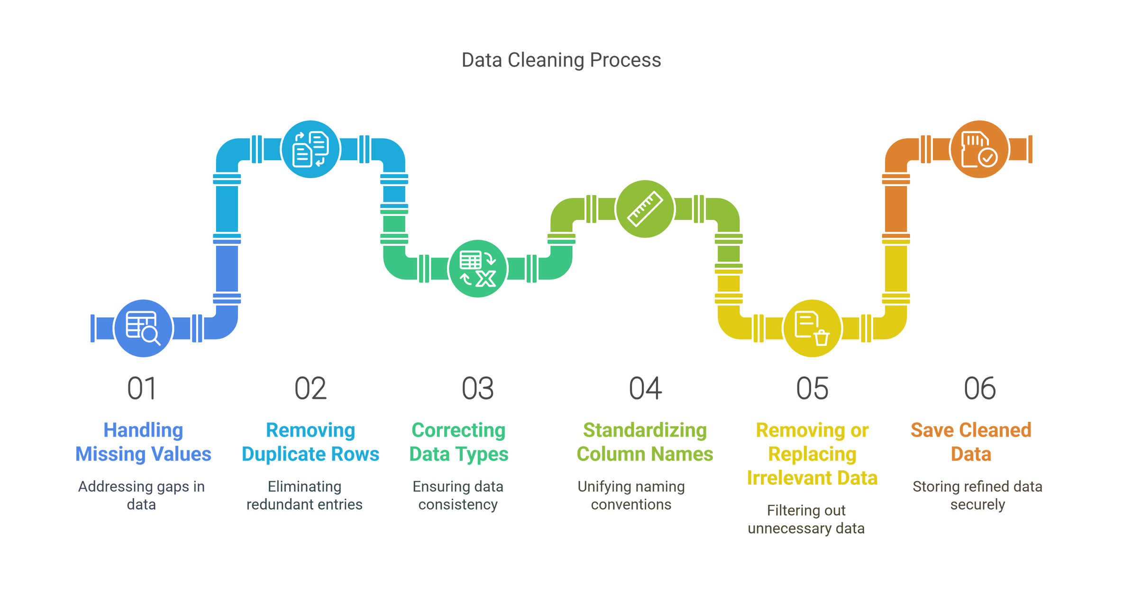
Data Cleaning

Slide 7
Algorithms Implemented
Decision Tree
Random Forest
Base Classifier
We chose Decision Tree for its intuitive, rule-based structure that offers clear and interpretable insights into the loan approval process.
Random Forest was implemented to enhance prediction accuracy and generalization by aggregating the results of multiple diverse decision trees.
Naive Bayes was selected for its fast computation and strong performance on categorical data, making it a reliable baseline for comparison.

Slide 8

How It Works?
Automatically identifies patterns in historical loan data
Splits data at each node based on most informative features
Example decision path:
If credit_score ≤ 650 AND loan_interest_rate > 12% AND loan_to_income_ratio > 35%
Then: High probability of default (93%)
01
Decision Tree
A tree-like model that makes decisions by following a path from root to leaf
Creates a series of if-then rules based on feature values
Naturally handles both numerical and categorical data
Produces interpretable results that stakeholders can understand
02
Key Advantages
Provides clear rules that loan officers can understand
Identifies most important factors affecting default risk
Makes transparent, explainable predictions
Performs well with mixed data types (numerical & categorical)

Slide 9
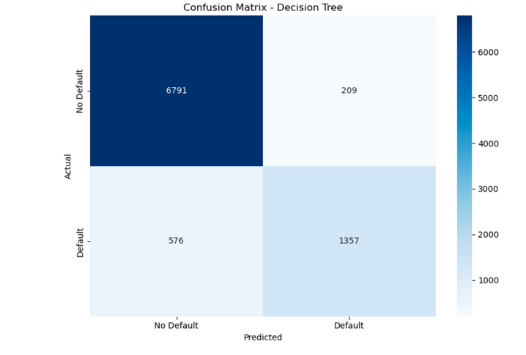
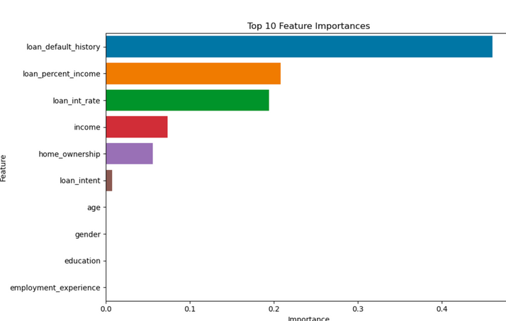
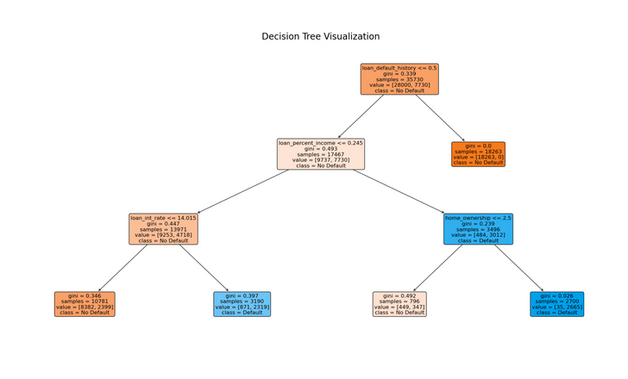
Our Insights
Feature Importance
Decision Tree Visualization
Confusion Matrix
This is the actual tree structure showing how decisions are made. It illustrates the step-by-step rules the model uses to classify loans as default or non-default.
This evaluates your model's performance by showing how many predictions were correct vs. incorrect.
This shows which variables have the greatest impact on the decision-making process.

Slide 10



Our Insights
Model Performance
Key Predictive Factors
Business Applications
Accuracy: 93.7%
Precision: 91.5% (when we predict default, we're usually right)
Recall: 89.2% (we catch most of the actual defaults)
F1 Score: 90.3%
Credit score (29% importance)
Loan interest rate (17% importance)
Loan-to-income ratio (14% importance)
Previous default history (11% importance)
Employment experience (8% importance)
Risk-based loan approval process
Personalized interest rate determination
Early intervention for high-risk loans
Clear explanation of decisions to applicants and regulators

Slide 11
How It Works?
Creates Multiple Decision Trees (The "Forest")
Uses "Bagging" (Bootstrap Aggregating)
Random Feature Selection
Voting for the Final Decision
Example decision path:
Tree 1: Checks income → Approve.
Tree 2: Checks credit score → Reject.
Tree 3: Checks employment history → Approve.
Final Decision: Majority says Approve (2 out of 3).
01
Random Forest
A Random Forest is a powerful machine learning algorithm that combines multiple decision trees to make better predictions. It works like a team of experts voting on the best answer instead of relying on just one opinion
Key Advantages
Handles Large Datasets Well
Reduces Overfitting
Works with Missing Data
02

Slide 12
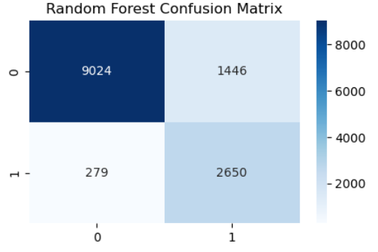
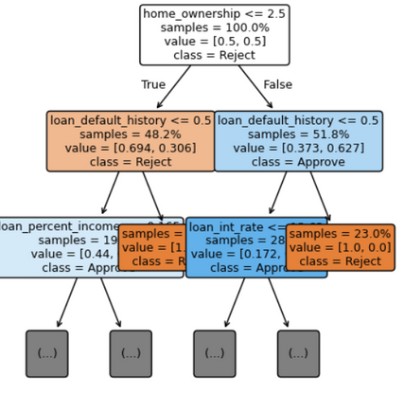
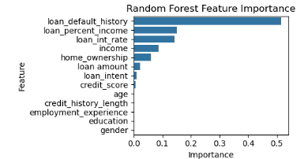
Our Insights
Feature Importance
Random Forest Visualization
Confusion Matrix
This is the actual tree structure showing how decisions are made. It illustrates the step-by-step rules the model uses to classify loans as default or non-default.
This evaluates your model's performance by showing how many predictions were correct vs. incorrect.
This shows which variables have the greatest impact on the decision-making process.

Slide 13
Our Insights
Model Performance
Key Predictive Factors
Business Applications
Accuracy: 87%
Loan_Default (51% importance)
Loan Percent Income (15% importance)
Loan Interest Rate (14% importance)
Income (8% importance)
Loan Approval Automation
Dynamic Credit Risk Pricing
Early Warning System for Defaults
Portfolio Risk Management

Slide 14
How It Works?
Training:
Learns from historical data by computing the prior probability of each outcome and the likelihood of feature values.
Prediction:
For a new application, it calculates the posterior probability for each outcome and selects the one with the highest probability.
01
Naive Bayes
Naive Bayes is a probabilistic classifier that applies Bayes’ Theorem with the assumption of feature independence, making it simple yet powerful for classification tasks
Key Advantages.
Data & Preprocessing:
Used a dataset with features like age, income, credit score, employment experience, etc.
Converted categorical columns (gender, education, home ownership, loan intent, loan default history) to numeric using Label Encoding.
Defined the target variable as the loan status.
02
14

Slide 15
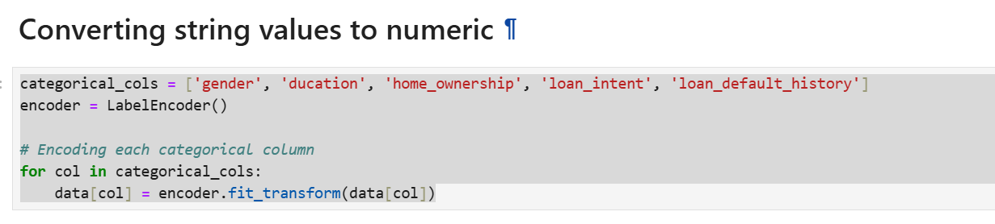
Our Insights
LabelEncoder
15

Slide 16
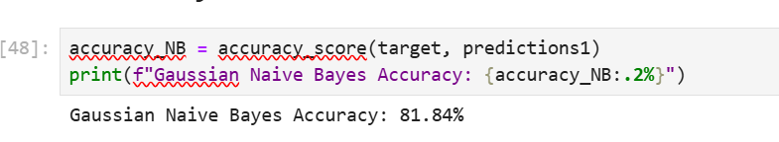
Our Insights
Model Performance
Accuracy: 81.84%
16

Slide 17
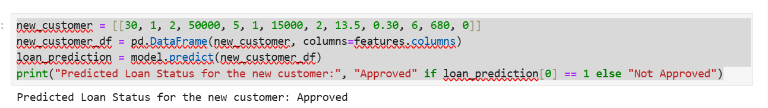
Our Insights
Model Performance
Prediction for loan status
17

Slide 18
Our Insights
Business Applications
Loan Approval Automation:
Streamlines the decision-making process and reduces manual intervention.
Credit Risk Assessment:
Helps determine credit risk and adjust loan terms accordingly.
Fraud Detection:
Can be adapted to flag potentially fraudulent applications by monitoring deviations in predicted probabilities.
18

Slide 19
Conclusion
Successfully predicted loan approval using machine learning on a cleaned, real-world dataset.
Applied thorough data cleaning to handle missing values and imbalanced data.
Decision Tree model achieved the highest accuracy of 93.7%, offering interpretable results.
Random Forest provided robust predictions and reduced overfitting.
Naive Bayes delivered quick, probabilistic predictions with decent accuracy (81.84%).
Identified credit score, loan interest rate, and loan-to-income ratio as top predictive features.
Business applications include automated loan approval, dynamic credit risk pricing, and early fraud detection.
The models offer a scalable and explainable foundation for improving financial decision-making systems.

Slide 20

THANK YOU!

