Slide 1

Stadium Surge
5G and 4G plan for a 1,00,000-fan final
₹3.52 Cr, sized from Airtel's site data
Amritha S & Shreya Kamath
VIT Chennai

Slide 2
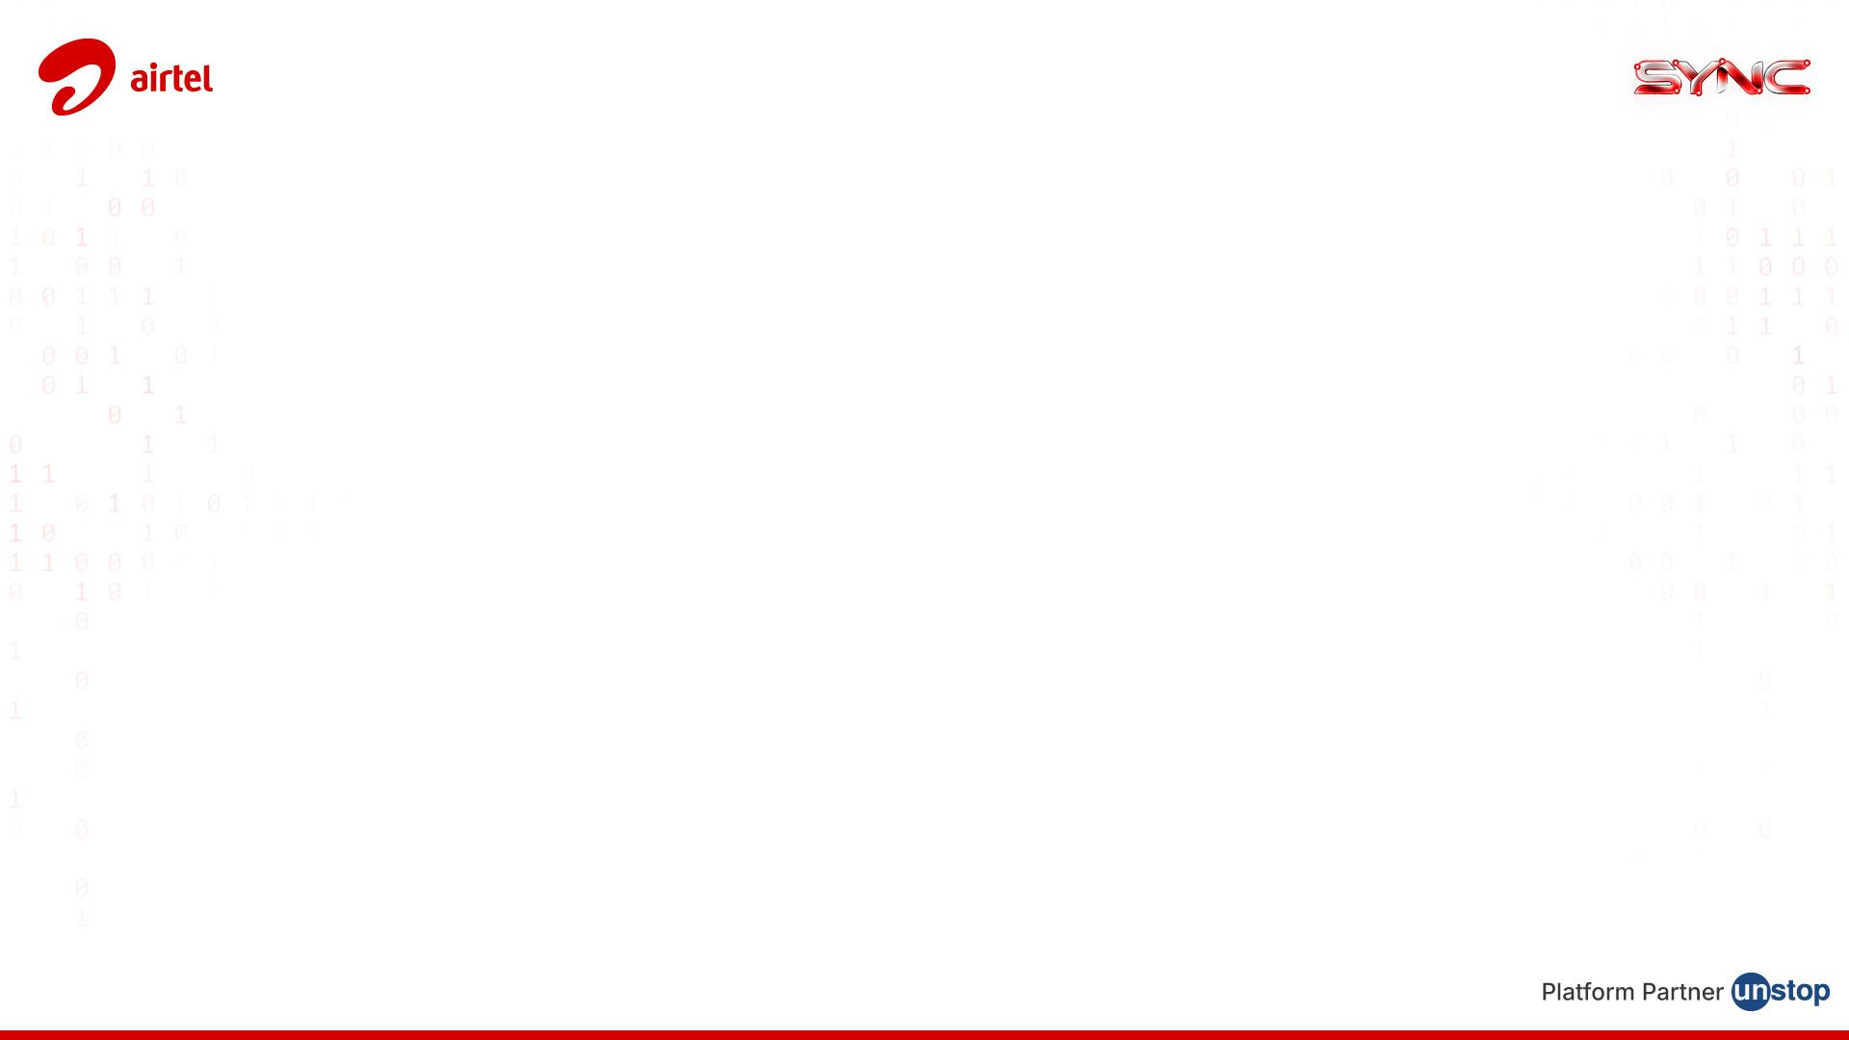
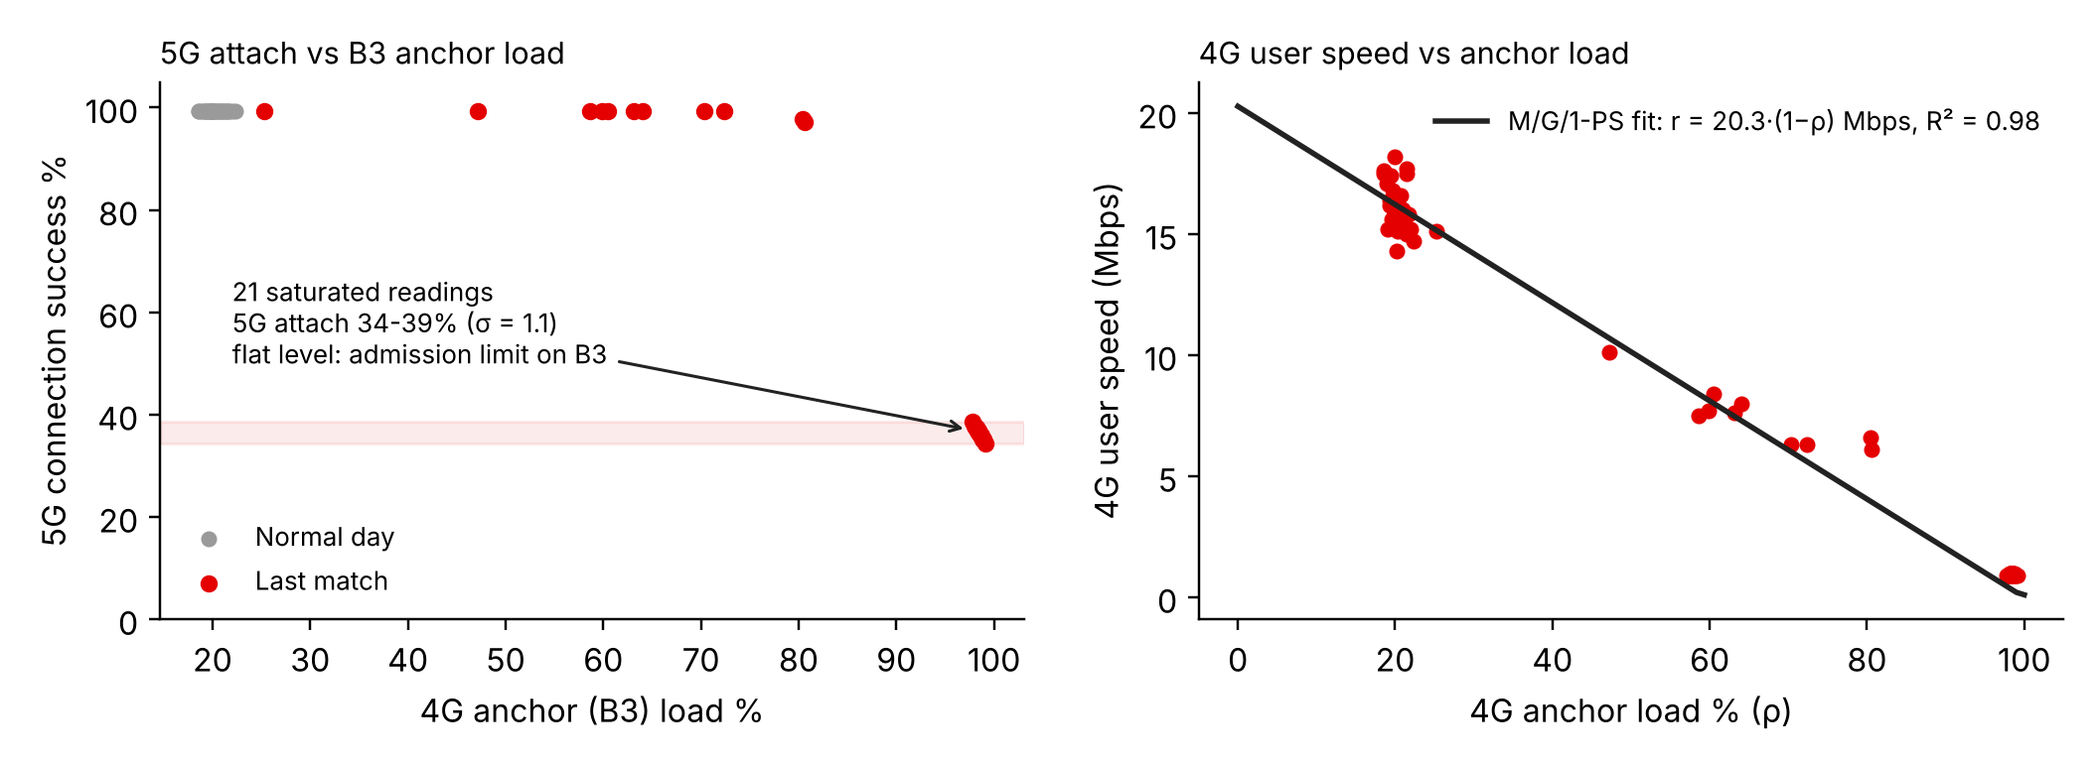
01 What broke at the last match
From Sync_V1.xlsx: 8 sites, 4 match moments, normal day vs the 65k-fan match
34-39%
5G attach success in all 21 saturated readings, spread of only 1.1
2.7x
attach requests per available anchor slot at the innings break
R² 0.98
4G speed vs load fits r = 20.3(1-ρ) Mbps
24%
expected 5G attach at the final if nothing changes
Reading the data
M6 stayed at 60% anchor load and kept 99.2% 5G attach. Every site above 97.8% dropped to roughly 36% and stayed there for three match phases. Plain congestion would scatter, so a level this flat points to an admission limit on B3 (RRC connected users).
Phones that could not add 5G stayed on LTE. That put about 2,100 extra users on a layer that was already full, which is why 4G fell to 1 Mbps.

Slide 3
02 Tasks 1 and 2: demand, cell count, budget
Cells sized at 80% load. 5G massive MIMO is loaded first since it gives the most Mbps per MHz
1,00,000
40,000
28k | 12k
5,040 | 2,160
25.2 | 6.5 Gbps
fans
Airtel (40%)
5G | 4G-only phones
online at peak (18%)
at 5 | 3 Mbps each
Cell type (DL) | Spectrum × SE | @80% | Users
5G macro 64T64R mMIMO | 100 MHz × 74% × 16 | 947 Mbps | 189 @5
5G small cell 4T4R | 100 MHz × 74% × 7 | 414 Mbps | 83 @5
4G macro sector | 70 MHz × 2.5 | 140 Mbps | 46 @3
4G small cell | 40 MHz × 3.0 | 96 Mbps | 32 @3
Item | Qty | Cost | Adds
Under-seat small cells (4G + 5G) | 24 × ₹8 L | ₹1.92 Cr | 9.9 Gbps 5G, 2.3 Gbps 4G
Cells on wheels (gates, M4/M6 side) | 4 × ₹25 L | ₹1.00 Cr | 12 sectors each on 4G and 5G
Fibre ring, 2 × 10G | 1.2 km | ₹0.60 Cr | backhaul for new cells
Reserve: licences, RRC uplift, dry run | - | ₹0.48 Cr | 12% of budget
Total |  | ₹4.00 Cr
Requirement @80% | 5G | 4G
Peak demand | 25.2 Gbps | 6.5 Gbps
Cells needed (macro-eq.) / existing | 27 / 12 | 47 / 20
Extra cells needed | +15 | +27
Capacity check @80% (Gbps) | 5G | 4G
Existing + 4 COWs + 24 small cells | 32.7 | 6.8
Peak load at the final | 62% | 76%
Budget note
Without the anchor changes, phones keep falling back at last match's rate and LTE demand reaches 16.2 Gbps. Covering that with COWs costs about ₹5.8 Cr. The small cells and fibre (₹2.52 Cr) stay for later matches. Only the COWs are a one-time cost.

Slide 4
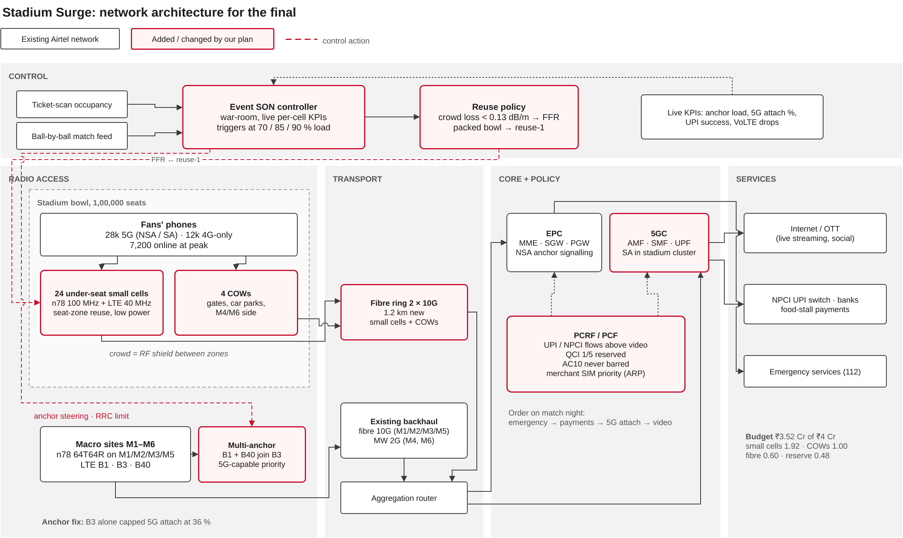
03 Network changes for match night
Black outline: existing. Red outline: new or changed. Dashed red: control actions
How it fits together
• SON controller takes ticket-scan counts, the ball-by-ball feed and live cell KPIs
• Under-seat cells and COWs connect to a new 2 × 10G fibre ring
• B1 and B40 become NSA anchors next to B3
• SA core for the stadium cluster, PCF rules for UPI and 112
Code and demo
github.com/Amritha902/airtel-sync-stadium-surge
Demo video (65 s)
MATLAB, Simulink, Python, draw.io source

Slide 5
04 Task 3: 5G attach, payments, emergency calls
B3 ran out of RRC room, SgNB addition failed, and 5G phones stayed on LTE
Getting 5G phones onto 5G
• B1 and B40 as extra anchors
• Keep anchor capacity for EN-DC phones, move LTE-only phones to other bands (SPID/RFSP)
• Lower B1 threshold for SgNB add, no SgNB release on anchor load
• Higher RRC licence and a shorter inactivity timer on match day
• SA on n78 for phones that support it
• Target: 95%+ attach (was 36%)
UPI payments
• Small packets, but time critical. PCC rule for NPCI and bank endpoints, ahead of video
• Stall merchant SIMs on a higher ARP profile, small cells near the food courts
• Backup: UPI Lite, UPI 123PAY, stall Wi-Fi
• Target: under 1.5% failures (was 7.1%)
112 and VoLTE
• AC10 and QCI 1 never barred, pre-emption allowed
• About 5% PRB and RRC headroom kept for QCI 1/5
• AC 11-15 SIMs for police, medical and ground staff
• Barring for normal users only past 90% load
• Target: every emergency call sets up
Priority if a cell fills up: 112, then UPI, then 5G attach, then video.

Slide 6
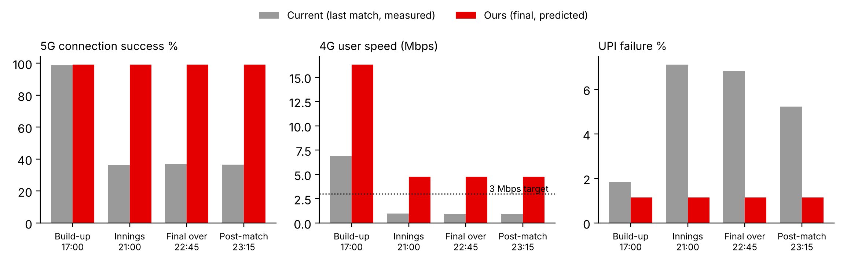
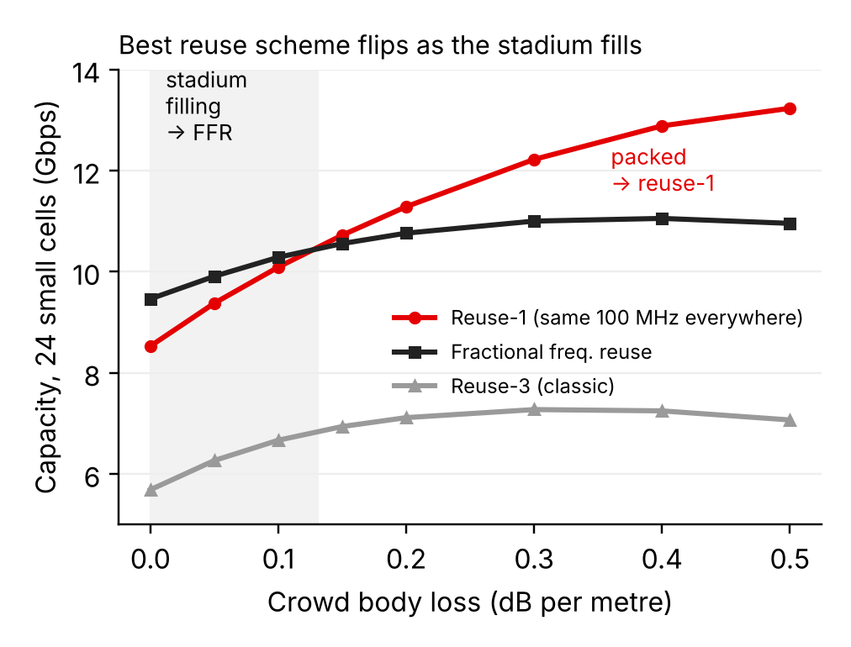
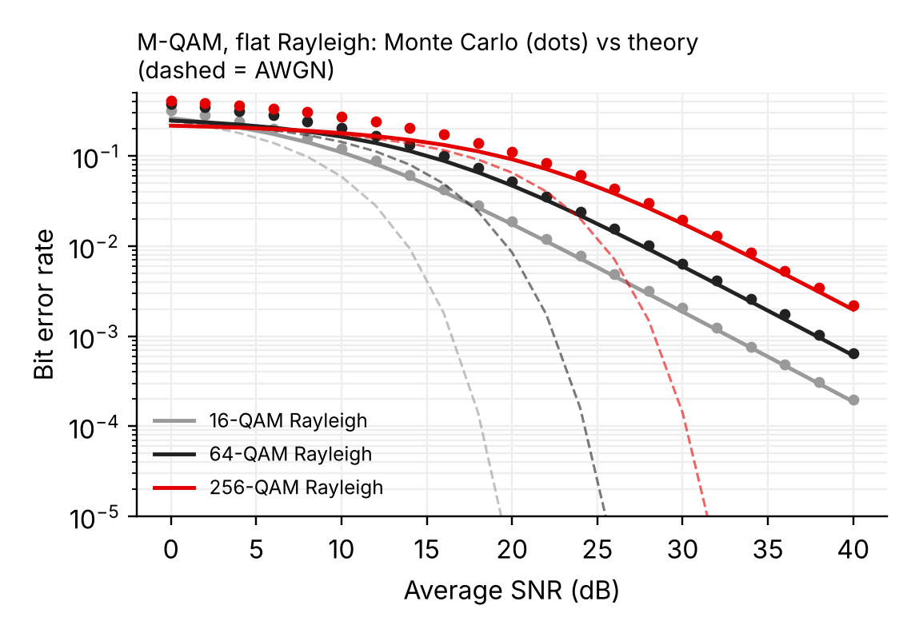
05 Current vs proposed
Grey: measured at the last match. Red: predicted for the final with the same fitted models. Below: our simulations
Seat-zone reuse
At 3.5 GHz a dense crowd adds body loss (TR 38.901 blockage model). Under-seat cells end up isolated from each other, so all 24 can run the full 100 MHz.
With the stands half empty FFR does better, so the controller changes scheme with occupancy.
Simulation results
• Full stadium, 24 cells: 12.2 Gbps with reuse-1, 11.0 with FFR, 7.3 with reuse-3
• Crossover near 0.13 dB/m crowd loss
• Rayleigh M-QAM Monte Carlo matches theory. 256-QAM needs about 25-30 dB
• 5 seeds, 5,040 users. Same code in MATLAB and Python

Slide 7
06 Task 4: user experience side effects
Mostly from adding 28 cells in and around one bowl
Possible impact | Cause | Mitigation
Interference, lower SINR | Many cells in a small area | Low-power under-seat antennas, downtilt, PCI/PRB planning for MU-MIMO
Handover ping-pong, dropped calls | Fans moving between macro, COW and small cell | Hysteresis and time-to-trigger tuning, MRO, checked at the dry run
Lower video quality for heavy users | Fair share and priority rules at peak | 720p cap only when load crosses 85%
Short access delay | Barring for normal users | Only above 90% load, short barring timers
Coverage change for nearby homes | Macros re-tilted towards the stadium | Event tilt profile on 3 h before, reverted after
Post-match crush at gates and metro | Traffic moves from bowl to exits | 2 COWs at the exits
Battery drain | NSA dual connectivity (4G + 5G) | SA on n78 drops the LTE leg, DRX tuning
Match-day monitoring
Per-cell dashboard (anchor load, 5G attach, UPI success, VoLTE drops) with actions at 70, 85 and 90% load. Dry run at a league match 30 days out, with rollback for every parameter. Extra capacity goes in 10 minutes before the innings break and the last over.

Slide 8
07 Competitive analysis and impact
Common ways operators handle big venues, judged against this case (60 days, ₹4 Cr)
 | COW-heavy (common at Indian events) | Permanent DAS (large US venues) | 5G SA only (Jio's network model) | Our plan
Fixes 5G attach failure | No | No | Yes, for SA phones | Yes: multi-anchor + SA
Capacity per seat | Medium, interference limited | High | Depends on radio layer | High: reuse-1 when packed
Ready in 60 days | Yes | No, months of civil work | Needs core changes | Yes
Cost profile | ₹25 L every event | High capex | Core and device dependent | ₹3.52 Cr, 73% reusable
Protects UPI and 112 | Not addressed | Not addressed | Possible with slicing | PCC rules + barring policy
Sized from measured data | Rule of thumb | Venue survey | - | Fitted on Sync_V1 (R² 0.98)
36% to 99%
1 to 4.8 Mbps
12 to 70+ Mbps
7.1% to 1.2%
all set up
5G attach
4G speed
5G speed
UPI failure
112 calls
Timeline: D-60 survey and orders | D-45 fibre and small cells | D-30 dry run at a league match | D-7 COWs placed | D+1 review
Within ₹4 Cr, about 40,000 Airtel fans get 5G that attaches, 4G above target, and payments that go through.
Code, MATLAB/Simulink and demo: github.com/Amritha902/airtel-sync-stadium-surge | demo video

