Slide 1
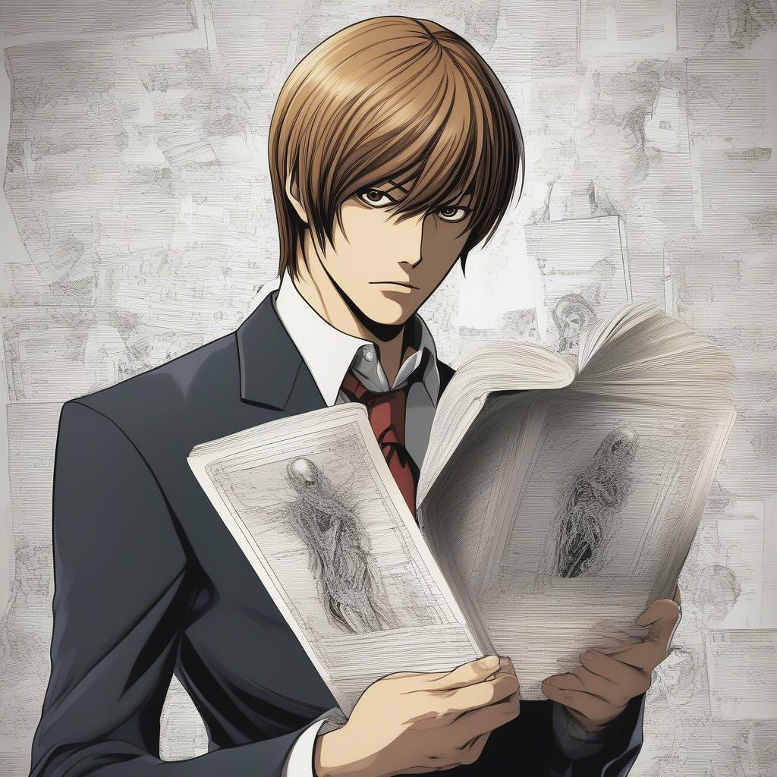
Death Note: The Premise
- Light Yagami discovers the Death Note, a supernatural notebook.
- Writing a name in the notebook causes that person to die.
- Light decides to use the notebook to create a "perfect" world.
- He becomes known as Kira, a mysterious figure dispensing justice.
- This attracts the attention of the enigmatic detective L.

Slide 2

The Mind Games Begin
- L and Light engage in a complex game of cat and mouse.
- L attempts to deduce Kira's identity while Light tries to remain anonymous.
- Both utilize intricate strategies and psychological manipulation.
- The investigation involves the Japanese Task Force and international agencies.
- The stakes are high as lives hang in the balance.

Slide 3
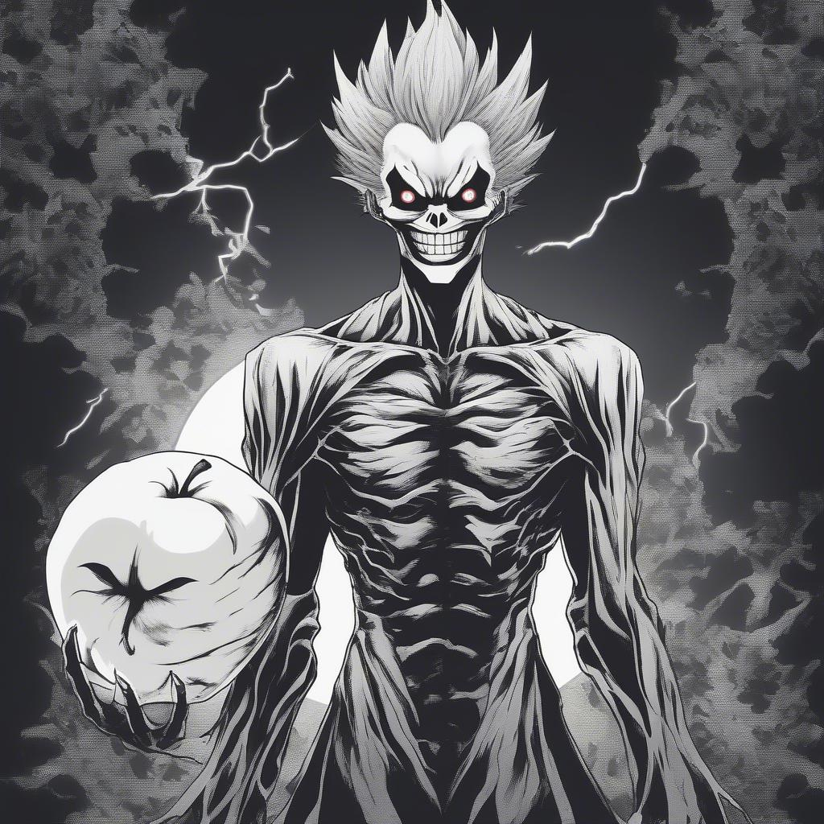
Shinigami: Gods of Death
- Ryuk, a Shinigami (death god), is the original owner of Light's Death Note.
- Shinigami follow humans who possess Death Notes out of boredom.
- They can see a human's lifespan but cannot directly interfere.
- Ryuk's involvement adds a supernatural element to the story.
- Other Shinigami, like Rem, also play crucial roles.

Slide 4
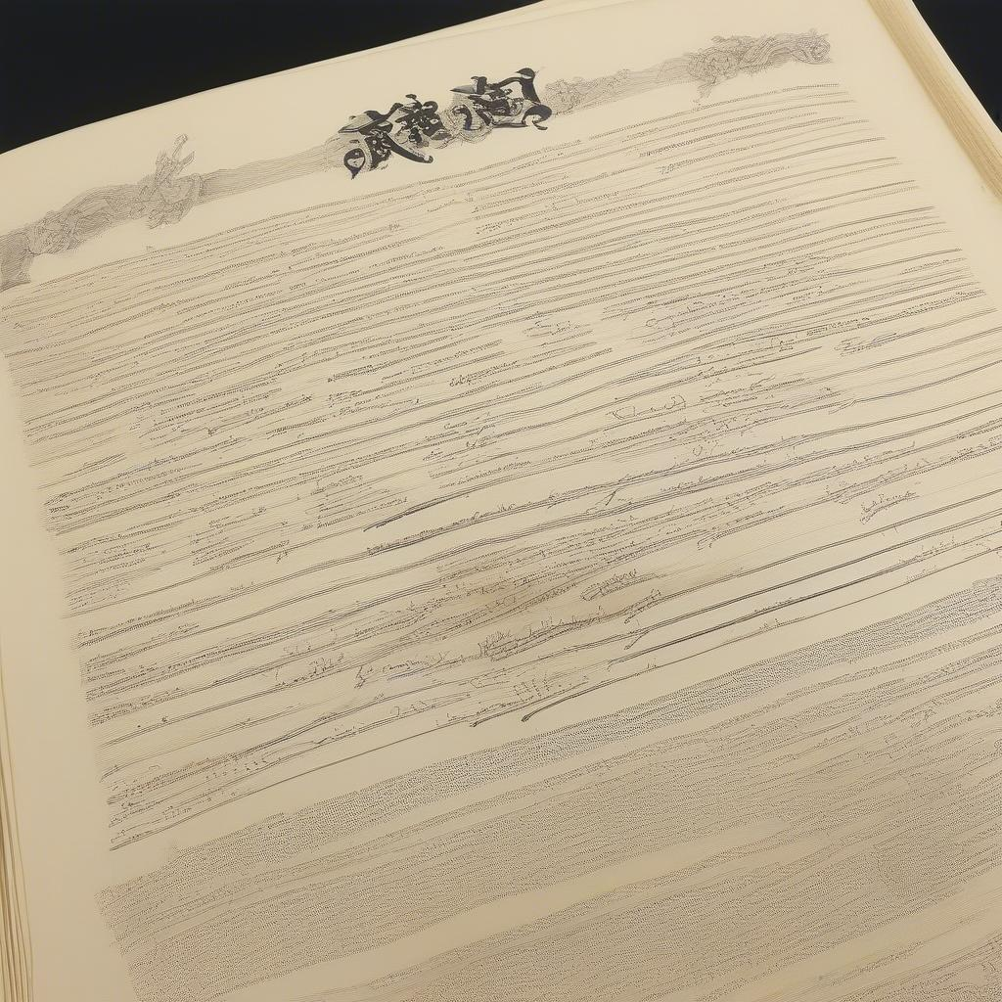
The Rules of the Death Note
- The human whose name is written in the notebook dies.
- The cause of death can be specified; otherwise, it's a heart attack.
- The writer must visualize the victim's face to prevent accidental deaths.
- Ownership of the Death Note can be relinquished.
- These rules create limitations and opportunities for both Light and L.

Slide 5

Legacy and Impact
- Death Note explores themes of justice, morality, and power.
- It raises questions about the nature of good and evil.
- The anime's popularity led to various adaptations, including live-action films.
- It remains a highly influential and critically acclaimed anime series.
- Death Note continues to spark debate and discussion among fans.

