Slide 1
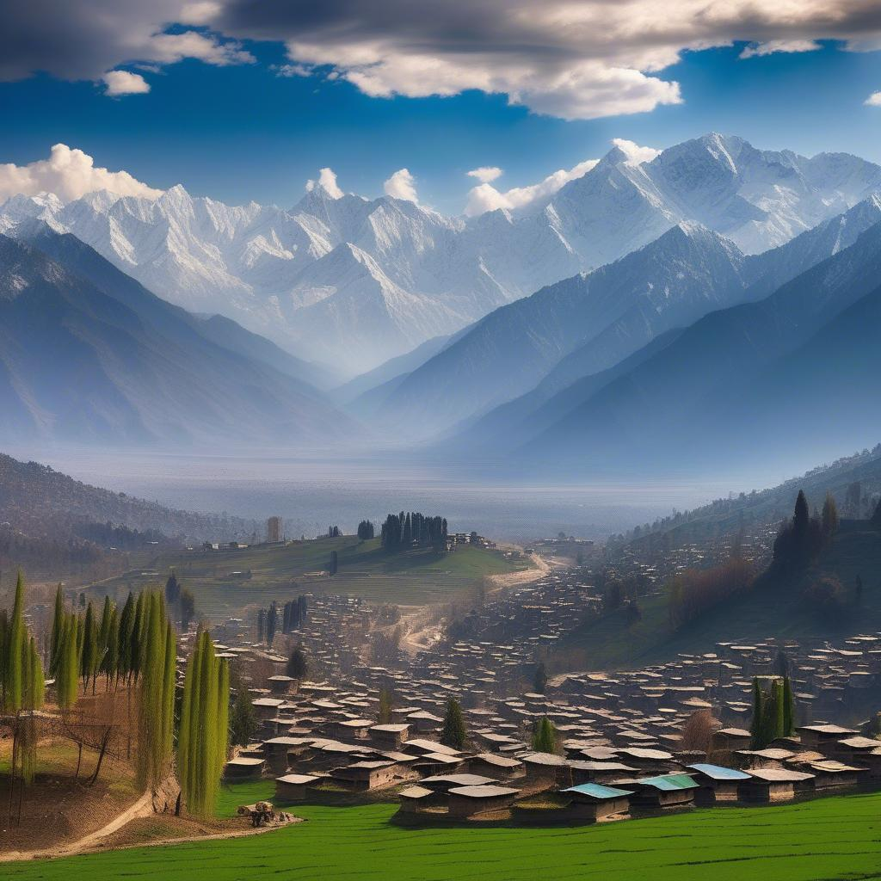
Kashmir: The Crown of India
- Snow-capped Himalayas dominate the landscape, offering breathtaking views.
- Lush green valleys are carpeted with wildflowers in spring and summer.
- Crystal-clear lakes like Dal and Wular reflect the surrounding beauty.
- Rich cultural heritage is visible in Mughal gardens and ancient temples.
- Abundant wildlife includes the Hangul deer and various bird species.

Slide 2
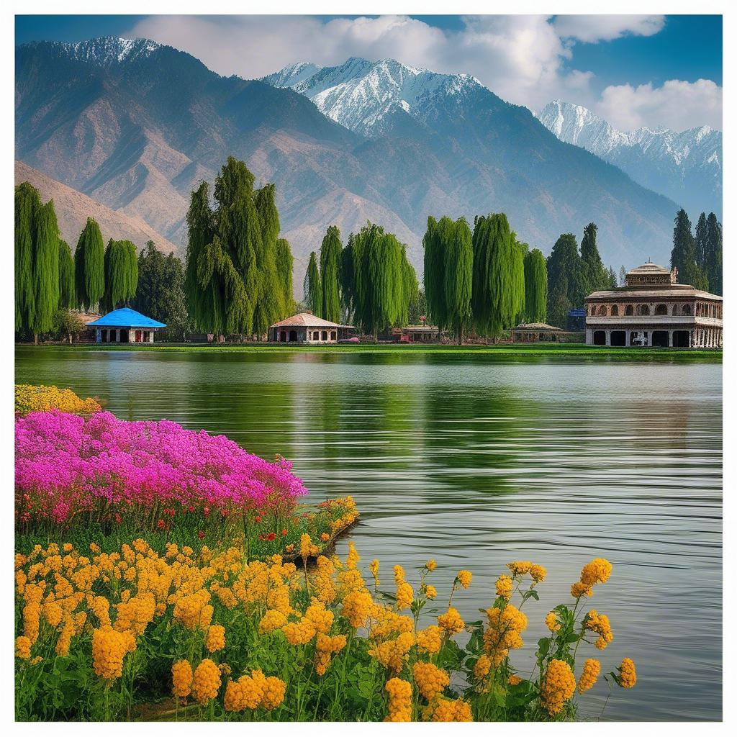
The Mughal Gardens of Kashmir
- Shalimar Bagh, built by Jahangir, is a terraced garden with fountains and chinars.
- Nishat Bagh, the 'Garden of Gladness,' offers stunning views of Dal Lake.
- Chashme Shahi, known for its fresh water spring, is a smaller, intimate garden.
- Pari Mahal, a seven-terraced garden, overlooks Srinagar city.
- These gardens showcase Mughal architecture and landscaping at its finest.

Slide 3
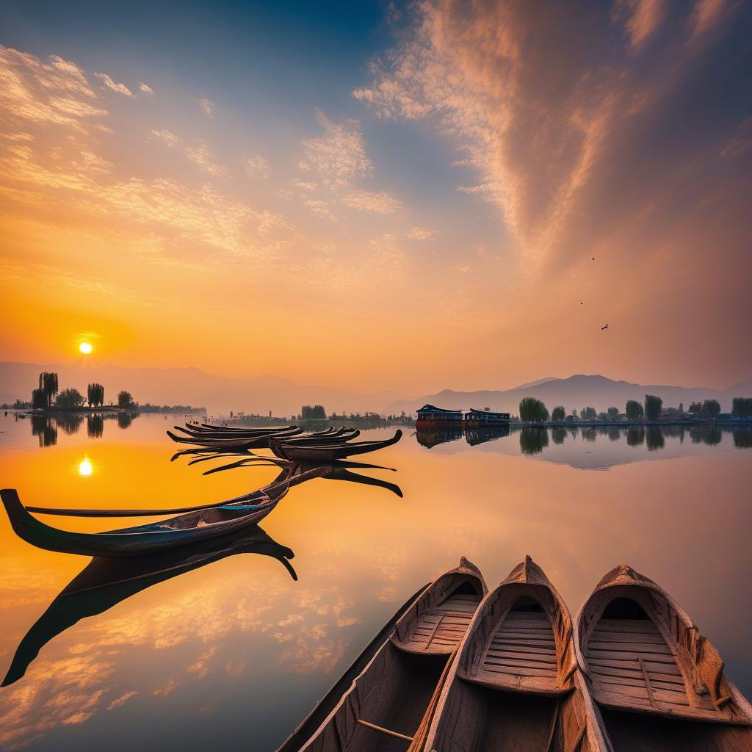
Dal Lake: A Jewel of Srinagar
- Shikaras, traditional wooden boats, offer rides across the serene lake.
- Floating gardens, unique to Dal Lake, grow vegetables and flowers.
- Houseboats provide a luxurious stay with intricate woodwork and stunning views.
- Migratory birds flock to the lake during winter, adding to its charm.
- The lake is surrounded by the Pir Panjal mountain range, creating a picturesque setting.

Slide 4
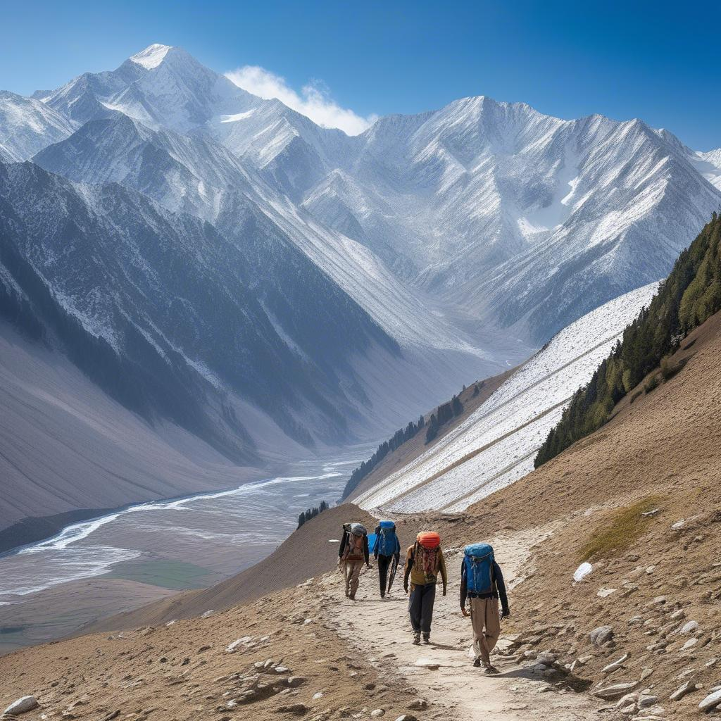
Adventure in the Himalayas
- Trekking trails cater to all levels, from beginner to expert.
- Skiing opportunities are available in Gulmarg, a popular winter destination.
- River rafting in the Lidder and Indus rivers offers an adrenaline rush.
- Gondola rides in Gulmarg provide stunning views of the surrounding peaks.
- Camping amidst the mountains is a unique way to experience the wilderness.

Slide 5
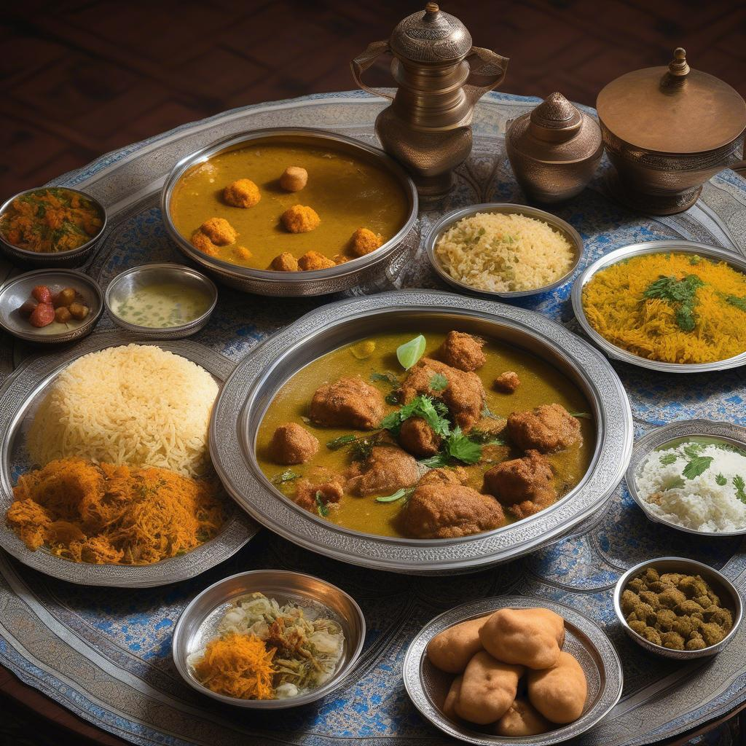
Kashmiri Culture and Cuisine
- Kashmiri arts and crafts include intricate woodwork, carpets, and shawls.
- Wazwan, a traditional multi-course meal, is a culinary highlight.
- Phiran, a long woolen gown, is the traditional attire of the region.
- Sufi music and poetry are integral to Kashmiri culture.
- The warmth and hospitality of the Kashmiri people enhance the visitor's experience.

