Slide 1

The Notorious B.I.G.
- Master storyteller with vivid lyrics and complex rhyme schemes.
- Released two critically acclaimed albums, "Ready to Die" and "Life After Death."
- Considered one of the greatest rappers of all time due to his impact and influence.
- His music explored themes of street life, crime, and the American dream.
- Tragically murdered in 1997 at the age of 24.

Slide 2
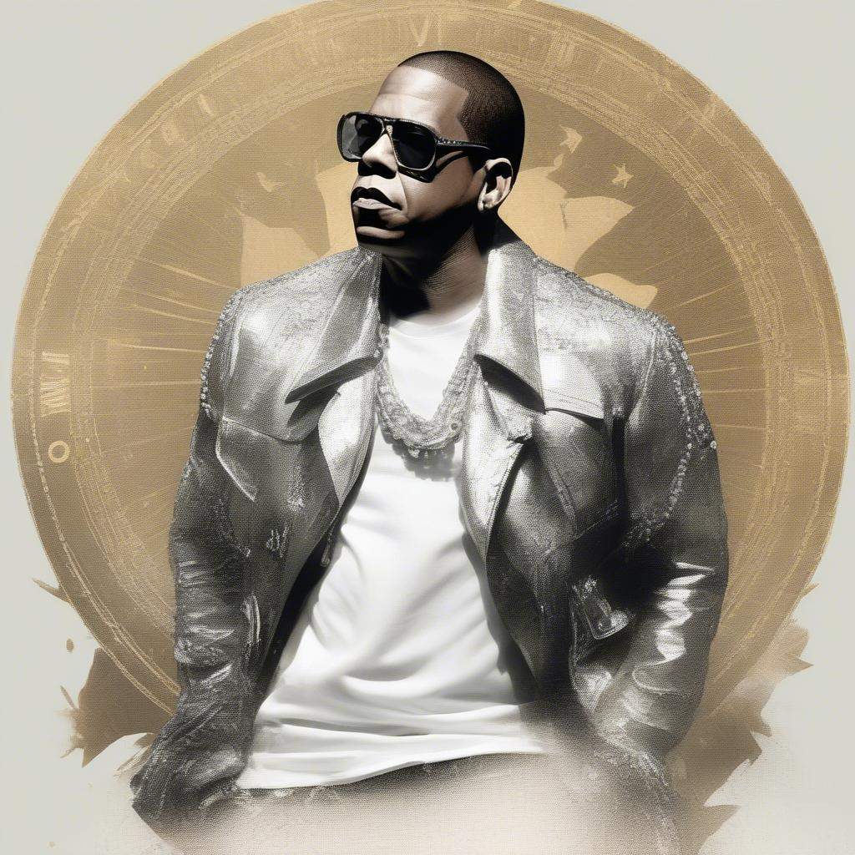
Jay-Z
- One of the best-selling music artists of all time with over 125 million records sold.
- Founded Roc-A-Fella Records and became a successful entrepreneur.
- Known for his intricate wordplay, flow, and business acumen.
- Released numerous classic albums, including "Reasonable Doubt" and "The Blueprint."
- Has won 24 Grammy Awards, more than any other rapper.

Slide 3
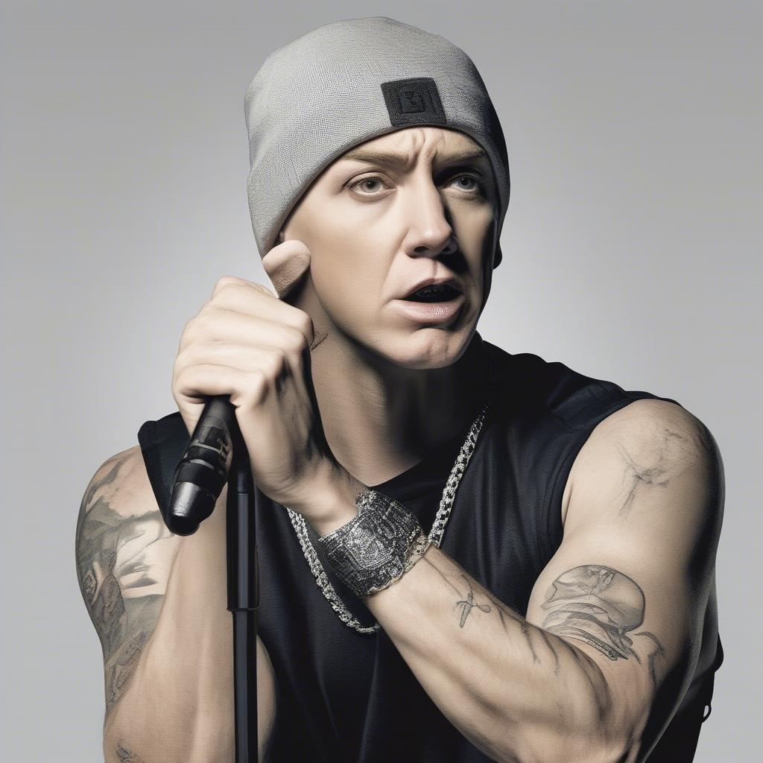
Eminem
- Known for his technical skills, complex rhyme schemes, and controversial lyrics.
- One of the best-selling artists of the 21st century, with multiple diamond-certified albums.
- Achieved mainstream success with "The Slim Shady LP" in 1999.
- Has won 15 Grammy Awards and an Academy Award.
- Explores themes of anger, social commentary, and his personal struggles.

Slide 4

Kendrick Lamar
- Widely considered one of the most influential and important rappers of his generation.
- Known for his conscious lyrics, storytelling, and jazz-influenced production.
- Has won 17 Grammy Awards and a Pulitzer Prize for Music.
- Released critically acclaimed albums like "good kid, m.A.A.d city" and "To Pimp a Butterfly."
- Addresses themes of race, social injustice, and personal growth.

Slide 5

Nas
- Released his debut album, "Illmatic," in 1994, which is widely considered a classic.
- Known for his intricate storytelling, vivid imagery, and complex rhyme schemes.
- Influenced numerous rappers and is highly respected within the hip-hop community.
- Has released multiple critically acclaimed albums throughout his career.
- Explores themes of street life, social commentary, and personal reflection.

