Slide 1
Team LT07
TECHNOPHILES

Slide 2

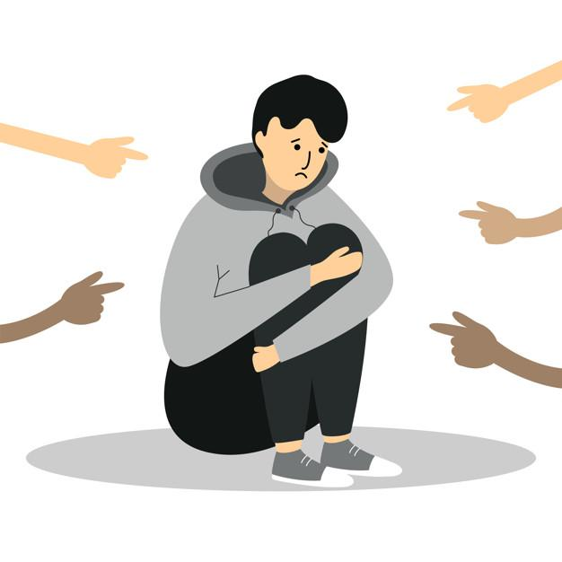
MOTIVATION
Bullying is a severe issue that
needs to be addressed on
priority.
Students go through immense
emotional distress during in this
situation.

Slide 3
INSIGHTS
Students lack awareness and understanding to deal with emotional distress.
Students hesitate to share their feelings.
Lack of knowledge to deal with bullying and overcoming it.

Slide 4
FINAL PROBLEM STATEMENT
15-18 year old students need awareness to deal with emotional distress caused by bullying.

Slide 5

HOW MIGHT WE?
How might we create awareness to deal with emotional distress ?

Slide 6
FINAL IDEA
Helping 15 - 18 year old students to analyse their feelings and understand the emotion behind them. Then dealing with that emotion effectively.
This was chosen because this solves the complete problem statement.

Slide 7
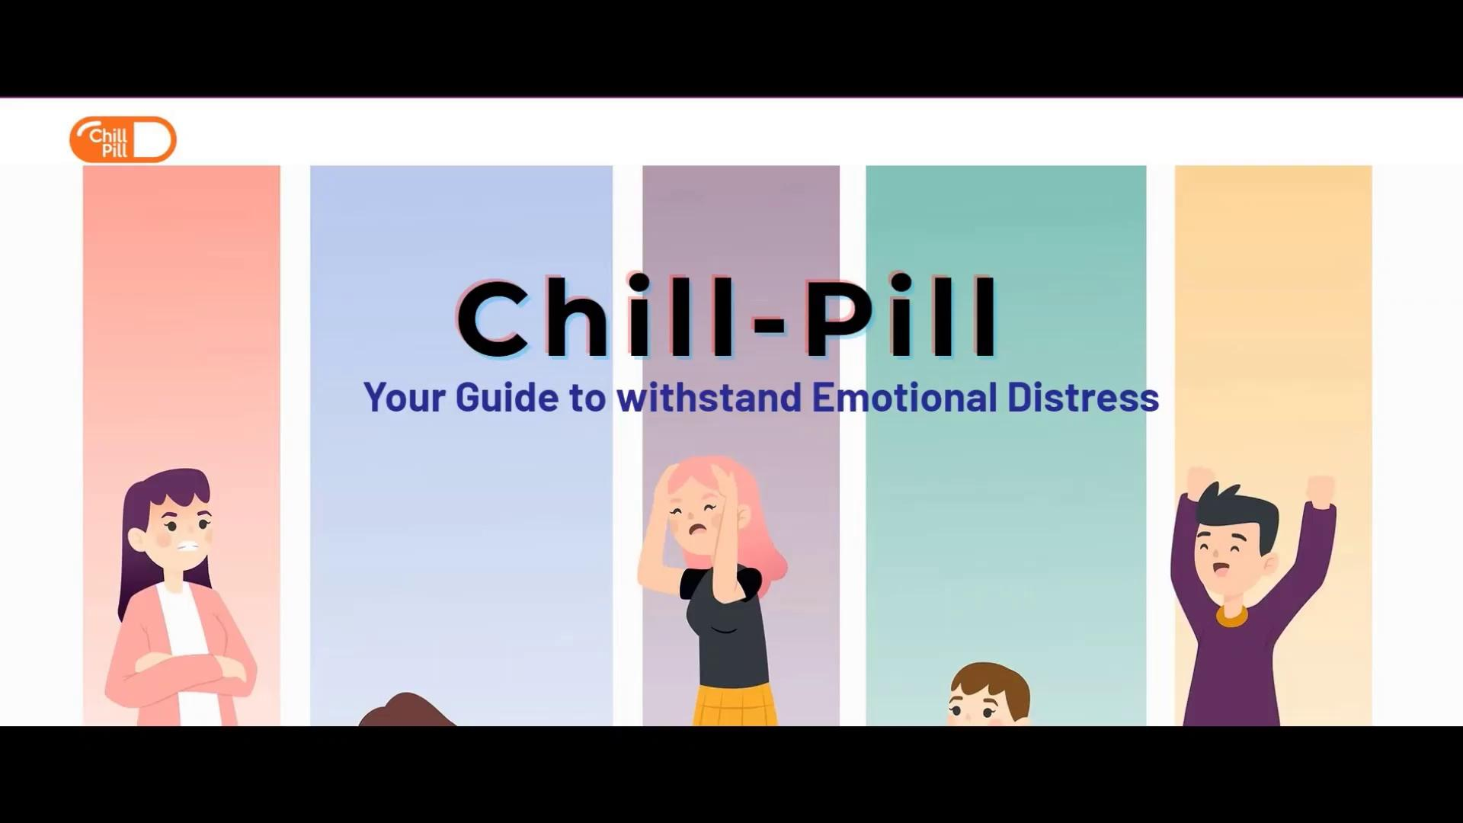
SOLUTION PROTOTYPE

Slide 8
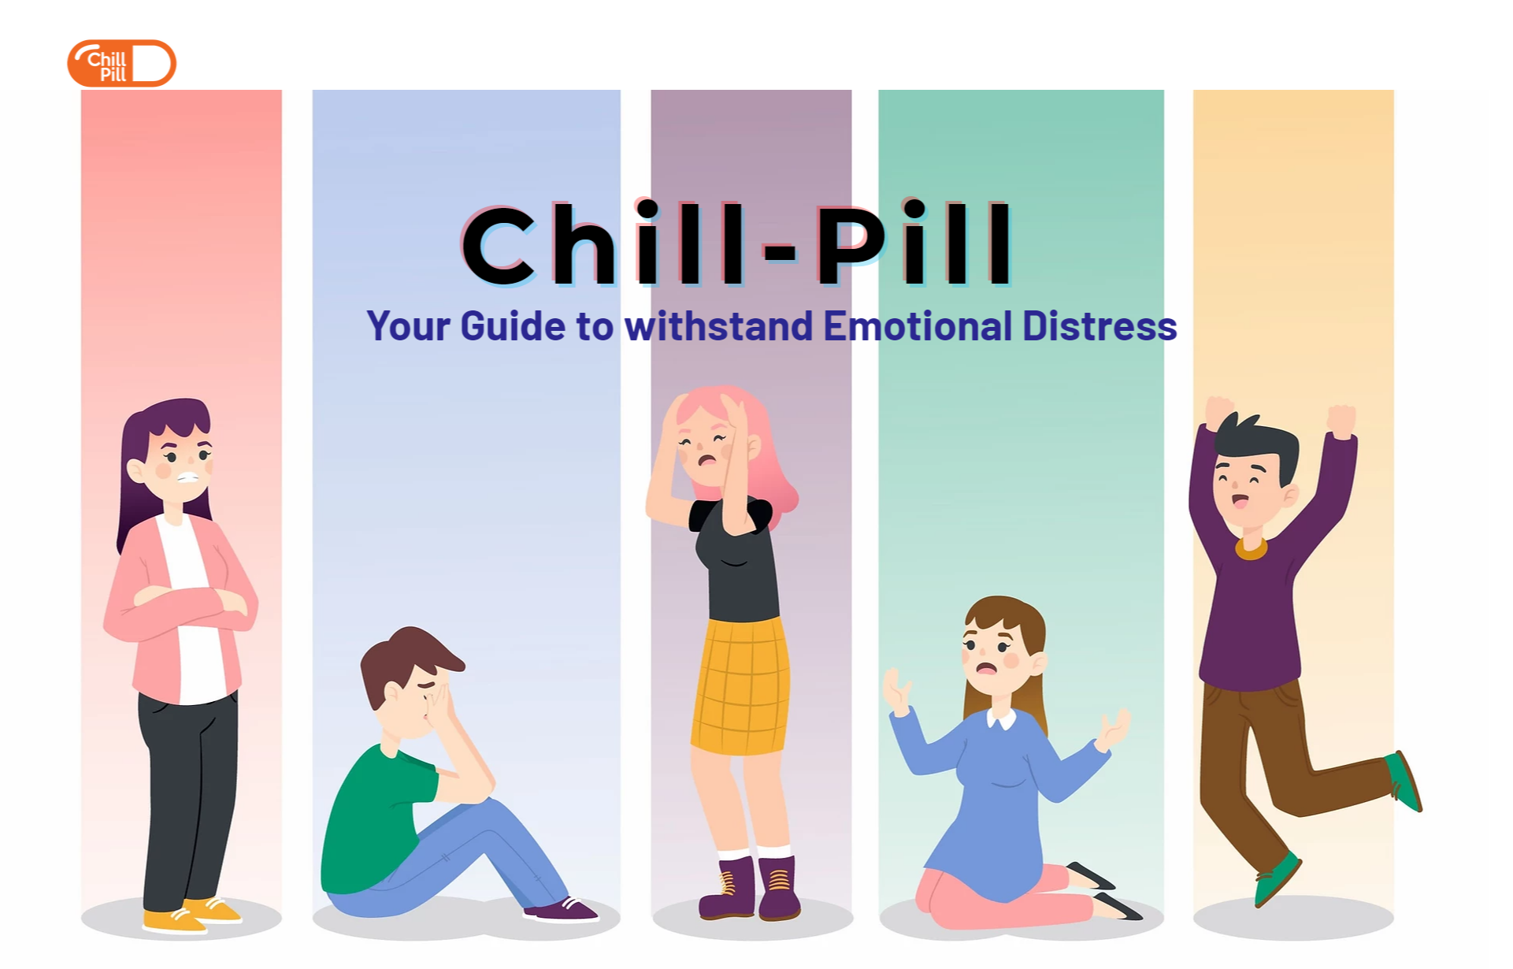
SOLUTION DEMO
Front page - Website

Slide 9
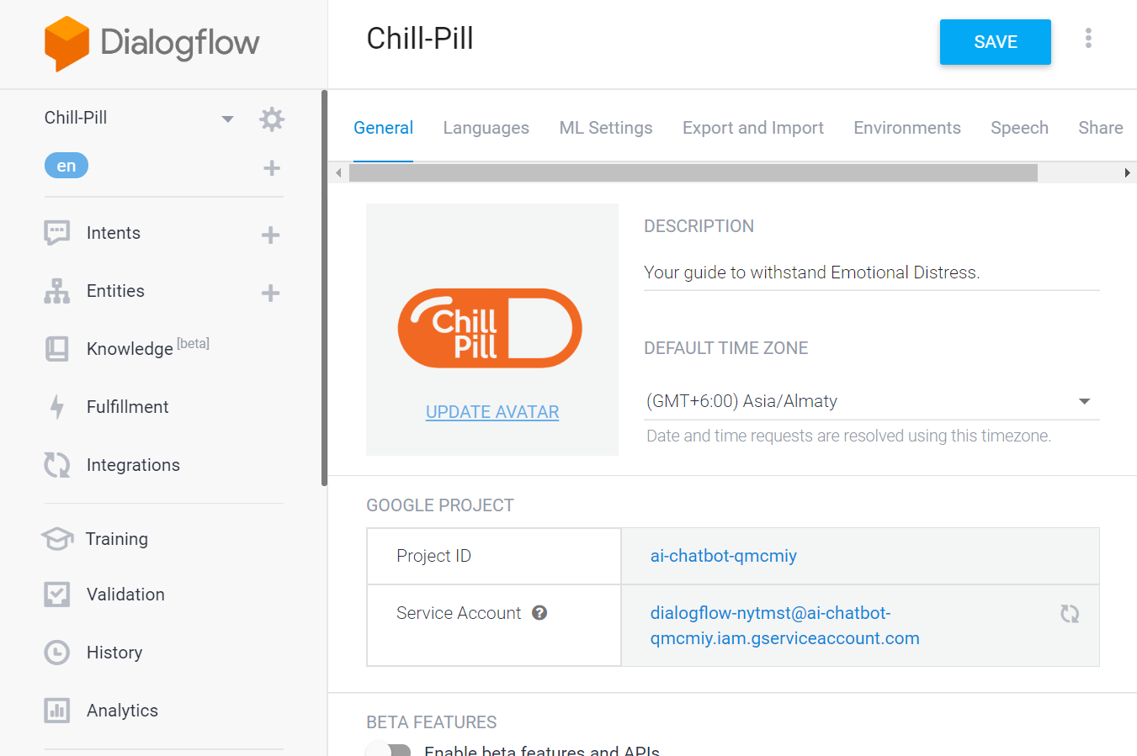
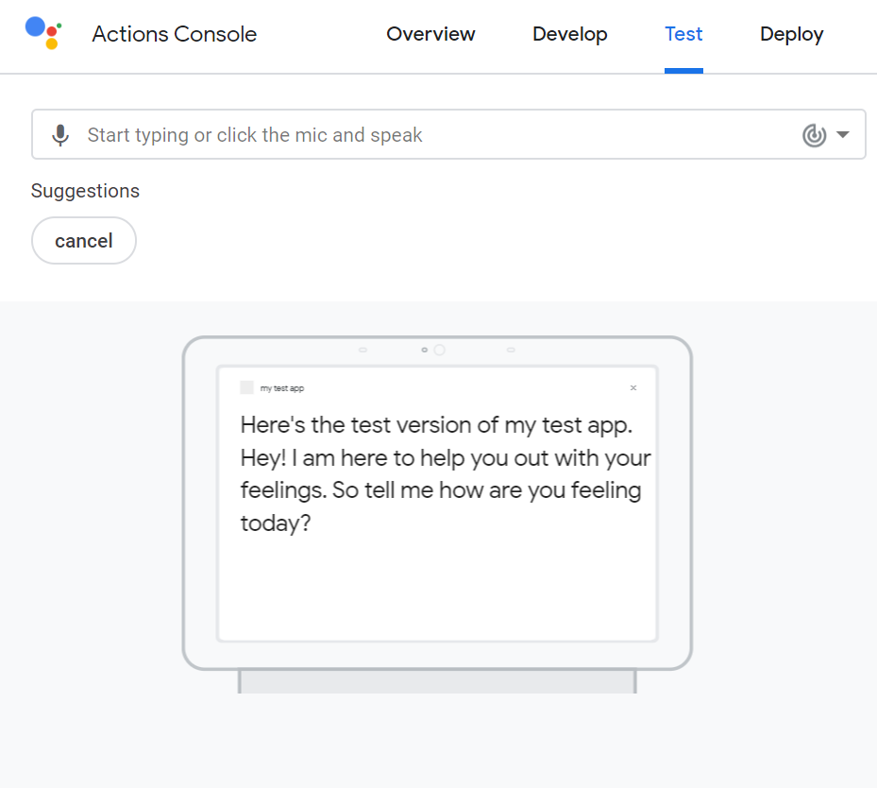
SOLUTION DEMO
Chatbot - Built & Deployment

Slide 10
THANK YOU
Team Members
Shreya Rastogi
Anushka Narula
Astika Nehra
Subham Patra

