Slide 1
🚑
Smart Ambulance Routing
& Hospital Allocation System
A React + Java-inspired project combining Graph Theory · DBMS · Advanced Java · Algorithm Design
BCS401 Algorithm Design
BCS402 Advanced Java
BCS403 DBMS
BCS405B Graph Theory
4th Semester Project · Viva-Ready Explanation · South Bangalore City Map

Slide 2
What This Project Does
The Problem
Our Solution
In real emergencies, the nearest hospital is chosen — but it may not have ICU, beds, or the right specialization.
✔
Match hospital
Check if it handles the emergency type (cardiac, trauma...)
✔
Check resources
This leads to delays, wrong allocation, and wasted time.
Confirm ICU or general beds are available
✔
Find best route
The system should find the BEST hospital — not just the closest one.
Graph algorithms compute the shortest road path
✔
Recommend
Pick the best hospital + a backup option for safety

Slide 3
BCS401 · Algorithm Design & Analysis
📈
Concepts used in this project — explained for viva
Problem Definition
Brute-Force vs Smart Search
Nearest hospital is NOT always best — formally defined the problem
Brute-force: check every hospital one by one — works, but slow
Analysed factors: emergency type, ICU, beds, road distance
Smart: filter hospitals first, then find best route — more efficient
This is called Requirements Analysis in algorithm design
Comparison shows you understand algorithm trade-offs
Why Dijkstra? (Justification)
Time Complexity
Roads have different distances (weights) — need a weighted-path algorithm
BFS / DFS: O(V + E) — visits every node and edge exactly once
Dijkstra always finds the shortest path in any weighted graph
Dijkstra: O((V + E) log V) — uses a priority queue for greedy picks
BFS = unweighted only; Dijkstra = weighted (like real roads)
A* Search: O(E) best case with a perfect heuristic function

Slide 4
BCS402 · Advanced Java
💻
Concepts used in this project — explained for viva
Object-Oriented Programming (OOP)
Classes · Packages · Encapsulation
Built with classes and packages — Patient, Hospital, CityGraph, each with one clear job. This is encapsulation and separation of concerns.
Java Collections Framework
HashMap · ArrayList · PriorityQueue
Adjacency list uses HashMap + ArrayList. Dijkstra uses PriorityQueue. These are real Java Collections solving a real algorithmic problem.
Swing UI (Graphical User Interface)
JFrame · JPanel · ActionListener · Events
MainFrame is the Swing window. Input fields, dropdowns for emergency type and location, results panel. This is event-driven GUI programming.
JDBC — Database Connector
JDBC · PreparedStatement · ResultSet
JDBC connector class lets the app talk to MySQL. SampleDataFactory provides test data now. JDBC replaces it in production.

Slide 5
BCS403 · Database Management System (DBMS)
🗄
Concepts used in this project — explained for viva
ER Diagram
Database Tables Designed
Drew an Entity-Relationship diagram: Patient, Hospital, EmergencyCase connected with PK/FK lines. This is the foundation of any database design.
patients
Patient name and emergency details
emergency_cases
Records each ambulance call
Relational Schema & Normalization
hospitals
Hospital info and location node
Converted ER to tables. Normalized to 3NF — removed duplicate data, ensured each table has exactly one responsibility.
hospital_specializations
What each hospital can treat
hospital_resources
Bed and ICU availability counts
location_nodes
Intersections on the city map
SQL Queries
road_edges
Roads with distance & traffic data
SELECT hospitals by specialization, UPDATE bed count after allocation, INSERT a new emergency case. Shows real DB usage during demo.
allocations
Which hospital was assigned, and route cost

Slide 6
BCS405B · Graph Theory
🕸
Concepts used in this project — explained for viva
Weighted Graph (City Model)
Adjacency List
BFS — Breadth First Search
City roads are a graph. Each intersection = Node. Each road = Edge. Weight = distance in km. Exactly how GPS map apps work internally.
Graph stored as HashMap<NodeId, List<RoadEdge>> in Java. Each node maps to its connected roads. Memory-efficient and fast for sparse networks.
Explores layer by layer (all 1-hop nodes, then 2-hop…). Used to check: 'Is this hospital reachable from the patient location?' YES/NO answer only.
DFS — Depth First Search
Dijkstra's Algorithm — Shortest Path (Core Algorithm)
Follows one path as deep as possible before backtracking. Used to list ALL hospitals reachable from a starting location. Good for connectivity analysis and understanding the full network.
The heart of this project. Starts at patient location, expands using a Priority Queue (always picks the lowest-cost next road), and finds the shortest route to every valid hospital. The one with the lowest total cost wins.

Slide 7
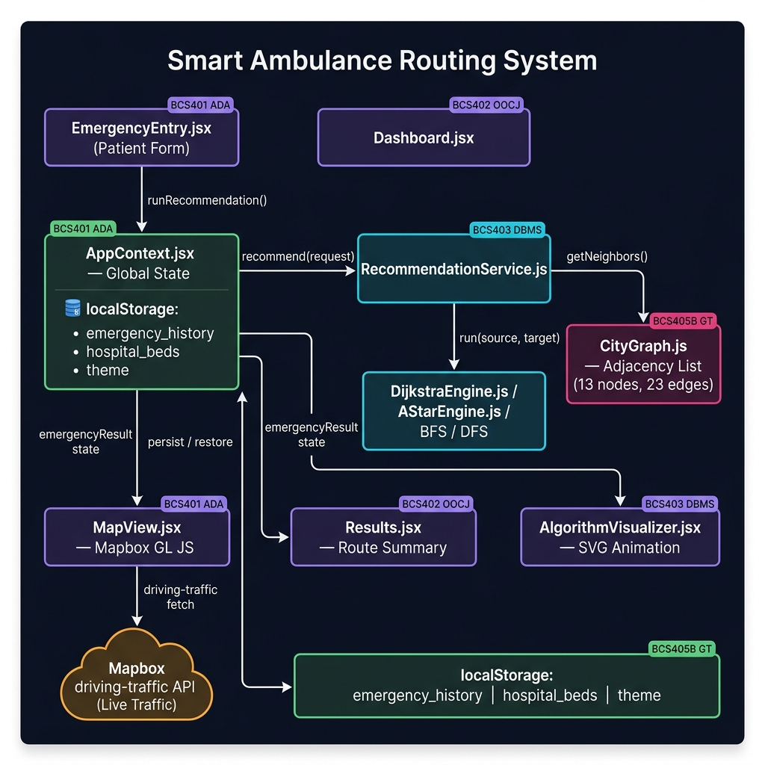
System Architecture
🏗
Component interaction & data flow — from patient form to ambulance animation
UI LAYER
Dashboard
EmergencyEntry
MapView
Visualizer
▼
CONTEXT
AppContext.jsx
runRecommendation()
localStorage
▼
ENGINES
CityGraph
Dijkstra
A*
BFS/DFS
▼
DATA
cityData.js (13 nodes · 23 edges · 6 hospitals)
Request Lifecycle
Form Submit → AppContext.runRecommendation()
RecommendationService: filter type → beds → Dijkstra per hospital
Sorted results → MapView fetches Mapbox driving-traffic route → Animation
React 18 · Mapbox GL JS · Turf.js · Framer Motion · Vite 5

Slide 8
How All 4 Subjects Work Together
BCS401
BCS403
BCS405B
BCS402
Algorithm Design
DBMS
Graph Theory
Advanced Java
📊
🗄
🕸
💻
Defines the PROBLEM and justifies WHY Dijkstra is used over brute-force search
Stores hospital data, roads, patients, and allocation history in a normalized schema
Models roads as a weighted graph. Runs BFS/DFS/Dijkstra to find the best route
Builds the full application — OOP classes, Swing UI, Collections, JDBC connector
Algorithm Design defines the WHY · Graph Theory does the routing · DBMS stores everything · Advanced Java builds it all

Slide 9
How All 4 Subjects Work Together
BCS401
BCS403
BCS405B
BCS402
Algorithm Design
DBMS
Graph Theory
Advanced Java
📊
🗄
🕸
💻
Defines the PROBLEM and justifies WHY Dijkstra is used over brute-force
Stores hospital data, roads, patients, and allocation history in a normalized schema
Models roads as a weighted graph. Runs BFS/DFS/Dijkstra to find the best route
Builds the full application — OOP classes, Swing UI, Collections, JDBC connector
Algorithm Design defines the WHY · Graph Theory does the routing · DBMS stores everything · Advanced Java builds it all

Slide 10
3 Demo Cases to Explain During Presentation
01
Nearest Hospital is Best — Simple Case
Scenario: Patient at Node 1 (JSSATE) | Emergency: GENERAL | No ICU needed
Result: BGS Gleneagles (Node 5, 1.2 km) handles GENERAL, has beds, and is the shortest Dijkstra path. System correctly recommends it as PRIMARY.
System works in the simple case — nearest IS best here.
02
Nearest Hospital Lacks Specialization — Filtered Out
Scenario: Patient at Node 1 (JSSATE) | Emergency: TRAUMA | Needs ICU
Result: BGS (1.2 km) handles CARDIAC not TRAUMA — filtered at Stage 1. RRMCH (Node 8, 7.2 km) handles TRAUMA with ICU available — selected as PRIMARY.
Nearest ≠ Best. Type + ICU filter is the key differentiator.
03
Multiple Valid Hospitals — Dijkstra Decides the Winner
Scenario: Patient at Node 10 (BSK Temple) | Emergency: CARDIAC | Needs ICU
Result: BGS, Apollo & Fortis all handle CARDIAC with ICU. Dijkstra computes road distances — Apollo (Node 11) wins at ~5.5 km vs BGS at 9+ km.
Best viva case — Dijkstra's role is crystal clear here.

Slide 11
One Line to Remember for Viva
"This project uses DBMS to store hospitals and roads, Advanced Java to build the application, Graph Theory to model and solve routing, and Algorithm Design to compare and justify the recommendation strategy."
BCS401
BCS402
BCS403
BCS405B
Defined the Problem
Built the App
Designed the DB
Solved the Routing
Smart Ambulance Routing & Hospital Allocation System · South Bangalore City Map · 13 Nodes · 6 Hospitals

