Slide 1
🚑
Smart Ambulance Routing
& Hospital Allocation System
Real-time emergency response powered by Dijkstra, A*, BFS/DFS & Mapbox live traffic
BCS401 ADA
BCS402 OOCJ
BCS403 DBMS
BCS405B GT
Shreya R Hipparagi | VTU 4th Semester CSE | 2025–26
South Bangalore Region · JSSATE Uttarahalli Campus Area

Slide 2
Problem Statement
Why do ambulances take the wrong route?
⏱️
Golden Hour Crisis
🏥
No Hospital Awareness
Ambulances lose precious minutes on wrong routes. Every 10 seconds matters in cardiac & trauma emergencies.
Ambulances rush to the nearest hospital — but it may have zero ICU beds or no cardiac specialist.
🚦
Traffic Blindness
🗺️
Manual Decision Making
Static routing ignores live congestion. Shortest distance ≠ fastest path during peak hours.
Dispatchers rely on memory and radio calls. No algorithmic optimization for multi-hospital scenarios.

Slide 3
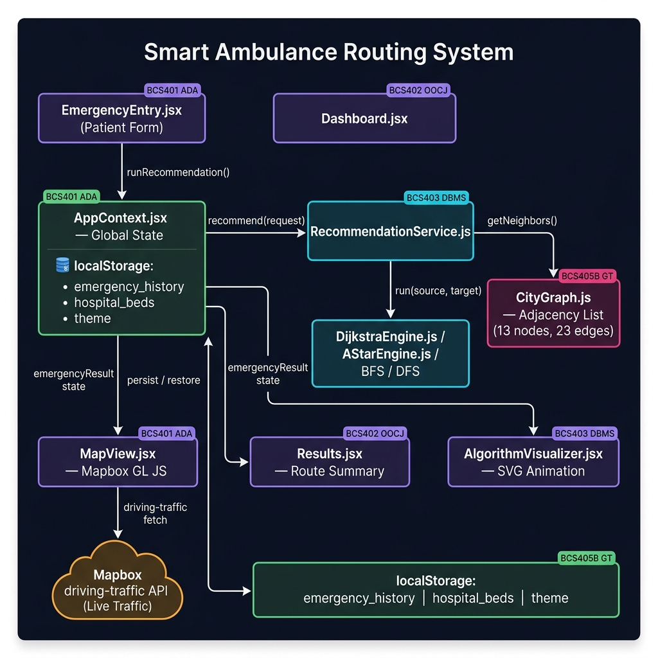
System Architecture
End-to-end component interaction & data flow
Component Legend
UI Pages (React JSX)
AppContext — Global State
Algorithm Engines
CityGraph (Data)
External: Mapbox API
localStorage Persistence
Data Flow
User Input → AppContext → RecommendationService → Dijkstra SSSP → Ranked Results → MapView → Mapbox Traffic API → Animation

Slide 4
Algorithm Engines
BCS401 ADA · BCS405B Graph Theory
Dijkstra SSSP
O((V+E) log V)
A* Search
O((V+E) log V)*
• Binary Min-Heap Priority Queue
• Haversine GPS heuristic: h(n) = great-circle dist
• Relaxes edges: dist[v] = min(dist[v], dist[u]+w)
• f(n) = g(n) + h(n) → priority in queue
• Handles traffic multipliers: w_eff = w × traffic
• Admissible: never overestimates → optimal
• Captures every step for visualizer
• Converges faster than Dijkstra on geospatial graphs
• Used in RecommendationService per hospital
• Same step trace format as Dijkstra
BFS
O(V+E)
DFS
O(V+E)
• Queue-based level-order traversal
• Stack-based deep exploration with backtracking
• Shortest path by hop count (not weighted)
• May not find optimal path in weighted graph
• Illustrates frontier expansion visually
• Shows recursion / call-stack behavior
• Educational: shows graph connectivity
• Educational: illustrates graph reachability
• Complete: always finds a path if one exists
• Demonstrates backtracking algorithm design

Slide 5
City Graph — Real Bangalore Network
BCS405B Graph Theory · 13 nodes, 23 edges, 6 hospitals
13
23
6
6
Graph Nodes
Road Edges
Hospitals
Emergency Types
#
Hospital
Node
Specializations
ICU Beds
H1
RRMCH Mysore Road
8
GENERAL, TRAUMA, MATERNITY
1 / 5
H2
Sagar Hospitals DSI
4
TRAUMA, BURNS
3 / 8
H3
BGS Gleneagles Global
5
CARDIAC, GENERAL, MATERNITY
2 / 10
H4
Astra Super Speciality
6
NEURO, GENERAL
4 / 6
H5
Apollo Hospital Bannerghatta
11
CARDIAC, NEURO, BURNS
5 / 12
H6
Fortis Hospital Bannerghatta
13
CARDIAC, TRAUMA, NEURO
4 / 10
★ All node coordinates GPS-verified for Bangalore · Edges are bidirectional with traffic multipliers (1.0 – 2.0)

Slide 6
Database Schema (DBMS)
BCS403 · 8 relational tables · 3NF normalized · localStorage persistence
patients
location_nodes
road_edges
patient_id PK
node_id PK
edge_id PK
name
name
from_node FK
age
area
to_node FK
blood_group
lat
weight_km
contact
lng
traffic_mult
hospitals
hospital_specializations
hospital_resources
hospital_id PK
spec_id PK
resource_id PK
name
hospital_id FK
hospital_id FK
address
emergency_type
icu_total
contact
icu_avail
node_id FK
gen_total
gen_avail
emergency_cases
allocations
case_id PK
allocation_id PK
patient_id FK
case_id FK
source_node FK
hospital_id FK
emergency_type
route_cost_km
💾 localStorage persistence: emergency_history | hospital_beds | theme (no backend — pure browser storage)
needs_icu
path_nodes
timestamp
algorithm

Slide 7
Live Map & Traffic Integration
BCS405B Graph Theory · Mapbox GL JS · driving-traffic API
🗺️
Mapbox Streets Map
🚦
Live Traffic Routing
streets-v12 style — real OSM base map centered on JSSATE Bangalore region
driving-traffic API profile — real-time congestion-aware route (not just static roads)
🎨
Congestion Color Coding
🚑
Ambulance Animation
Per-segment colors: 🟢 Low 🟡 Moderate 🔴 Heavy ● Severe — from Mapbox annotations
Turf.js along-path interpolation at 60fps. Bearing offset -90° so emoji faces direction of travel
📏
Distance Badges
📊
Live Stats Bar
km labels float at midpoint of each of 23 edges on the map canvas
Real-time: Mapbox distance, ETA, dominant congestion level, last-updated timestamp
🔄
Refresh Route
📍
13 Real GPS Nodes
Re-fetches route from Mapbox at any time to get updated traffic conditions
Verified coordinates: JSSATE, BGS, RRMCH, Apollo, Fortis, Sagar, Kengeri, BSK...

Slide 8
Bug Fixes & Quality Improvements
13 bugs identified and resolved during review
Sev
Bug Description
File
Fix Applied
🔴
History wiped on page refresh
AppContext.jsx
Persisted to localStorage['emergency_history'] via useEffect
🔴
Hospital bed edits lost on refresh
AppContext.jsx
Merged saved beds from localStorage on init; persist on every updateBeds()
🔴
MATERNITY → No Hospital Found (always)
cityData.js
Added MATERNITY to RRMCH (H1) and BGS Gleneagles (H3) specializations
🟡
Edge e14 waypoint missed Node 9
cityData.js
Fixed last coord to [77.4810, 12.9115] — exact Node 9 GPS
🟡
needsIcu missing from history records
AppContext.jsx
Added needsIcu: request.needsIcu to addToHistory() call
🟡
ETA speed 40 km/h (too slow)
Results.jsx
Changed to 50 km/h — realistic for Bangalore emergency vehicles
🟡
sourceLocationId string vs number
EmergencyEntry.jsx
Added parseInt() on select onChange; consistent number type
🟢
JSS campus loop in ambulance route
cityData.js
Moved Node 1 to main road junction (12.9060, 77.5028)
🟢
Static driving profile (no traffic)
MapView.jsx
Switched to driving-traffic Mapbox profile with congestion annotations
🟢
Ambulance emoji wrong direction
MapView.jsx
setRotation(bearing − 90) compensates for 🚑 facing east by default
🟢
All roads painted green (traffic tiles)
MapView.jsx
Removed mapbox-traffic-v1 tile layer; kept route-level segment colors
🟢
No way to clear history
History.jsx
Added Clear History button + clearHistory() action in AppContext
🟢
Comment said 9 nodes (actually 13)
cityData.js
Updated comment to '13 nodes'

Slide 9
End-to-End Data Flow
From patient form submit to ambulance animation on map
1
EmergencyEntry.jsx
2
AppContext.jsx
3
RecommendationService
handleSubmit()
runRecommendation(request)
recommend(request)
Patient fills form → needsIcu, emergencyType, sourceLocationId (parseInt), patientName
Sets emergencyRequest state, creates RecommendationService, calls service.recommend()
Stage 1: filter by specializations. Stage 2: filter by bed availability. Stage 3: Dijkstra per hospital
4
DijkstraEngine.js
5
CityGraph.js
6
AppContext.jsx
run(source, target, useTraffic)
getNeighbors() + getEffectiveWeight()
setEmergencyResult() + addToHistory()
Binary min-heap SSSP: relax edges with w × trafficMultiplier, reconstruct path via previous[]
Adjacency list lookup → returns neighbors; effective weight = edge.weight × (traffic ? multiplier : 1)
Stores ranked hospital results, persists case record to localStorage['emergency_history']
7
Results.jsx
8
MapView.jsx
9
Turf.js + rAF
render()
fetchAndDrawRoute()
runAnimation()
Displays primary/backup hospitals, ETA (cost/50×60 min), path nodes, filter steps, call button
Fetches Mapbox driving-traffic route with congestion annotations, draws per-segment colored line
along(route, progress×distance) → setLngLat + setRotation(bearing − 90) every frame

Slide 10
Academic Syllabus Coverage
VTU 4th Semester CSE — all 4 subjects demonstrated end-to-end
BCS401
Analysis & Design of Algorithms
BCS402
Object Oriented Concepts with Java
✓ Dijkstra SSSP — O((V+E) log V)
✓ CityGraph class — encapsulation + adjacency list
✓ A* Search with GPS heuristic f(n)=g(n)+h(n)
✓ DijkstraEngine, AStarEngine — single responsibility
✓ Binary Min-Heap Priority Queue from scratch
✓ RecommendationService — dependency injection
✓ BFS & DFS traversal step-by-step visualization
✓ AppContext — singleton state pattern
✓ Algorithm comparison across all 4 methods
✓ PriorityQueue — clean class interface
✓ Traffic-weighted edge relaxation
✓ React components — modular OO design
BCS403
Database Management Systems
BCS405B
Graph Theory & Applications
✓ 8-table relational schema in 3NF
✓ Graph G = (V=13, E=23) weighted undirected
✓ ER Diagram — PK/FK, 1:N and 1:1 relationships
✓ Adjacency list representation
✓ CRUD on hospital resources (Hospitals page)
✓ Reachability & degree analysis
✓ Persistent audit log (localStorage → History page)
✓ BFS/DFS traversal proofs
✓ Query simulation: filter by specialization + beds
✓ Dijkstra & A* SSSP on spatial graph
✓ Transaction logging: addToHistory() on each case
✓ Real GPS coordinate mapping

Slide 11
🚑
Thank You
Smart Ambulance Routing & Hospital Allocation System
13
23
6
4
13
3
Graph Nodes
Road Edges
Hospitals
Algorithms
Bugs Fixed
localStorage Keys
Shreya R Hipparagi · VTU 4th Semester CSE · 2025–26
github.com/ShreyaRHipparagi/Ambulance
BCS401 ADA
BCS402 OOCJ
BCS403 DBMS
BCS405B GT
Built with React · Vite · Mapbox GL JS · Turf.js · Framer Motion · Vanilla CSS

