Slide 1
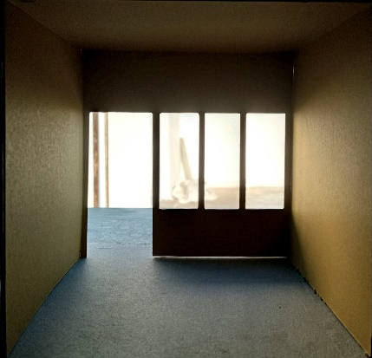
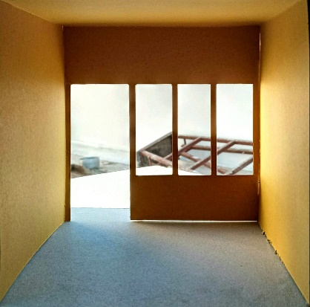
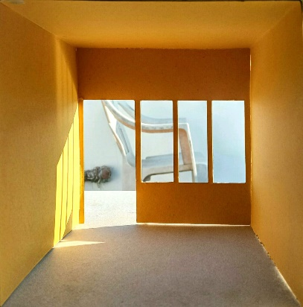
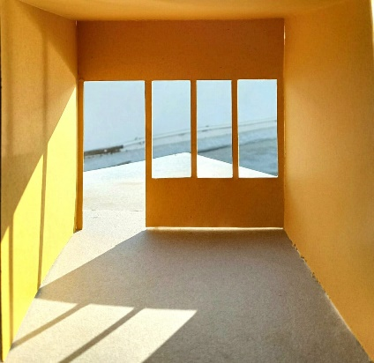
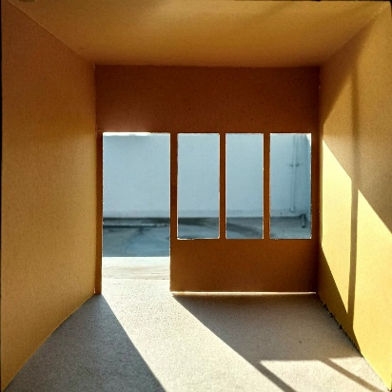
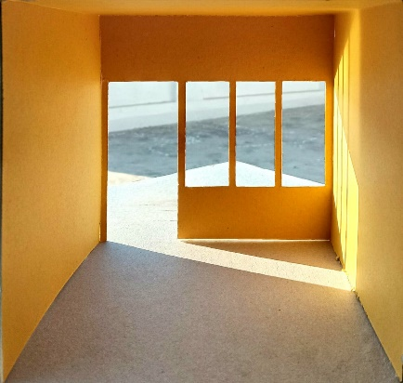
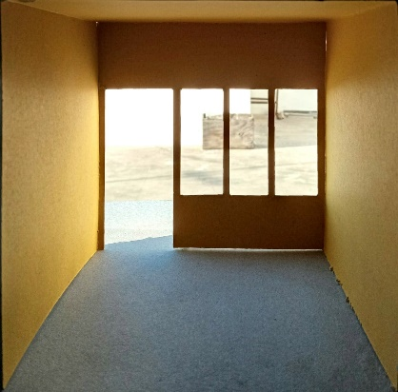
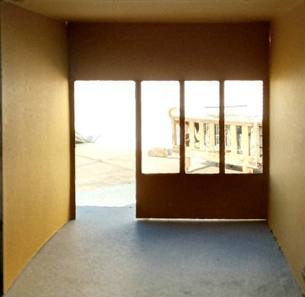
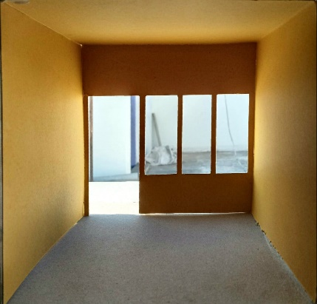
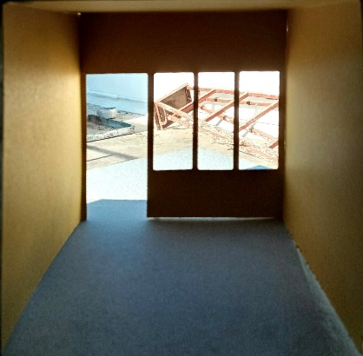
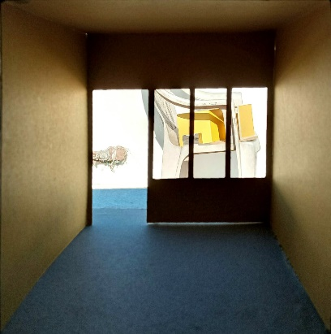
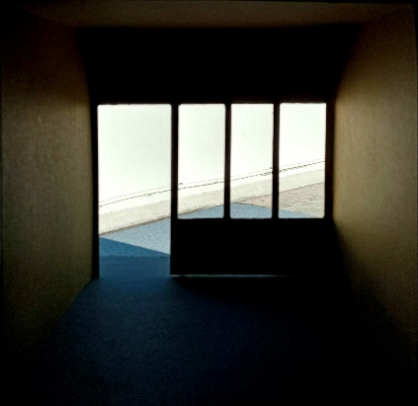
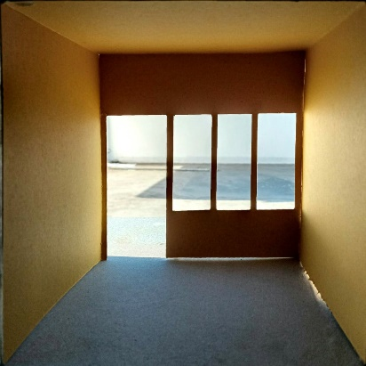
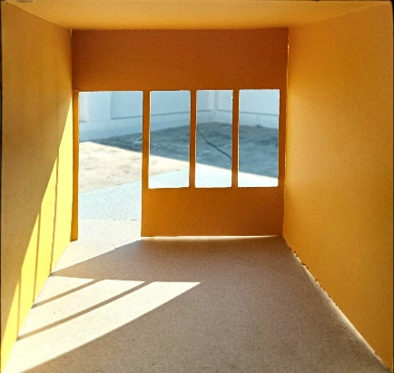
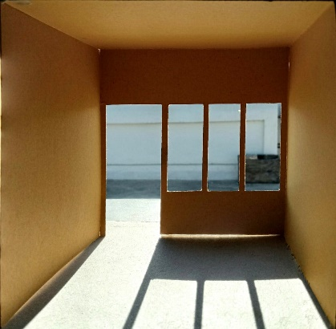
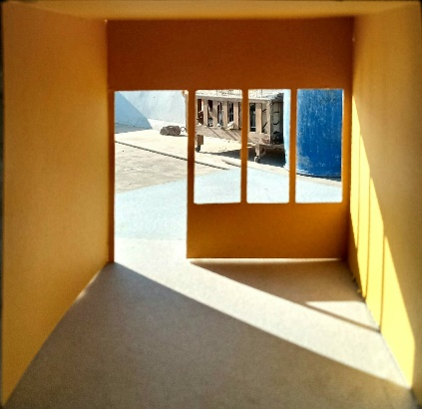
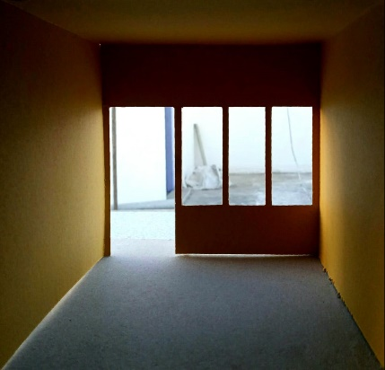
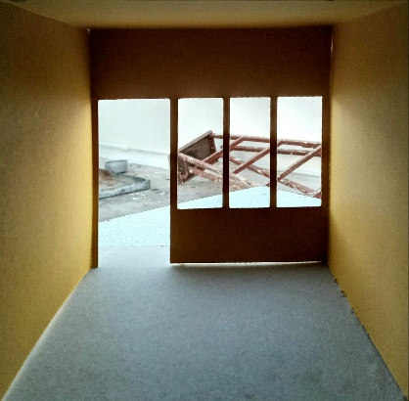
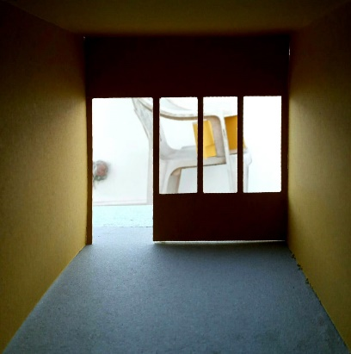
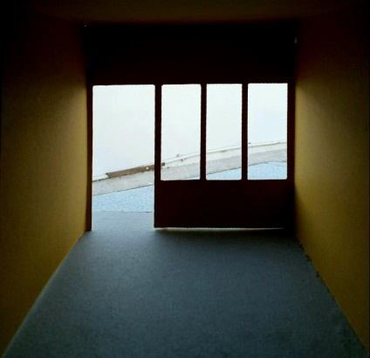
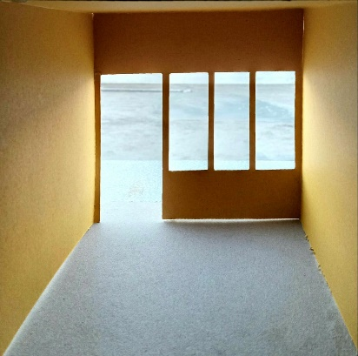
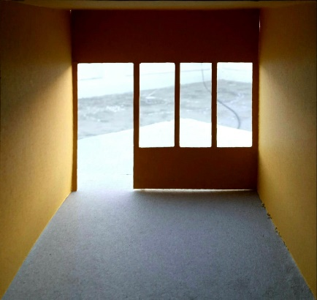
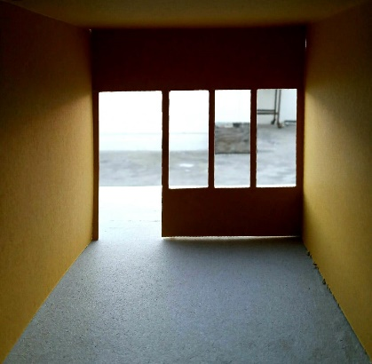
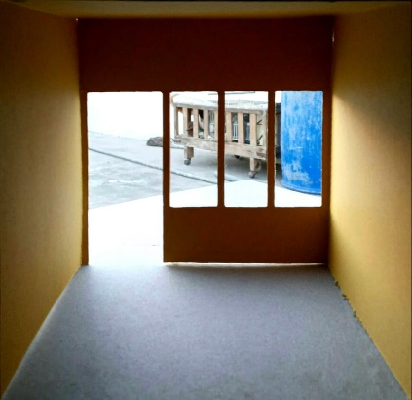

 | NORTH | NORTH-EAST | EAST | SOUTH-EAST | SOUTH | SOUTH-WEST | WEST | NORTH-WEST
MORNING
NOON
EVENING
INSTITUTE OF ARCHITECTURE
H.N.G.U.-PATAN
SUBJECT : ENVIRONMENTAL SCIENCE-II
TOPIC : INTERIOR SAIOGRAPHY (BIG OPENING)
NAME : SHREYA RASTOGI
E.N.R. No. : BARCH2831973291
DATE : 29-01-2021
SEM : IV
SIGN :

Slide 2
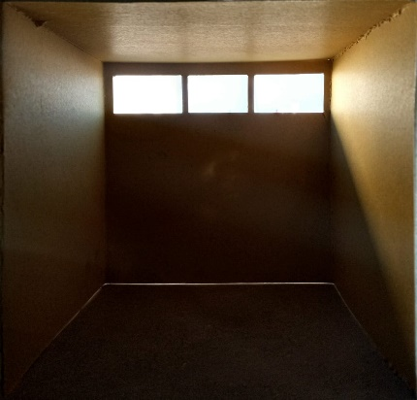
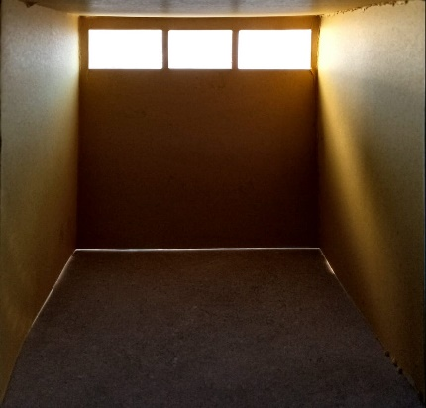
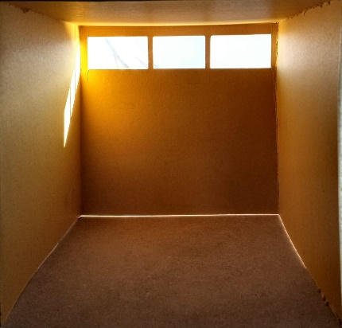
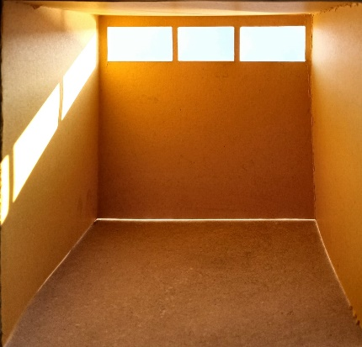
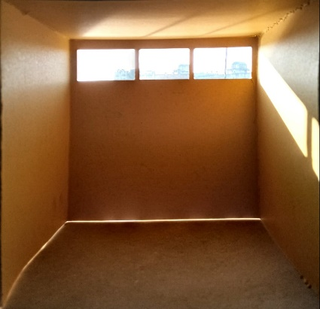
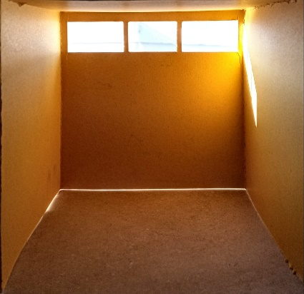
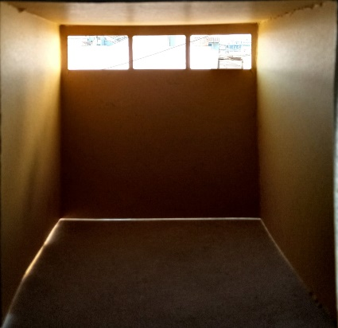
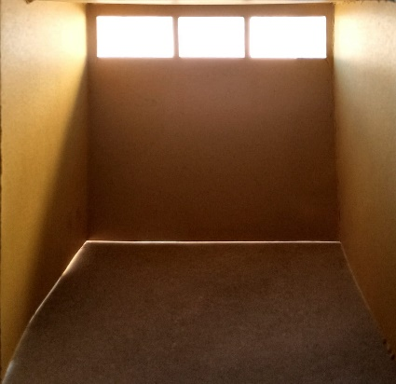
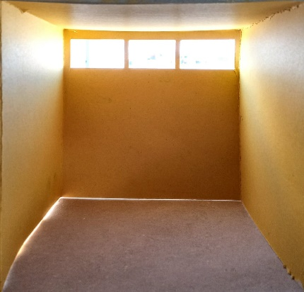
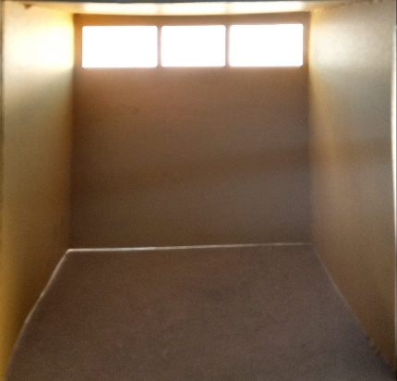
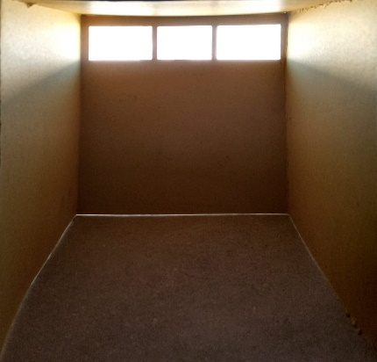
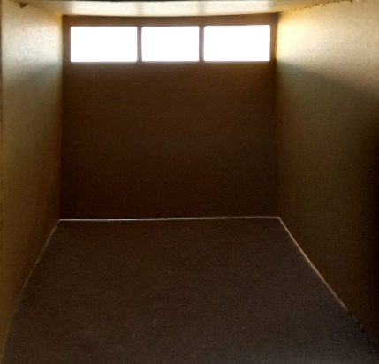
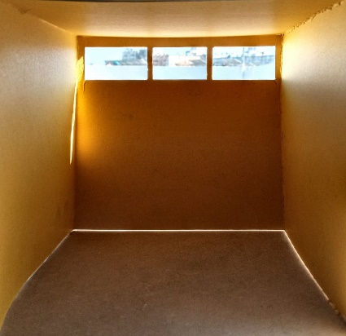
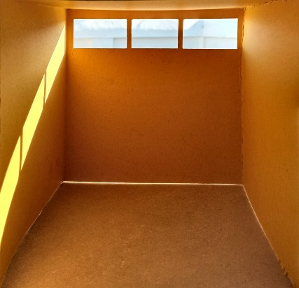
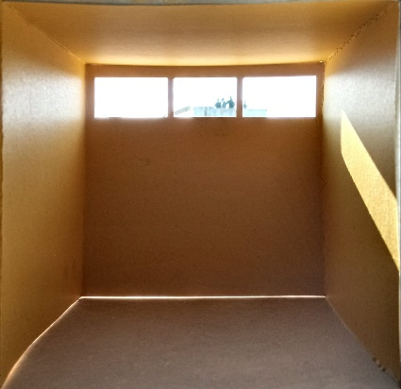
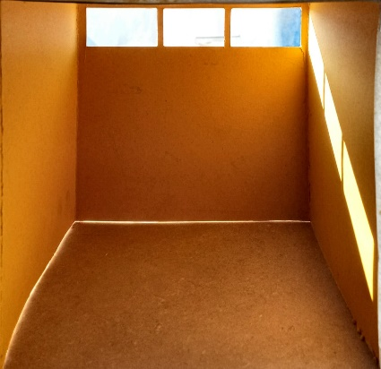
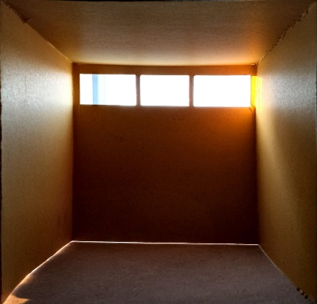
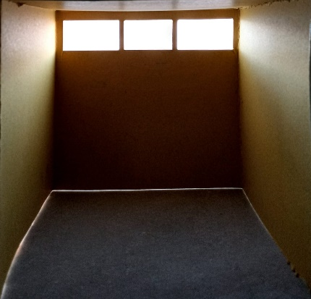
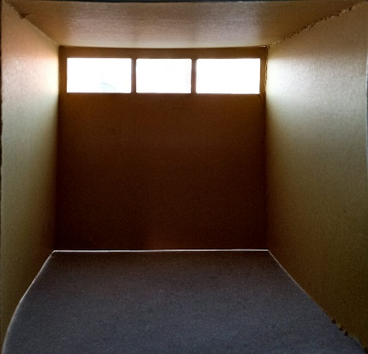
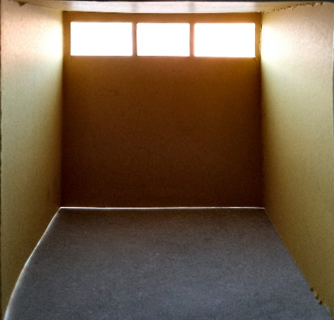
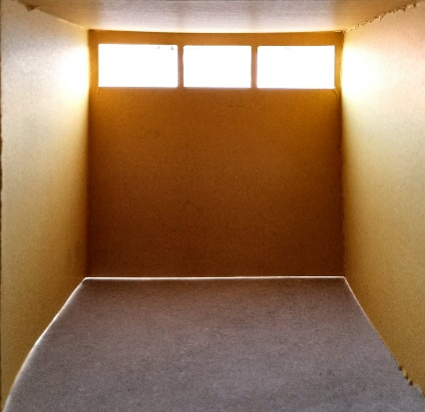
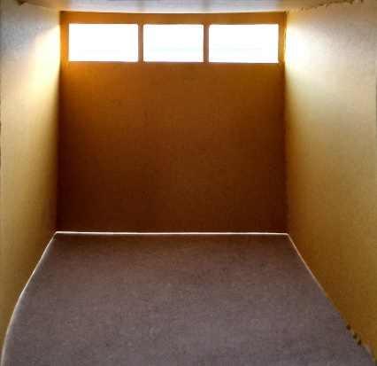
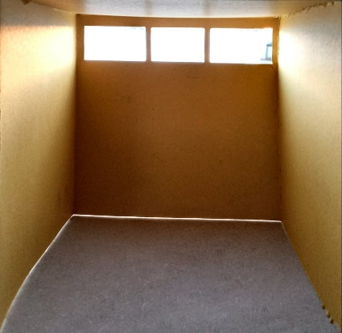
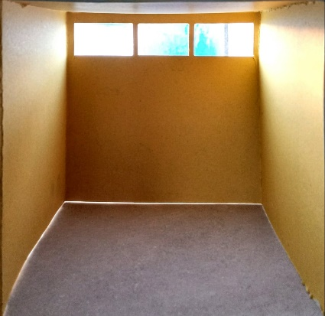
 | NORTH | NORTH-EAST | EAST | SOUTH-EAST | SOUTH | SOUTH-WEST | WEST | NORTH-WEST
MORNING
NOON
EVENING
INSTITUTE OF ARCHITECTURE
H.N.G.U.-PATAN
SUBJECT : ENVIRONMENTAL SCIENCE-II
TOPIC : INTERIOR SAIOGRAPHY (SMALL OPENING)
NAME : SHREYA RASTOGI
E.N.R. No. : BARCH2831973291
DATE : 29-01-2021
SEM : IV
SIGN :

Slide 3
OBJECTIVES | ANALYSIS
SIZE OF OPENINGS | IN UNITS WITH SMALL SIZE OF OPENINGS – FROM SOUTH DIRCTION IT GETS MAXIMUM LIGHT (WHOLE DAY) IN UNITS WITH LARGE SIZE OF OPENINGS - FROM NORTH DIRECTION IT GETS BLURRY LIGHT (WHOLE DAY)
COLOUR OF UNIT | DIFFERENT COLOUR MAKES VAST CHANGE IN THE LIGHT ABSORPTION AND REFLECTION. IF THE LIVING ROOM HAS LESS OPENINGS THEN WHITE COLOUR IN INTERIOR IS THE BEST WAY TO INCREASE THE BRIGHTNESS IN A ROOM.
DIRECTION | OPENING IN NORTH DIRECTION HAS THE REFLECTIVE LIGHT AND REMAIN CONSTANT IN THE DAY TIME. OPENING IN SOUTH-WEST DIRECTION HAS THE MAXIMUM HARSH LIGHT COMING INSIDE CONSTANT IN THE DAY TIME
TYPE OF UNIT | UNITS LIKE LIVING AND BEDROOM NEEDS REFLECTIVE LIGHT, SO NORTH IS THE BEST DIRCTION OF OPENINGS FOR IT. IN OTHER SIDE UNITS LIKE WORK SPACE AND STUDY ROOM NEEDS MAXIMUM LIGHT, SO SOUTH-WEST IS THE BEST DIRCTION OF OPENINGS FOR IT.
LIGHT EFFECT | DUE TO VARIATIONS IN SIZE OF OPENINGS SAIOGRAPHY DIFFERS. IN THE MORNING FROM EAST TILL EVENING TO THE NORTH-WEST, MAXIMUM WORKOUT IN SAIOGRAPHY CAN BE DONE
INTENSITY OF LIGHT | MORNING MAXIMUM LIGHT - SOUTH-EAST, MORNING MINIMUM LIGHT – NORTH NOON MAXIMUM LIGHT – SOUTH-WEST, NOON MINIMUM LIGHT – SOUTH-EAST EVENING – ALL DIRECTION GETS BLURRY AND REFLECTIVE LIGHT
INSTITUTE OF ARCHITECTURE
H.N.G.U.-PATAN
SUBJECT : ENVIRONMENTAL SCIENCE-II
TOPIC : INTERIOR SAIOGRAPHY ANALYSIS
NAME : SHREYA RASTOGI
E.N.R. No. : BARCH2831973291
DATE : 29-01-2021
SEM : IV
SIGN :

