Slide 1


AMAZON SALES ANALYSIS

Slide 2
ANALYSIS PROBLEM:
Sales management has gained importance to meet increasing competition and the need for improvement is to reduce the cost and increase profit. Sales management is the most important function in commercial and business enterprises.
Based on the information the ultimate goal of this project would be to analyze and predict sales figures month and year wise by connecting different aspects of data. We will find important insights highlighting key indicators and metrics that influence the sales figures. Visualization of trend and pattern empowers to optimize sales strategies.

Slide 3
KEY COMPONENTS OF THE PROJECT:
Through the presentation , we will explore-
Data Exploration : Understanding the structure and content of the dataset.
Analysis Techniques : Implementing various analysis techniques.
Visualization : Show the findings through charts, graphs, maps.
Interpretation : Interprete the result to have actionable insight.

Slide 4
OVERVIEW OF DATASET:
To observe the dataset for Amazon Sales click here.
The dataset covers a wide range of Amazon Products providing a view of diverse sales activities of company.
It includes information about amount of product sold and the profit allowing an in-depth analysis of trend.
The dataset has information on what regions and countries the order was taken which provides a knowledge about the outreach of Amazon.
The sales revenue provides a view of overall business performance.
The net profit indicates financial efficiency of Amazon.
The data was collected and updated due time which provides an opportunity to make an analysis yearly as well as monthly.

Slide 5
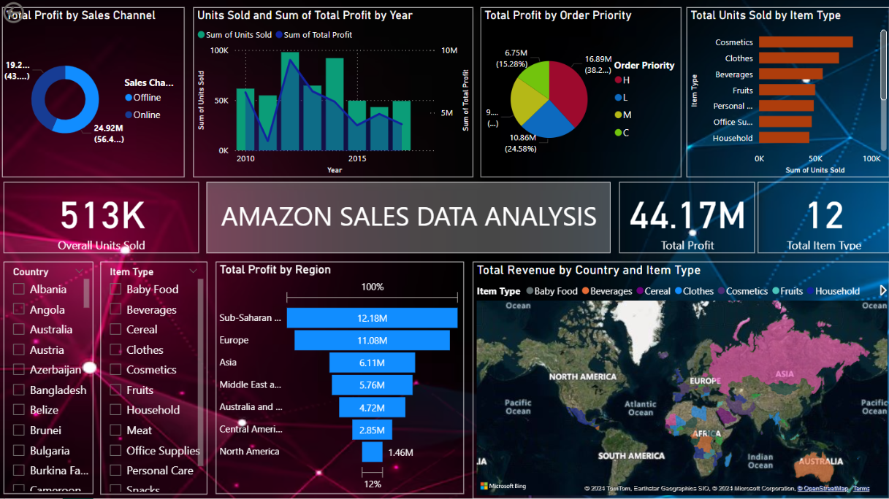
POWER BI DASHBOARD

Slide 6
CONCLUSION:
Most number of units is sold by Sub-Saharan Africa. Middle East and Africa has least number of units sold.
Most profit is gained by cosmetics and least by baby food.
Countries with lowest profit- Russia, UK, Portugal, Albania.
There is a seasonal increase in profit on May, October-December.
RECOMMENDATION:
Improvement in customer’s satisfaction may lead to higher profit.
Cosmetics, office supplies, clothes are highest selling items. We should provide offers on other items to makes higher selling.
Customers are much more dependent on offline sales channel.

Slide 7

THANK YOU

