Slide 1


Sales analysis : Analysis on the supermarket data set using python
Name: SHREYA SARI
AICTE No: STU659a3641090a71704605249

Slide 2

PROBLEM STATEMENTS
Analyze Sales Trends by Ship Mode
Explore how sales vary across different shipping modes (e.g., standard class, second class, etc.).
Identify which shipping mode contributes the most to overall sales.
Determine if there are any trends or patterns in sales over time for each shipping mode.
Analyze Customer Distribution by Geographic Region
Investigate the distribution of customers across different geographic regions (e.g., West, East, Central, South).
Identify regions with the highest and lowest number of customers.
Determine if there are any regional preferences or disparities in customer distribution.
Profitability Analysis by Customer Segment
Analyze the profitability of different customer segments (e.g., consumer, corporate, home office).
Identify which customer segment generates the highest profit.
Determine if there are any significant differences in profitability among customer segments.
Discount Effectiveness Analysis by Product Category
Explore the effectiveness of discounts offered on sales within different product categories (e.g., office supplies, furniture, technology).
Analyze the average discount rates applied to each product category.
Determine if discounts have a significant impact on sales within specific product categories.

Slide 3
Through a thorough examination of sales data from an online retail platform, the "E-commerce Sales Analysis and Optimization" project aims to identify the underlying patterns and trends that influence revenue and profitability. The goal of the research is to identify characteristics that impact customer behavior and purchasing decisions by carefully examining sales trends across various shipping types and geographic locations. With a focus on customer buying patterns and demographics, as well as an assessment of the effectiveness of discounts across product categories, the project aims to segment its customer base and develop customized marketing strategies and optimal discounting techniques that maximize revenue while preserving profitability. Comprehensive product performance research will also reveal best-selling items and areas where margin can be increased. The initiative will make use of these insights in conjunction with a calculated plan for geographic expansion. This project focusses on getting the insightful outputs while also using graphs and charts for better analysis.
PROJECT DESCRIPTION

Slide 4

WHO ARE THE END USERS?
Executives and decision-makers: Utilize insights to inform strategic planning, resource allocation, and overall business strategy.
Marketing teams: Leverage segmentation strategies and discount optimization plans to tailor promotional activities and enhance customer engagement.
Operations teams: Benefit from understanding sales trends and customer behavior to streamline logistics, inventory management, and fulfillment processes.
Finance and accounting departments: Utilize profitability analysis to monitor financial performance, assess the effectiveness of marketing initiatives, and ensure sustainable growth.
Sales teams: Gain insights into customer preferences and behavior to improve targeting, sales tactics, and overall sales performance.
Customer service teams: Utilize data-driven insights to better understand customer needs, address issues, and enhance the overall customer experience.
Product development teams: Utilize feedback from sales analysis to inform product development, identify market trends, and introduce new offerings that align with customer preferences.
Geographic expansion teams: Utilize insights to identify growth opportunities in new markets, develop market entry strategies, and optimize distribution channels for expanded reach.

Slide 5

Technology Used
Programming Languages: Python
Data Analysis and Machine Learning Tools: Jupyter Notebooks, Pandas, NumPy, Matplotlib, Seaborn, scikit-learn
Data Storage and Management: SQL databases (e.g., PostgreSQL, MySQL), NoSQL databases (e.g., MongoDB)
Data Visualization: Matplotlib, Seaborn
Presentation Tools: Microsoft PowerPoint, Google Slides
Collaboration Tools: GitHub, GitLab, Bitbucket
Cloud Computing: Amazon Web Services (AWS), Microsoft Azure, Google Cloud Platform (GCP)
Dashboarding Tools: Tableau, Power BI, Google Data Studio

Slide 6
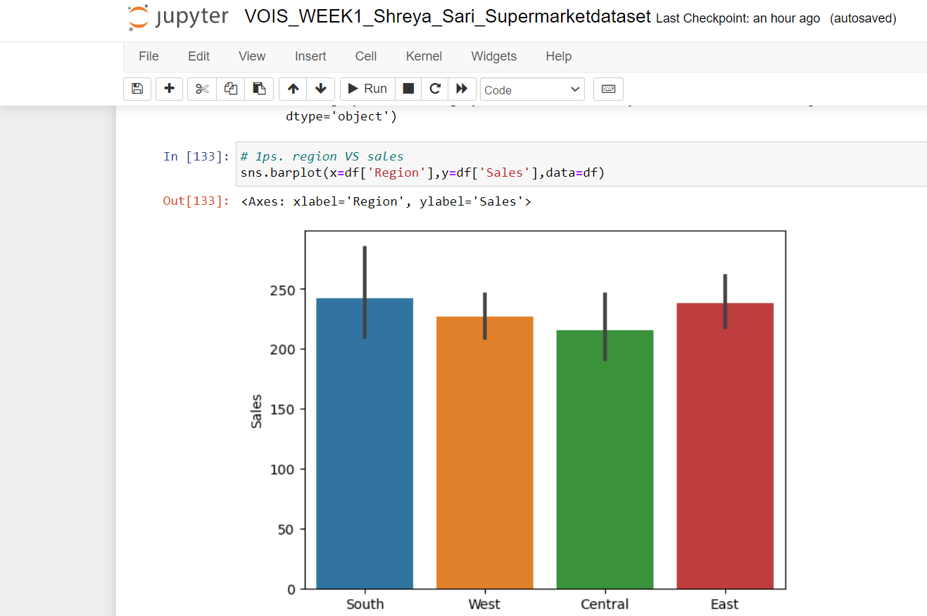
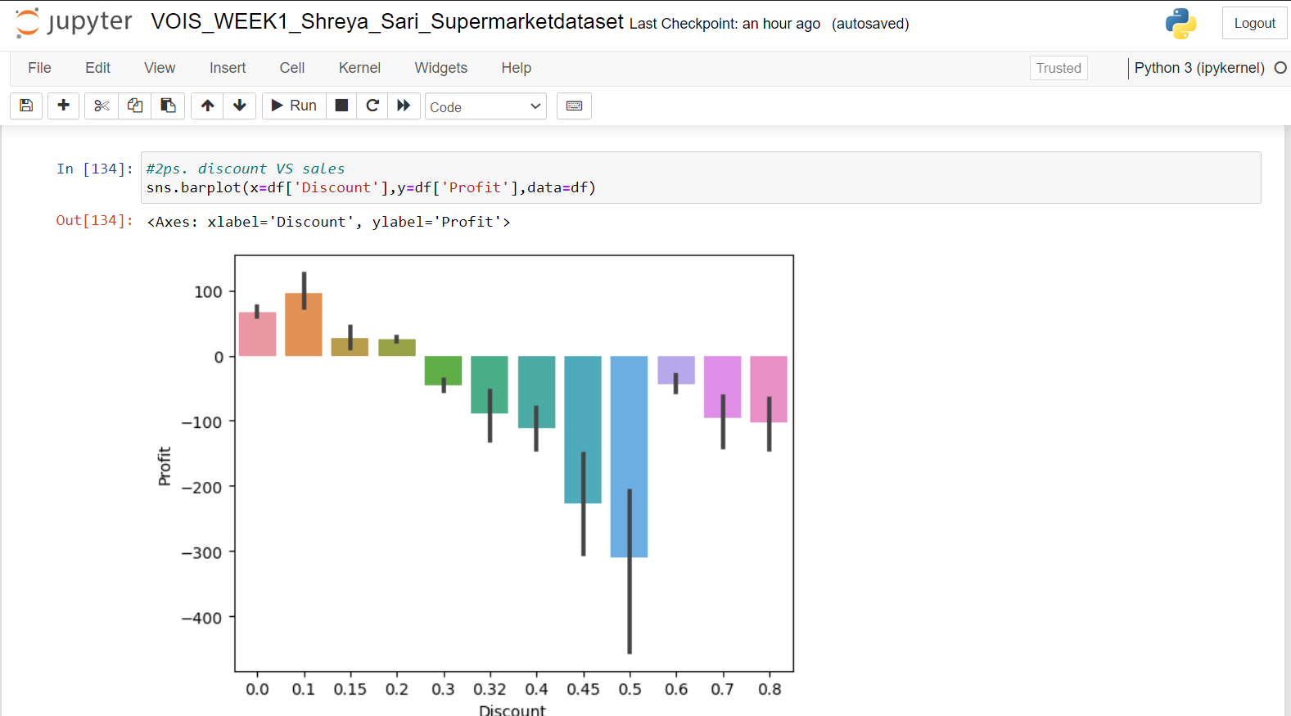
RESULTS

Slide 7
RESULTS

Slide 8
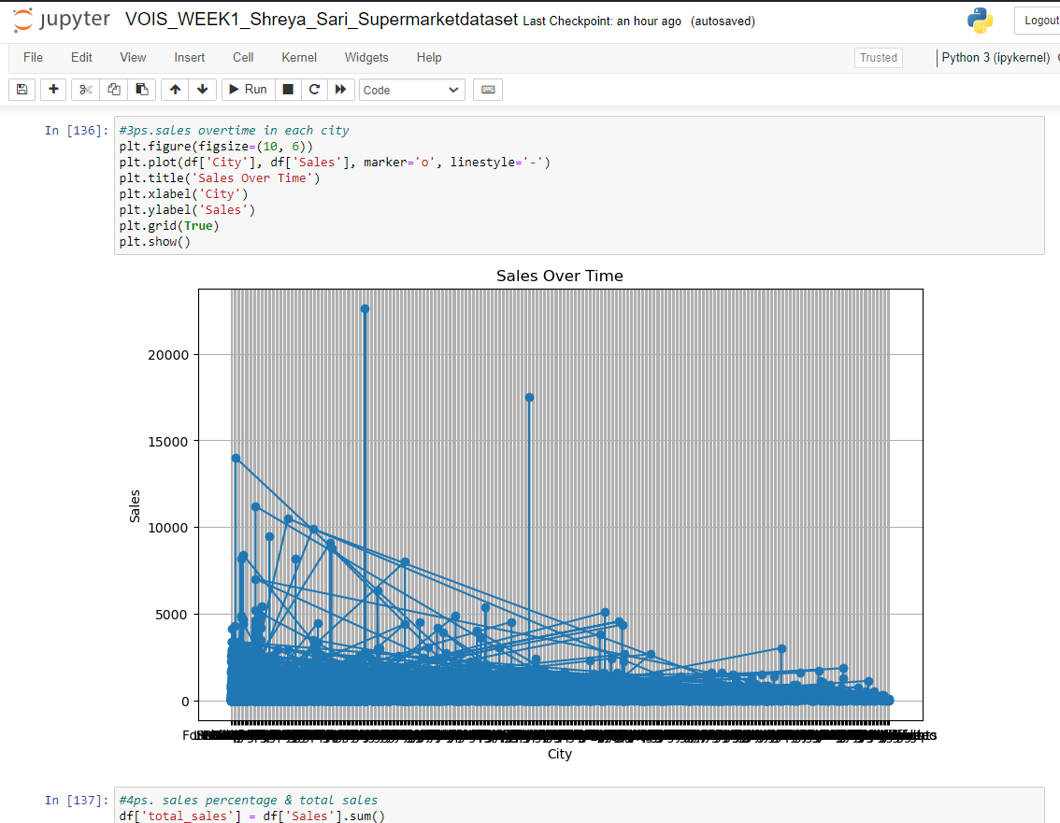
RESULTS

Slide 9
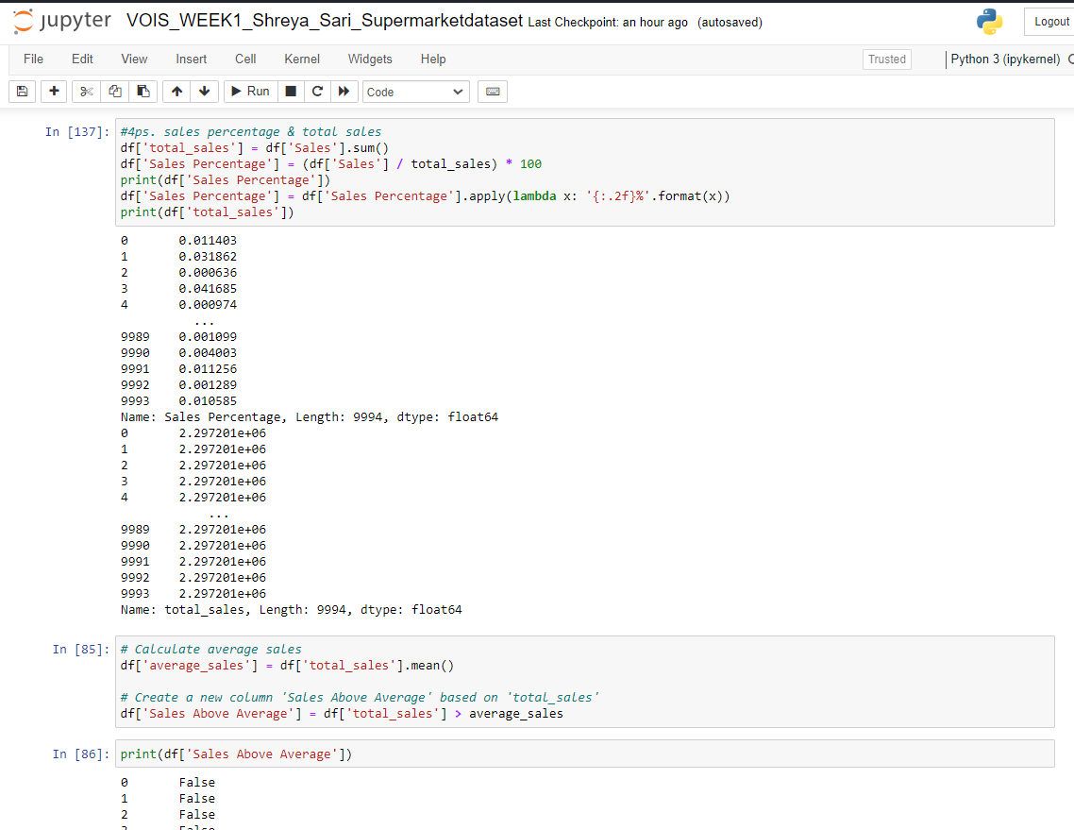
RESULTS

Slide 10
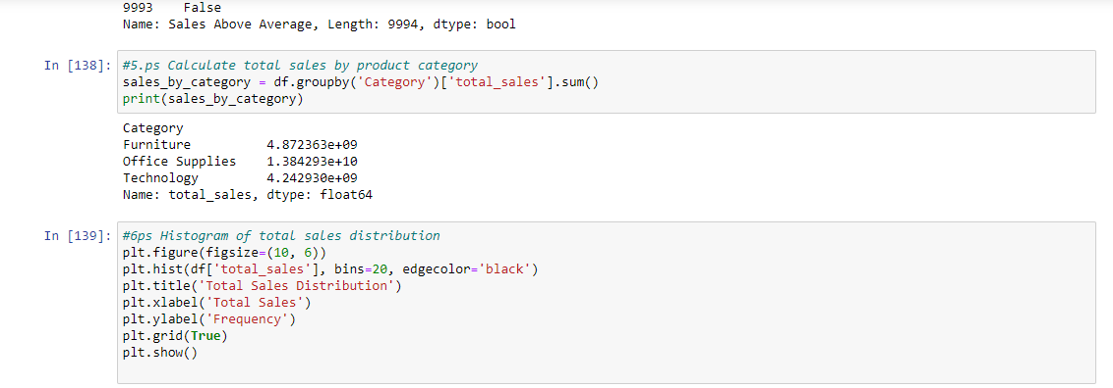
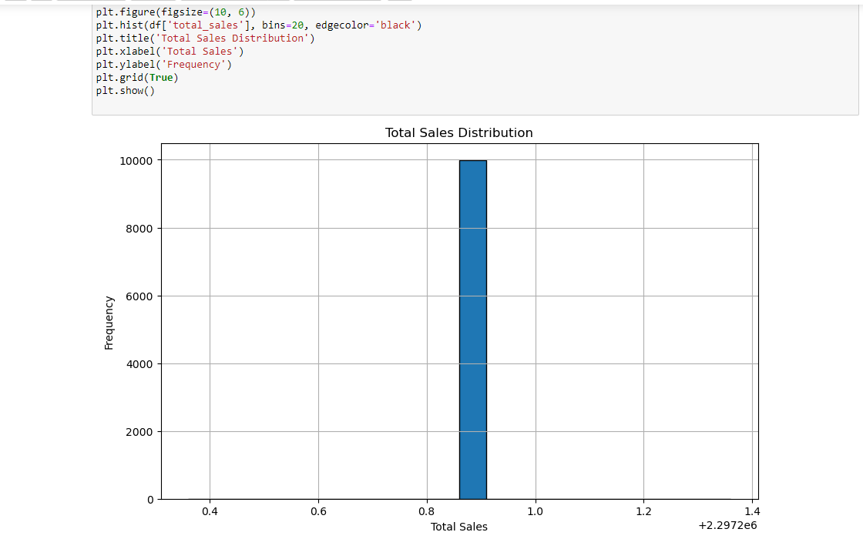
RESULTS

Slide 11
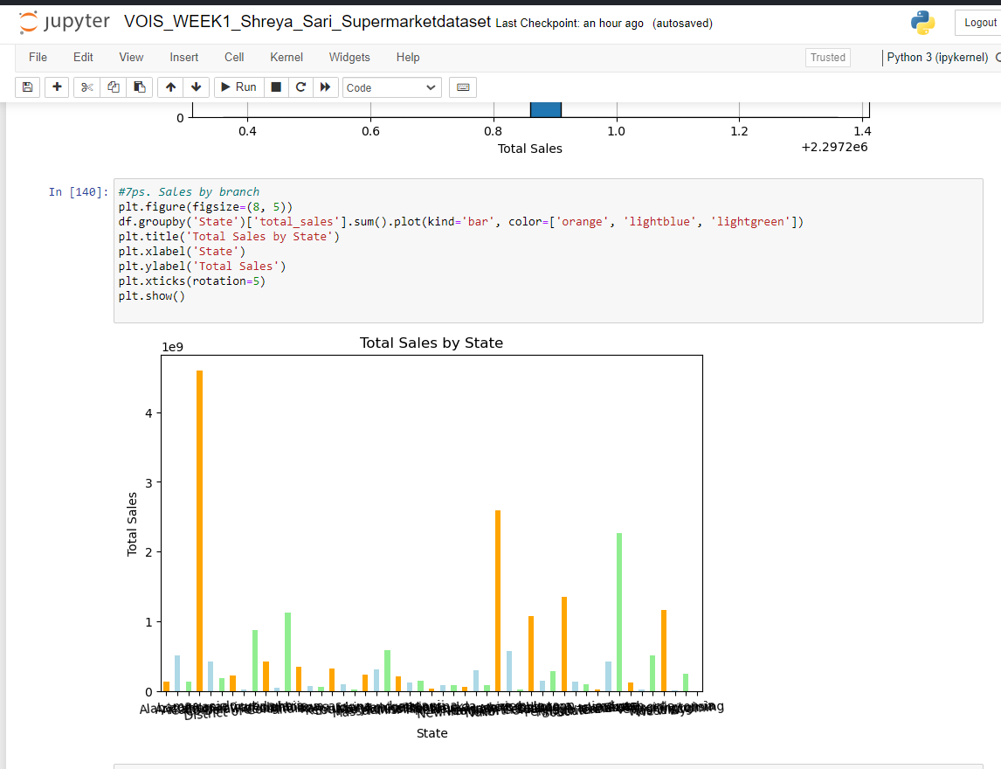
RESULTS

Slide 12
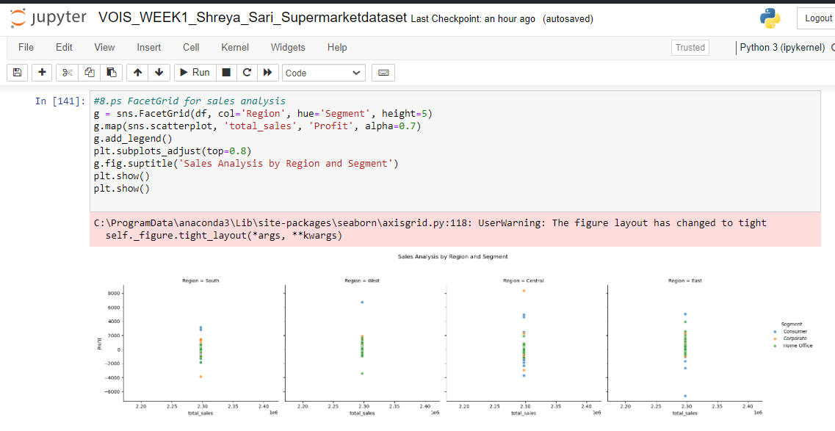
RESULTS

Slide 13
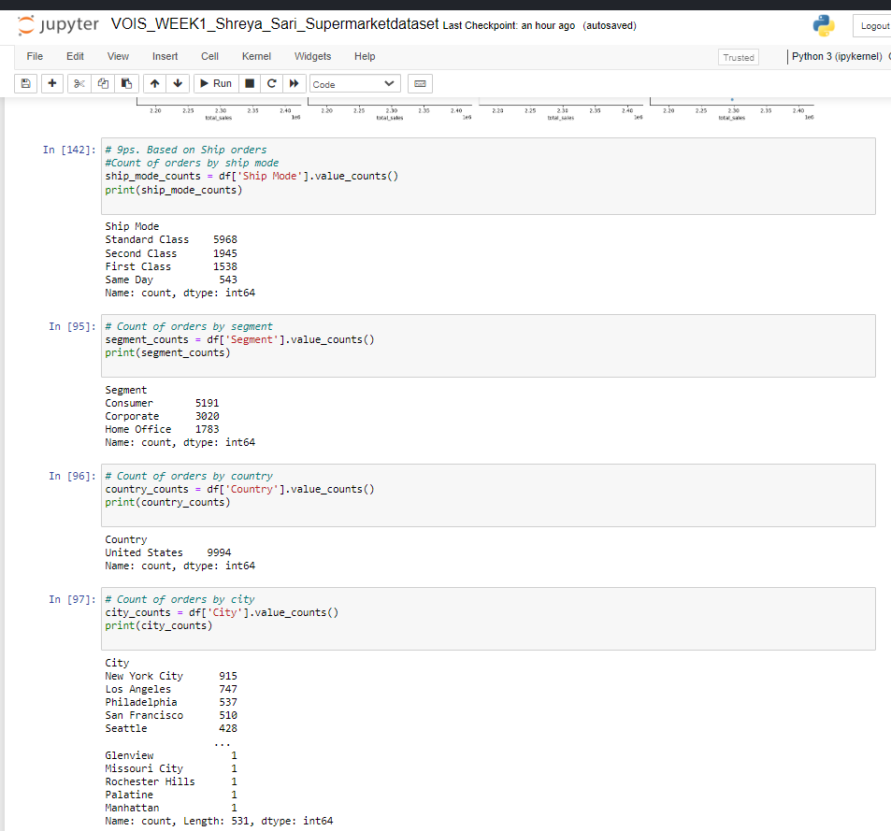
RESULTS

Slide 14
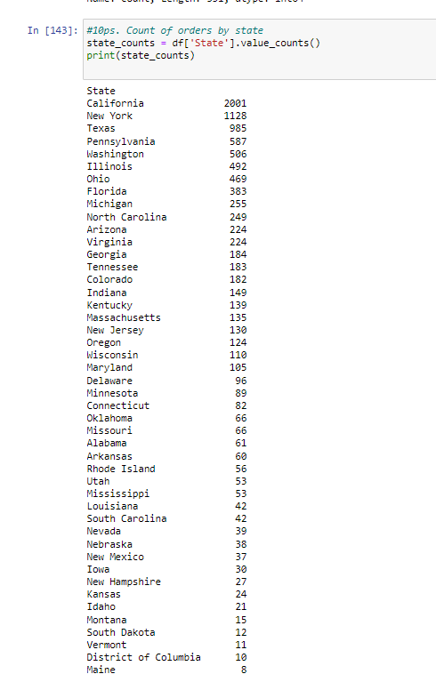
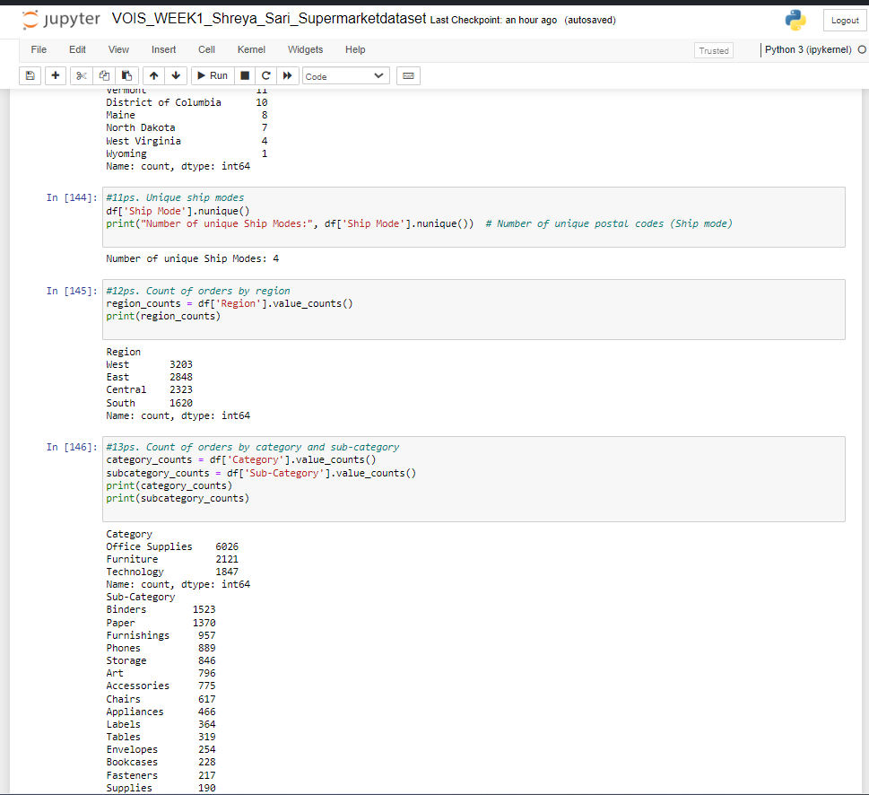
RESULTS

Slide 15
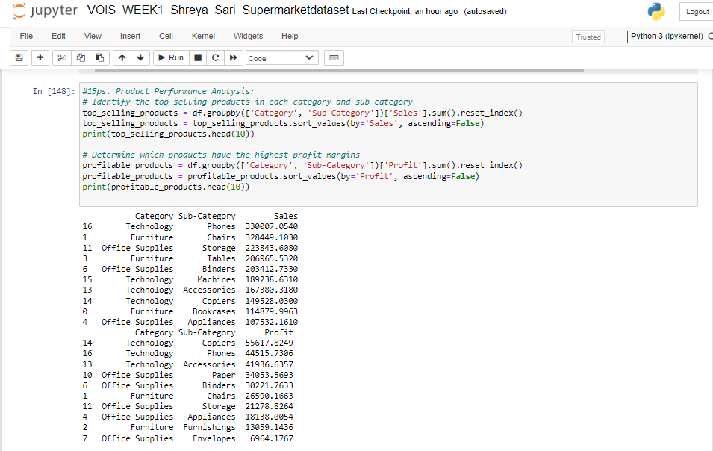
RESULTS

Slide 16
RESULTS

Slide 17
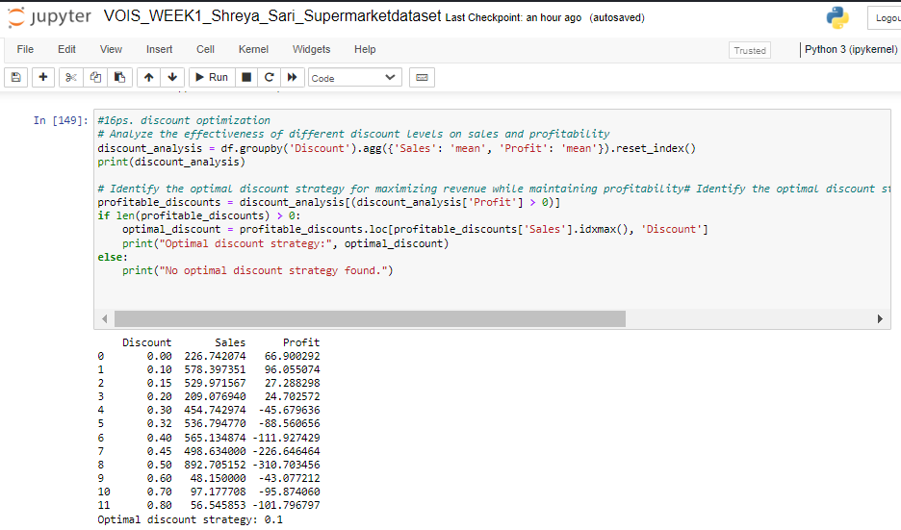
RESULTS

Slide 18
RESULTS

Slide 19
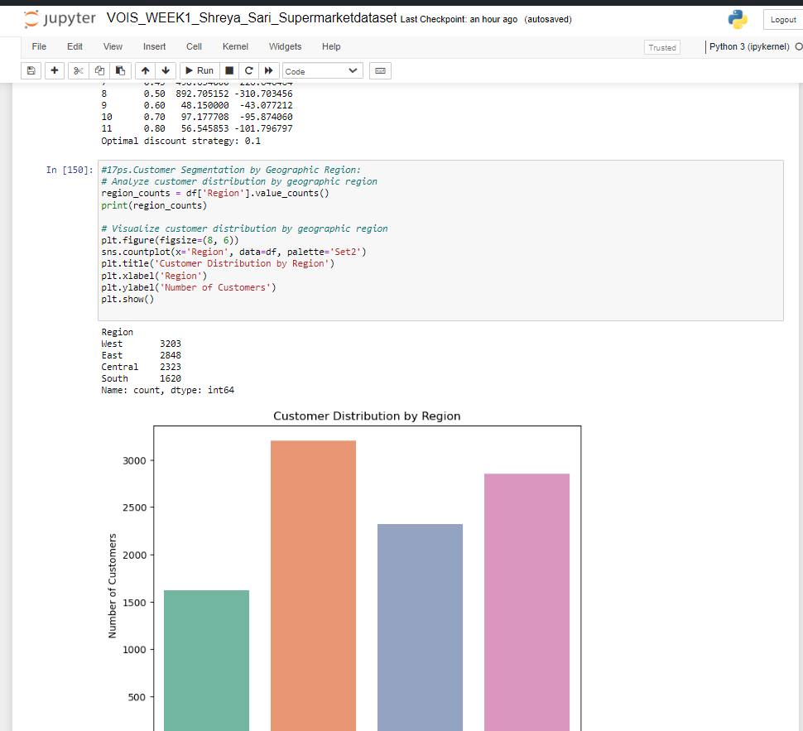
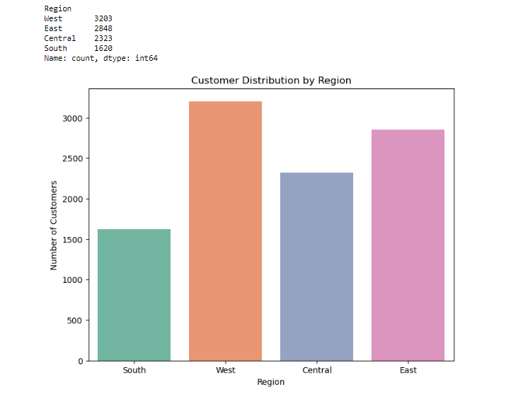
RESULTS

Slide 20
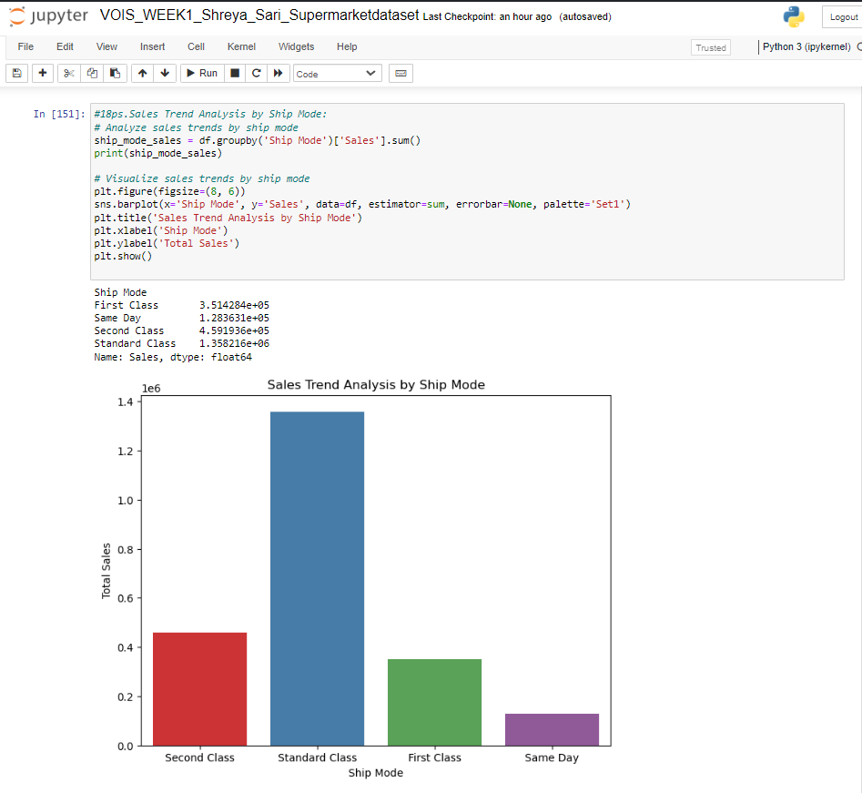
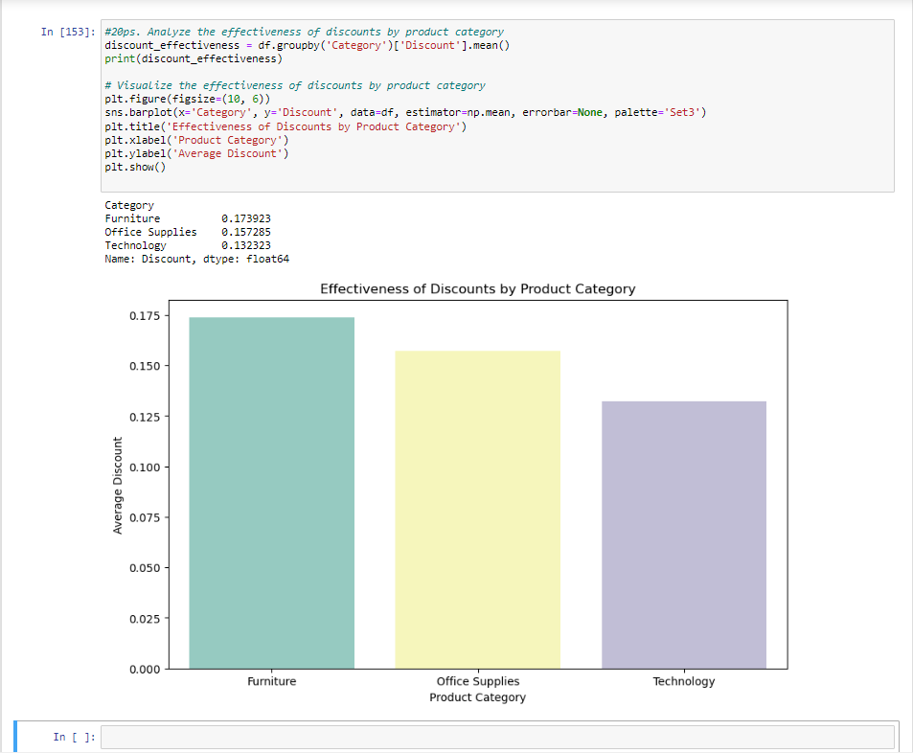
RESULTS

Slide 21
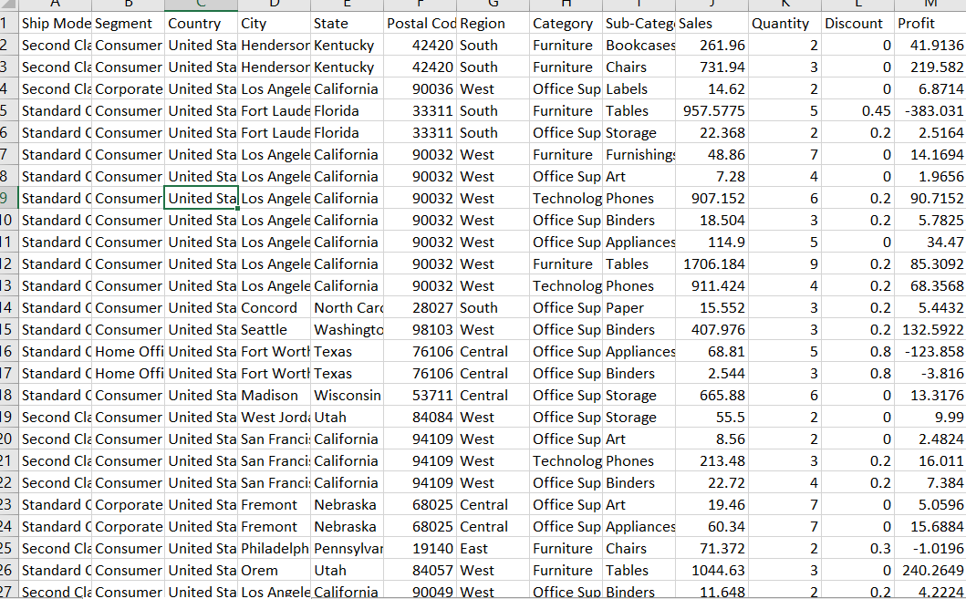
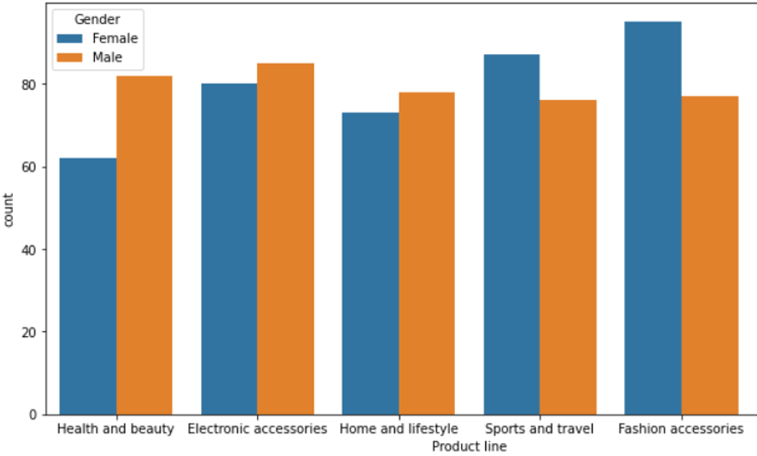
The "E-commerce Sales Analysis and Optimization" project has been effective in utilizing data-driven insights to find important patterns and trends in the online retail platform's sales data. The project has yielded actionable insights for strategic decision-making through a thorough analysis and visualization of sales patterns by shipping mode, geographic region, and client segment. Customer segmentation based on demographics and purchasing patterns has made focused marketing techniques possible, and optimization efforts to enhance revenue and profitability have been informed by the assessment of discount efficacy. Furthermore, chances for margin enhancement and best-selling products have been found through the examination of product performance. The project has offered a road map for market expansion and a rise in market share through its recommendations for geographic expansion tactics. In general, the project has given participants the information and
CONCLUSION
GITHUB PROJECT LINK:
https://github.com/ShreyaSari/internship_week1
https://github.com/ShreyaSari/internship_week1

Slide 22

.

