Slide 1
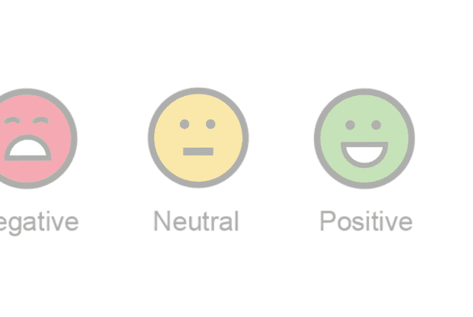


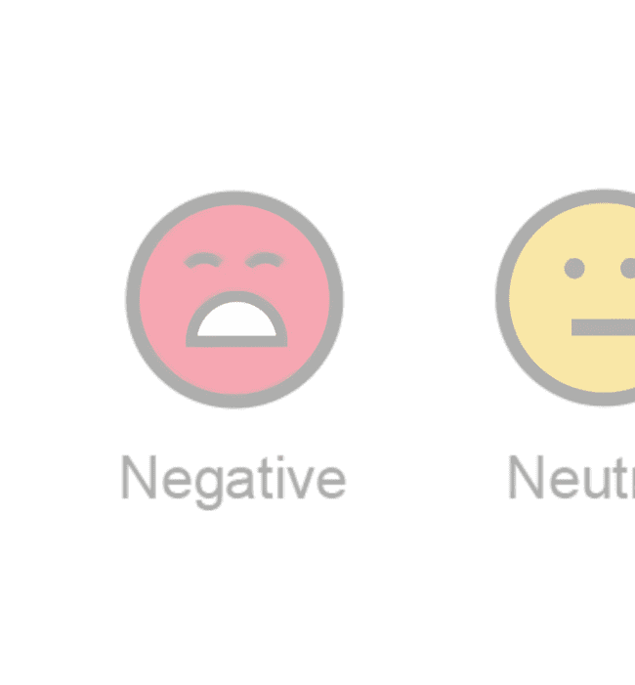

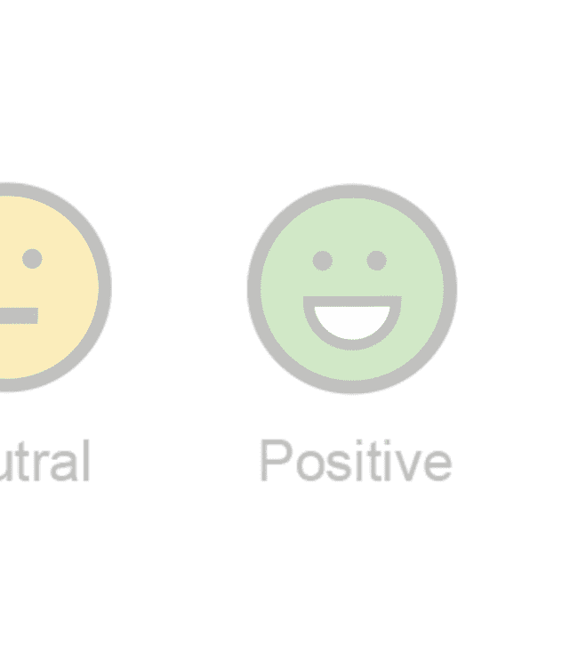
SENTIMENT ANALYSIS USING LSTM AND PRE-TRAINED
EMBEDDING VECTORS
Shreya Sari : HU21CSEN0300148 Shravya Sari : HU21CSEN0300169 Gnaneswar Mudiyam:HU21CSEN0300326

Slide 2

what is sentiment analysis?
Sentiment analysis is a technique through which you can analyze a piece of text to determine the sentiment behind it. It combines machine learning and natural language processing (NLP) to achieve this.

Slide 3


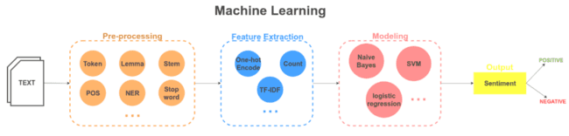
Abstract
The task of natural language processing to determine whether a piece of text contains some subjective information and what subjective information it expresses, i.e., whether the attitude behind this text is positive, negative or neutral.

Slide 4







How can this help?
Social Media Sentiment Analysis
Brand Experience Insights
Improve Customer
News Trend Analysis
Real-Time Sentiment Insights

Slide 5








Problem
statement
To analyze the reviews from the IMDB reviews and twitter using the natural language processing, LSTM and machine learning algorithms.

Slide 6






Techniques generally used are:
Lexicon based techniques
Machine learning based techniques
Hybrid techniques

Slide 7




Lexion based technique
Lexicon-based sentiment analysis is a technique that uses a dictionary of words labeled as positive, negative, or neutral to determine the sentiment of a text. There are two main approaches to lexicon-based sentiment analysis: dictionary-based and corpus-based1.
Dictionary-based methods create a database of positive and negative words from an initial set of words by including synonyms and antonyms. Corpus-based methods, on the other hand, obtain the dictionary from the initial set by usage of statistical techniques1.

Slide 8




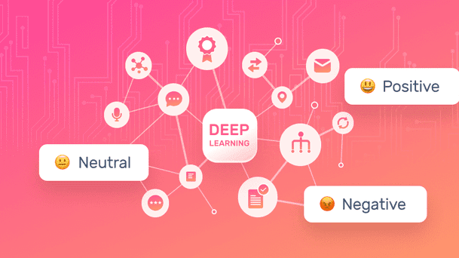
Machine Learning techniques
Machine learning-based techniques involve training a machine learning model on a dataset of text where each piece of text is labeled with its sentiment.
The model learns to associate features of the text with the sentiment.
When given new, unlabeled text, it can then predict the sentiment based on these learned associations.
Naive Bayes or Support Vector Machines, or a more complex neural network model like RNN or CNN can be used.

Slide 9



Hybrid technique
Hybrid techniques combine both lexicon-based and machine learning-based approaches. They might use a lexicon-based method to generate features that are fed into a machine-learning model, or use a machine-learning model to predict sentiment, which is then reﬁned using a set of rules.

Slide 10



There are three major types of algorithms used in sentiment analysis
Automated Systems
Rule-based Systems
Unlike automated models, rule-based approaches are dependent on custom rules to classify data. Popular techniques include tokenization, parsing, stemming, and a few others. You can consider the example we looked at earlier to be a rule-based approach.
These algorithms can be tailor-made based on context by developing smarter rules.
Automatic approaches to sentiment analysis rely on machine
learning models like clustering.
Long pieces of text are fed into the classiﬁer, and it returns the
results as negative, neutral, or positive.
Hybrid Systems
Hybrid techniques are the most modern, eﬃcient, and widely-used approach for sentiment analysis. Well-designed
hybrid systems can provide the beneﬁts of both automatic and
rule-based systems.
An example of a hybrid model would be a self-updating wordlist based on Word2Vec. You can track these wordlists and update them based on your business needs.

Slide 11



LSTM:
S
L
T
.
.
M
LSTM recurrent unit tries to “remember” all the past knowledge that the network is seen so far and to “forget” irrelevant data.
This is done by introducing diﬀerent activation function layers called “gates” for diﬀerent purposes
LSTM networks are the most commonly used variation of Recurrent Neural Networks (RNNs).
T
S
L
.
.
M
T
S

Slide 12






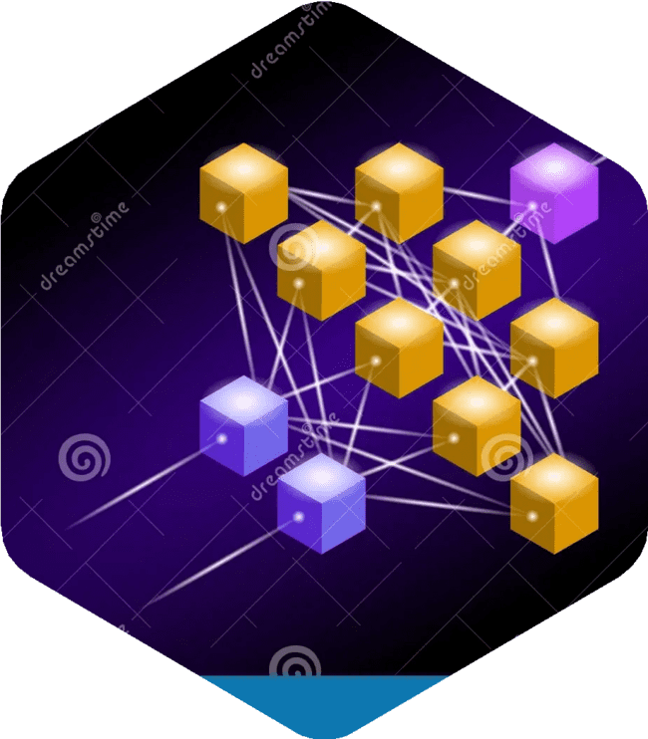
Advantages of LSTM:
Handles long-term dependencies eﬀectively.
Utilizes a memory cell state to store information over long sequences.
Mitigates the vanishing gradient problem in traditional RNNs.
Allows for eﬃcient parallelization during training.
Can handle sequences of varying lengths.
Supports stateful processing for carrying information between batches.
Particularly eﬀective for time series prediction tasks.
Can be stacked to create deep LSTM networks for learning hierarchical representations.

Slide 13







Some challenges in sentiment analysis :
Contextual understanding: Sentiment can be highly dependent on context, which is diﬃcult to analyze.
Domain-speciﬁc sentiment: Sentiment analysis models may not perform well in specialized domains
Data quality: Poorly labeled or biased training data can lead
to inaccurate
sentiment analysis results.
Sarcasm and irony: Identifying sarcasm and irony in text can be diﬃcult for machines.

Slide 14
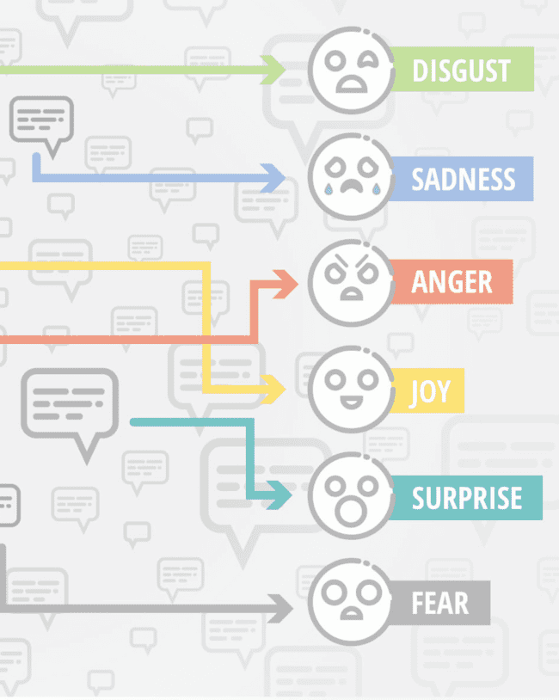
Libraries used
numpy as np
import pandas as pd
seaborn as sns
matplotlib.pyplot as plt
nltk
CountVectorizer
stopwords
word_tokenize,sent_token ize

Slide 15









Steps for sentiment analysis
Collect Dataset
Setting Up Libraries
Data Preprocessing
Text stemming
Removing stopwords and normalization
Removing special characters
Bag of words Model
Labeling the sentiment text and splitting sentiment data
Modelling the dataset
Model Training
Model performance on test data
Accuracy of the model & Visualizing the classiﬁcation report

Slide 16

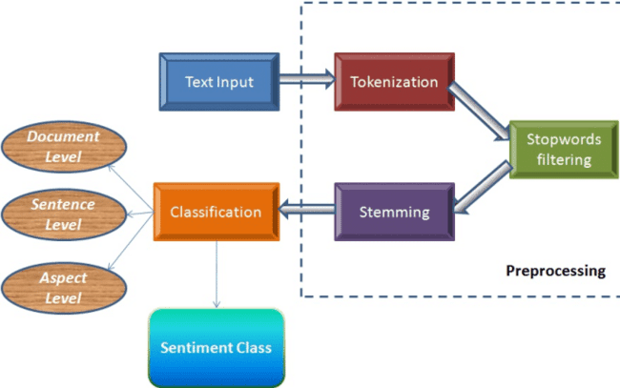

Implementation of sentiment analysis
Choose your content.
First, you have to decide what kind of content you want to analyze.
Gather your dataset.
Split your dataset.
Train a machine learning model.
Validate your model.
Deploy your model.
Monitor your model's performance.

Slide 17





Bag of words Model
Itʼs used to turn text ﬁles into numerical vectors or a bag of words.
The Bag of Words (BoW) model is the most basic type of numerical text representation. A phrase can be represented as a bag of words vector, just like the term itself (a string of numbers).
Bag of Words model is used to preprocess the text by converting it into a bag of words, which keeps a count of the total occurrences of most frequently used words.

Slide 18

Some common tools and libraries for sentiment analysis in Python
NLTK (Natural Language Toolkit)
TextBlob
VADER (Valence Aware Dictionary and sEntiment Reasoner)
spaCy
Transformers (Hugging Face's library)
Stanford NLP
IBM Watson Natural Language Understanding

Slide 19

To sum up.....
Sentiment analysis is a powerful tool that you can use to solve problems from brand inﬂuence to market monitoring. New tools are built around sentiment analysis to help businesses become more eﬃcient.
Sentiment analysis is used for many buisness to analye their customer reviews and gain the required insights which can improve their peroformance.

Slide 20
Code representation
https://colab.research.google.com/drive/1LjI4JjnLLd2 UNwQlVrgh_9HMvdE1D-qj?usp=sharing
https://colab.research.google.com/drive/1M3JxW07m4 JFLr-yXxVmnW6TQeuLqDDri?usp=sharing

Slide 21


