Slide 1
RetailInsight
Customer Purchase Pattern Analysis
Using Data Mining
DS · AIML-B · 2026
Domain: Business Analytics SDG: Goal 9 — Industry, Innovation & Infrastructure
V SHREYA (RA2311026050034)
SHAIK ARBAAZ (RA2311026050051)
SRM Institute of Science and Technology

Slide 2
Problem Statement & Dataset
Problem Statement
Dataset (Link)
Retail businesses generate massive transactional data daily, yet most remains underutilised.
This project analyses UK e-commerce data to uncover:
• Products frequently bought together
• Customer segments by purchasing behaviour
• Seasonal demand patterns
Name
Online Retail II
Source
UCI / Kaggle
Rows
~1,067,371
Clean
805,549
Period
Dec 2009–Dec 2011
Country
41 countries
5,878
36,969
4,631
£17.7M
Customers
Invoices
Products
Revenue
RetailInsight | SRM Institute of Science and Technology | Mini Project DS AIML-B 2026

Slide 3
Methodology & Workflow
01
02
03
04
05
06
07
Problem
Identification
Dataset
Collection
Data Cleaning
& Preprocessing
Exploratory
Data Analysis
Visualization
Model
Development
Result
Interpretation
Tools Used
Python 3.10
Pandas
NumPy
Matplotlib / Seaborn
Scikit-learn
mlxtend (Apriori)
WordCloud
Jupyter
RetailInsight | SRM Institute of Science and Technology | Mini Project DS AIML-B 2026

Slide 4
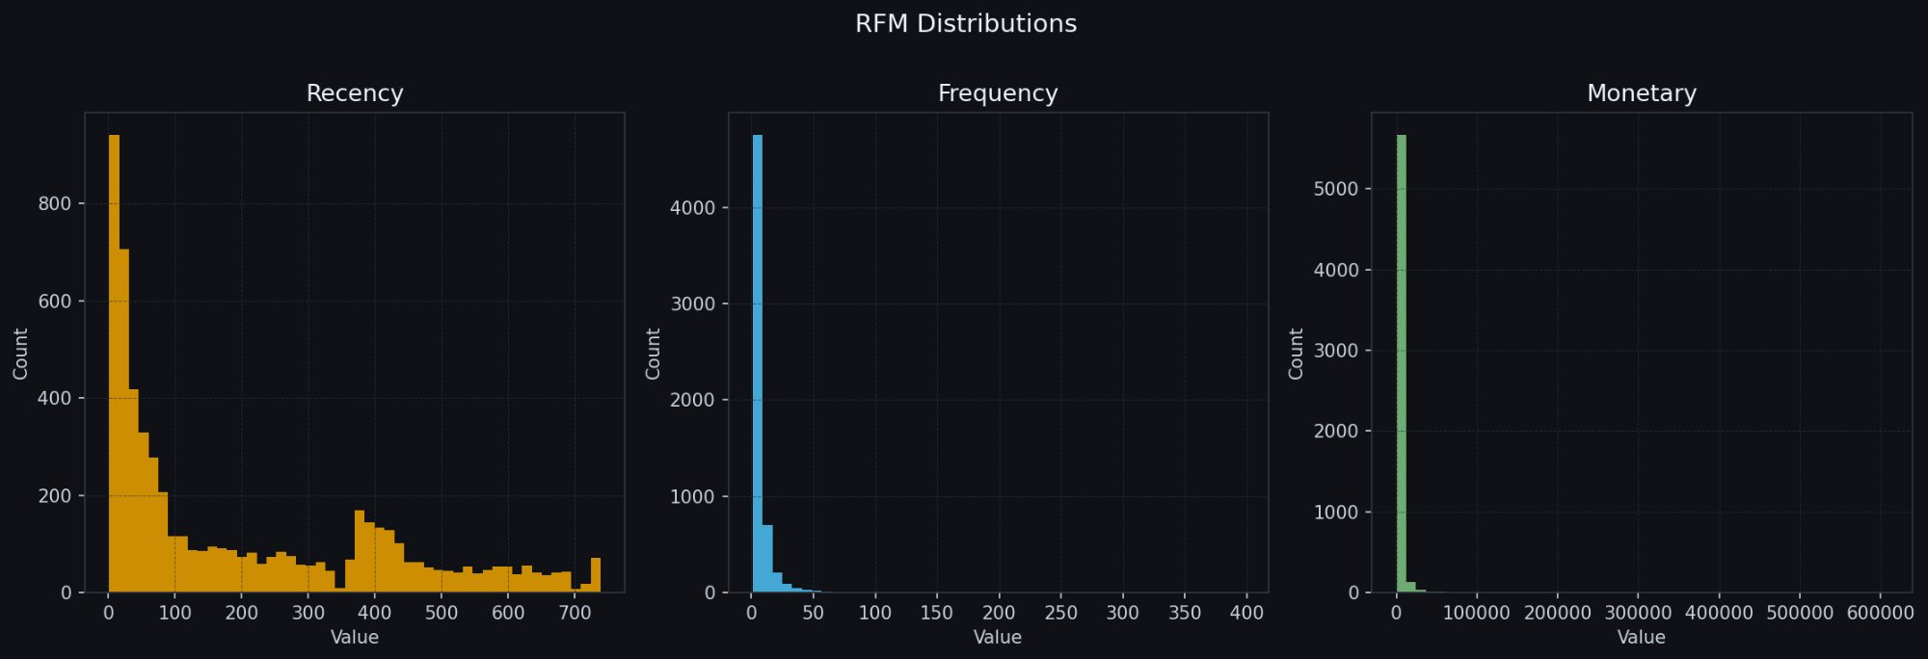
RFM Analysis — Distributions
Recency: Most customers bought within 100 days — high short-term engagement
Frequency: Heavily right-skewed — majority are 1–10 purchase customers
Monetary: Extreme outlier at £608K — one wholesale account dominates
RetailInsight | SRM Institute of Science and Technology | Mini Project DS AIML-B 2026

Slide 5
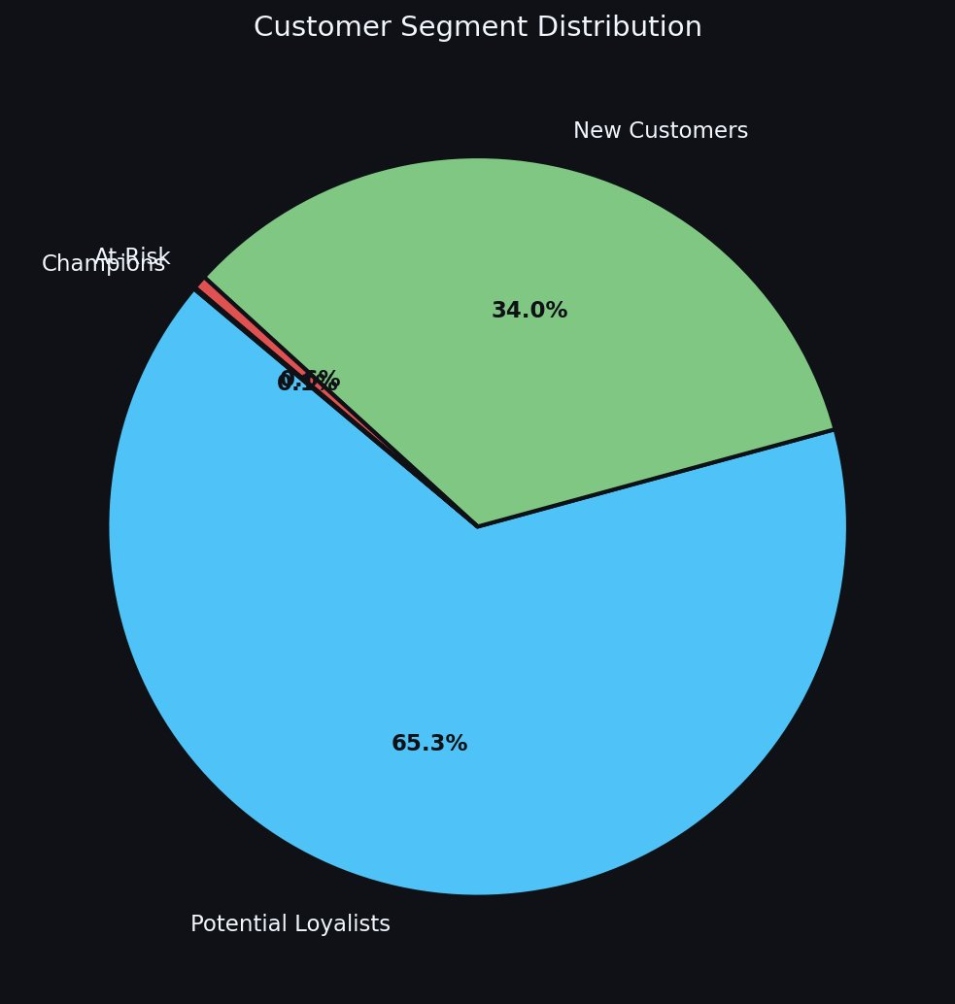
Customer Segmentation — K-Means Clustering
Champions
3.5d
213×
£436,836
£1.75M
4 customers (0.1%)
Recency
Freq.
Avg Spend
Revenue
At-Risk
26d
104×
£83,086
£2.91M
35 customers (0.6%)
Recency
Freq.
Avg Spend
Revenue
Potential Loyalists
67d
7×
£3,009
£11.56M
3841 customers (65.3%)
Recency
Freq.
Avg Spend
Revenue
New Customers
463d
2×
£765
£1.53M
1998 customers (34.0%)
Recency
Freq.
Avg Spend
Revenue
RetailInsight | SRM Institute of Science and Technology | Mini Project DS AIML-B 2026

Slide 6
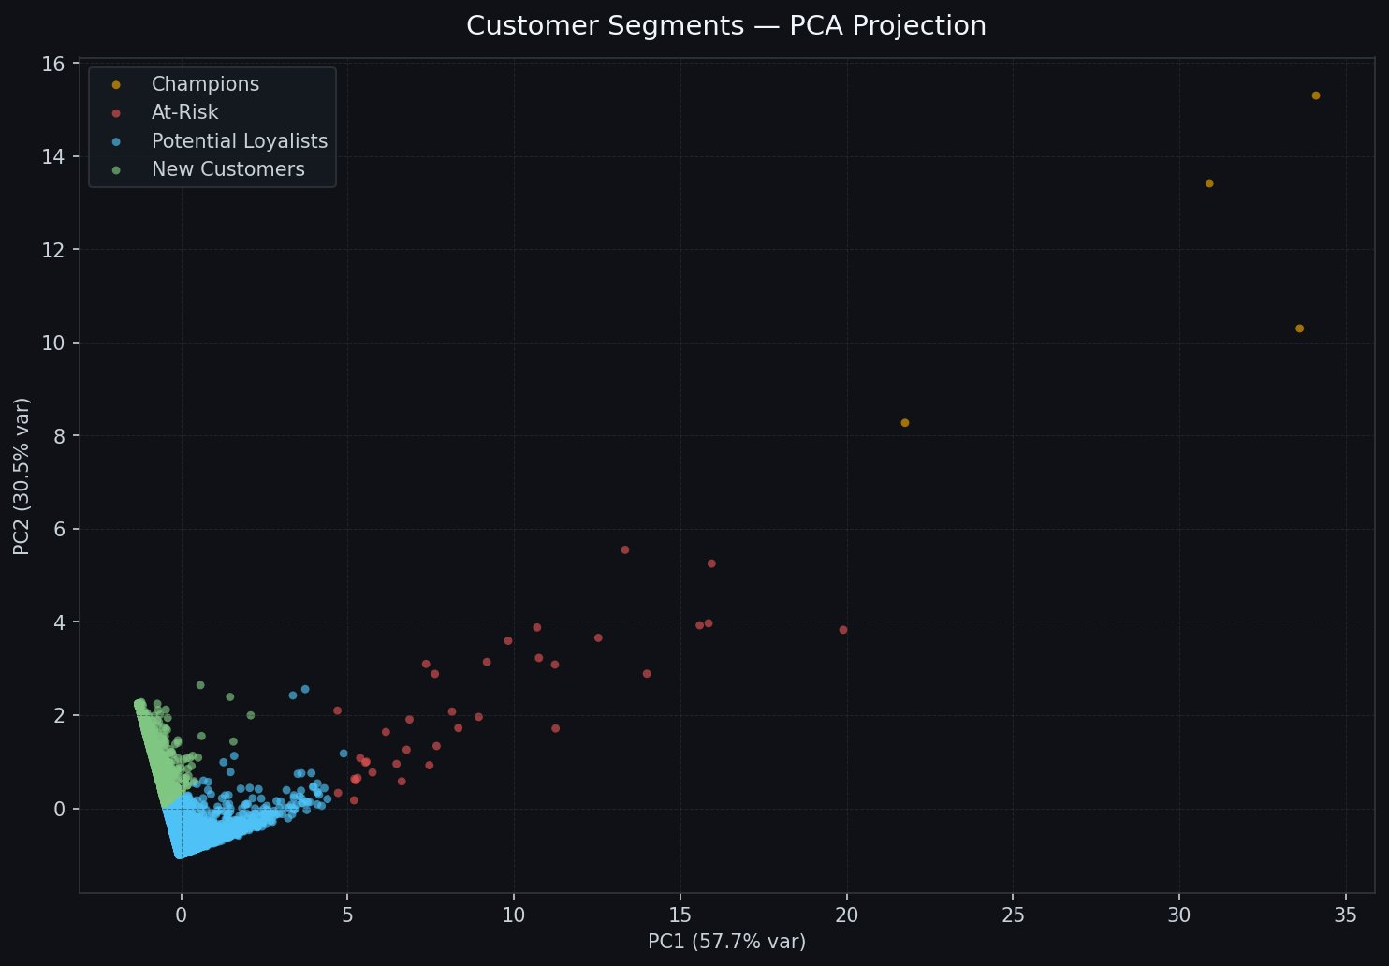
Cluster Separation — PCA Projection
Champions (4)
Far upper-right outliers. Extremely high frequency and monetary value — wholesale-tier buyers.
At-Risk (35)
Mid-range PC1. Previously high-value, now drifting — prime re-engagement targets.
Pot. Loyalists
Dense cluster at origin. Largest segment; consistent mid-frequency shoppers.
New Customers
Overlaps loyalists near origin; low recency score separates them on PC2.
RetailInsight | SRM Institute of Science and Technology | Mini Project DS AIML-B 2026

Slide 7
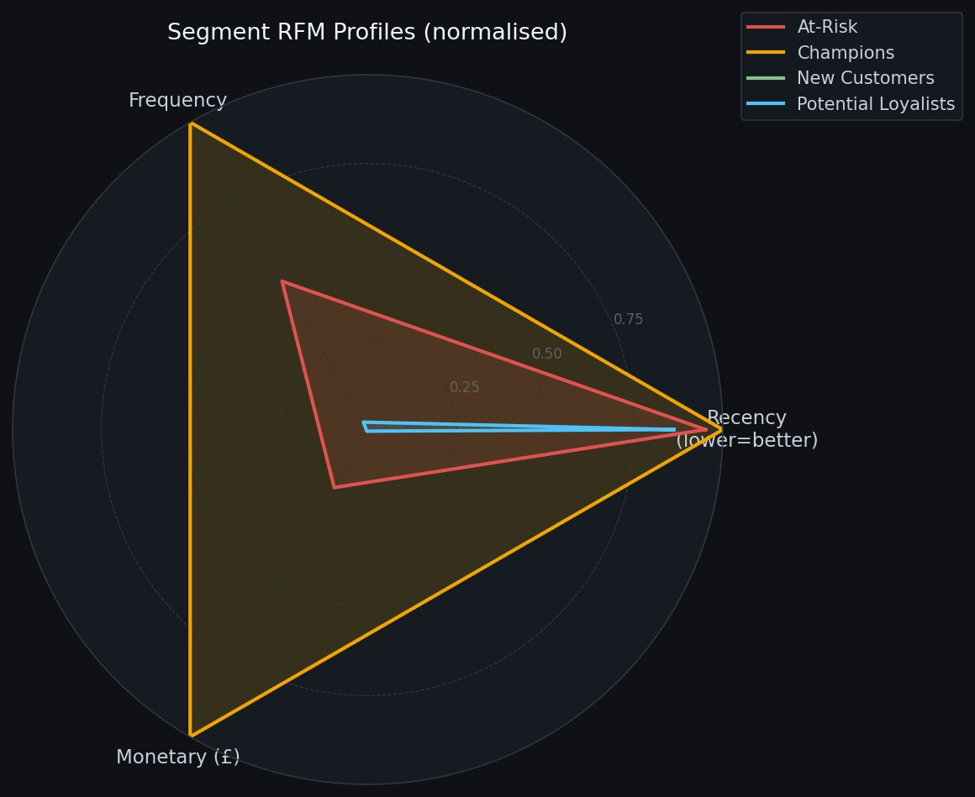
Segment RFM Profiles — Radar
Business Recommendations
Champions
Offer exclusive loyalty rewards & early access. Protect at all costs.
At-Risk
Win-back campaigns with personalised discount codes. Act within 30 days.
Pot. Loyalists
Upsell & cross-sell using association rules. Nurture toward Champion tier.
New Customers
Onboarding email sequence. Convert second purchase within 60 days.
RetailInsight | SRM Institute of Science and Technology | Mini Project DS AIML-B 2026

Slide 8
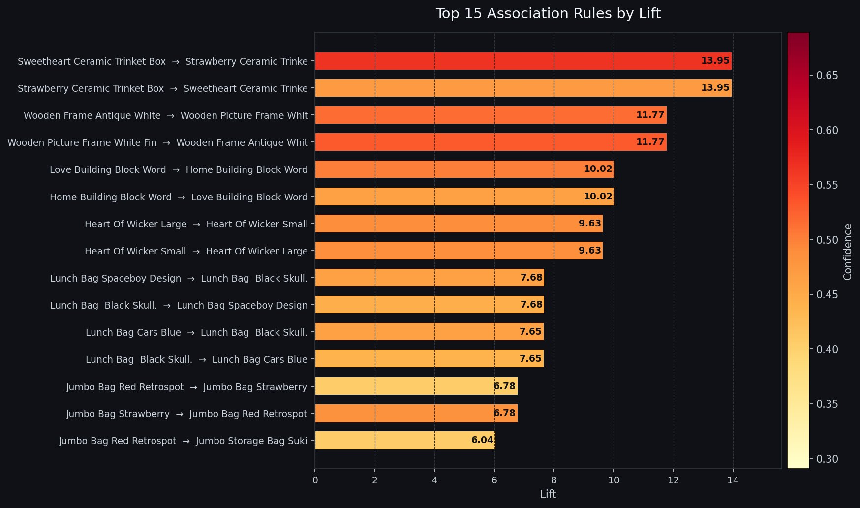
Association Rule Mining — Top 15 Rules
180
18
13.95
0.029
0.69
UK
Frequent
Itemsets
Association
Rules Found
Max Lift
Score
Max
Support
Max
Confidence
Market
Analysed
RetailInsight | SRM Institute of Science and Technology | Mini Project DS AIML-B 2026

Slide 9
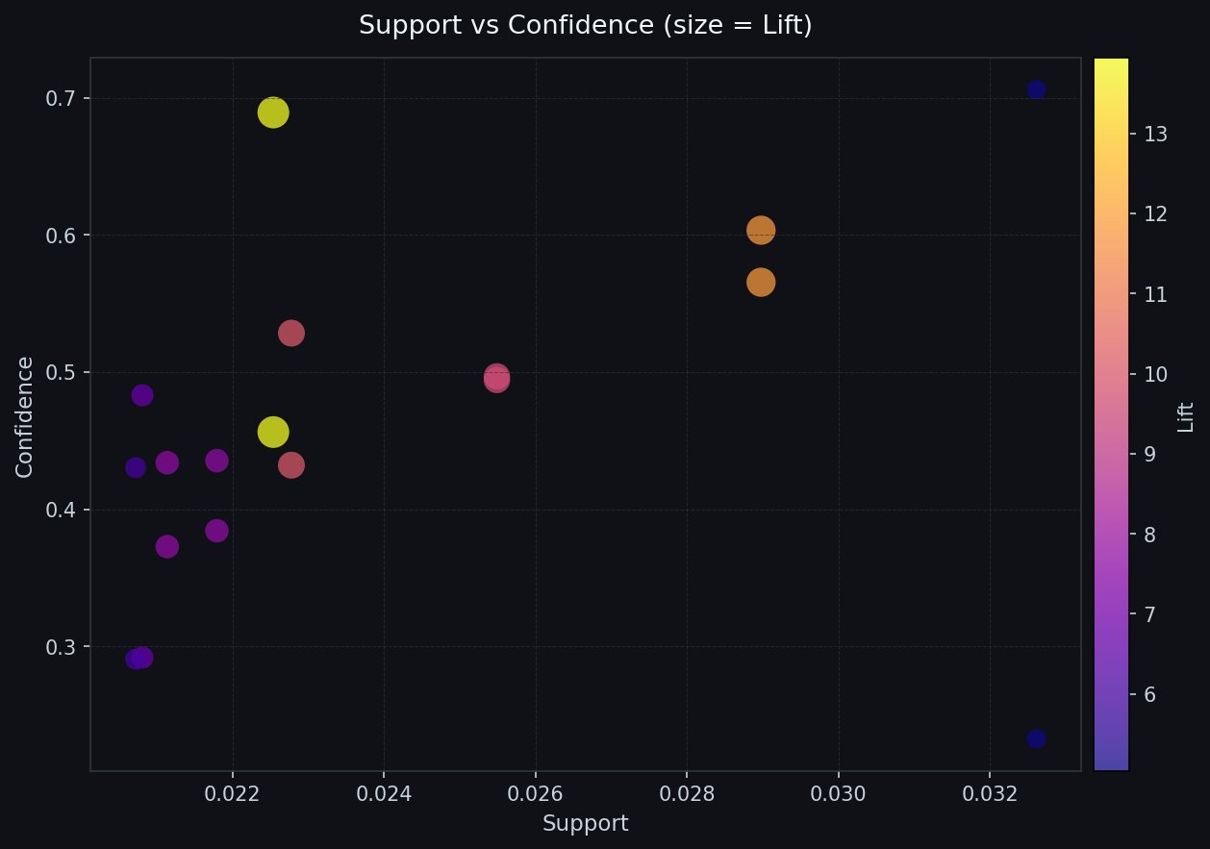
Support vs Confidence Analysis
How to Read This Chart
X-axis — Support
How often the product pair appears in all transactions. Higher = more common.
Y-axis — Confidence
Given antecedent, how likely is the consequent? Higher = stronger rule.
Bubble size — Lift
How much better than random? Lift >1 = genuine association. >10 = very strong.
Color — Lift scale
Yellow = highest lift (13.95). Purple = lowest lift (≥1.5 threshold).
RetailInsight | SRM Institute of Science and Technology | Mini Project DS AIML-B 2026

Slide 10
Key Results & Findings
01
Holiday Demand Spike
02
Trinket Box Cross-Sell
03
4 Distinct Customer Tiers
Nov–Dec accounts for ~40% of annual revenue. Inventory optimisation should begin by October to capture peak demand.
Sweetheart ↔ Strawberry ceramic trinket boxes: Lift 13.95, Confidence 69%. Strongest cross-sell pair in the dataset.
Champions (4) drive £1.75M. 3,841 Potential Loyalists hold the most revenue opportunity (£11.56M total).
04
Lunch Bag Category Bundles
05
35 High-Value At-Risk Accounts
06
UK Dominates (89%)
3 lunch bag design pairs show Lift >7.6 — a clear bundle-and-discount opportunity for kids/gifting categories.
Formerly frequent, now dormant. Average spend £83K each — targeted win-back campaigns have high ROI potential.
Netherlands, Germany & EIRE are the next largest markets. International expansion strategy should target these first.
RetailInsight | SRM Institute of Science and Technology | Mini Project DS AIML-B 2026

Slide 11
CONCLUSION
RetailInsight
From 1M+ raw transactions to actionable customer intelligence — this project demonstrates the full data science pipeline: cleaning, EDA, association mining, and ML-driven segmentation.
SDG Goal 9 — Industry, Innovation & Infrastructure
Future Enhancements
Open-source, reproducible analytics lowers the barrier for small businesses to adopt data-driven decision making — directly supporting innovation in retail infrastructure.
• Collaborative filtering for product recommendation • Time-series forecasting (ARIMA / Prophet) • Real-time dashboard (Streamlit / Power BI) • Churn prediction model
GitHub: MiniProject_DS_AIML-B_2026_RetailInsight
Team Leader | Teammate A | Teammate B · SRM Institute of Science and Technology
Data Science · Business Analytics · SDG Goal 9 · AIML-B 2026

