Slide 1
Big Data analytics Final project By : Shreya Jain, Tushar and Junhao

Slide 2
OBJECTIVE
To build a project which could scrape reviews from the web. Perform sentiment analysis by identifying positive and negative reviews. Feed these reviews to a DBN and SVM to classify the reviews.

Slide 3
APPROACH
To scrape amazon reviews from the web using Rvest
Apply the sentiment analysis to the reviews using positive and negative dictionary from the lexicon libraries
Vectorize the documents into vectors using Text2Vec
Build DBN and SVM models

Slide 4

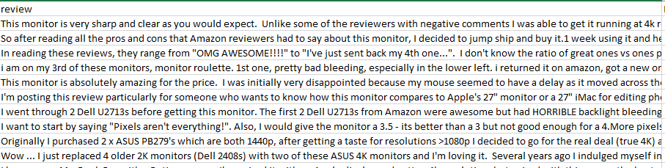
SCRAPING DATA FROM THE WEB
Scraped the amazon reviews:
Step 1: Loading the review page by it’s URL.
Step 2: Grabbing the HTML content by RVEST & CSS selectors.
Step 3: Store the content and loading the next page by increasing the inline parameters “pageNumber = n”

Slide 5
WHAT IS SENTIMENT ANALYSIS?
In a nutshell: extracting attitudes toward something from human language
It aims to map qualitative data to a quantitative output(s)
I love this Monitor. It is amazing to use.
=> Positive (?)
The Asus Monitor was not brand new and screen has many scratch on it. so disappointed.
=> Negative (?)

Slide 6
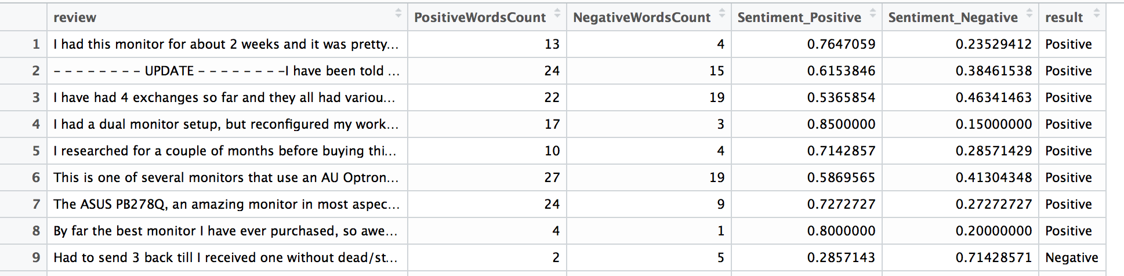
SENTIMENT ANALYSIS
Used positive and negative dictionary from the lexicon library
Assign sentiment score to words (“hate”: -1, “love”: +1)
Took the sentiment percentage of the words of each of the review
Gave an overall sentiment value to each review

Slide 7
Drawbacks of Sentiment Analysis
Need to label words
Can’t implicitly capture negation (“Not good” = 0 ??)
Ignores word context

Slide 8
VECTORIZATION
Txt2Vec is a toolkit to represent text by vector
For a specified term, phrase or sentence, Txt2vec is able to generate corresponding vector according its semantics in text.
Each value in the vector represents a dimension of feature. So for different text, Txt2vec can calculate their similarity by score in vectors.
Txt2Vec, likes word2vec, is based on neural network for model encoding and cosine distance for terms similarity.

Slide 9
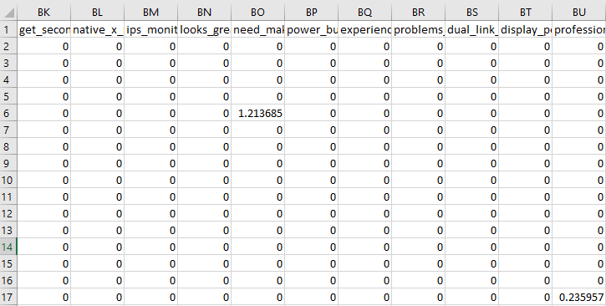
VECTORIZATION
Package: Text2Vec Output from Text2Vec: 1728*2905

Slide 10
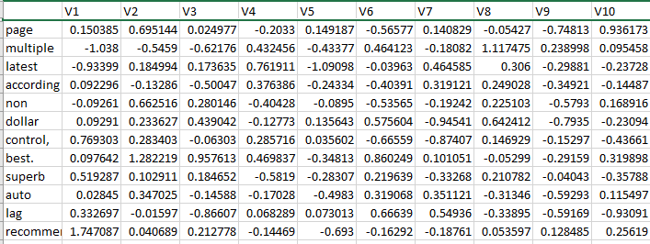
Other Techniques of Vectorization
Other methods: Word2Vec and Doc2Vec
Output from Word2Vec

Slide 11
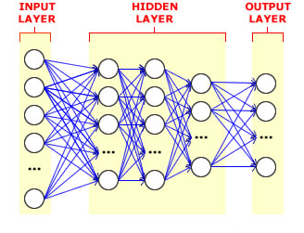
DBN
Deep neural networks are a network with two or more hidden layers.
In our model we used 1 Hidden layers with 350 nodes.
Tried with different learning rate, Hidden layers and neurons.

Slide 12
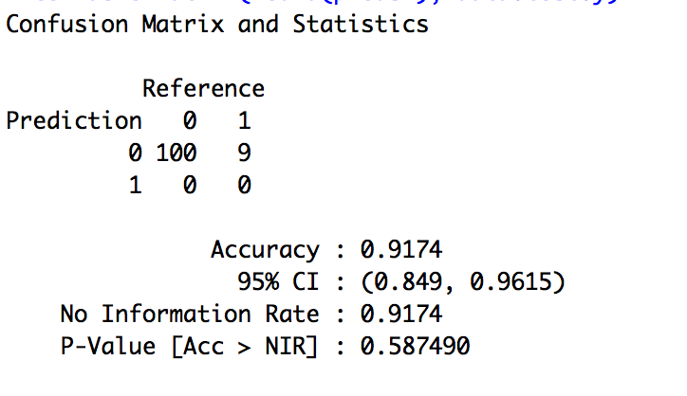
DBN
Divided the dataset into test and train in the ratio of 80/20%
Created the models to see which one is the best for our dataset
Predicted the no. of positive and negatives based on the confusion matrix

Slide 13
SVM
Performed Binary classification using SVM
Divided the dataset into test and train
Created different models with different kernel, cost, gamma values.

Slide 14
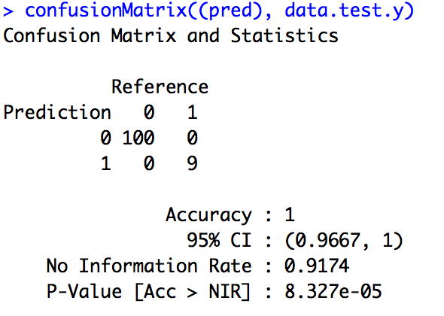
SVM
Calculated the accuracy using confusion matrix

Slide 15
Comparison
Which one is better?
SVM OR DBN ?
Key factor to decide that:
SVM
DBN

Slide 16
THANK YOU! ☺

