Slide 1
Namma-Shaale Inventory
Digital Asset Management for Government Schools
Empowering Schools with Smart Maintenance

Slide 2
The Problem
• Manual inventory tracking is slow and error-prone.
• High risk of asset loss or damage without documentation.
• Proactive maintenance is difficult without data insights.
• Existing solutions often require expensive cloud subscriptions.

Slide 3
Our Solution
• Offline-first Android application.
• Integrated local photo storage for physical proof.
• Rule-based advisory engine for maintenance insights.
• Zero reliance on paid cloud services.

Slide 4
Key Features
• Comprehensive Asset Dashboard.
• Dynamic Asset Registration & Search.
• Proactive Health Monitoring System.
• Detailed Issue Logging & Resolution Tracking.

Slide 5
Technology Stack
• Kotlin & Jetpack Compose for Modern UI.
• Room Database for offline-first data storage.
• CameraX for professional photo integration.
• Rule Engine for Smart Advisories.
• MVVM Architecture for scalability.

Slide 6
Impact & Conclusion
• 100% data privacy and offline capability.
• Zero cost of operation (No cloud bills).
• Improved school infrastructure management.
• Scalable to thousands of government schools.

Slide 7
Application Screenshots
The following slides showcase the actual implementation of the Namma-Shaale Inventory app.

Slide 8
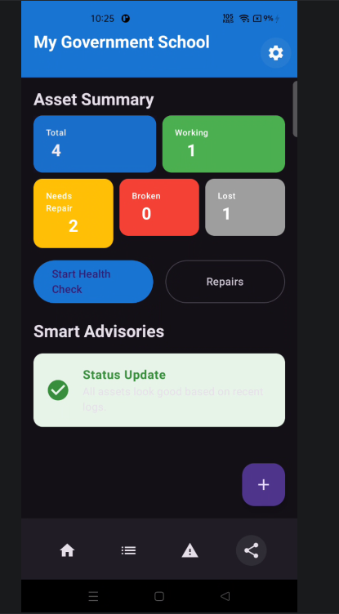
Dashboard Overview
Real-time summary of asset status and smart advisories for maintenance.

Slide 9
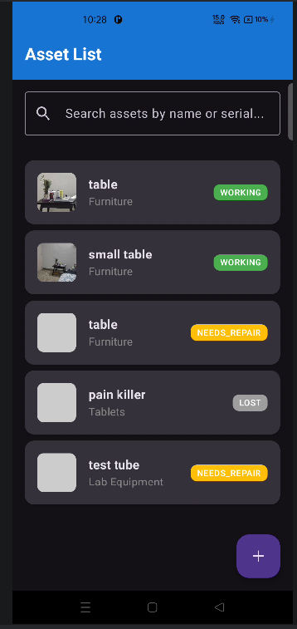
Inventory List
Comprehensive view of all assets with category filtering and status tags.

Slide 10
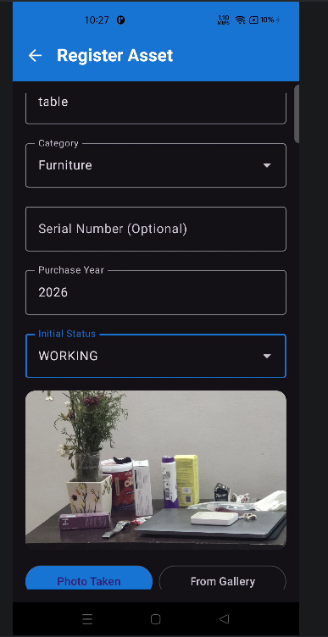
Asset Registration
User-friendly form with CameraX integration for capturing physical proofs.

Slide 11
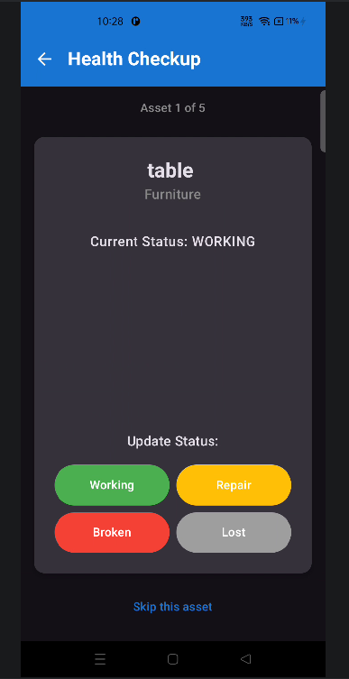
Health Checkup Flow
Interactive process to verify the physical condition of assets periodically.

Slide 12

Issue Log Tracking
Detailed log of damaged items and their resolution status for accountability.

