Slide 1
Constraint Satisfaction Problems

Slide 2
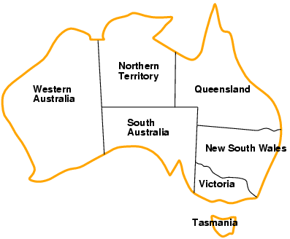
In CSP is solved when each variable has a value that satisfies all the constraints on the variable.
Example- Color Mapping
Variables WA, NT, Q, NSW, V, SA, T
Domains D_{i} = {red,green,blue}
Constraints: adjacent regions must have different colors
e.g., WA ≠ NT

Slide 3
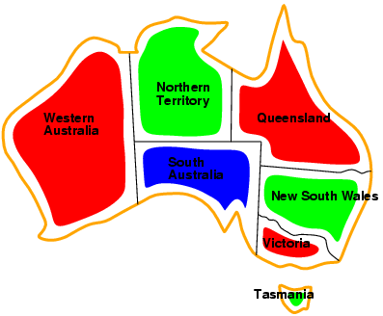
Example: Map-Coloring
Solutions are complete and consistent assignments
e.g., WA = red, NT = green, Q = red, NSW = green,V = red,SA = blue,T = green

Slide 4
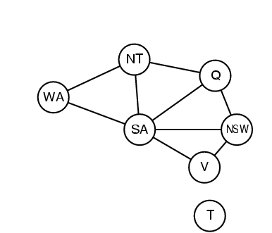
Constraint graph
Constraint graph: nodes are variables, arcs are constraints

Slide 5
Varieties of CSPs
Discrete Variables: Discrete variable CSPs involve variables that can take values from a finite or infinite set of discrete options, such as integers or enumerated values.
Continuous variable CSPs involve variables that can take values from continuous domains, such as real numbers.
Unary CSPs constraints involve a single variable,
e.g., SA ≠ green
Binary CSPs involve pairs of variables,
e.g., SA ≠ WA
Higher-order CSPs involve 3 or more variables,
e.g., SA ≠ WA ≠ NT

Slide 6
Inference in CSP
Inference in CSP involves using constraint information to reduce the search space before or during the process of finding solutions.
Key Inference Techniques:
Node Consistency:
Each variable is checked individually to ensure that every value in its domain satisfies its unary constraints (constraints involving only one variable).
If a value doesn't satisfy the unary constraint, it is removed from the domain.

Slide 7
Example- Node Consistency:
Variables: A, B
Domain of A: {1, 2, 3, 4}
Domain of B: {3, 4, 5, 6}
Unary Constraints:𝐴≤3 , B>4
-----------------------------------------------------------------------------------------------
Applying node Consistency
Updated domain of A: {1, 2, 3}
Updated domain of B: {5, 6}

Slide 8
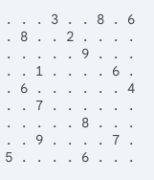
Example - Node Consistency
Sudoku puzzle:
Applying node consistency:
Row 1: The row already contains 3, 8, and 6. These values can be eliminated from the domain of the top-left cell.
Column 1: The value 5 is already filled in this column.
3x3 Subgrid: The top-left 3x3 subgrid contains 3 and 6. These values can also be eliminated.
After applying node consistency, the domain of the top-left cell is reduced to {1, 2, 4, 7, 9}.

Slide 9
Arc Consistency:
A variable X is arc-consistent with another variable Y if for every value in the domain of X, there is a corresponding value in the domain of Y that satisfies their binary constraint.

Slide 10
Example
Variables X,Y,Z
Each variable has a domain of possible values:
Domain of X: {1, 2, 3}
Domain of Y: {2, 3}
Domain of Z: {2, 3, 4}
The binary constraints between the variables are
X≠ Y
Y=Z.

Slide 11
Step 1. For each value in the domain of X, there must be a value in the domain of Y such that X≠ Y.
Ans: No change
Step 2. Checking arc consistency between Y and Z (for Y=Z):
Ans: No change
Step 3. Checking arc consistency between 𝑍 and 𝑌 (reverse direction, for 𝑍=𝑌)
Ans. For Z=4: There is no value in Y's domain that satisfies as Y only has values 2 and 3.
Therefore, the value Z=4 is inconsistent and must be removed from the domain of Z.

Slide 12
Check arc consistent or not?
Variables X,Y,Z
Each variable has a domain of possible values:
Domain of X: {2, 3, 4}
Domain of Y: {2, 8}
Domain of Z: {2, 8, 5}

Slide 13
Path Consistency:
Path consistency involves ensuring that the relationships between three variables are consistent.
If variables X, Y, and Z are path-consistent, then for any pair of consistent assignments to X and Y, there is a corresponding assignment to Z that satisfies the constraints.
Variables: A, B, and C
Domains:
Domain of A: {1, 2, 3}
Domain of B: {2, 3, 4}
Domain of C: {3, 4, 5}
Constraints:
A+B=5
B + C =7
Notes:
Path consistent

Slide 14
Variables X(1,2,3)
Y(1,2,3)
Z(1,2,3)
Constraints
X+Y=4
Y+Z=5
CSP problem.docx
Notes:
B= 1 to be removed

Slide 15
Backtracking Search for CSPs
Fundamental method to solve CSP problems.
Incremental in nature- One variable at a time and backtracks the assignments that violate the constraints.
Start with an empty assignment. No values are assigned to any variable at the beginning.
Choose an unassigned variable. Select a variable that has not yet been assigned a value.
Try assigning a value from its domain. Assign the first available value from the variable's domain that does not violate any constraints.
Check constraints:
If the current assignment is consistent with all constraints, continue.
If a violation occurs, undo the assignment (backtrack) and try the next value.
Repeat the process:
If the assignment is complete return the solution.
If no valid value exists for a variable, backtrack to the previous variable and try a new value.
Terminate when a solution is found or all options are exhausted.

Slide 16
Algorithm: Backtracking Search
Constrained Graph
1
2
3
4
Variables- 1, 2 , 3, 4
Doman – Red, Green, Blue
Constrains 1 ≠ 2, 1 ≠ 3, 1 ≠ 4, 1, 2≠ 4, 3 ≠ 4

Slide 17
 | 1 | 2 | 3 | 4
Initial Domains | R,G,B | R,G,B | R,G,B | R,G,B
1=R | R | GB | GB | GB
2=G | R | G | GB | B
3=B | R | G | B | B
 | 1 | 2 | 3 | 4
Initial Domains | R,G,B | R,G,B | R,G,B | R,G,B
1=R | R | GB | GB | GB
2=G | R | G | GB | B
3=G | R | G | G | B

Slide 18
Backtracking Search
6. Backtrack: If the assignment is not consistent, or if further assignments do not lead to a solution, undo the last assignment (backtrack) and try the next possible value.
Example
N-Queens. Place N Queens on an N X N chess board so that no Queen can attack any other Queen.
N Variables, one per row.
Value of Qi is the column the Queen in row i is placed.
Constrains:
Vi ≠ Vj for all i ≠ j
|Vi-Vj| ≠ |i-j| (Diagonal constraint) . This is the diagonal constraint. It ensures that the difference in row numbers between two queens is not equal to the difference in their column numbers.
{Vi: The row number of the i-th queen.
Vj: The row number of the j-th queen.
i and j represent the column numbers, while Vi and Vj represent the row numbers of the queens on the chessboard.}

Slide 19
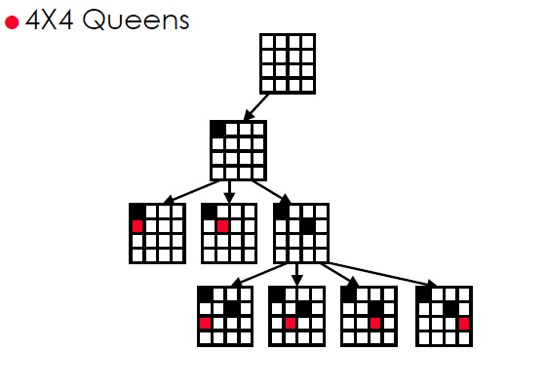
Backtracking Search

Slide 20
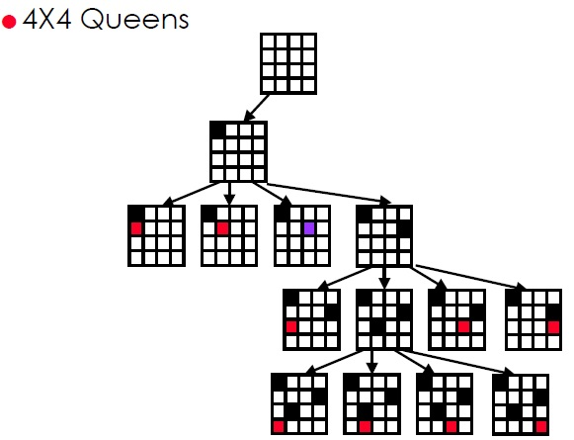
Backtracking Search

Slide 21
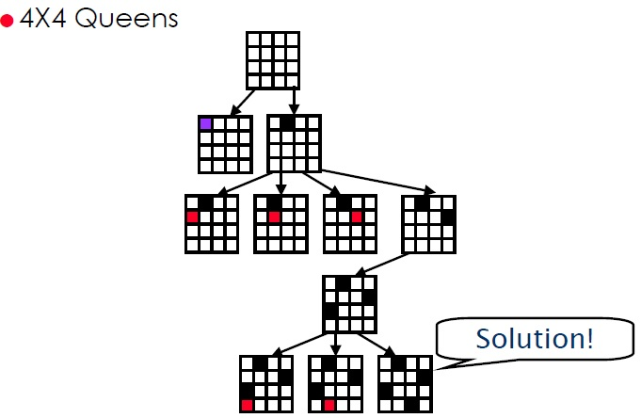
Backtracking Search

Slide 22
Propositional logic in Artificial intelligence
Propositional logic (PL) is the simplest form of logic.
All the statements are made by propositions.
A proposition is a declarative statement which is either true or false.
It is a technique of knowledge representation in logical and mathematical form.
Example:
a) It is Sunday.
b) The Sun rises from West (False proposition)
c) 3+3= 7(False proposition)
d) 5 is a prime number.

Slide 23
Propositional logic is also called Boolean logic as it works on 0 and 1.
In propositional logic, we use symbolic variables to represent the logic, and we can use any symbol for a representing a proposition, such A, B, C, P, Q, R, etc.
Propositions can be either true or false, but it cannot be both.
Propositional logic consists of an object, relations or function, and logical connectives.
These connectives are also called logical operators.
The propositions and connectives are the basic elements of the propositional logic.
Connectives can be said as a logical operator which connects two sentences.
A proposition which is always true is called tautology, and it is also called a valid sentence.
A proposition which is always false is called Contradiction.

Slide 24
Statements which are questions, commands, or opinions are not propositions such as "Where is Rohini", "How are you", "What is your name", are not propositions.
There are two types of Propositions:
Atomic Propositions
Compound propositions

Slide 25
Atomic Proposition:
Atomic propositions are the simple propositions.
It consists of a single proposition symbol.
These are the sentences which must be either true or false.
Example:
2+2 is 4, it is an atomic proposition as it is a true fact.
"The Sun is cold" is also a proposition as it is a false fact.

Slide 26
2
Compound proposition:
Compound propositions are constructed by combining simpler or atomic propositions, using parenthesis and logical connectives.
Example:
a) "It is raining today, and street is wet."
b) "Ankit is a doctor, and his clinic is in Mumbai."

Slide 27
Logical Connectives:
Logical connectives are used to connect two simpler propositions or representing a sentence logically.
We can create compound propositions with the help of logical connectives.
There are mainly five connectives, which are given as follows:
Negation: A sentence such as ¬ P is called negation of P. A literal can be either Positive literal or negative literal.
Conjunction: A sentence which has ∧ connective such as, P ∧ Q is called a conjunction.
Example: Rohan is intelligent and hardworking. It can be written as,
P= Rohan is intelligent, Q= Rohan is hardworking. → P∧ Q.

Slide 28
Disjunction: A sentence which has ∨ connective, such as P ∨ Q. is called disjunction, where P and Q are the propositions.
Example: "Ritika is a doctor or Engineer", Here P= Ritika is Doctor. Q= Ritika is Engineer,
so we can write it as P ∨ Q.
Implication: A sentence such as P → Q, is called an implication. Implications are also known as if-then rules. It can be represented as
If it is raining, then the street is wet.
Let P= It is raining, and Q= Street is wet, so it is represented as P → Q
Biconditional: A sentence such as P⇔ Q is a Biconditional sentence, example If I am breathing, then I am alive
P= I am breathing, Q= I am alive, it can be represented as P ⇔ Q.
Biconditional (If and only if)

Slide 29
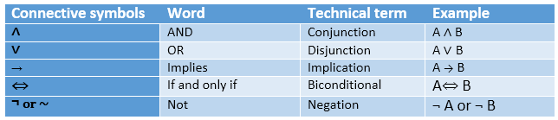
summarized table for Propositional Logic Connectives:

Slide 30
Truth Table:
In propositional logic, we need to know the truth values of propositions in all possible scenarios.
We can combine all the possible combination with logical connectives.
The representation of these combinations in a tabular format is called Truth table.
Following are the truth table for all logical connectives:

Slide 31
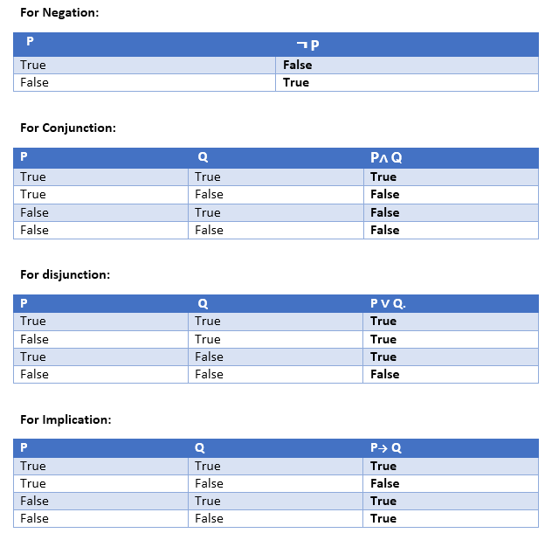
Notes:
[Antecedent (P): Consequent (Q)] --- This Implication truth table- You go shop, you will get 10 rs. 1. You went shop. You got money, implication is correct. 2. You went shop, but you didn’t get money,
You got cheated, implication failed. 3. You didn’t went shop, but you got money, so true. 4. You didn’t went shop and you didn’t got money, implication holds

Slide 32
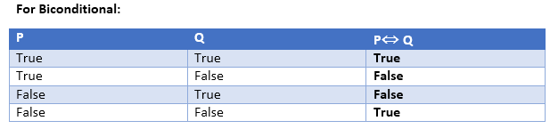
Bi conditional truth table-(if and only if)
If and only if- both should have same value for condition to hold.

Slide 33
Precedence of connectives:
Just like arithmetic operators, there is a precedence order for propositional connectors or logical operators.
This order should be followed while evaluating a propositional problem.
Precedence | Operators
First Precedence | Parenthesis
Second Precedence | Negation
Third Precedence | Conjunction(AND)
Fourth Precedence | Disjunction(OR)
Fifth Precedence | Implication
Six Precedence | Biconditional

Slide 34
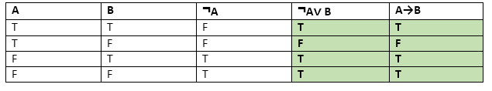
Logical equivalence:
Logical equivalence is one of the features of propositional logic.
Two propositions are said to be logically equivalent if and only if the columns in the truth table are identical to each other.
Let's take two propositions A and B, so for logical equivalence, we can write it as A⇔B.
In below truth table we can see that column for ¬A∨ B and A→B, are identical hence A is Equivalent to B

Slide 35
Properties of Operators:
Commutativity:
P∧ Q= Q ∧ P, or
P ∨ Q = Q ∨ P.
Associativity:
(P ∧ Q) ∧ R= P ∧ (Q ∧ R),
(P ∨ Q) ∨ R= P ∨ (Q ∨ R)
Identity element:
P ∧ True = P,
P ∨ True= True.
Notes:
P ∧ True = P,- If p is true, P ∧ True =true=P.

Slide 36
Distributive:
P∧ (Q ∨ R) = (P ∧ Q) ∨ (P ∧ R).
P ∨ (Q ∧ R) = (P ∨ Q) ∧ (P ∨ R).
DE Morgan's Law:
¬ (P ∧ Q) = (¬P) ∨ (¬Q)
¬ (P ∨ Q) = (¬ P) ∧ (¬Q).
Double-negation elimination:
¬ (¬P) = P.

Slide 37
Limitations of Propositional logic:
We cannot represent relations like ALL, some, or none with propositional logic. Example:
All the boys are intelligent.
Some apples are sweet.
Propositional logic has limited expressive power.
In propositional logic, we cannot describe statements in terms of their properties or logical relationships.

Slide 38
first-order logic
In propositional logic, we can only represent the facts, which are either true or false.
PL is not sufficient to represent the complex sentences or natural language statements.
The propositional logic has very limited expressive power.
Consider the following sentence, which we cannot represent using PL logic.
"Some humans are intelligent", or
"Sachin likes cricket."
To represent the above statements, PL logic is not sufficient, so we required some more powerful logic, such as first-order logic.

Slide 39
First-Order logic:
First-order logic is another way of knowledge representation in artificial intelligence. It is an extension to propositional logic.
FOL is sufficiently expressive to represent the natural language statements in a concise way.
First-order logic is also known as Predicate logic or First-order predicate logic.
First-order logic is a powerful language that develops information about the objects in a more easy way and can also express the relationship between those objects.
First-order logic (like natural language) does not only assume that the world contains facts like propositional logic but also assumes the following things in the world:
Objects: A, B, people, numbers, colors, wars, theories, squares, pits, ......
Relations: It can be unary relation such as: red, round, is adjacent, or n-any relation such as: the sister of, brother of, has color, comes between
Function: Father of, best friend, third inning of, end of, ......

Slide 40
As a natural language, first-order logic also has two main parts:
Syntax
Semantics
The syntax of FOL determines which collection of symbols is a logical expression in first-order logic.
The basic syntactic elements of first-order logic are symbols. We write statements in short-hand notation in FOL.
Notes:
syntactic Syntax (adjective)

Slide 41
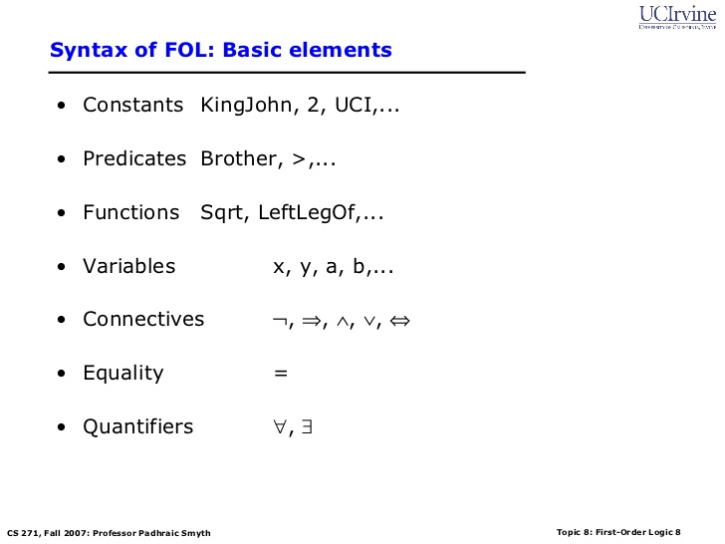

Slide 42
Atomic sentences:
Atomic sentences are the most basic sentences of first-order logic.
These sentences are formed from a predicate symbol followed by a parenthesis with a sequence of terms.
We can represent atomic sentences as Predicate (term1, term2, ......, term n).
Example: Ravi and Ajay are brothers: => Brothers(Ravi, Ajay). Chinky is a cat: => cat (Chinky).
Complex Sentences:
Complex sentences are made by combining atomic sentences using connectives.
Notes:
=> implication->

Slide 43
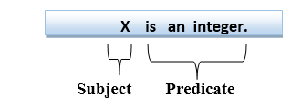
First-order logic statements can be divided into two parts:
Subject: Subject is the main part of the statement.
Predicate: A predicate can be defined as a relation, which binds two atoms together in a statement.
Consider the statement: "x is an integer.", it consists of two parts, the first part x is the subject of the statement and second part "is an integer," is known as a predicate.

Slide 44
Quantifiers in First-order logic:
A quantifier is a language element which generates quantification.
The quantification specifies the quantity of specimen in the universe of discourse.
These are the symbols that permit to determine or identify the range and scope of the variable in the logical expression.
There are two types of quantifier:
Universal Quantifier, (for all, everyone, everything)
Existential quantifier, (for some, at least one).

Slide 45
Universal Quantifier:
Universal quantifier is a symbol of logical representation, which specifies that the statement within its range is true for everything or every instance of a particular thing.
The Universal quantifier is represented by a symbol ∀, which resembles an inverted A.
Note: In universal quantifier we use implication "→".
If x is a variable, then ∀x is read as:
For all x
For each x
For every x.

Slide 46
Example:
All man drink coffee.
∀x man(x) → drink (x, coffee).
It will be read as: There are all x where x is a man who drink coffee.

Slide 47
Existential Quantifier:
Existential quantifiers are the type of quantifiers, which express that the statement within its scope is true for at least one instance of something.
It is denoted by the logical operator ∃, which resembles as inverted E. When it is used with a predicate variable then it is called as an existential quantifier.
Note: In Existential quantifier are typically followed by a conjunction (AND) symbol (∧) when combined with other logical expressions.
If x is a variable, then existential quantifier will be ∃x or ∃(x). And it will be read as:
There exists a 'x.'
For some 'x.'
For at least one 'x.'

Slide 48
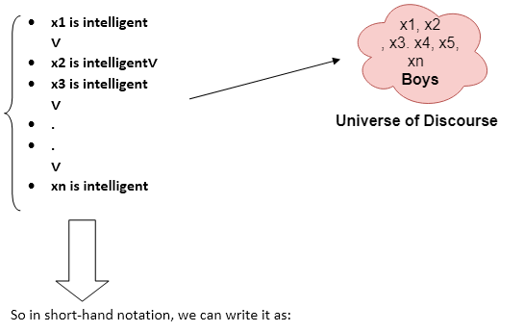
Example:
Some boys are intelligent.
∃x: boys(x) ∧ intelligent(x)
It will be read as: There are some x where x is a boy who is intelligent.
Notes:
The existential quantifier (∃x) is used to indicate the existence of at least one individual (x) that satisfies the given conditions.
The conjunction (∧) is used to combine the conditions "x is a boy" and "x is intelligent."

Slide 49
Properties of Quantifiers:
In universal quantifier, ∀x∀y is similar to ∀y∀x.
In Existential quantifier, ∃x∃y is similar to ∃y∃x.
∃x∀y is not similar to ∀y∃x.

Slide 50
Some Examples of FOL using quantifier:
1. All birds fly. In this question the predicate is fly. Applying predicate "fly(bird).“ And since there are all birds who fly so it will be represented as follows.
∀x bird(x) →fly(x). There are all x where x is a bird who fly.
2. Every man respects his parent. In this question, the predicate is "respect(x, y)," where x=man, and y= parent. Since there is every man so will use ∀, and it will be represented as follows: ∀x man(x) → respects (x, parent). And it can be read as there all x where x is a man who respects parents.
3. Some boys play cricket.
In this question, the predicate is "play(x, y)," where x= boys, and y= game. Since there are some boys so we will use ∃, and it will be represented as:
∃x boys(x) ∧ play(x, cricket) and it can be read as - There exists at least one x is a boy and x plays cricket."

Slide 51
Some examples
"All dogs are mammals.
"FOL representation: ∀x (Dog(x) → Mammal(x))
"Every student has a backpack."
FOL representation: ∀x (Student(x) → HasBackpack(x))
"Some birds can't fly."
FOL representation: ∃x (Bird(x) ∧ ¬Fly(x))
"There exists a city with a population over a million."
FOL representation:
∃x (City(x) ∧ Population(x) > 1000000)

Slide 52
4. Not all students like both Mathematics and Science. In this question, the predicate is "like(x, y)," where x= student, and y= subject. Since there are not all students, so we will use ∀ with negation, so following representation for this: ¬∀ (x) [ student(x) → like(x, Mathematics) ∧ like(x, Science)].
5. Only one student failed in Mathematics. In this question, the predicates is failed(x, Mathematics). X=student Since there is only one student who failed in Mathematics, so we will use following representation for this:
∃x(student(x)∧ failed(x,Mathematics) ∧ ∀y[student(y)∧failed(y, Mathematics)→(y=x)])
Notes:
∃x(student(x)∧failed(x,Mathematics)– there exists a student who failed in mathematics.
∧∀y[student(y)∧failed(y,Mathematics)→(y=x)]) – For all y in students failed in maths , only if y=x.

Slide 53
Free and Bound Variables:
The quantifiers interact with variables which appear in a suitable way. There are two types of variables in First-order logic which are given below:
Free Variable: A variable is said to be a free variable in a formula if it occurs outside the scope of the quantifier.
Example: ∀x ∃(y)[P (x, y, z)], where z is a free variable.
Bound Variable: A variable is said to be a bound variable in a formula if it occurs within the scope of the quantifier.
Example: ∀x [A (x) ] There x is a bound variable

Slide 54
Resolution is a theorem proving technique
Resolution is a theorem proving technique that proceeds by building refutation proofs, i.e., proofs by contradictions.
Resolution is used, if there are various statements are given, and we need to prove a conclusion of those statements.
Steps for Resolution:
Conversion of facts into first-order logic.
Convert FOL statements into CNF (Conjunctive Normal Form)
Negate the statement which needs to prove (proof by contradiction)
Draw resolution graph.
In null set is arrived statement is proved.
A CNF is a sentence represented as a conjunction (AND) of clauses.
A clause is a disjunction (OR) of literals.
Example: (P OR Q) AND (NOT P OR R) is in CNF.
Notes:
https://www.youtube.com/watch?v=pkLcCto83u0
We can only use or and not inside, AND outside. Convert AND to OR using demorgans law. We cant convert AND directly to OR, use instead negation . ¬(P ∧ Q) ≡ ¬P ∨ ¬Q. This means that the negation of "P and Q" is equivalent to "not P or not Q."

Slide 55
Resolution graph
Given Facts:
Humidity is high or the sky is cloudy.
If the sky is cloudy, then it will rain.
If the humidity is high, then it is hot.
It is not hot.
Prove It will rain.
Step 1. Conversion of facts into FOPL.
From a)Humidity is high or the sky is cloudy.
Let P: Humidity is high
Let Q: Sky is cloudy
P ∨ Q
From b) R: It will rain (Q: Sky is cloudy already declared)
Q → R
From c) If the humidity is high (P) , then it is hot (S)
P → S
From d) it is not hot
¬S
Step 2: FOPL to CNF
Conversion:
a) P ∨ Q remains the same.
b) Q → R becomes ¬Q ∨ R.
c) P → S becomes ¬P ∨ S.
d) ¬S remains the same.

Slide 56
Step 3.
Negate the statement which needs to prove (proof by contradiction)
Statement to be proven is it will rain.
It will rain is R. (¬R)
Step 4
Draw resolution tree
Starts with the negation of statement to be proven (¬R)
¬Q ∨ R.
¬R
S.
P ∨ Q
¬Q
¬P ∨ S.
P
¬S
S
{}
Tree reached null state that so ¬R is false which means R( It will rain ) is true.
Notes:
CNF (Conjunctive Normal Form)
In graph Never use same CNF more than once, try to find cancel out terms

Slide 57
Problem 2
a) If it rains then, the ground will be wet.
b) If the ground is wet, the plants will grow.
c) The plants did not grow.
Prove: It did not rain
(Note - negation of the negation is to be proved)

Slide 58
Step 1: Convert to FOPL:
P: It rains., Q: The ground is wet., R: The plants will grow.
a) P → Q
b) Q → R
c) ¬R

Slide 59
Step 2: Convert to CNF:
a) ¬P ∨ Q
b) ¬Q ∨ R
c) ¬R

Slide 60
Step 3: Negate the statement to be proven:
¬(¬P) = P
Step 4: Draw resolution tree:
Resolve P with ¬P ∨ Q to get Q.
Resolve Q with ¬Q ∨ R to get R.
Resolve R with ¬R to get the empty clause ({}).

Slide 61
Unification
Unification is the process of finding a substitution that makes two expressions identical.
Unification is a "pattern matching" procedure that takes two atomic sentences as input, and returns "failure" if they do not match.
Example: Expression 1: P(x, f(y) Expression 2: P(a, f(g(y)))
Unification: [a/x, g(y)/y]
After substitution: P(a, f(g(y))) (both expressions are now identical)
a for x in the first expression g(y) for y in the second expression.
This substitution results in both expressions becoming P(a, f(g(y))).

Slide 62
Unification
Condition for unification
1. Predicate Symbol Must Be the Same:
The predicate symbols of the two expressions must be identical. Expressions with different predicate symbols cannot be unified.
2. Number of Arguments Must Be the Same:
Both expressions must have the same number of arguments.
3. Unification Will Fail if There Are Two Similar Variables with the Same Expression:

Slide 63
KNOWLEDGE-BASED AGENTS
Knowledge-based agents are artificial intelligence systems that use a knowledge base to reason and make decisions.
The central component of a knowledge-based agent is its knowledge base, or KB.
A knowledge has a set of sentences.
Each sentence is expressed in a language called a knowledge representation language (KRL) and represents some assertion about the world.
The operation to add new sentences to KB is generally know as TELL.
A way to query what is known in KB is termed as ASK

Slide 64
Pseudo code to implements a basic knowledge-based agent
Pseudo code
TELL(KB, MAKE-PERCEPT-SENTENCE(percept, t)):
Creates a sentence representing the current percept and the time.
Adds this sentence to the knowledge base.
action ← ASK(KB, MAKE-ACTION-QUERY(t)):
Creates a query to ask the knowledge base for an appropriate action based on the current time and stored knowledge.
Assigns the result of the query to the action variable.
TELL(KB, MAKE-ACTION-SENTENCE(action, t)):
Creates a sentence representing the chosen action and the time. Adds this sentence to the knowledge base KB.
function KB-AGENT(percept) returns an action
persistent: KB, a knowledge base
t, a counter, initially 0, indicating time
TELL(KB, MAKE-PERCEPT-SENTENCE(percept, t))
action ← ASK(KB, MAKE-ACTION-QUERY(t))
TELL(KB, MAKE-ACTION-SENTENCE(action, t))
t ← t + 1
return action

Slide 65
Forward and Backward Chaining
Forward Chaining
Forward chaining is a method used to retrieve information from Knowledge Base using inference principles.
Forward chaining is indeed referred to as forward deduction or forward reasoning.
Before deriving new information, the inference engine evaluates current data, derivations, and conditions in this sort of chaining.
The manipulation of information in the knowledge base results in the achievement of an objective (goal).
It is a bottom-up approach performed redundantly to reach the endpoint or goal (decision).
It begins with evaluating existing information, followed by the manipulation based on the knowledge base.
The existing information can be as facts, derivations, and conditions.
Notes:
inference principles -

Slide 66
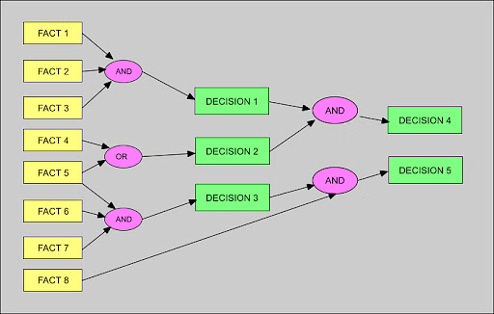
Forward and Backward Chaining

Slide 67
Forward Chaining
Forward chaining may be employed for application planning, monitoring, management, and interpretation.
Properties of forward chaining
It follows a down-up strategy, going from bottom to top.
It is the process of reaching a decision based on known facts or information, beginning with the initial state and progressing to the target state.
The forward-chaining method is also known as data-driven because we achieve our objective by employing available data.
The forward-chaining method is widely used in expert systems such as CLIPS (C Language Integrated Production System), business rule systems, and manufacturing rule systems.

Slide 68
Forward and Backward Chaining
Advantages and Disadvantages of Forward Chaining
Advantages
Suitable to draw multiple conclusions simultaneously
Higher flexibility than backward chaining
Reliable for conclusion
Disadvantages
Time-consuming due to data synchronization
The fact explanation is unclear

Slide 69
Forward and Backward Chaining
Backward Chaining
Is an inference engine reasoning method that begins with an imagined objective.
It employs backtracking to discover the most optimum method for dispute resolution or to achieve the target state.
The top-down approach involves using decisions or goals to reach the facts.
The backward chaining is the backtracking process of finding usage in diagnostics, debugging and prescription.

Slide 70
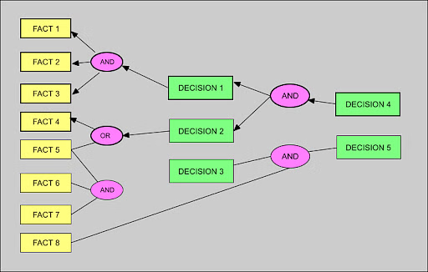
Backward Chaining

Slide 71
Backward Chaining
Properties of backward chaining
It is referred to as a top-down strategy.
Backward chaining divides the objective into sub-goals to demonstrate the truth of the facts.
A goal-driven strategy is used because a list of objectives determines which rules are chosen and used.
The backward-chaining method is used in game theory, automatic theorem-proving techniques, inference engines, prove assistants and other artificial intelligence uses.

Slide 72
Forward and Backward Chaining
Advantages
Because it is concentrated on a specific objective, it only employs parts of the knowledge base that are pertinent to the hypothesis.
The problem typically begins by developing a hypothesis and afterward determining whether or not it can be proven.
It is appropriate for issues requiring an expert system for diagnosis, prescribing, and troubleshooting.
Backward chaining is a faster procedure because it only analyses and verifies the necessary rules.
Disadvantages
Backward chaining can be difficult to execute at times.

Slide 73
Example- Forward Chaining
Goal: Determine if it's a good day for a picnic.
Knowledge Base Rules:
If it is sunny, then it is a good day for a picnic.
If the temperature is above 25 degrees Celsius, then it is sunny.
Forward Chaining Process:
Initial Facts:
The temperature is 30 degrees Celsius.
Rule Matching: Rule 2 matches the initial fact.
Rule Application: Rule 2 is applied, and the new fact "It is sunny" is added to the knowledge base.
Rule Matching: Rule 1 now matches the facts "It is sunny"
Rule Application: Rule 1 is applied, and the conclusion "It is a good day for a picnic" is derived.

Slide 74
Backward Chaining
Goal: Determine if a student is eligible for a scholarship.
Knowledge Base Rules:
If a student has a GPA of 3.5 or higher and has volunteered for 20 hours or more, then the student is eligible for a scholarship.
If a student has won a national-level competition, then the student is eligible for a scholarship.
Backward Chaining Process:
Goal: Student is eligible for a scholarship.
Rule Matching: The system finds rules 1 and 2 whose conclusion matches the goal.
Subgoal Generation:
Rule 1: Subgoals:
Student has a GPA of 3.5 or higher.
Student has volunteered for 20 hours or more.
Rule 2: Subgoal:
Student has won a national-level competition.
Subgoal Checking: The system checks if these subgoals are true or can be derived from other rules.
Solution Path: If any of the subgoals are true, the system can conclude that the student is eligible for a scholarship.

