Slide 1

FLIPPING THE TILES
(MINI PROJECT)

Slide 2
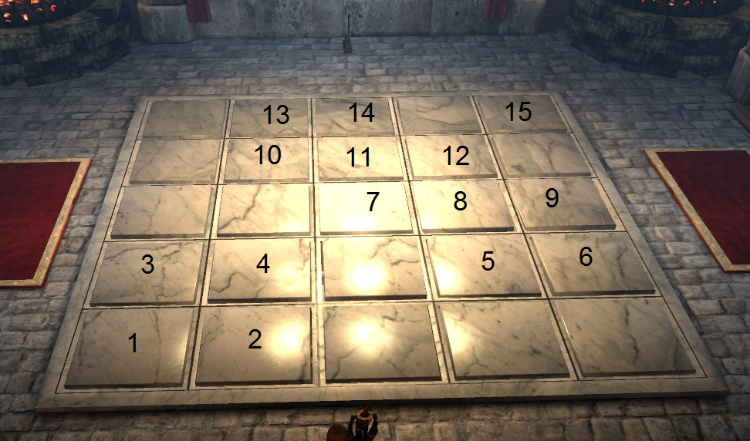
ABSTRACT
->Flipping tiles is a game which can be played to test our memory.
->In this project we are using tkinter module to have GUI interface, and random module.
->Random module is used to shuffle the tiles whereas tkinter is used for providing sufficient GUI interface

Slide 3
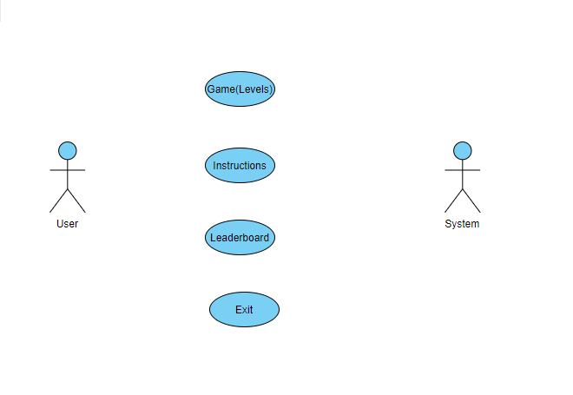
USE CASE DIAGRAM

Slide 4
TECHNOLOGY
->The Framework used in the project was in python
->We used python GUI in order to built the main structure of the game with help of tkinter module .

Slide 5
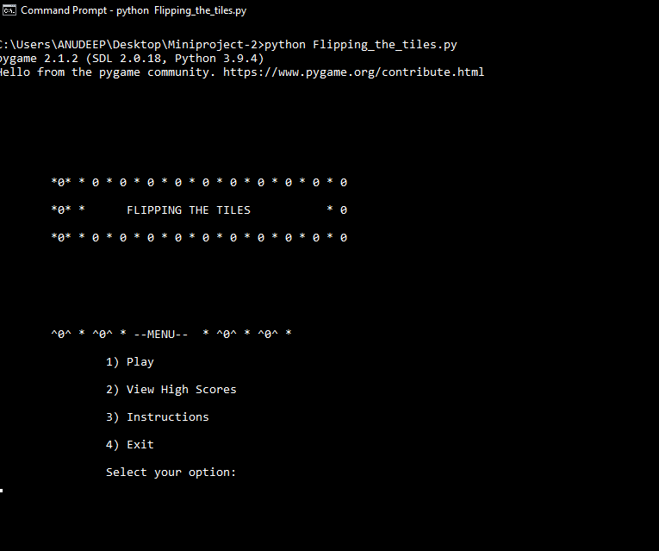
MAIN MENU

Slide 6
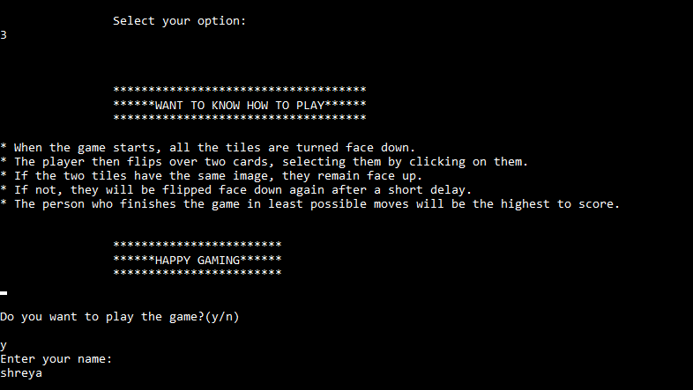
INSTRUCTIONS

Slide 7
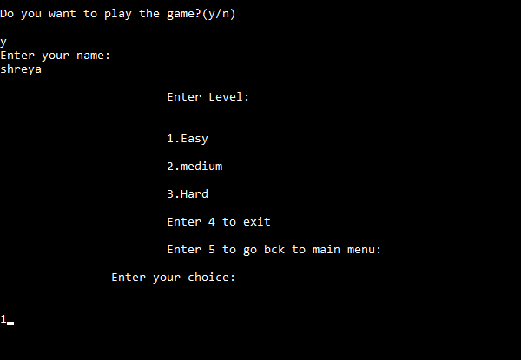
SELECTING LEVELS

Slide 8
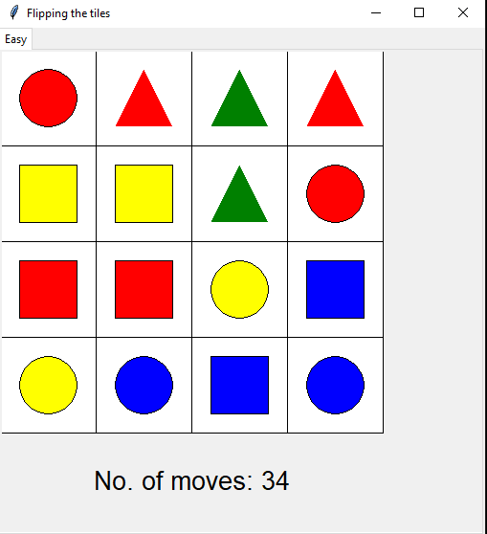
EASIER LEVEL

Slide 9
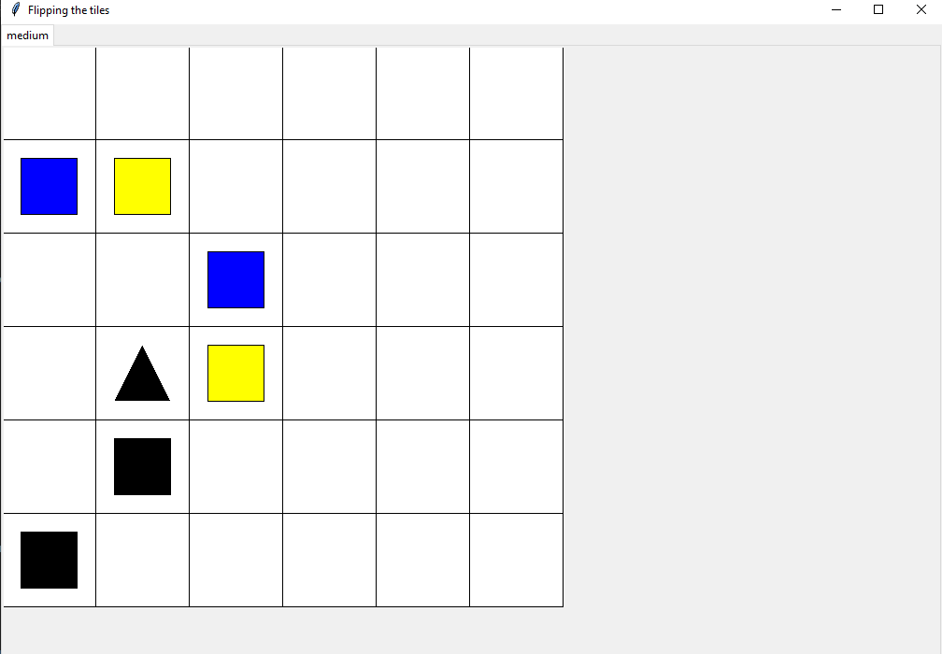
MEDIUM LEVEL

Slide 10
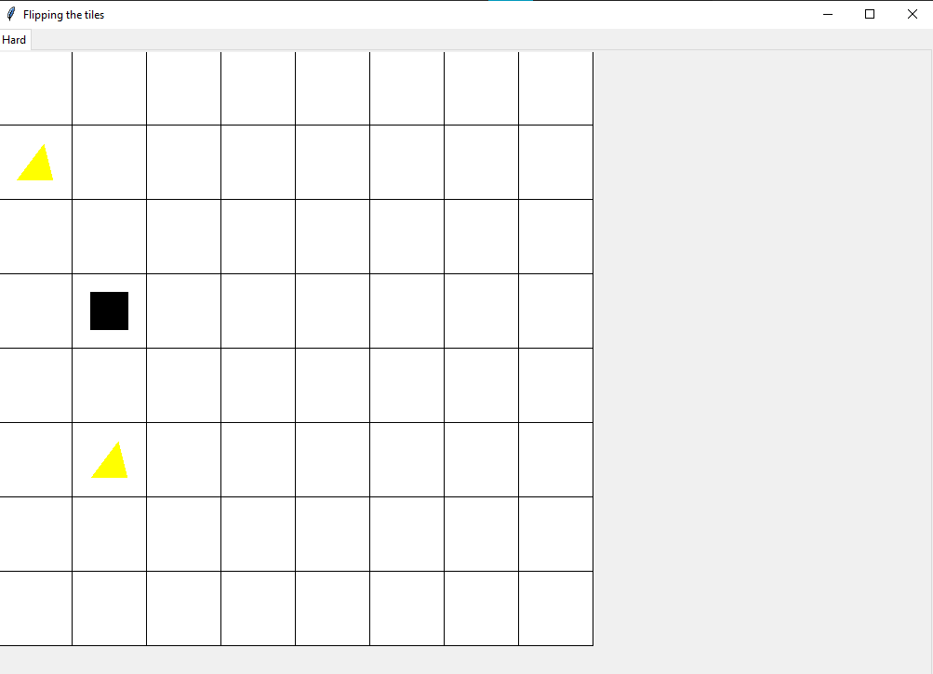
HARD LEVEL

Slide 11
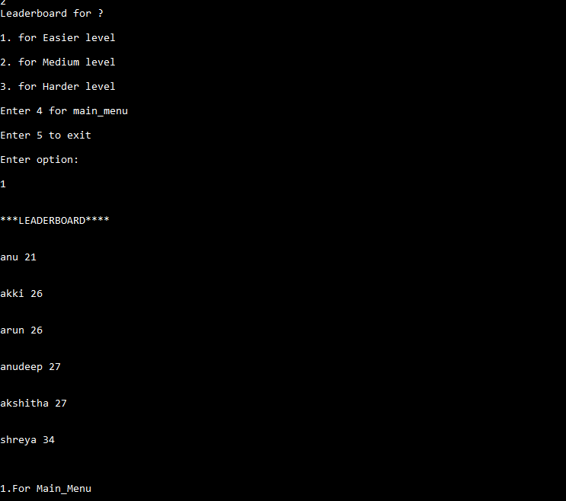
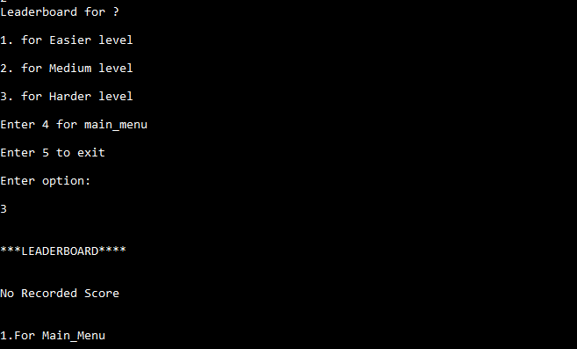
LEADERBOARD

Slide 12
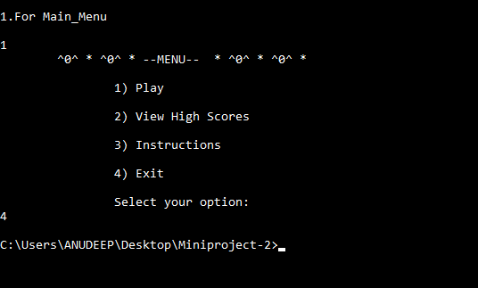
EXIT

Slide 13
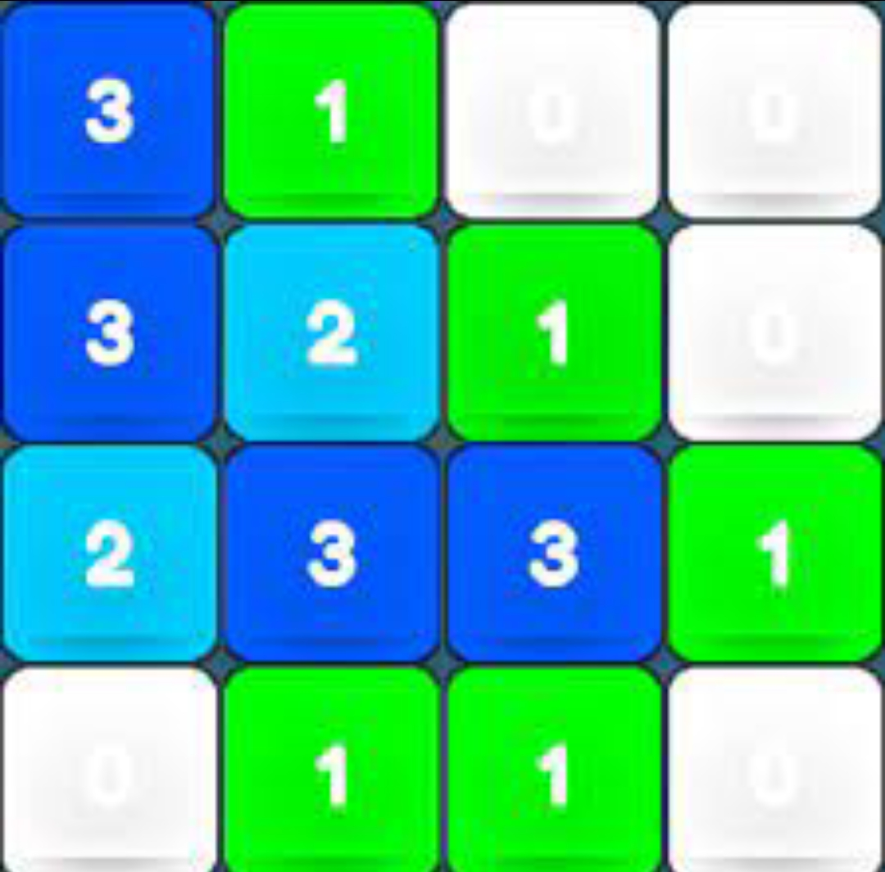
CONCLUSION AND FUTURE SCOPE
->As we know Gaming is one of the largest segment of the entertainment industry .It is a demanding career in today's modern world. With the wide access to the internet has created a humongous demand for online games and with the advent of technology, this industry is growing at fast pace. So this kind of memory games still have a scope in future world.
>Playing memory games can improve other brain functions, such as attention, concentration, and focus.
-> Memory games give space to critical thinking and that helps children nurture their attention to detail.

Slide 14
THANK YOU!!!
(Flip the tile, flip the game)

