Slide 1

AWP PROJECT
PASSWORD GENERATOR
(For all Social Media Platforms)
by -
Nandini Garg(ENG20CA0023)
Shivansh Parmar(ENG20CA0041)
Shreya Jaiswal(ENG20CA0042)

Slide 2
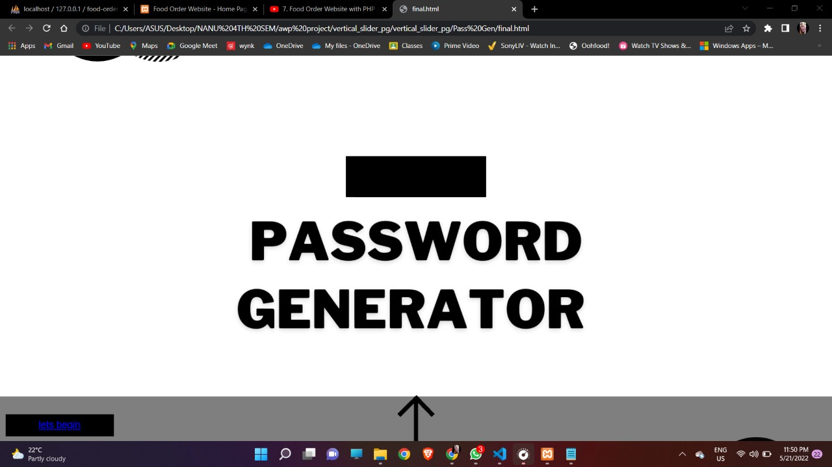
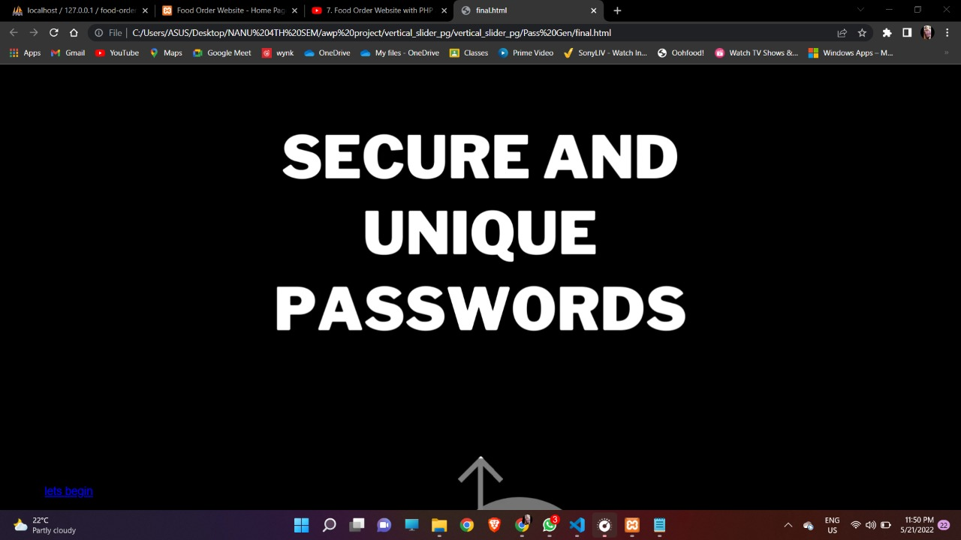
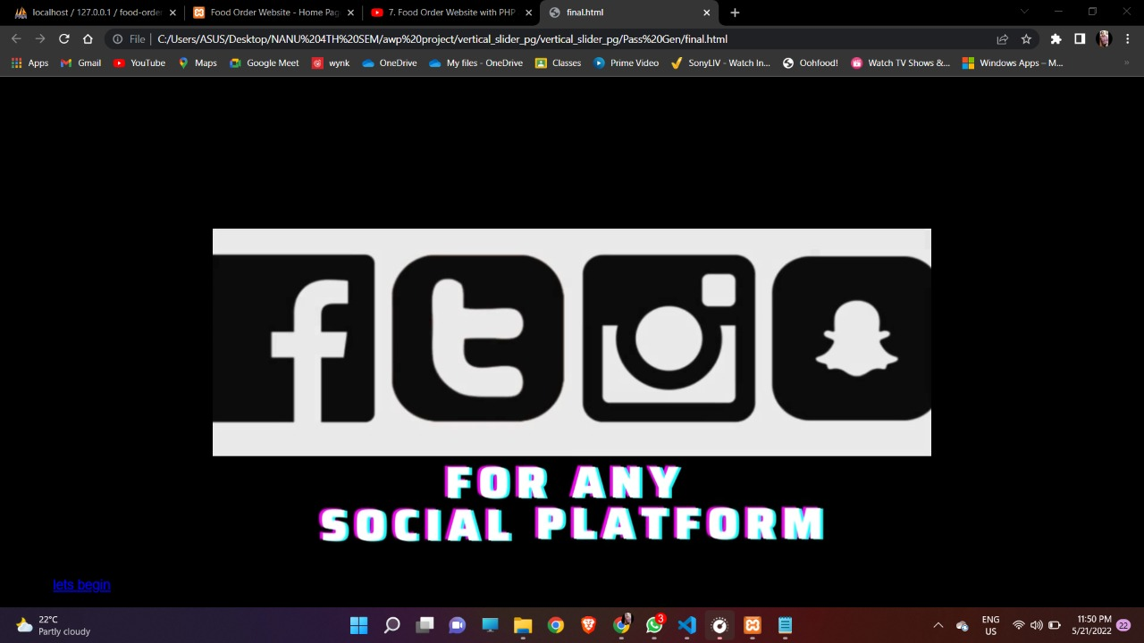
INTRODUCTION
Despite its widely-discussed shortcomings, text password authentication is widely used to authenticate users to online services. Many attempts have been made to replace simple password authentication, e.g. using biometrics, tokens and multi-factor authentication. However, single-factor password-based authentication remains very widely used. Moreover, in recent years the number of widely-used password-protected services has grown signiﬁcantly, in turn, increasing the number of passwords users are expected to remember. There are a range of issues associated with the use of text passwords. These issues can be categorized as either user-related or online service-related.

Slide 3


Languages used
in designing
this webpage
Languages
HTML
CSS
JAVASCRIPT

Slide 4
Elements used
in designing
this webpage
Elements
Home Page
Vertical Slider
Social Media Login Pages
Password Generator
Instagram Dummy I’d

Slide 5
Login Pages For Various Social Media Platform

Slide 6
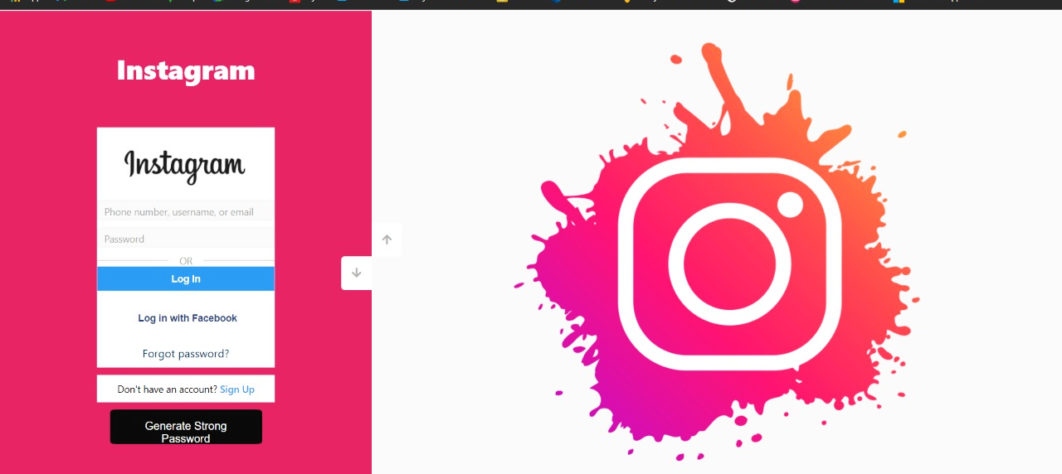
Instagram
Login Page

Slide 7
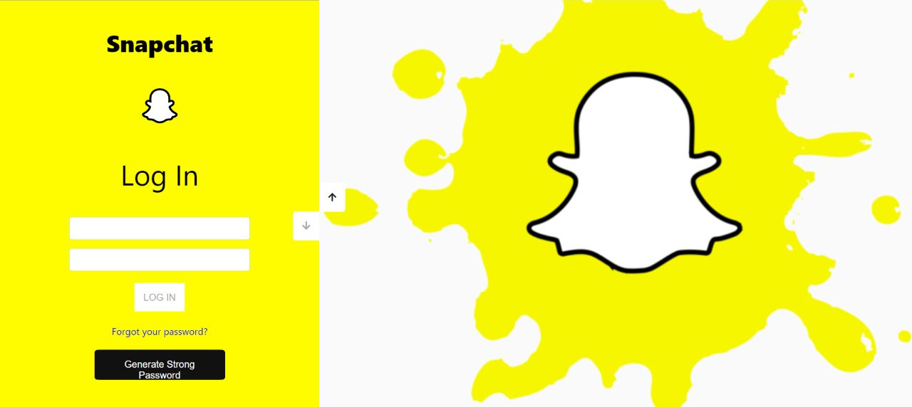
Snapchat
Login Page

Slide 8
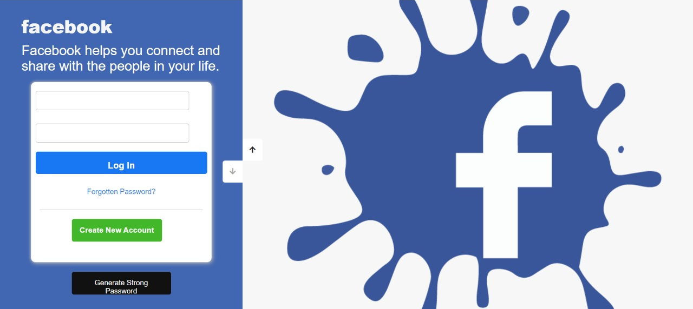
Facebook
Login Page

Slide 9
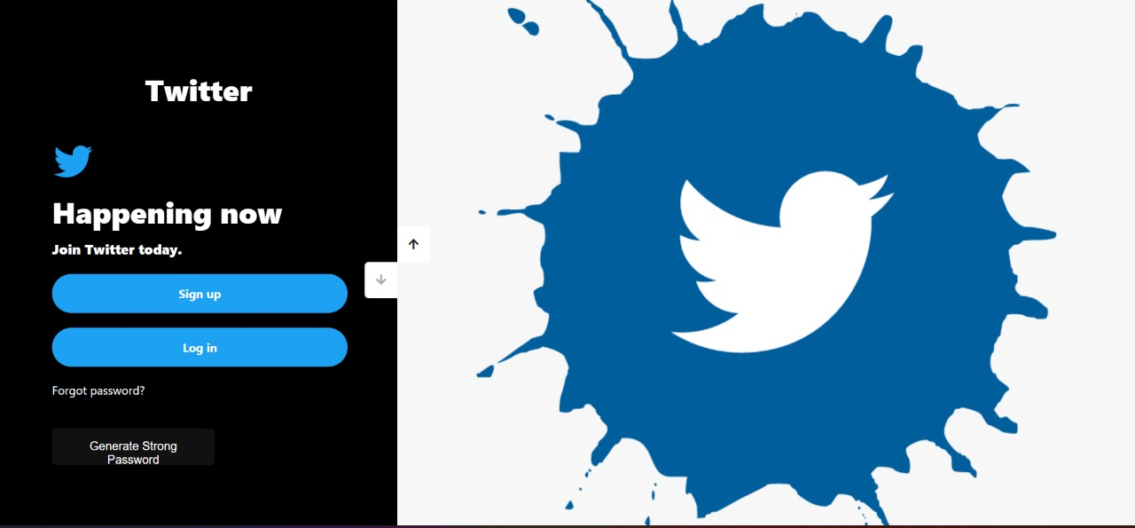
Twitter
Login Page

Slide 10
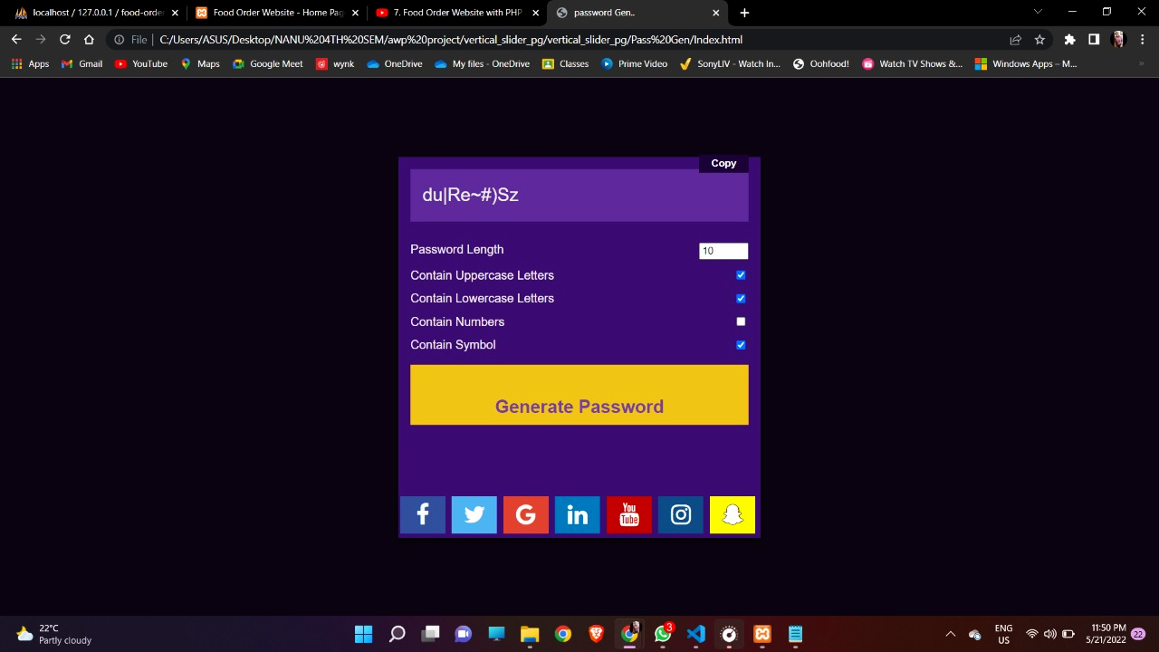
Password Generator
The new methodology has been created to generate random password which consists of both upper & lower case letter and digits from 0 to 9 and special symbols with fixed length. It can hold minimum values up to 8 and maximums up to 30.

Slide 11
Procedures
Step 1: Start the process
Step 2: Create random character list with numbers, upper & lower-case letters, special characters.
Step 3: Password must be in fixed length of 8-30.
Step 4: Create Random Password Generator method to generate the password.
Step 5: Random Password Generator chooses any of the four character set.
Step 6: The index position of any one of the characters from the random character set is returned.
Step 7: Copy the password.
Step 8: End

Slide 12
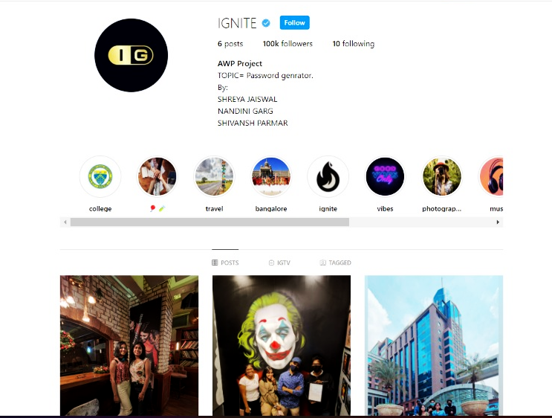
Dummy I’d For Instagram

Slide 13

CONCLUSION
The password generated using the random password mechanism that was illustrated above is practical and can be used with great results. When the password is selected manually, most of the time, the users select the password that is related to himself or herself and related to any of the events.
This gives the space for the intruders to deploy various
attacks in breaking the passwords. The randomly generated passwords avoid this particular situation.
One of the drawbacks could be the difficulty in memorizing
the randomly generated password. But when comparing the
security achieved through the randomly generated
Password, it is much preferable than the manually
chosen password.
Future Enhancements
Since all the applications are protected with passwords, more research can be accomplished for secured automatic password generations. New encryption and decryption standards could be implemented with the randomly selected passwords.

Slide 14
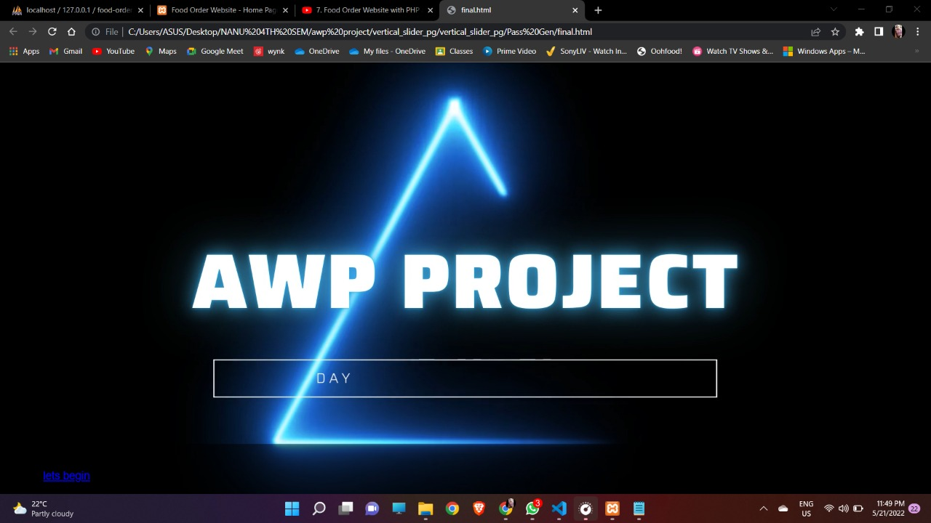
REFERENCES!
https://www.ijert.org/research/alpha-numerical-random-password-generator-for-safeguarding-the-data-assets-IJERTV3IS120404.pdf
https://codecary.com/vertical-image-slider-using-javascript/
https://www.avast.com/en-in/random-password-generator#pc
https://www.w3schools.com/howto/howto_css_social_login.asp
https://www.w3schools.com/js/js_events.asp
THANK
YOU

