Slide 1
GROUP PROJECT · MARCH 2026
How can seismic data help us make smarter real estate investment decisions?
Data: USGS Earthquake Hazards Program · Live API feed
Boumediene Rayane Mazari – Felipe De Leon Castro – Marco De Palma – Sacha Huberty – Shreya Jha – Smaragda Apostolou

Slide 2
THE CHALLENGE
Why static risk maps are no longer enough
When buying property in earthquake-prone areas, investors today typically rely on risk zone maps that were drawn years ago. These maps treat entire regions as equally risky — and they can't tell you whether seismic activity has been increasing recently.
Our approach
We built a live, data-driven platform using real earthquake data — updated continuously — so investors can see actual risk, not estimated risk.
Paying too much for insurance
Properties in zones labelled 'high risk' pay elevated premiums — even when recent earthquake data shows activity has been minimal.
Live earthquake data from the US government, refreshed every 5 minutes
Risk scores that weigh both how often earthquakes happen and how powerful they are
Underestimating new hotspots
Areas with rising seismic activity may not yet appear on static maps, leaving investors unaware of growing exposure.
Real-time alerts when seismic activity spikes in a market you are evaluating
Automatic grouping of markets into risk tiers — backed by machine learning
Source: USGS Earthquake Hazards Program — usgs.gov/programs/earthquake-hazards

Slide 3
OUR FRAMEWORK
Four questions. One complete picture.
Each step in our analysis answers a different question an investor needs to ask before committing capital to a seismically active market.
01
02
03
04
Where is the risk?
Is it getting worse?
Are my investments linked?
Which tier am I in?
Historical analysis
Real-time monitoring
Portfolio correlation
Risk classification
We rank every market by a risk score that combines earthquake frequency and destructive power.
We monitor live data in 5-minute windows so any sudden spike in activity triggers an immediate alert.
We map which markets sit on connected fault systems — so you know if a single event could hit multiple assets.
Machine learning groups all 59 markets into three distinct risk tiers, each with a different insurance strategy.

Slide 4
HOW IT WORKS
From live earthquake data to actionable insight
Every 5 minutes, the US Geological Survey publishes new earthquake data. Our pipeline picks that up automatically and processes it in real time.
USGS API
Apache NiFi
MinIO Data Store
Apache Spark
4 Outputs
Live data
every 5 min
Automated
collection
JSON + CSV
formats
Processing
engine
Risk · Alerts
Graph · Tiers
59
2
5 min
Spark 3.5.4
Markets
covered
File formats
JSON + CSV
Refresh
rate
Processing
platform
NiFi collects both JSON and CSV files from the USGS API and stores them in a cloud-compatible data store. Apache Spark then reads both formats simultaneously — making the system resilient to changes in data format.

Slide 5
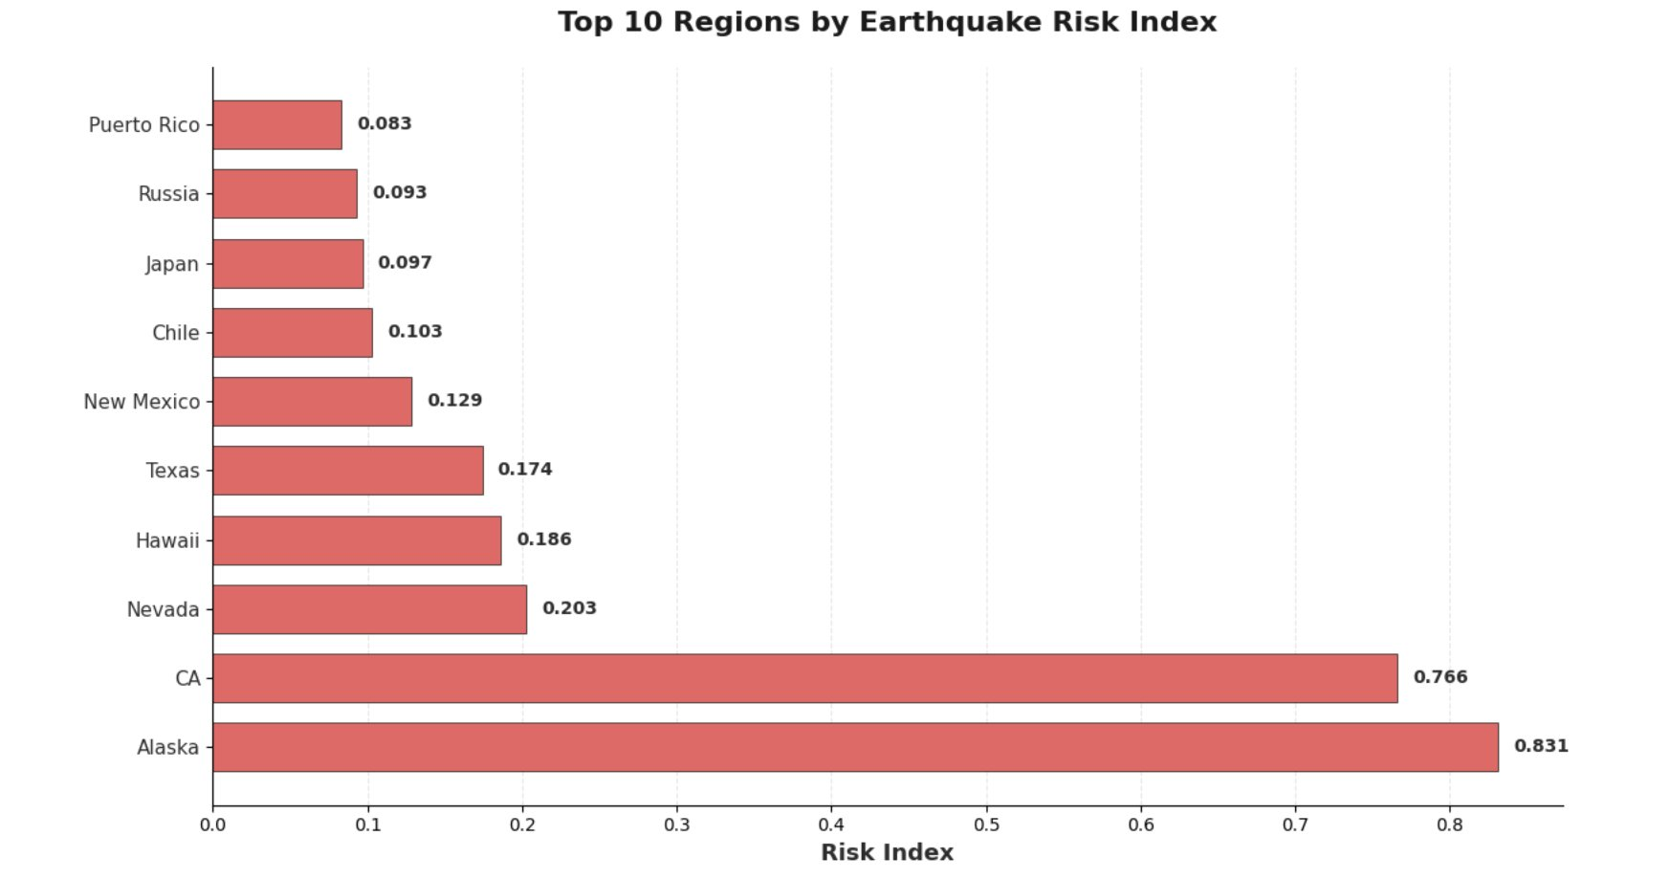
STEP 1 · WHERE IS THE RISK?
Alaska and California stand apart from every other market
How to read this
Each bar shows a market's overall risk score — a single number that combines how frequently earthquakes happen there and how powerful they typically are.
0.83
Alaska's risk score — the highest in the dataset
4×
Gap between the top 2 markets and everyone else
Risk score = 40% earthquake frequency + 60% earthquake power

Slide 6
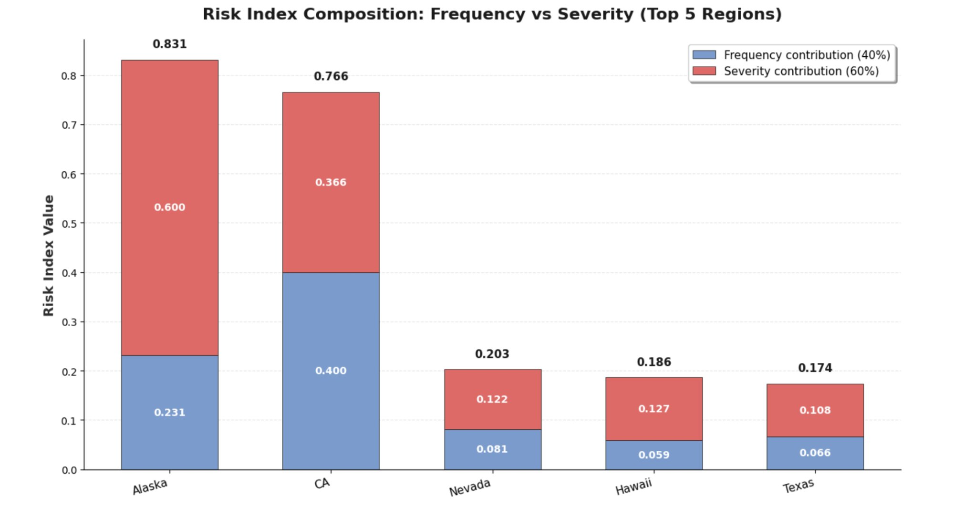
STEP 1 · A COUNTERINTUITIVE FINDING
California has more earthquakes — but Alaska is more dangerous
What this means
California records far more earthquakes than Alaska. But Alaska's earthquakes are significantly more powerful — and powerful quakes cause far greater damage to buildings and infrastructure.
Alaska
72% of its risk score comes from raw destructive power. Fewer events, but each one hits harder.
California
52% of its score comes from sheer frequency. The constant drumbeat of smaller events adds up.
Blue = frequency contribution (40% weight) · Red = power contribution (60% weight)

Slide 7
STEP 2 · IS IT GETTING WORSE?
A live early-warning system for active due diligence
The historical risk score tells you where risk has been. But during the weeks or months it takes to close on a property, seismic activity can change. Our streaming layer watches the data in real time and flags any sudden increases.
Market
Time window
Magnitude
Severity
CA
01:00–01:05
3.30
10.89
B.C., Mexico
21:05–21:10
3.39
11.49
Washington
17:25–17:30
2.94
8.64
1
Continuous monitoring
Alaska
03:00–03:05
2.60
6.76
New earthquake data is processed the moment it arrives — no waiting for end-of-day reports.
Puerto Rico
09:55–10:00
3.02
9.12
New Mexico
01:00–01:05
2.00
4.00
2
5-minute snapshots
Tennessee
14:00–14:05
1.75
3.06
Activity is grouped into 5-minute windows, so spikes are visible almost immediately.
Oklahoma
05:50–05:55
2.29
5.24
Alaska
19:10–19:15
2.20
4.84
3
Automatic deduplication
The system filters out duplicate records so each event is counted exactly once.
Highlighted rows = severity spikes that would trigger a due diligence review · Sample output, 15 Dec 2025

Slide 8
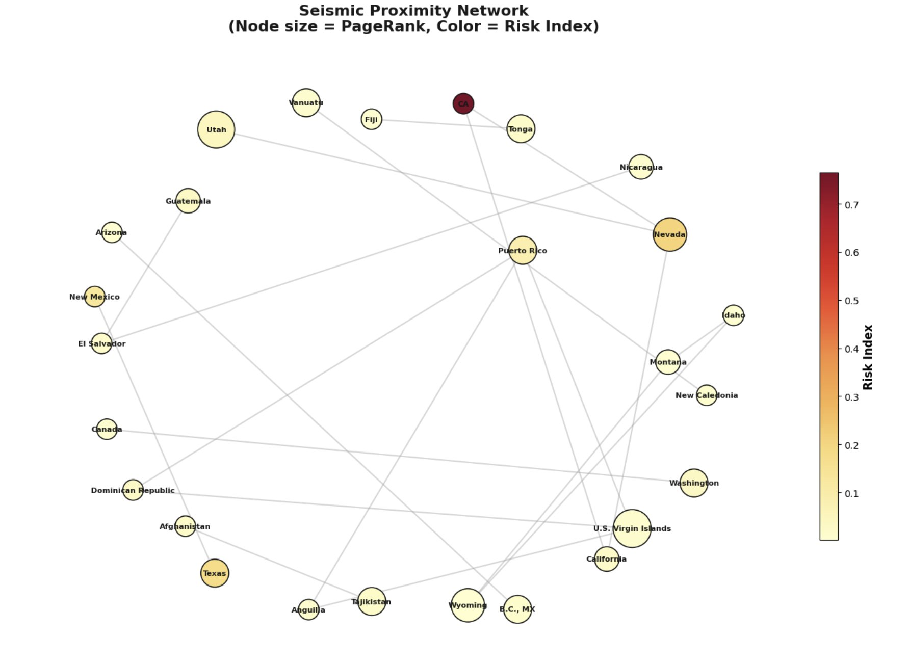
STEP 3 · ARE MY INVESTMENTS LINKED?
Not all markets are as independent as they appear
How to read this map
Each dot is a market. The size of the dot shows how structurally connected it is — a larger dot means more markets are exposed through it. The darker the colour, the higher the individual risk score.
U.S. Virgin Islands
Low individual risk score — but the largest dot in the Caribbean cluster. A single major event there would hit Puerto Rico and Dominican Republic at the same time.
Nevada
High risk score AND highly connected. Holding properties in California, Nevada and Utah simultaneously is not true diversification — they all sit on the same fault corridor.
Lines connect markets within 500 km of each other · Built with GraphFrames on Apache Spark

Slide 9
STEP 3 · THE HIDDEN RISK IN YOUR PORTFOLIO
Connectivity matters as much as individual risk scores
Our analysis identifies which markets act as hubs — where a single event ripples out and affects everything connected to it. These hubs deserve extra attention even when their own risk score looks low.
Market
Hub score
Risk score
What it means
2.71
U.S. Virgin Islands
2.71
0.01
Caribbean cluster hub
Hub score — U.S. Virgin Islands
Utah
2.56
0.04
Western US corridor
A risk score of just 0.01 — but the highest hub score in the network. Low-risk on its own, but a Caribbean-wide event would trigger simultaneous claims across four connected markets.
Nevada
2.09
0.20
High risk + high connectivity
Wyoming
2.09
0.00
Exposed through Nevada
Nevada
Texas
1.46
0.17
Washington
1.46
0.03
The most dangerous node in the network
High individual risk (0.20) and the highest connectivity in the western US. Owning assets in California and Utah alongside Nevada is not diversification.
Tajikistan
1.46
0.02
Indirect risk corridor discovered: CA → Nevada → Utah — no direct CA–Utah link, but a Nevada event affects both simultaneously.
Hub score = PageRank algorithm · Higher score = more markets are exposed through this node

Slide 10
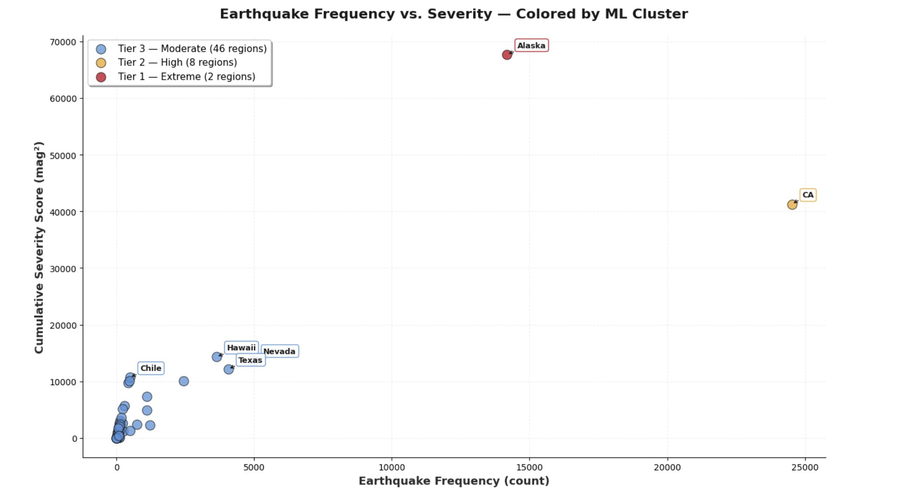
STEP 4 · WHICH TIER DOES MY MARKET BELONG TO?
Our algorithm reveals three naturally distinct groups
What this chart shows
Each dot is a market. Its horizontal position shows how often earthquakes occur there. Its vertical position shows the total destructive power. The machine learning algorithm grouped them into three tiers automatically — without us setting any thresholds.
Tier 1 — Extreme
Alaska: very powerful earthquakes. California: extremely frequent.
Tier 2 — High
Nevada, Hawaii, Texas and others — elevated on both dimensions.
Tier 3 — Moderate
57 markets — fewer and less powerful events, but still worth monitoring.
Clustering validated with a confidence score of 0.95 — indicating the three tiers are clearly distinct, not arbitrary groupings.

Slide 11
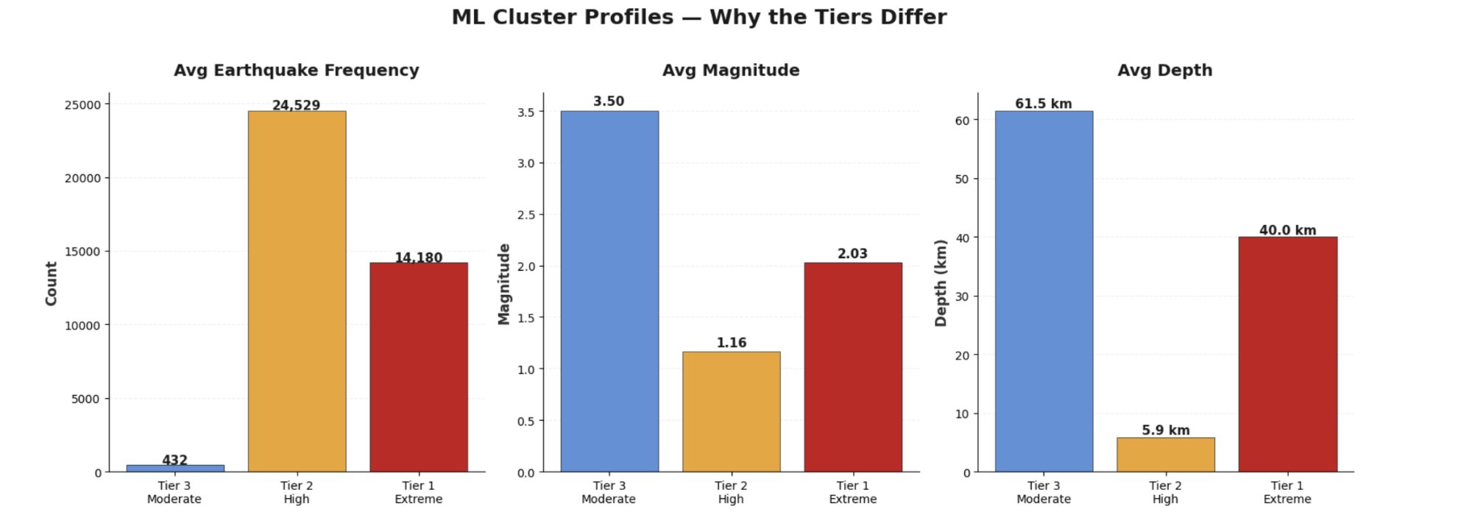
STEP 4 · WHAT MAKES EACH TIER DIFFERENT?
Three tiers — three distinct risk profiles
The key finding
Tier 3 (the 57-market group) has the highest average earthquake magnitude of all three tiers. These markets produce fewer earthquakes, but each one is more powerful on average.
Tier 2 — California
Prioritise cover for business interruption and rapid claims. The constant stream of moderate events is the primary exposure.
Tier 1 — Alaska
Prioritise structural damage cover. Fewer events but each one can cause catastrophic damage. Specialist reinsurance recommended.
Tier 3 — 57 markets
Standard cover with magnitude-based review. Markets like Chile and Japan in this group still warrant careful individual assessment.
Tiers discovered by KMeans machine learning — not preset by analysts · Confidence score: 0.9491

Slide 12
PUTTING IT ALL TOGETHER
When to use each layer of the analysis
The four steps are not separate tools — they map directly onto the stages of any real estate investment process.
Stage
Question you are asking
Our tool
What you get
Market screening
Is this region broadly safe to invest in?
Step 1 · Batch
Risk score — go, caution, or avoid
Active due diligence
Has anything changed while we were evaluating the deal?
Step 2 · Streaming
Live spike alert — pause or proceed
Portfolio review
Are our existing assets correlated to this new one?
Step 3 · Graph
Correlation check — diversified or not
Insurance budgeting
What level of cover do we need and what will it cost?
Step 4 · ML tiers
Tier assignment — Tier 1, 2 or 3
Answer:
Seismic data can support better real estate decisions at every stage of the investment lifecycle — from first screening through to ongoing portfolio monitoring.

Slide 13
IMPORTANT CAVEATS
What this analysis tells us
Limitations to keep in mind
Natural next steps
This is one day's data
01
Connect to property pricing
The analysis covers a single collection on 16 March 2026. A 12-month rolling dataset would produce more reliable risk scores.
Join the risk scores to property valuations to produce a risk-adjusted return figure for each market.
Proximity ≠ fault connectivity
02
Automate investment alerts
We link markets that are within 500 km of each other. The actual fault line geometry may be different — two markets further apart could still be geologically connected.
Wire the live monitoring layer to an automated notification system so portfolio managers receive real-time alerts.
The weighting is a starting point
03
Use real fault line maps
We weighted earthquake power at 60% and frequency at 40%. These are informed assumptions. Actual insurance data could refine these numbers.
Replace the 500 km proximity rule with actual geological fault line data from USGS for more accurate correlation detection.
Most markets fall in one group
04
Build a 12-month rolling view
57 of 59 markets land in Tier 3. As more data is collected, finer-grained tiers could emerge.
Ingest continuous data to detect trends — is a market getting riskier over time, or quieter?

Slide 14
CONCLUSION
Smarter data leads to smarter decisions
Real estate investment has always carried uncertainty. What our analysis demonstrates is that a significant portion of that uncertainty — specifically the seismic dimension — is now measurable, monitorable and actionable. Investors who treat earthquake risk as a static background condition are leaving a material blind spot in their decision-making.
Risk is not uniform
Risk is not static
Risk is not isolated
Alaska and California carry risk scores four times higher than the next market. Properties within the same broad region can differ substantially — blanket zone-based pricing does not reflect that.
Seismic activity changes week to week. Decisions made on annual risk maps can be undermined by activity that occurred after the map was drawn. Live monitoring closes that gap.
Portfolio diversification across neighbouring markets does not guarantee uncorrelated exposure. Graph analysis reveals which combinations of assets are seismically linked through shared fault systems.
Apache Spark Group Project · March 2026

Slide 15
Thank you
We are happy to answer any questions.
Data source
USGS Earthquake Hazards Program
usgs.gov/programs/earthquake-hazards/earthquakes
Boumediene Rayane Mazari – Felipe De Leon Castro – Marco De Palma – Sacha Huberty – Shreya Jha – Smaragda Apostolou

