Slide 1

Legal
Sphere
By:
Ms. Shreya Kadam
T318- Master’s in Data Science and Analytics with AI
Notes:
Line spacing + Page numbers

Slide 2
Introduction:
Legal Sphere is management system designed specifically for legal professionals seeking to streamline their practice and enhance productivity.
Store and manage all your case, client, and administrative data in one centralized, easily accessible database. This ensures that your data is organized and retrievable when you need it.
simplifies billing processes, helping you to ensure timely payments and financial transparency.
Powered by MySQL, Legal Sphere ensures high performance, reliability, and uptime, giving you peace of mind that your practice management system is always available.

Slide 3
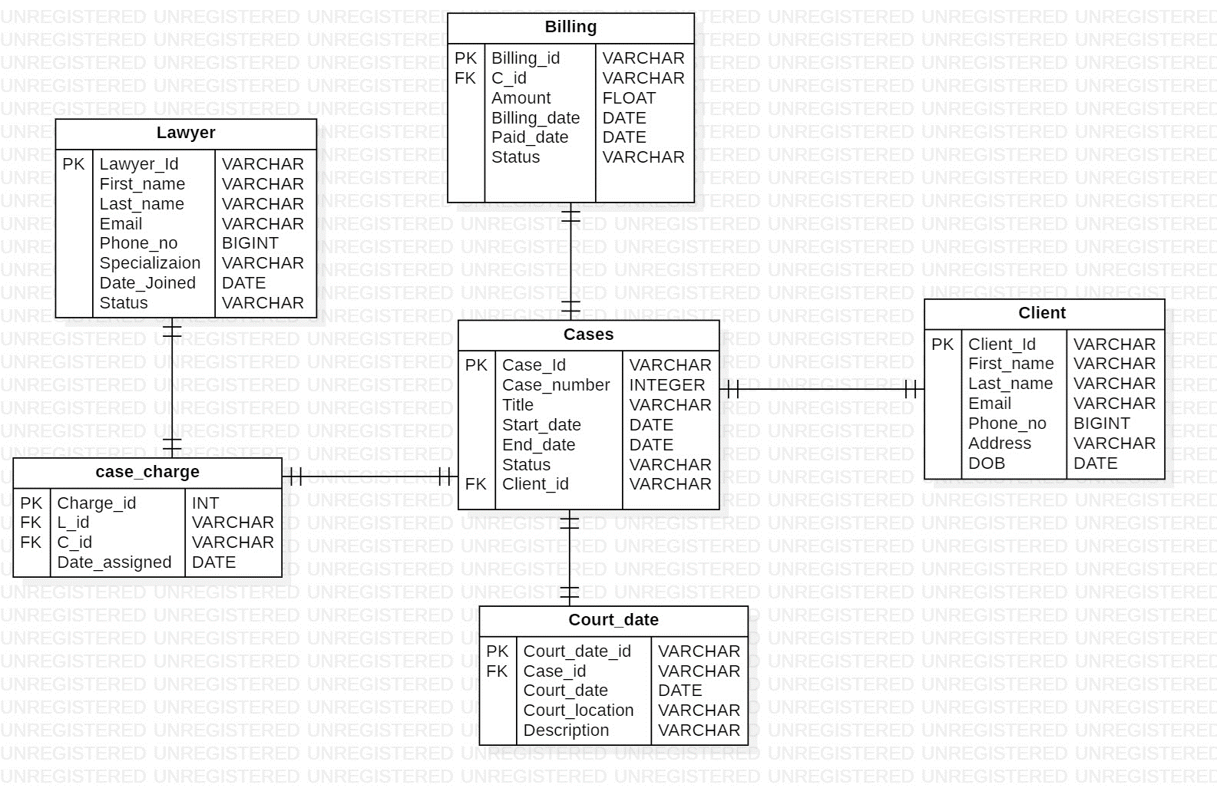
Entity-Relationship(ER) Diagram

Slide 4
Structure of Table

Slide 5
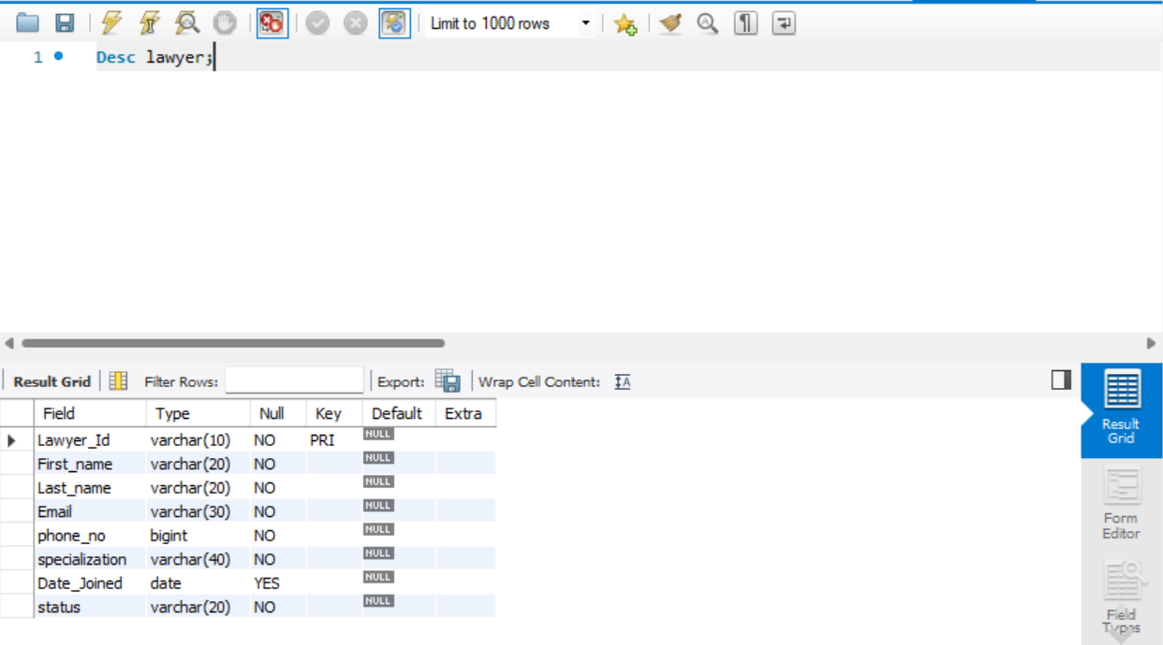
Lawyer Table
Query: Desc lawyer;

Slide 6
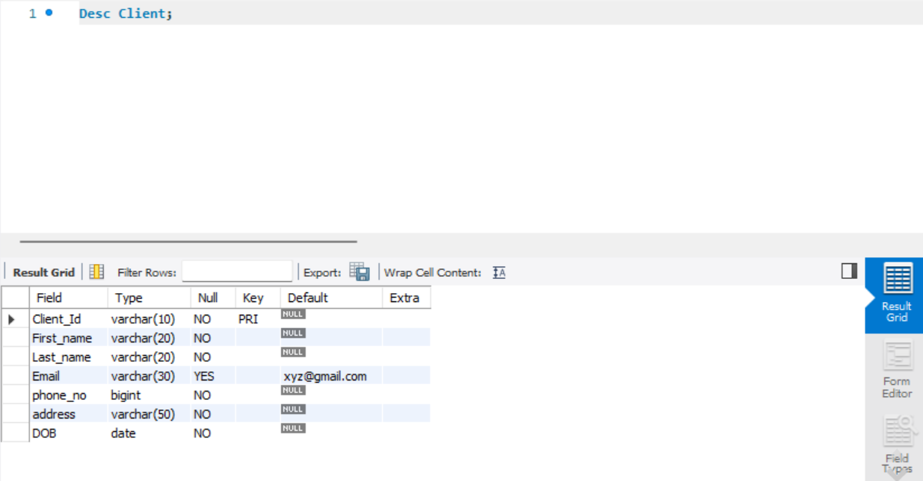
Client Table
Query: Desc client;

Slide 7
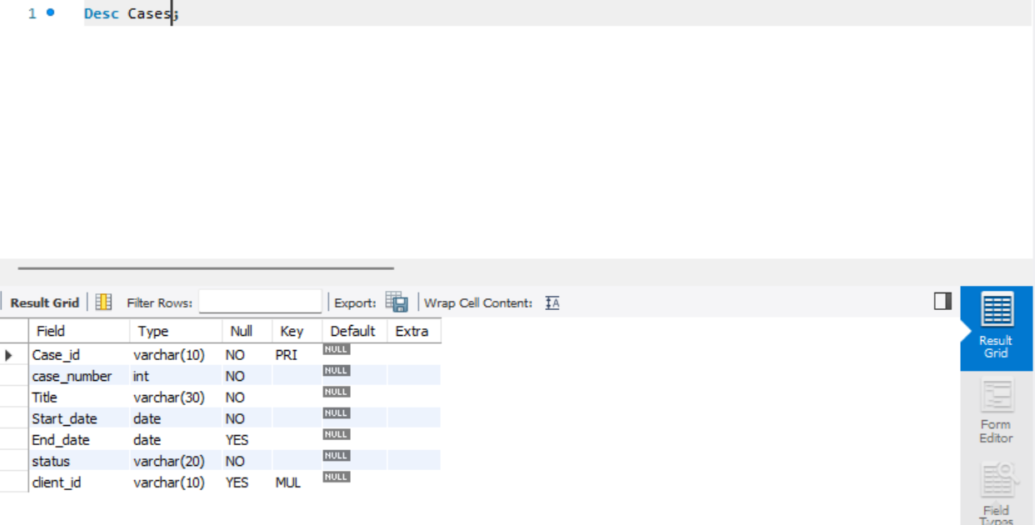
Cases Table
Query: Desc cases;

Slide 8
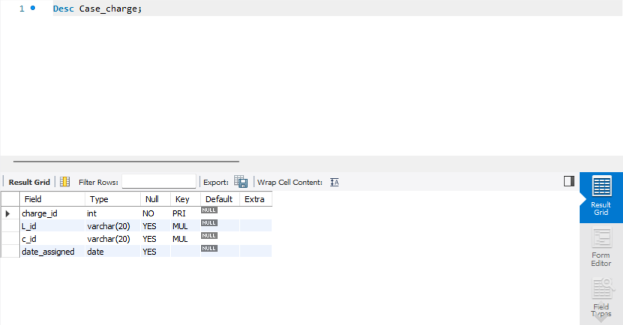
Case_charge Table
Query: Desc case_charge;

Slide 9

Billing Table
Query: Desc biiling;

Slide 10
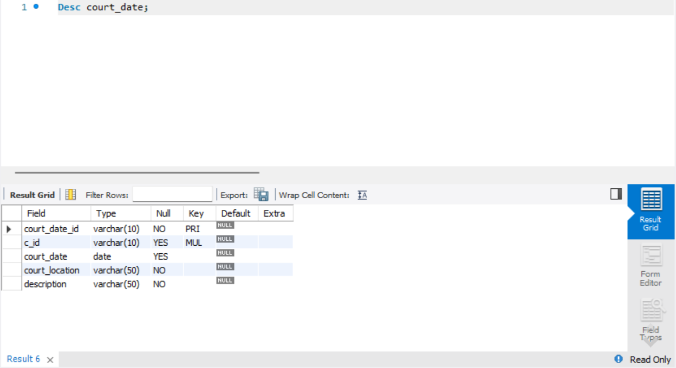
Court_date Table
Query: Desc court_date;

Slide 11
Data of Table

Slide 12
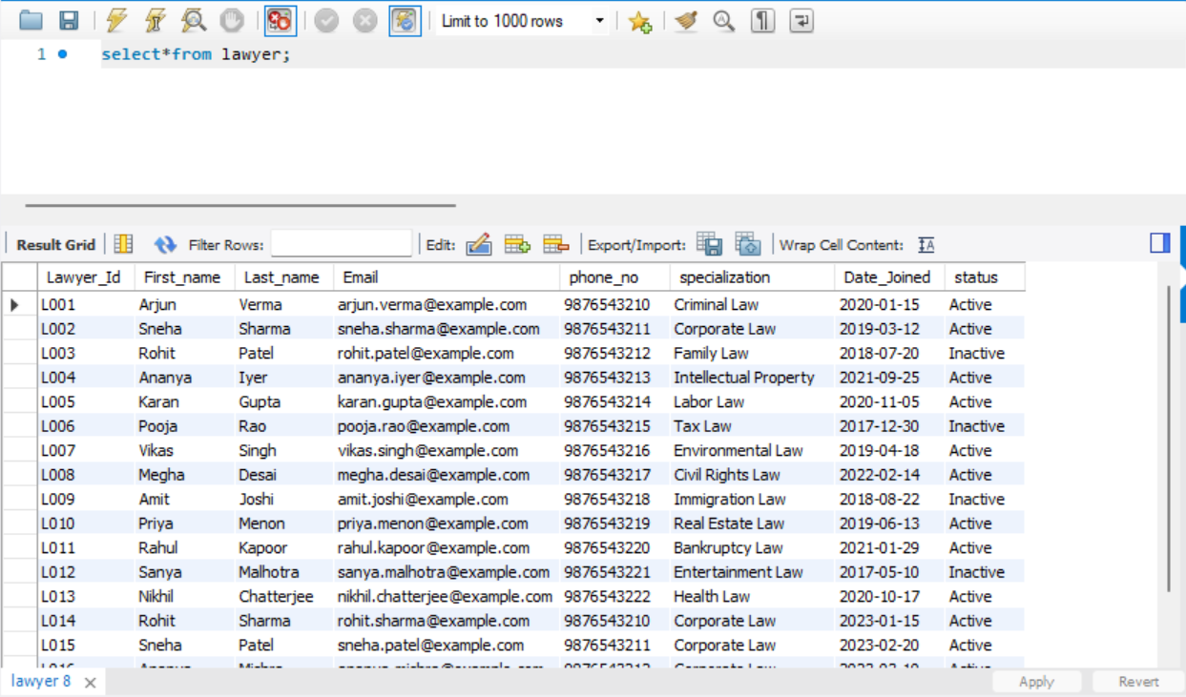
Lawyer Table
Query: select*from lawyer;

Slide 13
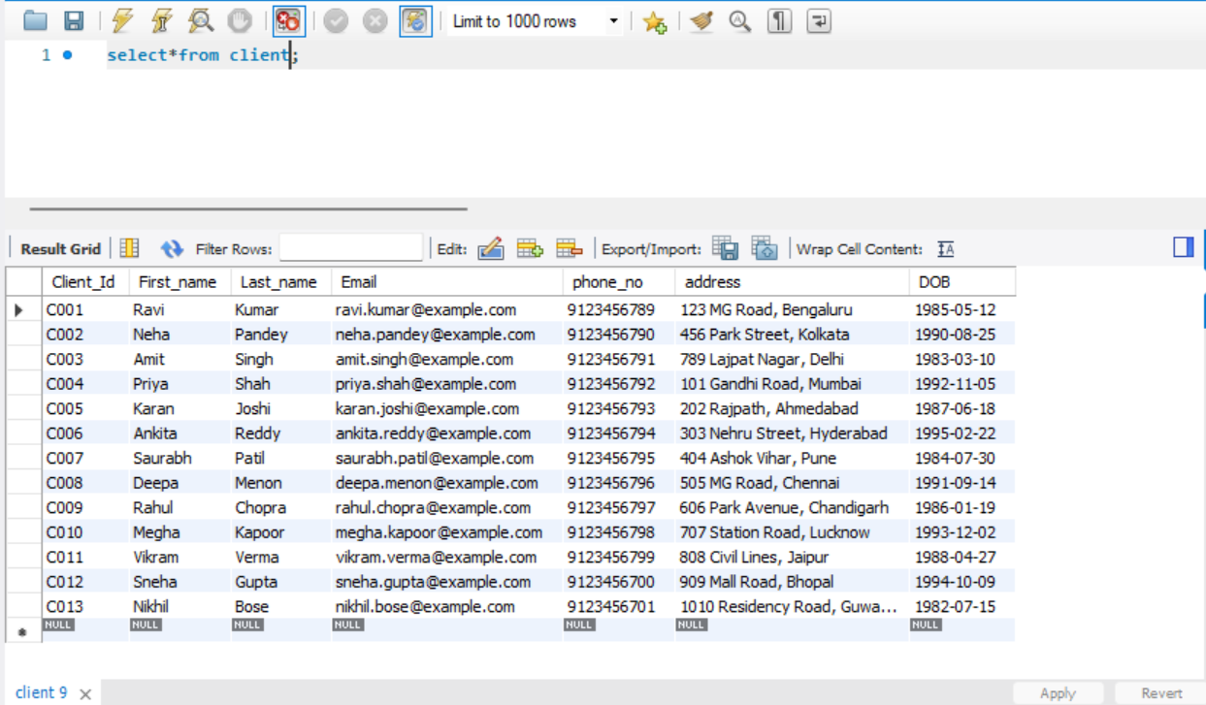
Client Table
Query: select*from client;

Slide 14
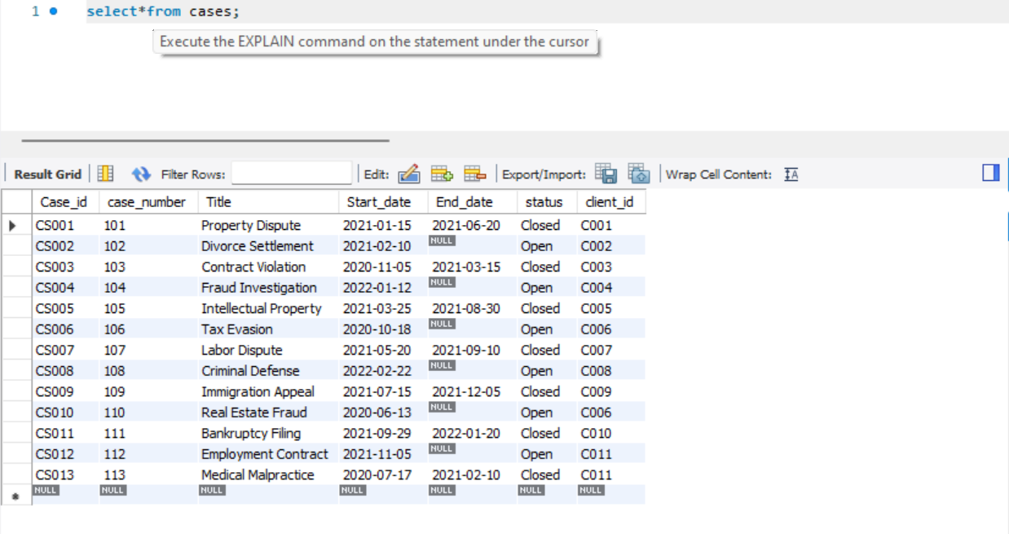
Cases Table
Query: select*from cases;

Slide 15
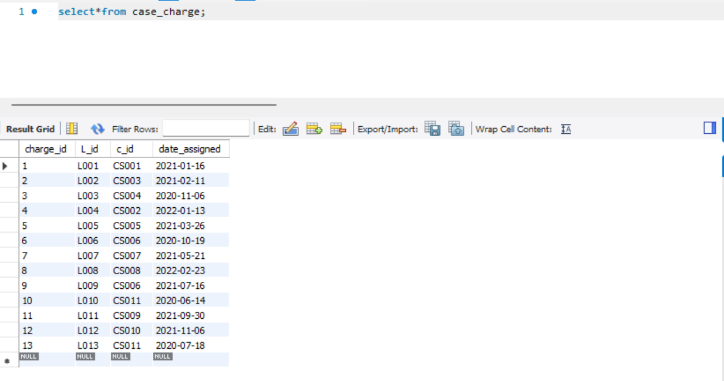
Case_charge Table
Query: select*from case_charge;

Slide 16
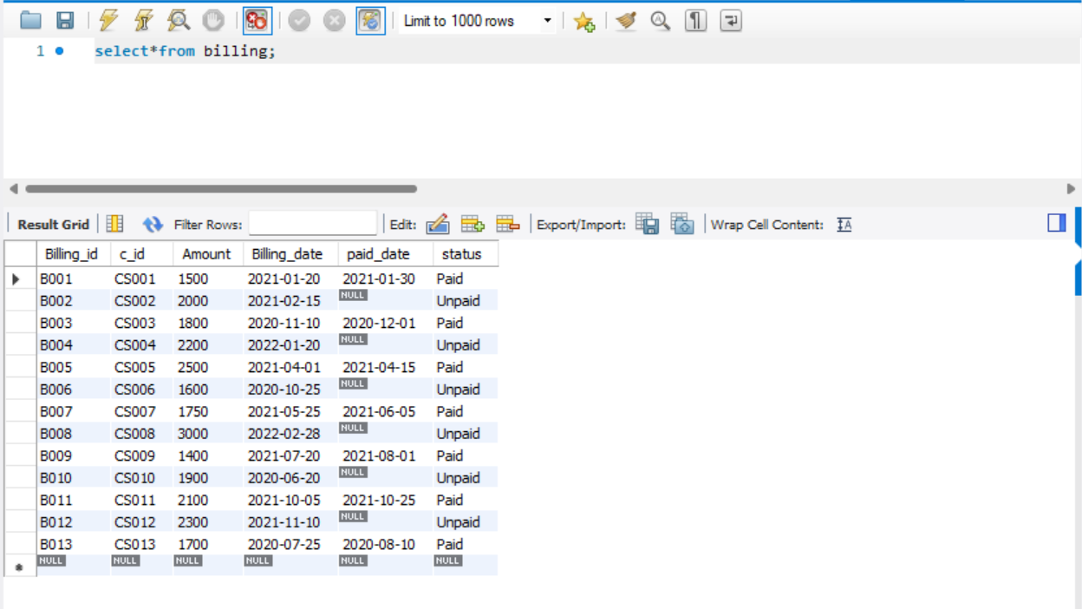
Billing Table
Query: select*from billing;

Slide 17
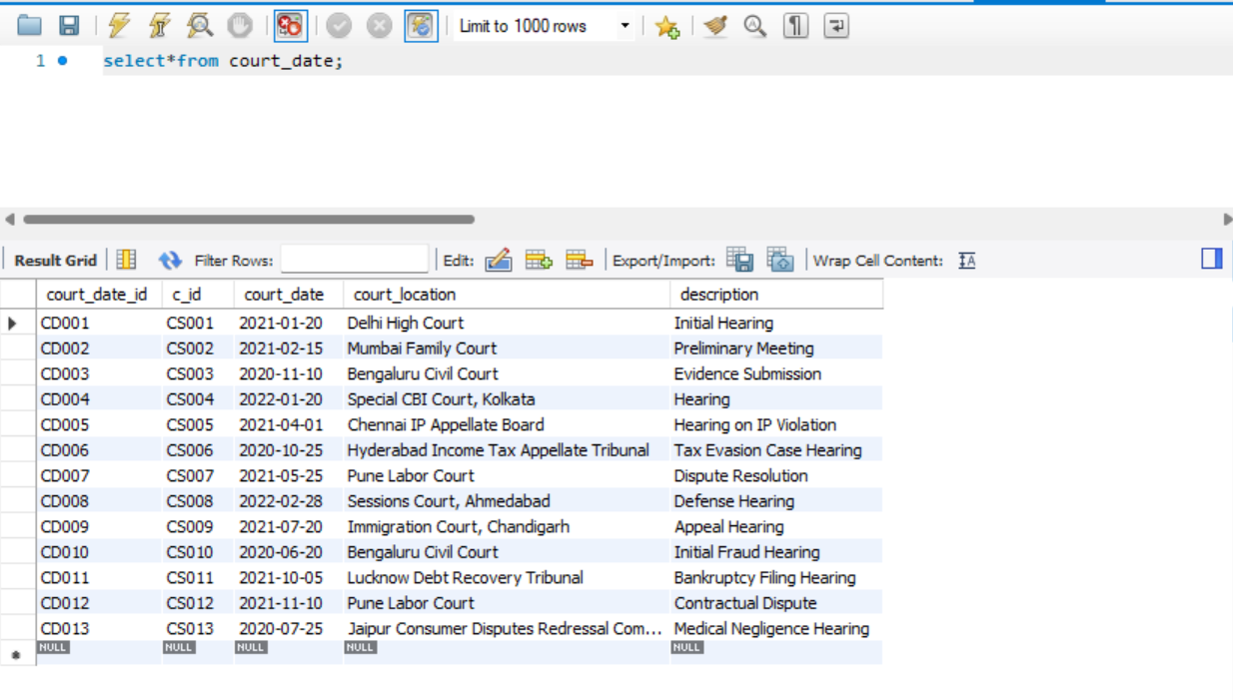
Court_date Table
Query: select*from court_date;

Slide 18
Sub Query

Slide 19
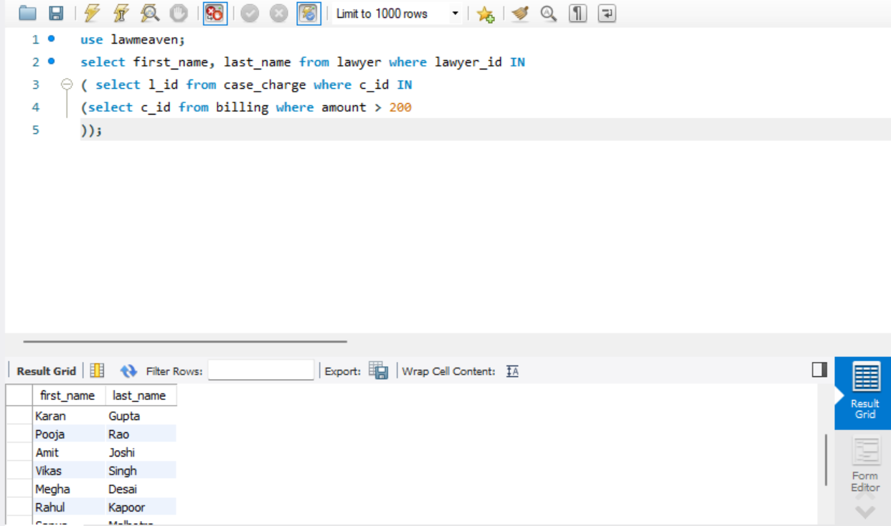
Find the names of lawyers who have handled cases that have billed amounts greater than 2000.
Query:
SELECT first_name, last_name
FROM lawyer
WHERE lawyer_id IN
(SELECT l_id from case_charge
WHERE c_id IN
(SELECT c_id from billing WHERE amount > 2000));

Slide 20
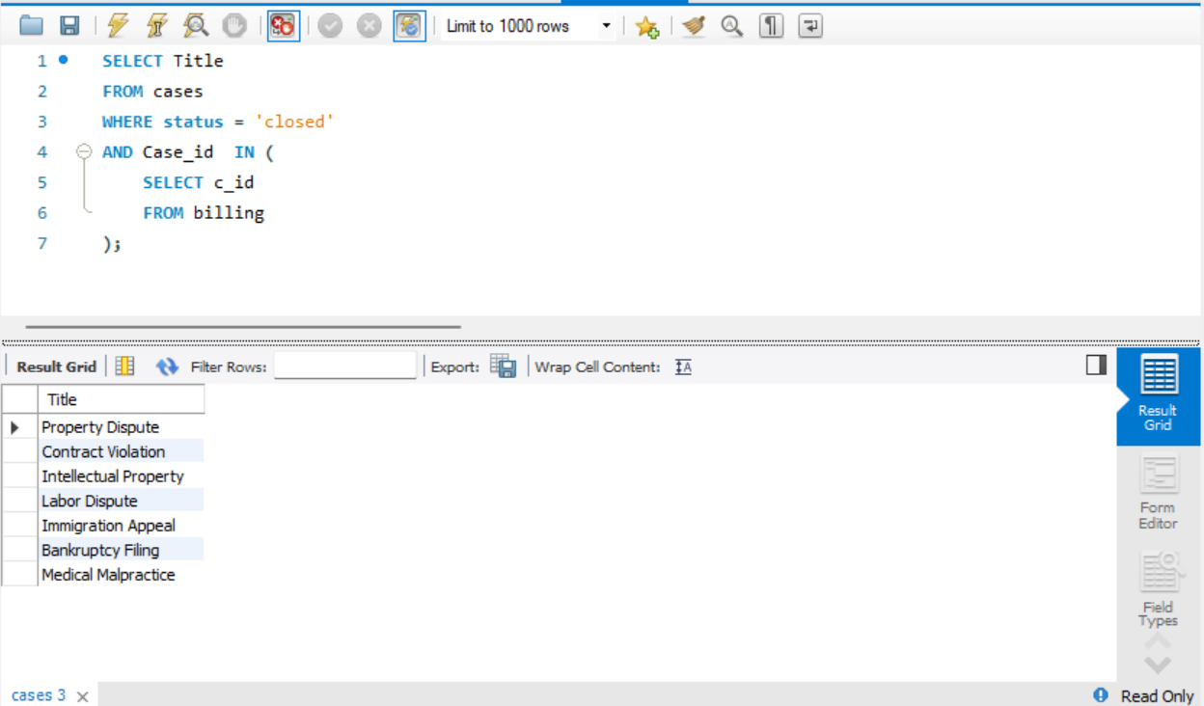
Find the titles of open cases that have billed .
Query:
SELECT title
From cases
WHERE status = 'Open’
AND Case_id
IN( SELECT c_id FROM billing );

Slide 21
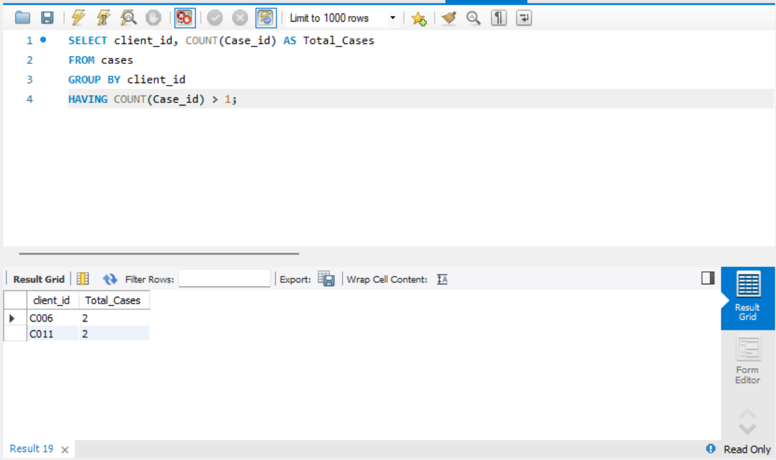
List the total number of cases each client has been involved in and display clients with more than 1 case.
Query:
SELECT client_id, COUNT(Case_id) AS Total_Cases
FROM cases
GROUP BY client_id
HAVING COUNT(Case_id) > 1;

Slide 22
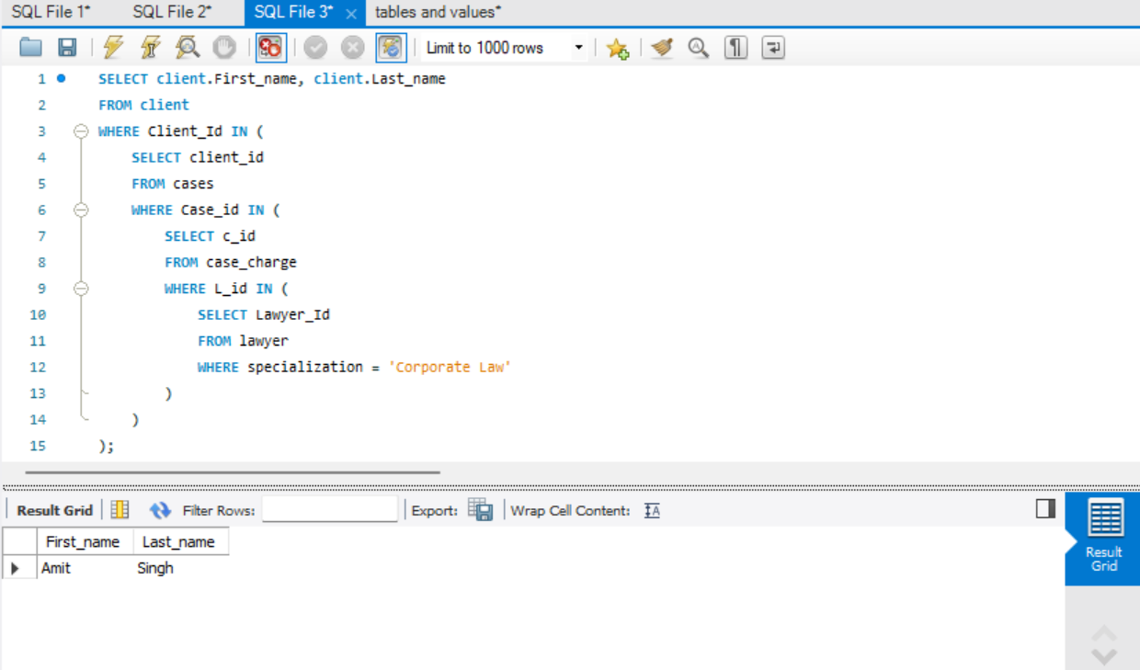
List all clients who have cases assigned to lawyers specializing in 'Corporate Law'
Query:
SELECT client.First_name, client.Last_name
FROM client
WHERE Client_Id IN (
SELECT client_id
FROM cases
WHERE Case_id IN (
SELECT c_id
FROM case_charge
WHERE L_id IN (
SELECT Lawyer_Id
FROM lawyer
WHERE specialization = 'Corporate Law’)));

Slide 23
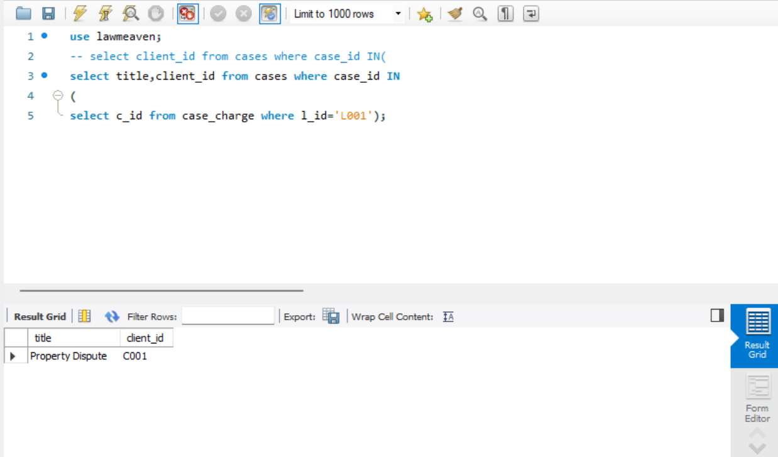
Retrieve the case titles and their respective client Id for all cases handled by lawyer 'L001'
Query:
SELECT title, client_id
FROM cases
WHERE case_Id IN (
SELECT c_id
FROM case_charge
WHERE l_id =‘L001’);

Slide 24
JOINS

Slide 25
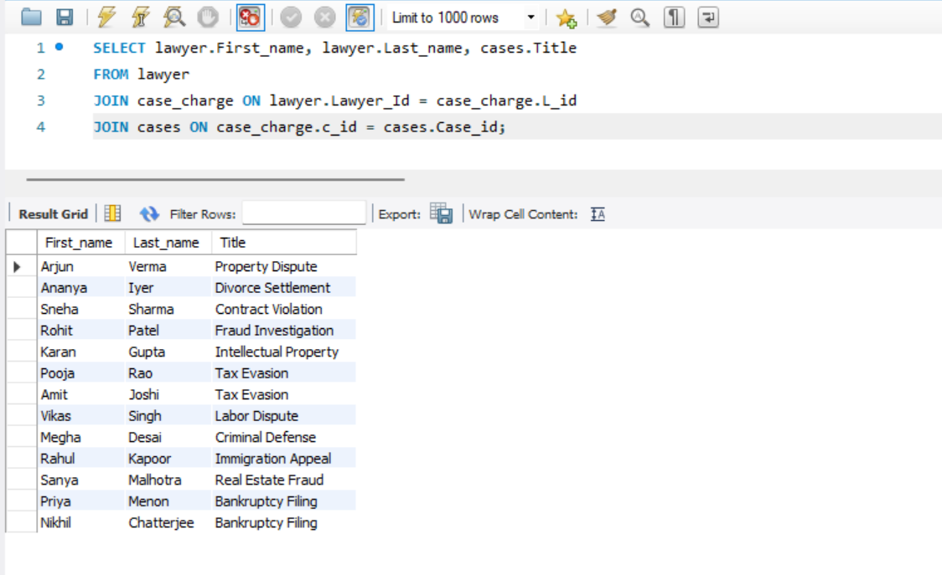
Find the names of lawyers and the titles of cases they are handling
Query:
SELECT lawyer.First_name, lawyer.Last_name, cases.Title
FROM
lawyer JOIN case_charge
ON
lawyer.Lawyer_Id = case_charge.L_id JOIN cases ON case_charge.c_id = cases.Case_id;

Slide 26
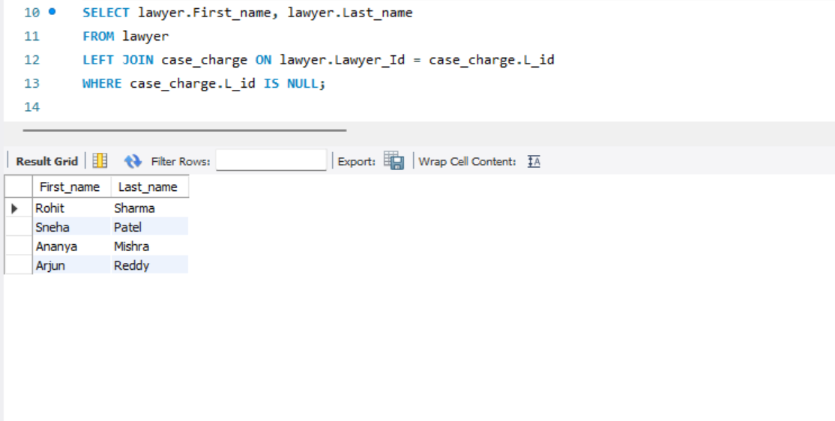
Find all lawyers who have not been assigned any cases.
Query:
SELECT lawyer.First_name, lawyer.Last_name
FROM lawyer
LEFT JOIN
case_charge
ON lawyer.Lawyer_Id =case_charge.L_id
WHERE case_charge.L_id IS NULL;

Slide 27
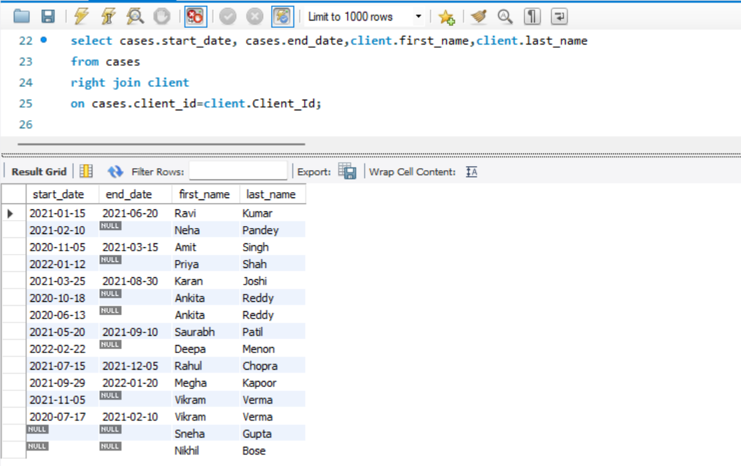
Find all start and end dates of lawyer and names of clients.
Query:
SELECT cases.start_date, cases.end_date,client.first_name,client.last_name
FROM cases
RIGHT JOIN client
ON cases.client_id=client.Client_Id;

Slide 28
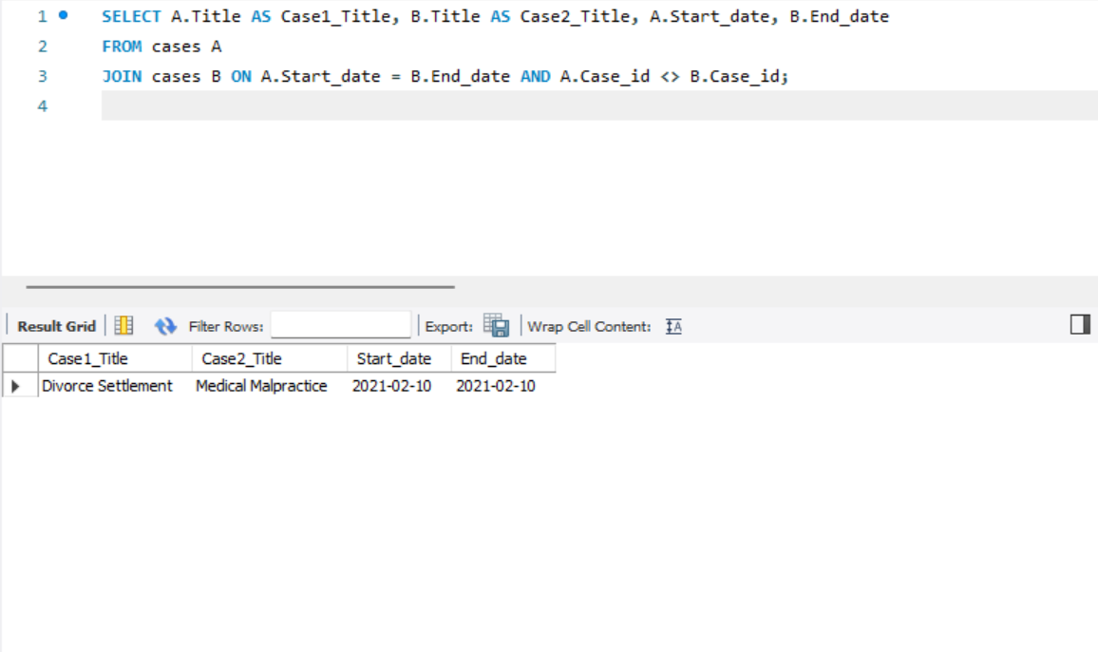
Find pairs of cases where the start date of one case is the same as the end date of another case.
Query:
SELECT A.Title AS Case1_Title, B.Title AS Case2_Title, A.Start_date, B.End_date
FROM cases A
JOIN cases B
ON A.Start_date = B.End_date
AND A.Case_id <> B.Case_id;

Slide 29
Any Questions?

Slide 30
Thank You!

