Slide 1
ANALYSIS FOR chip sales
Data ANALYSIS
DATA
Category review: Chips

Slide 2
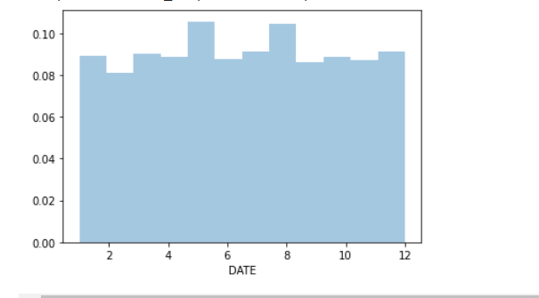
Insights from TASK 1
MENU
ANALYSIS
CONTACT
Data ANALYSIS
Product number 28 has most transaction with 2 grade quality goods.
Most of the sales occur in month of MAY and AUGUST.

Slide 3
Almost 1653 young singles and couples are purchasing huge goods with mainstream.
Young Singles/Couples (Mainstream) has the highest population, followed by OLDER FAMILIES (Mainstream). Which explains their high total sales.
Around 9592 retirees are using mainstream.
Customers with mainstream are buying chips in large scale.
Most of the young singles and couples having mainstream.
Around 9592 retirees are using mainstream

Slide 4
Sales mainly came from Budget - older families, Mainstream - young singles/couples, and Mainstream - retirees. In total contributing 25% of sales revenue.
Older and Young Family segment have the highest average purchase units per unique customer.

Slide 5
Insights from TASK 2
Total sales revenue - 1933114.9999999998
Total number of customers- 264834
Average number of transactions per customer - 1.0
Kettle brand has maximum transaction and huge total sales
Smiths brand has around 1000 transaction by retirees customer having mainstream with maximum sale.
Burger rings is on high demand.

Slide 6
Suggestions
As most of the sales occur in month of MAY (Summer vaccaTrtions) and AUGUST , try to give some discount on products to increase sales.
Provide various flavor of chips during MAY and AUGUST months .
Young singles and couples and retired peoples are most seen as a customer. They may buying chips to their childs or for grandchildren . along with chips, try to offer elder-friendly products.
Customers are mainly prefer mainstream over premiurship.
Burger rings , Woolworths Mild are most demanded products.

