Slide 1
Machine Learning SCM-Car sales Prediction
Submitted by: Shreyank Purohit
LinkedIn Id : shreyankpurohit13
Github Id : Shreyank1397

Slide 2
Information About Dataset
There are 1000 rows and 33 columns in dataset.
No null values in any column.
Data type of columns is int64 (5 columns), float64 (4 columns) and object (24 columns).
We will be building regression models for this dataset.

Slide 3
OBJECTIVES
Perform basic EDA
Data Cleaning
Z-score test for treating outliers
Clean the data with formatting issues if any. (converting data types, replacing dollars, etc.)
Build a classification model first and calculate Confusion Matrix, AUC, F1 Score, Precision, Recall and Accuracy.
Build at least a minimum of 4 different models. All the models should use K-Fold cross Validation to train the model with at least 5-fold cross validation.
Run hyperparameter tuning on all the models and pick the best parameters (A minimum of 2 Parameters should be tuned) and picked.
Now, compare the models and pick the ideal one.

Slide 4
Exploratory Data Analysis
Note : Our AIM is to examine that what are the independent features on which the sales(Target) of Car depends and hence drop all the non essential columns.

Slide 5
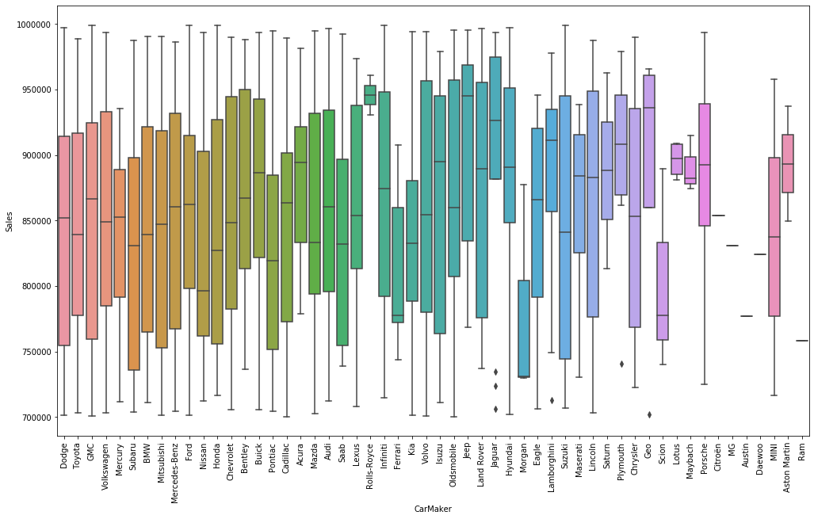
Box Plot between car sales and Car Make
Note : Car Sales depends on Car Make

Slide 6
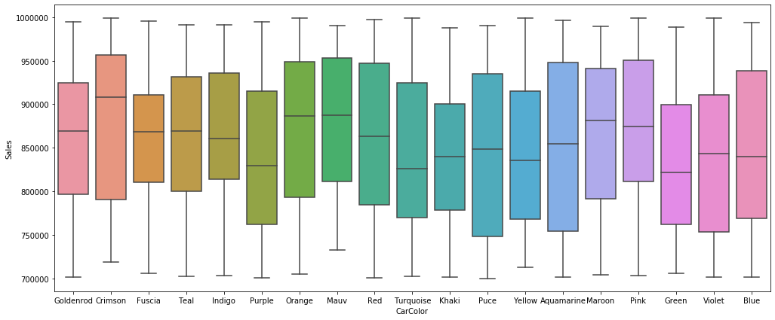
Box Plot Between Color of Car and Sales
Note : Car Sales depends on Color of Car

Slide 7
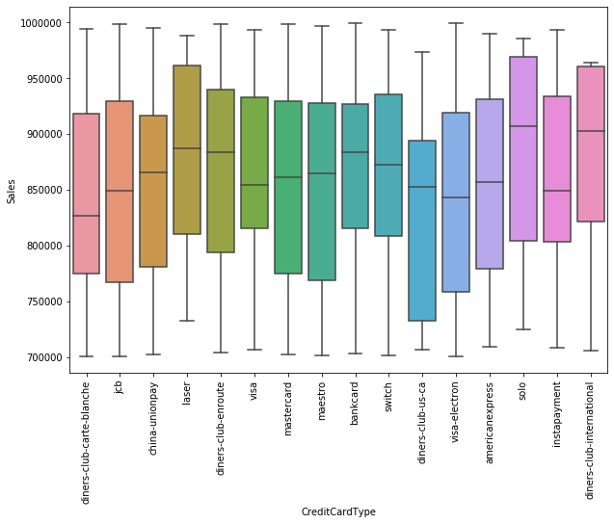
Box Plot between Credit card type and Sales
Note : Car Sales also depends on Credit card type

Slide 8
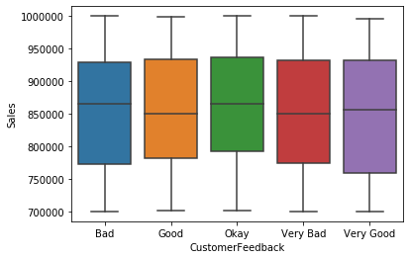
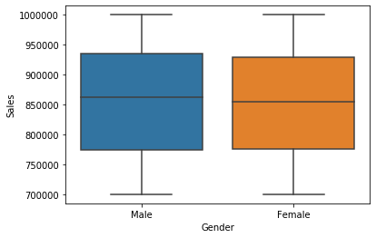
Box Plot of Gender and Customer Feedback with Sales
Note : Car Sales depends on Customer feedback

Slide 9
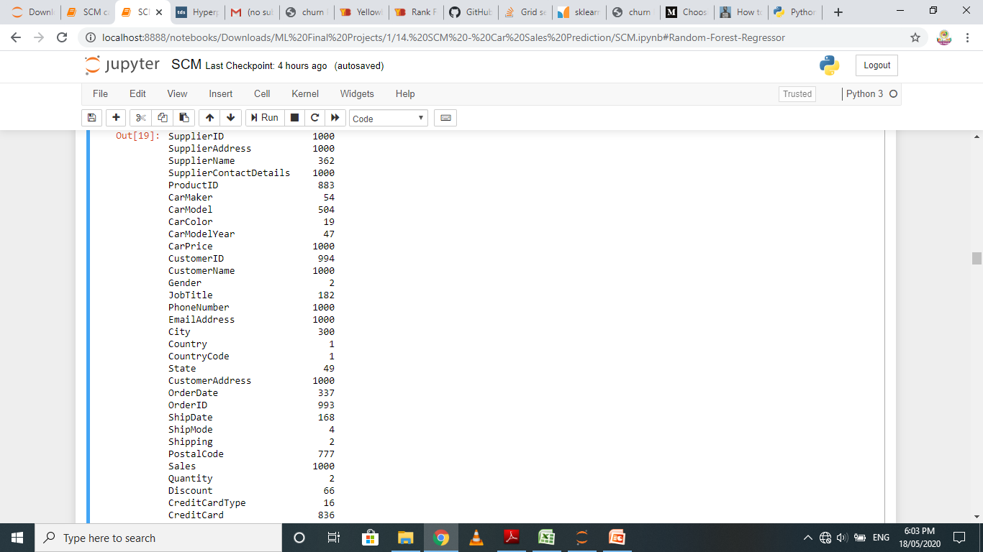
Checking unique values for each column
Note : Customer feedback have 5 unique values

Slide 10
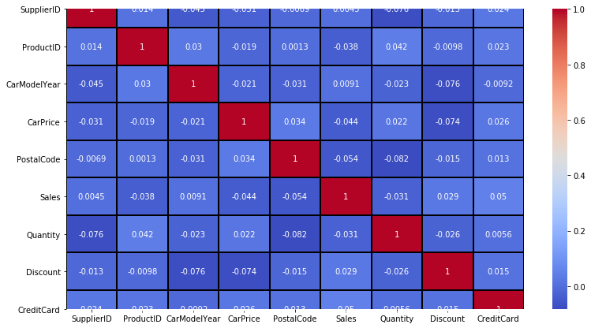
Correlation Matrix for numerical columns
Note : We will convert other categorical data to numerical

Slide 11
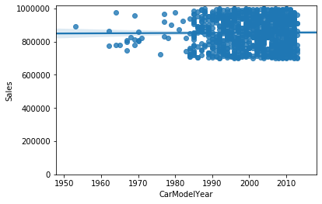
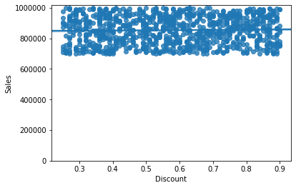
Regression Plots with Target
Note : Data is continuous

Slide 12
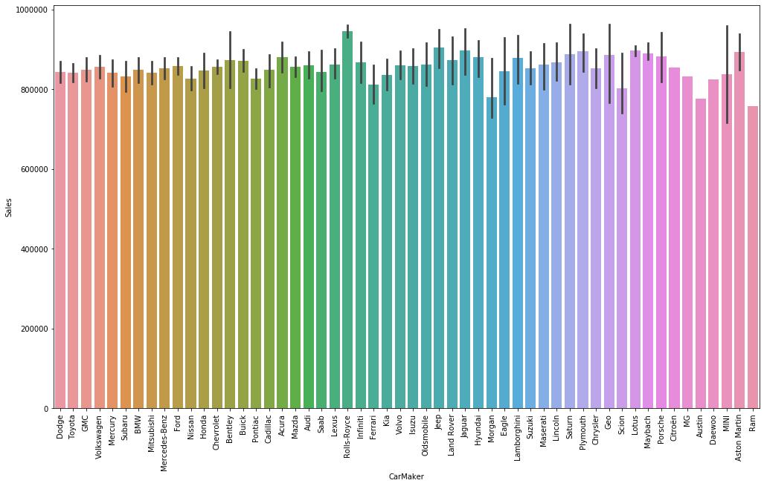
Bar Graph between Car Maker and Sales
Note : Sales for Rolls Royce is maximum

Slide 13
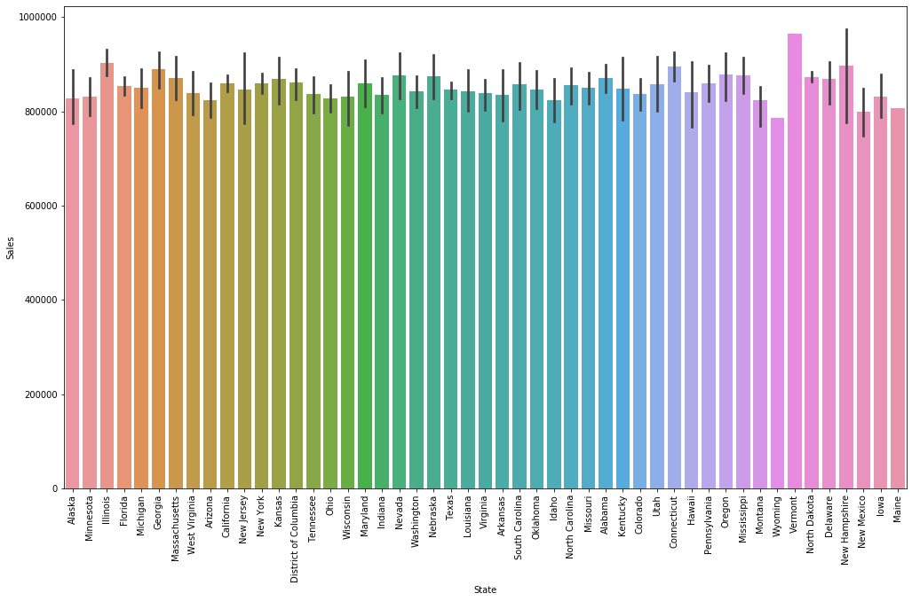
Bar Graph between State and Sales
Note : Rest other categorical columns have less impact on sales

Slide 14
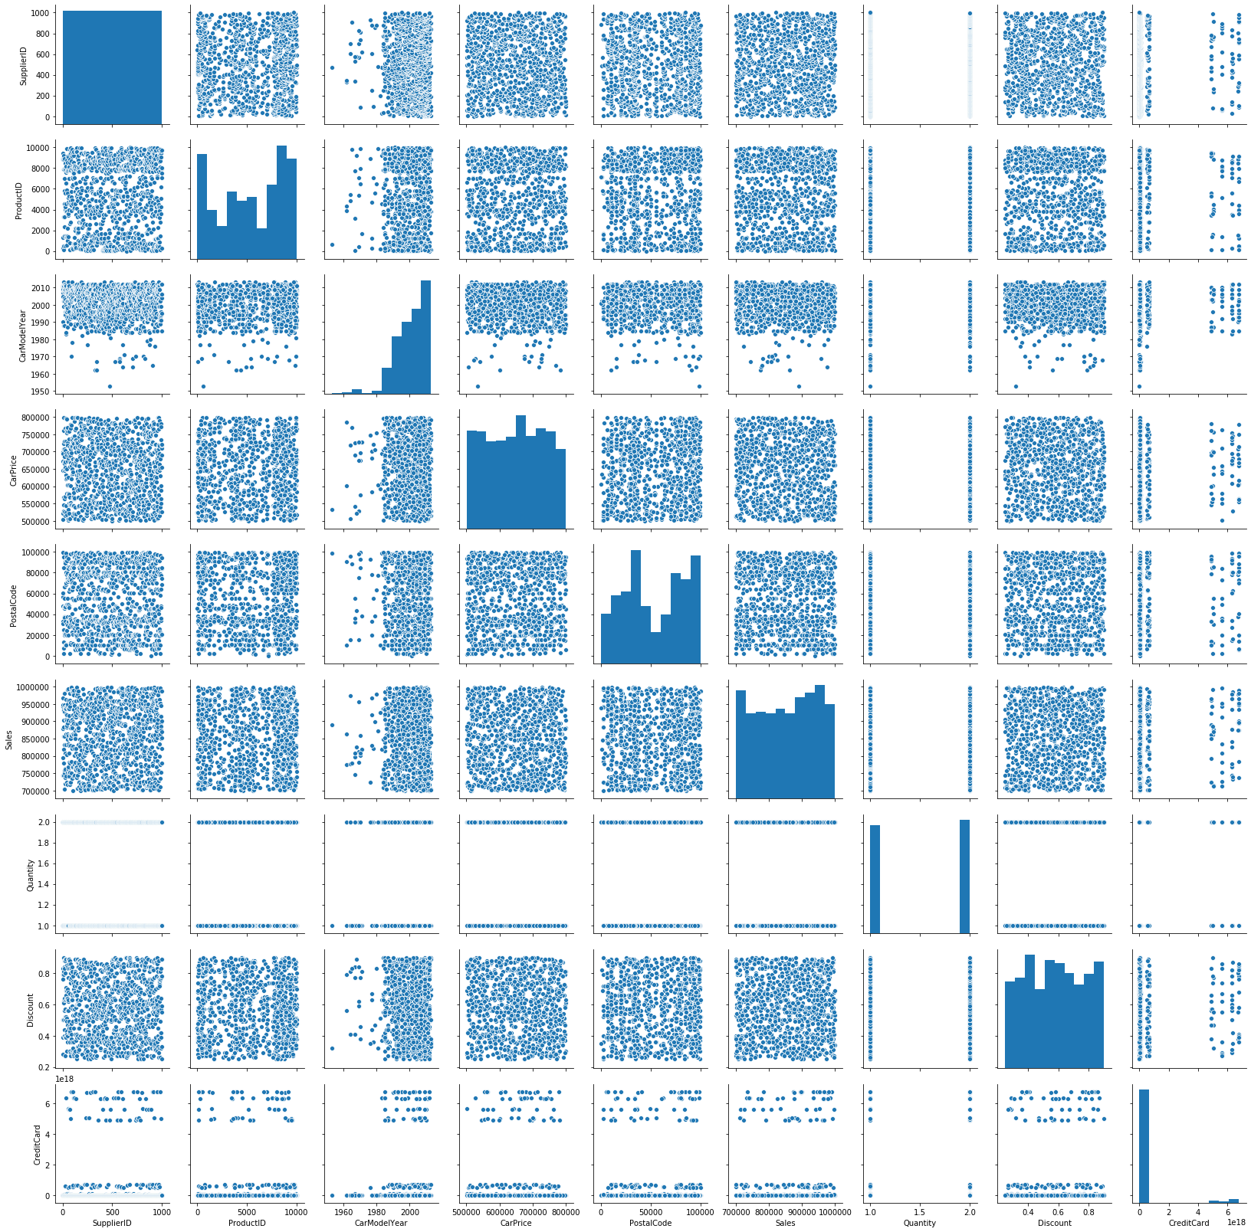
Pair Plot

Slide 15
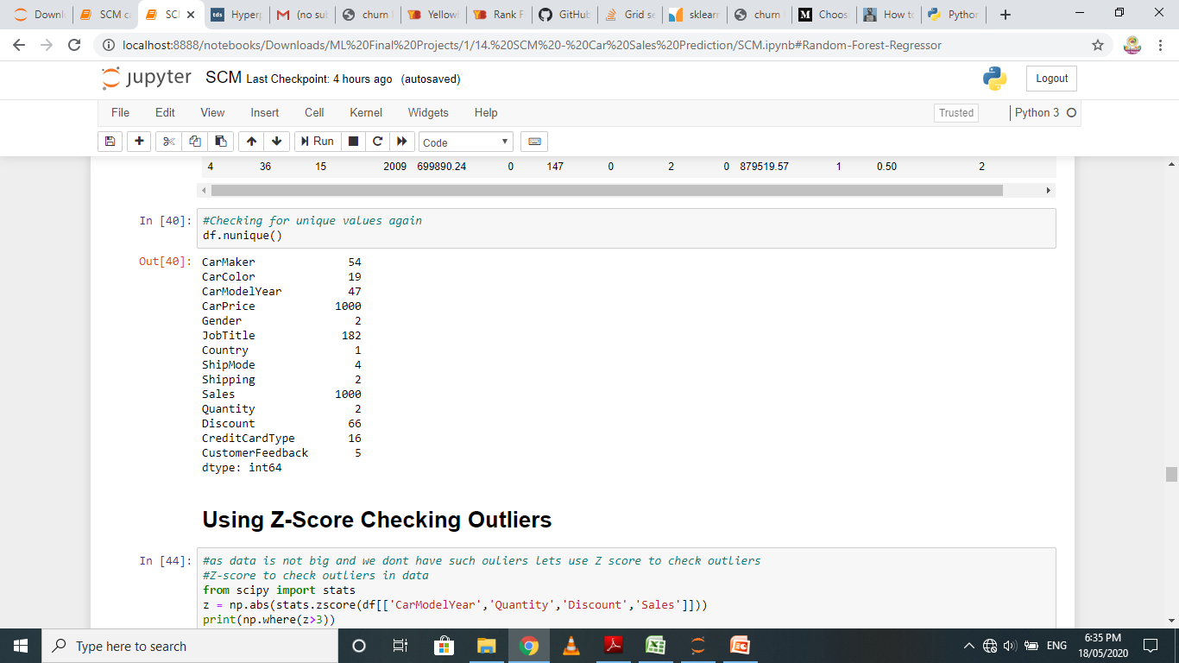
Cleaning the data
This image shows the list of remaining columns after dropping all the non essential columns from the data.

Slide 16
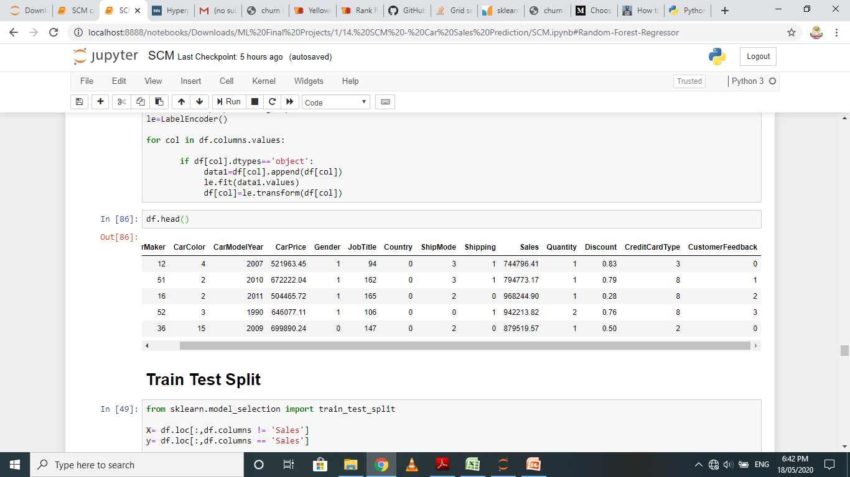
Look of dataset after Encoding
Converted all the categorical columns to numeric values using label encoder

Slide 17
Model Building and checking Score and Accuracy
Note: Only Random forest regressor model is supportive in this data, the other models failed to perform.

Slide 18
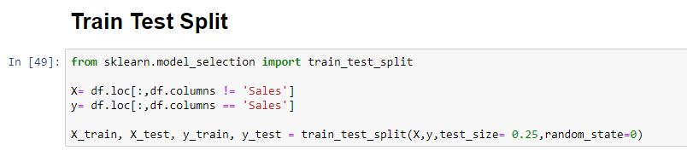
Performing Train Test Split
Note : Took test size as 0.25, it is default value

Slide 19
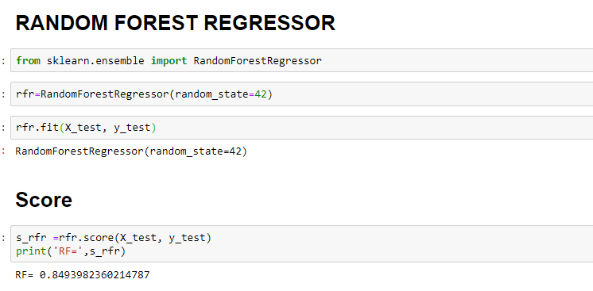
Building Random Forest Regressor Model
Note : Score for this model is 84.93%.

Slide 20
Hyper Parameter Tuning
Using 5 fold Cross validation

Slide 21
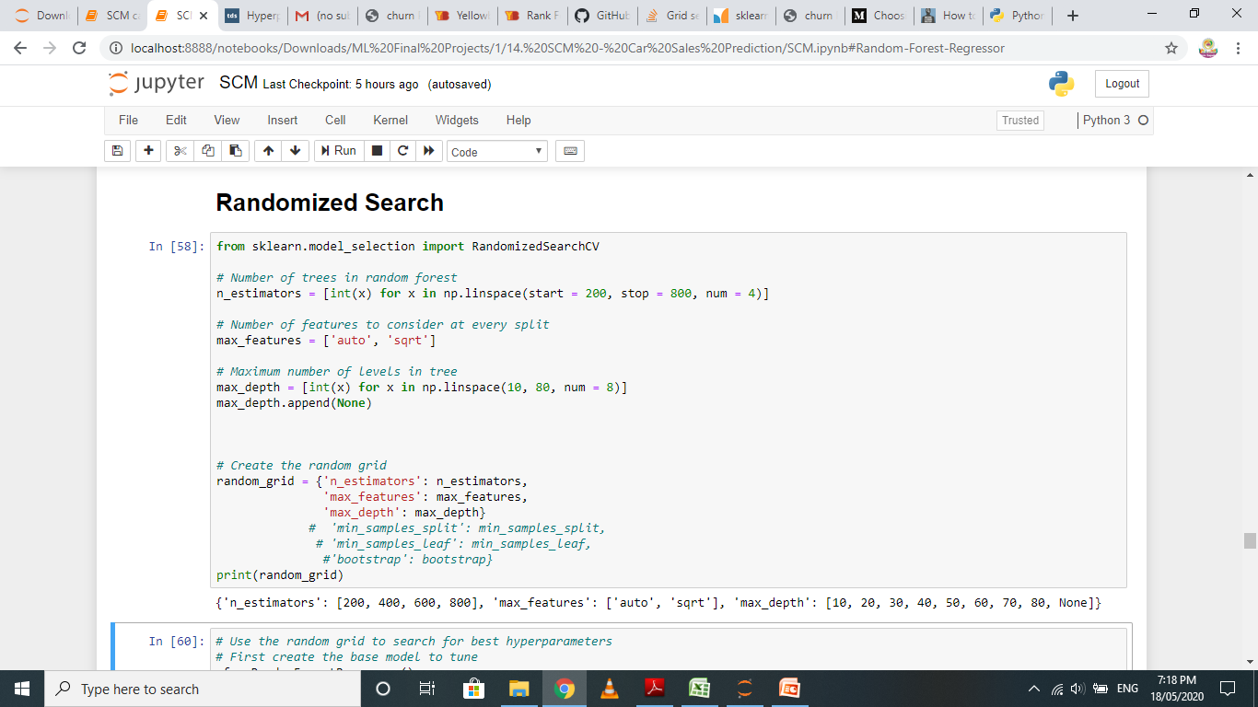
Randomized Search
Note : Taking 3 parameters for random search.

Slide 22
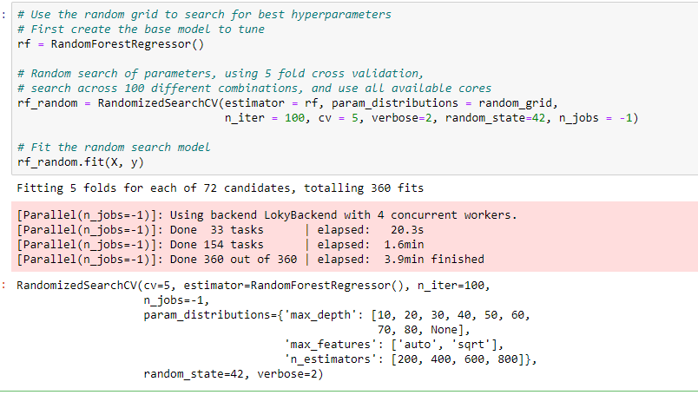
Fitting data in Randomized Search

Slide 23
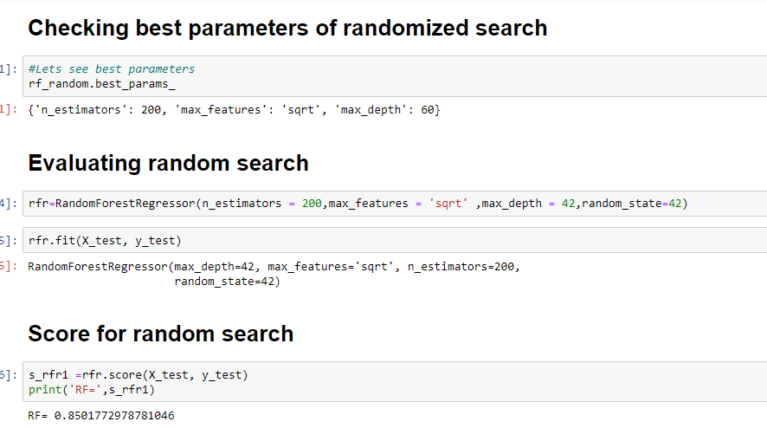
Randomized search best parameters & score
Note : This accuracy is found best after running code several times.

Slide 24
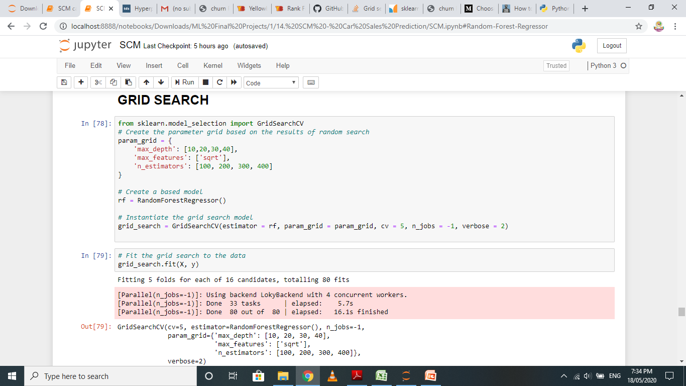
Performing Grid Search
Note : Parameters are selected based on random search result.

Slide 25

Grid Search Parameters and Score
Note : The accuracy score for Grid search increased by 0.04%.

Slide 26
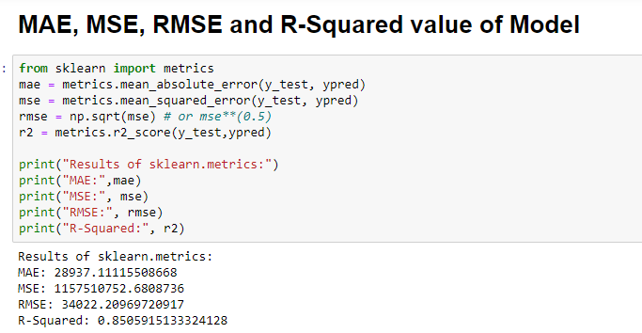
Final Report of Final Model
The Final model is built based on the parameters given by grid search and the accuracy of that model is best amongst all.
Note : The best accuracy of model found is 85.05%.

Slide 27
CONCLUSION
We observed that SVM, Linear Regression and Decision Tree Model failed to perform for this dataset.
Hence, Random Forest Regressor Model is the best suitable model for this dataset with accuracy score of 85.05%.

Slide 28


