Slide 1
Groundwater Scheme Analysis
An Overview of the 6th Minor Irrigation Census-shallow tube well Andharapradesh Dataset

Slide 2
Dataset Overview
- Total Entries: 198,162
- Total Columns: 61
- Covers groundwater schemes across multiple states
- Includes financial, operational, and utilization details

Slide 3
Key Data Fields
- Location: State, District, Block, Village
- Scheme Details: Type, Ownership, Costs, Subsidies
- Operational Metrics: Depth, Horsepower, Pumping Days
- Financial Data: Construction and Machinery Costs
- Utilization Status: Functionality and Underutilization Reasons

Slide 4
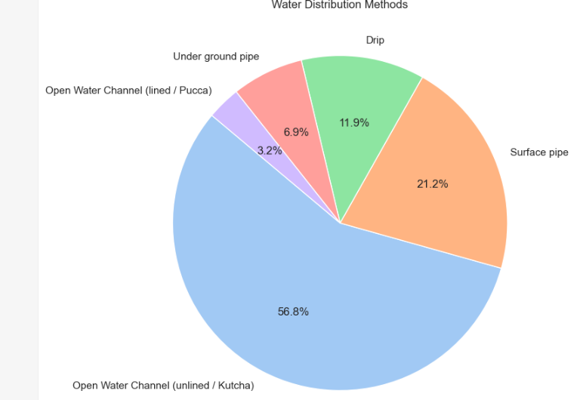
Water Distribution Method

