Slide 1
Name : Omkar Sawant Branch : Comps Division : B Roll No. : 1911118

Slide 2
A Comprehensive Database for Benchmarking Imaging Systems By: Karen Panetta, Qianwen Wan , Sos Agaian , Srijith Rajeev , Shreyas Kamath, Rahul Rajendran, Shishir Paramathma Rao, Aleksandra Kaszowska , Arash Samani and Xin Yuan

Slide 3
Introduction
1

Slide 4
Algorithms performing autonomous facial recognition have many profound implications in the fields of:
Homeland Security
Human Trafficking
Law Enforcement
Biometric Identification
Multimedia

Slide 5
Difficulties faced:
In spite of these profound implications, the field continues facing difficulties with heterogeneous face recognition (HFR) algorithms: matching face images across different image types, such as thermal, near-infrared (NIR), 2D, 3D, and other modalities.
Often times, the motivation behind HFR is there is only one modality of face images can be acquired as probe images . For instance, face sketches of a criminal are sometimes the only evidence in law enforcement applications.

Slide 6
Heterogeneous face recognition in real-life scenarios: images captured through different sources:
(a) (b) (c) (d) (e)
(a) social media
(b) driver’s licenses, passports, and other identification documents
(c) night-vision surveillance cameras
(d) Thermal cameras
(e) 3D cameras

Slide 7
Solution:
Accurate cross-modality face matching is necessary due to the increasing variety of imaging sensors in different real-life scenarios, such as depth, optical, capacitive, and thermal: for example, night vision cameras can provide more information in low/no light military applications.
Such cross-modality matching algorithms need to be extensively tested and validated in order to ensure their robustness in recognizing faces across images from advanced sensors and traditional surveillance cameras.
Therefore, it is crucial to provide researchers with the ground truth images to benchmark their recognition algorithms and aid in the development of potential solutions to the existing HFR challenges.

Slide 8
Key Concepts covered in this paper:
An up-to-date review of existing facial recognition algorithms and systems.
Information on the Tufts Face Database, a comprehensive face database, which contains face images captured in multiple modalities.

Slide 9
Related Work
2
This section outlines different types of recognition systems
currently in use, their existing challenges and forthcoming
advances

Slide 10
Different Types of Face Recognition Systems:
Conventional visible face recognition system.
Sketch-to-face recognition
Thermal face recognition
Heterogonous face recognition (HFR)

Slide 11
Conventional visible face recognition system:
Conventional visible face recognition systems have been used in abroad range of real-life applications in fields such as law enforcement, homeland security, biometric identification, cognitive psychology, and entertainment . Generally, an automatic real-time facial recognition system comprises of two steps face detection and face recognition.
Existing Challenges: The existing challenges for an automated facial recognition system include: uncontrolled conditions caused by low-quality surveillance cameras or sensors, unpredictable environments, difficulty in detecting faces in video content, emulating the effects of aging, low tolerance to the variation in facial expressions, illumination changes ,and the difference in body positions

Slide 12
Sketch-to-face recognition:
It is a commonly used method to assist police to identify persons of interest, such as suspects or missing persons, especially when there is limited access to other evidence. Usually there are two types of sketches: hand-drawing sketches and computerized sketches, both based on an eyewitness’ testimony.
Existing Challenges: The existing challenges of a sketch-to-face recognition system include: significant differences in shape and textures across modalities, and limited amount of testing and training data. Methods such as component-based MLBP, holistic SIFT feature descriptors, and Log-Gabor filtering were utilized and tested to perform promising computerized sketch-to-face recognition. Moreover, intra-modality and inter-modality algorithms for face-sketch recognition can be fused together to yield better performance.

Slide 13
Thermal face recognition:
It is widely used in biomedical applications. This type of image contains reliable and distinguishable physiological biometric features . The amount of radiation emitted by an object increases with temperature; therefore, thermography depicts variations in temperature. When viewed through a thermal imaging camera, warm objects stand out well against cooler backgrounds; humans become easily visible against the environment, regardless of environmental illumination.
Existing Challenges: However, thermal imaging technology has several drawbacks in the context of autonomous facial recognition system. The infrared face images displays the body heat pattern, which can be easily affected by ambient temperature, air flow conditions, exercise, illness, and drugs. Also, thermal face images provide less facial features when compared to visible face images.

Slide 14
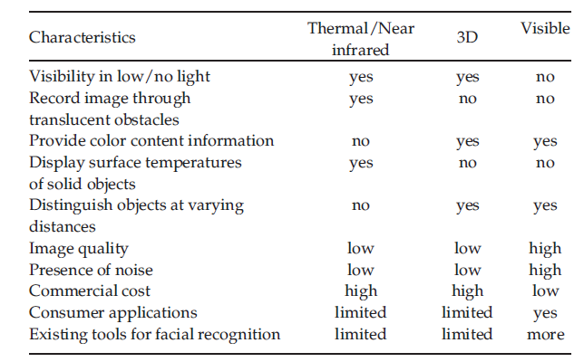
Advantages and Limitations of Popular Imaging Sensors:

Slide 15
Heterogonous face recognition:
HFR matches face images across different image types. As diverse imaging sensors are widely used in practical applications, heterogonous face recognition is now attracting growing attentions in both research and industry community. For instance, face recognition using thermal camera, near infrared camera and 3D depth camera emerged in literature as new modalities addressing issues of complicated light conditions, biometric identification, and military applications .
Existing Challenges: Research continues facing difficulties that arise from the modality gaps between heterogeneous face images. Conventional approaches can be categorized as synthesis based methods , common space projection based methods and feature descriptor based methods.

Slide 16
THE TUFTS FACE DATABASE

Slide 17
Tufts Face Databases:
Tufts Database includes a set of pictures with occlusions (such as glasses) and exaggerated facial expressions to allow for robust validation of existing algorithms and would serve as a testbed for development of approaches allowing to minimize the impact of abovementioned noise on recognition accuracy.
It contains a large-scale thermal facial database, with pose variance and facial expression, which provides a benchmark for thermal face recognition research.

Slide 18
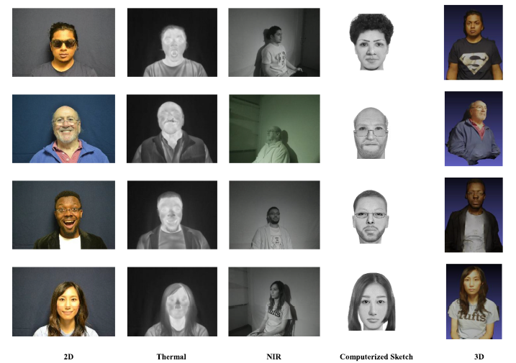
Example images selected from the Tufts face database

Slide 19
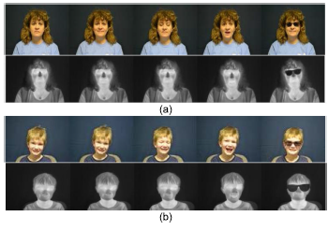
(a) and (b) are two sets of frontal images of an individual with the different constraints for both visible and thermal. The images in the first row of each set illustrate visual images of a participant with various facial expressions; and the images in the second row of each set provide corresponding expressions in thermal imaging.

Slide 20
Existing Databases Summary and Comparison
An institution research board (IRB) protocol was developed in order to collect and publish the Tufts Face Database.
The IRB protocol discussed the purpose and procedure of the study, the confidentiality and public access of the database, as well as the protection of participants’ identity.
Each photographic session took approximately 15 minutes.
The raw image data was collected from 113 volunteers; 100 participant’s images were selected and assessed for good image quality.

Slide 21
Conclusion

Slide 22
Studied our newly developed Tufts Face Database, which we believe will be a valuable resource to facilitate 2D, 3D, thermal, near-infrared, computerized sketch, and heterogeneous facial recognition research for multimedia, forensic, security, biometric, and entertainment applications.
The database content and acquisition process are introduced; and the method to obtain the dataset is carefully described.
In addition, a comprehensive review on face recognition systems and face datasets are presented.
To date, the Tufts Face Database is the most comprehensive large-scale face dataset

Slide 23
Bibliography:
https://tischlibrary.tufts.edu/find/databases/all

