Slide 1
Optical Character Recognition Based Intelligent Database Management System for Examination Process Control
Mehdi Rizvi, Hasnain Raza, and Shahab Tahzeeb
Presentation by Shreyans Mehta
1911124

Slide 2
Aim.
To reduce the workload of entering marks manually into system’s database and generating results afterwards by extraction of enrolment number of students for their identification, marks of students for their result generation and signature recognition of invigilator and checker by object detection technique to automate the post examination work.

Slide 3
Introduction.
Artificial intelligence and machine learning techniques have gained much prominence by minimizing external input and optimizing processing in many labor intensive tasks, both mechanically and computationally.
Out of several important applications of machine learning, image recognitions and pattern recognitions enable identification of images or patterns for different use cases, respectively.
Optical character recognition (OCR) has gained much importance as it is able to recognize texts from any given image. The OCR technique can even identify characters from handwritten scripts.

Slide 4
Introduction..
Recently, researchers have emphasized on image preprocessing methodologies for optical character recognition and object recognition using dedicated libraries.
In this project, we use OpenCV library to accomplish preprocessing tasks. These tasks include image alignment, extraction of region of interests, noise reduction, threshold management and segmentation.
This research has made contribution in the domain of academics by combining image processing with OCR for post examination process control.

Slide 5
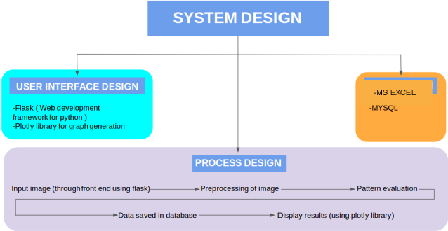
System Design.
The main components for the system design are UI design, data design, and process design.
UI design - Flask
Graph Representation - Plotly Python Library
Data Management - MS Excel
Data Processing

Slide 6
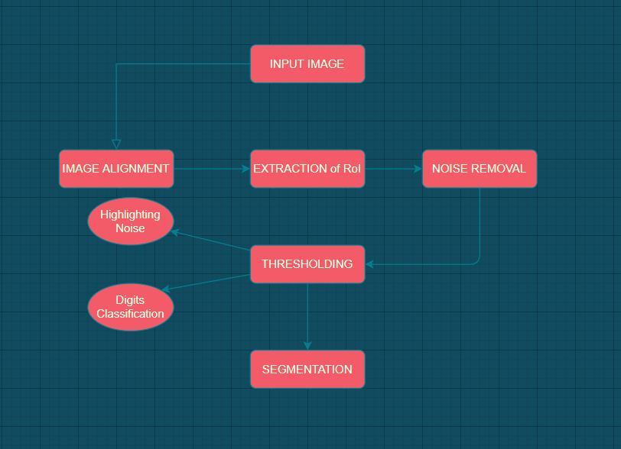
Pre-Processing Design.

Slide 7
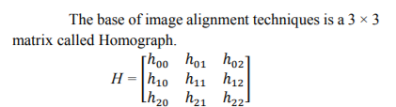
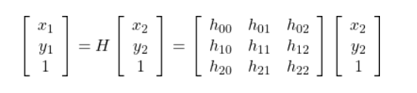
Image Alignment.
Image alignment is a technique of warping one image so that the relevant features align perfectly.
In order to extract features like roll number, marks and signatures perfectly, an input image must be aligned with respect to the reference image so that coordinates of interest do not change.
Notes:
Scenario where same pic taken differently, w.r.t coordinates.

Slide 8
Region of Interest.
RoI can be extracted using two methods - by layout analysis algorithms if we have variable layout inputs or by specifying the coordinates of RoI if we have static layout input.
As we are taking an image as input, we have a static layout and hence specifying the coordinates of RoI is the preferred approach.
Due to this, any random image must first be aligned with respect to the reference image.

Slide 9
Noise Removal.
Noise is an unwanted variation of pixels in an image that reduces the efficiency of image processing mechanism.
Gaussian Blurring is a smoothing technique used to remove minor quantities of noise.
A small area around a pixel is designated and is known as a kernel and does operations like Gaussian Weighted Average, to replace the central element.
Gaussian blurring is most effective in eliminating Gaussian noise from the picture.

Slide 10
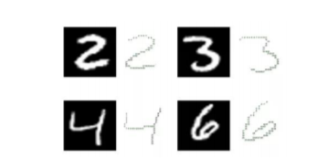
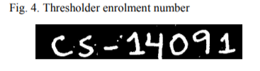
Thresholding.
In thresholding, if pixel value is not lesser than a threshold value, it is allocated white value, otherwise it is allocated black value in our scenario. Its vice versa is also possible. We have used thresholding for two purposes,
Highlighting Noise
Digits Classification.

Slide 11
Segmentation.
The algorithm used works on a single digit. Due to this the need for segmentation arises.
In this process, to separate digits we use segmentation technique, in which we find the contours of the digits and find out their coordinates.
Using coordinates, we crop them out and save them in a list, from where they are passed to the digit recognition algorithm.

Slide 12
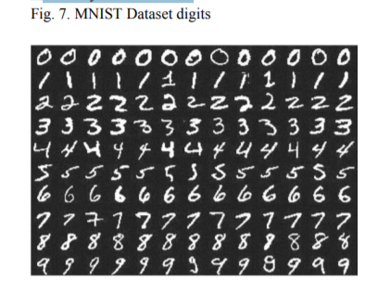
MNIST Dataset.
Once the input image is preprocessed and RoI is selected, we apply segmentation on enrolment number and marks and save them to the list. Saved digits in list are then passed to our digit classification algorithm which is a developed deep learning model to get a near advanced performance on the MNIST.
MNIST was built from a numerous scanned document datasets accessible at National Institute of Standards and Technology. These images were then centered and normalized in size. Every image is in a square of 28x28 pixels. 60,000 images were used for training a model and 10,000 were used to test it. Results with 99% accuracy were achieved.

Slide 13
Keras and CNN.
In accordance with the MNIST, Keras library gives a convenient method for loading its dataset. Keras automatically downloads the dataset of MNIST when its mnist_data () function is called and stores it in home directory.
In the layers of a CNN, neurons are arranged in 3 dimensions: width, height, depth. Here three main types of layers are used to build ConvNet architectures:
Convolutional Layer,
Pooling Layer, and
Fully-Connected Layer

Slide 14
Signature Recognition.
The signatures are treated as an object.
The features of signatures are extracted to classify the query signatures.
Scale Invariant Feature Transform (SIFT) algorithm is used for features extraction.
SIFT detects key points of the signature to recognize the signature under test as either fake or original using following processes
Construction of a scale space
Fast Approximation
Finding key points
Remove nasty key points
Assigning an orientation to the key points.

Slide 15
Database.
The most important thing in top sheet automation is to save data in a digital file for instance excel sheet to easily use, edit and visualize the data.
The library used for writing data and formatting information to Excel files is xlwt.
All the extracted data from top sheet is saved in the excel sheet, hence reducing the manual work.

Slide 16
Conclusion.
In this research, the workload of entering marks manually into system’s database and generating results afterwards is being largely decreased. Image processing tools like image alignment, thresholding, blurring, noise reduction and segmentation to make image of the first page of examination copy understandable for our digit recognition algorithm. After segmentation of our region of interest, each separate digit is sent to our trained model, it recognizes it and then send it to the database. From database, the information is used and displayed in front of the teachers in form of graphs which are easy to understand and can be quickly analyzed to see the result trends among the students in a subject.

Slide 17
Strategy for Implementation.
As the research is mostly based on image processing and character recognition -
I hope to implement most of the pre-processing techniques explained earlier.
40-60% implementation of the paper.

Slide 18
Bibliography.
https://ieeexplore.ieee.org/document/8667127
https://www.semanticscholar.org/paper/Optical-Character-Recognition-Based-Intelligent-for-Rizvi-Raza/e4ca3716ec8c7367fe5d78ef392011432ba5b6fb
http://yann.lecun.com/exdb/mnist/

Slide 19
Thank You

