Slide 1
Dynamic Inventory Pricing for the Airline/Hospitality Industry

Slide 2
Airline industry incurs major losses due to empty flights
An airline loses $24,009 every time a plane makes a 1,000-mile trip at 20% capacity
Mispricing of airline fare leads to lost revenue in billions of dollars annually
The high cross-price elasticity of demand for airline tickets provides a unique opportunity to –
re-direct passenger flow to under-booked flights and
optimize inventory utilization
Source: https://www.forbes.com/sites/jamesasquith/2020/03/31/analysis-how-much-money-do-empty-flights-really-cost-airlines/?sh=fac1d2c5854f

Slide 3
Intelligent pricing can maximize revenue and minimize lost customers
Closed loop pricing takes into account –
current inventory state
expected future price vs demand dynamics
Optimizes price/inventory trajectory to maximize expected revenue out to a pricing horizon
Repeats process at every re-price period, dynamically responding to inventory changes

Slide 4
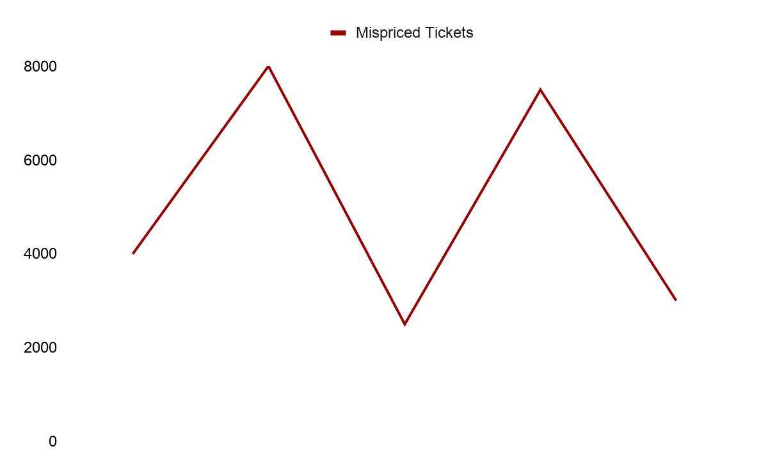

Mispricing tickets leads to inefficient use of flight inventory, loss of revenue, and potential customers

Slide 5
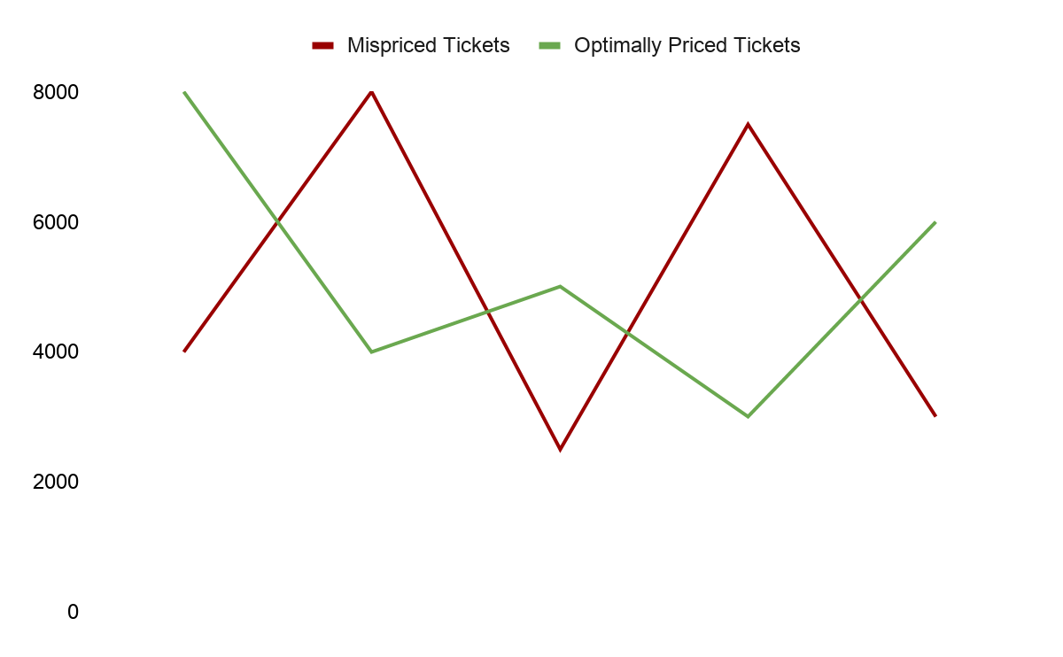

The Solution – Automated pricing of tickets based on demand and dynamic inventory state

Slide 6
Airlines can exploit cross-price elasticity of demand to redirect customers from over-booked to under-booked flights

Slide 7
The Result – Optimally used flight inventory, maximized revenue, and minimized lost seats

Slide 8
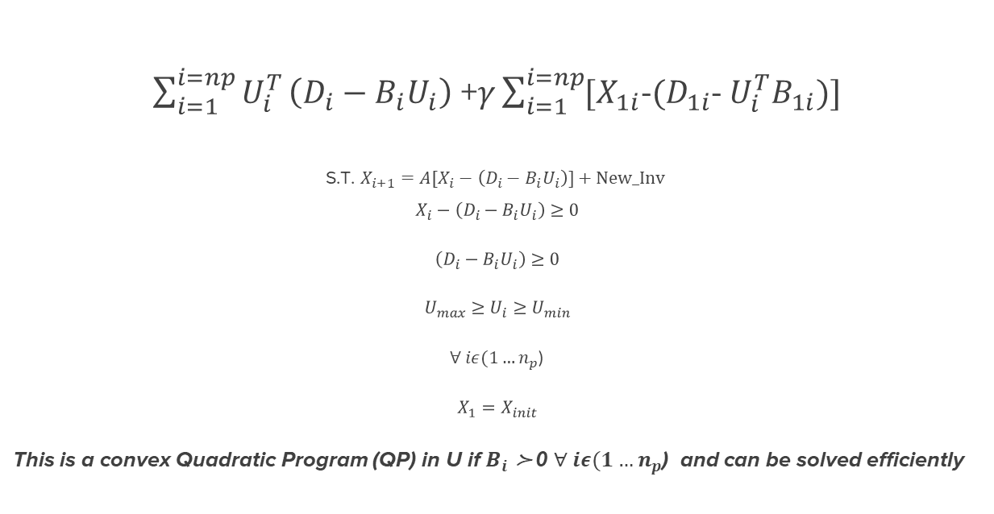

Maximizing Expected Revenue Along An Inventory Trajectory
≻
$\sum_{i=1}^{i=np}{U_{i}^{T}}\left(D_{i}−B_{i}U_{i}\right)$ +$γ\sum_{i=1}^{i=np}{{[X}_{1i}}$-${(D}_{1i}$- $U_{i}^{T}B_{1i})]$
S.T. $X_{i+1}={A[X}_{i}−\left(D_{i}−B_{i}U_{i}\right)]+New_Inv$
$$X_{i}−\left(D_{i}−B_{i}U_{i}\right)≥0$$
$$\left(D_{i}−B_{i}U_{i}\right)≥0$$
$$U_{max}≥U_{i}≥U_{min}$$
$∀ iε(1…n_{p}$)
$$X_{1}=X_{init}$$
This is a convex Quadratic Program (QP) in U if $B_{i}$ ≻ 0 $∀ iε(1…n_{p}$) and can be solved efficiently
$$\max{}U_{1}U_{2}…U_{np}$$

Slide 9
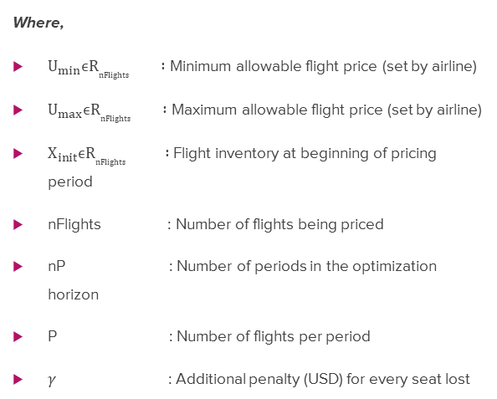
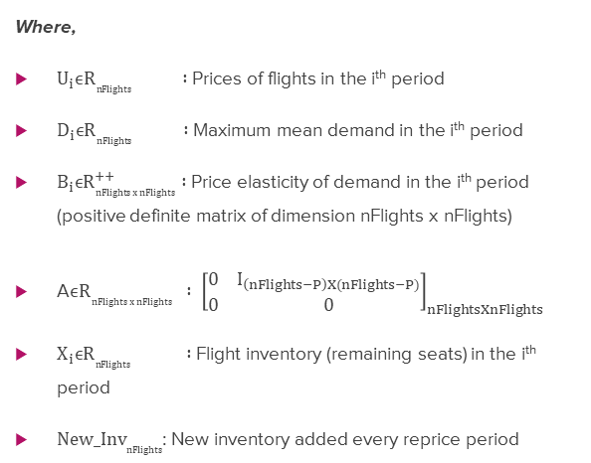
Maximizing Expected Revenue Along An Inventory Trajectory
Where,
$U_{i}ϵR_{nFlights} :$Prices of flights in the i^{th} period
$D_{i}ϵR_{nFlights} :$ Maximum mean demand in the i^{th} period
$B_{i}ϵR_{nFlights x nFlights}^{++} :$Price elasticity of demand in the i^{th} period (positive definite matrix of dimension nFlights x nFlights)
A$ϵR_{nFlights x nFlights}^{} : {\left[\begin{matrix}0 & I_{\left(nFlights−P\right)X(nFlights−P)} \\ 0 & 0\end{matrix}\right]}_{nFlightsXnFlights}$
$X_{i}ϵR_{nFlights} :$ Flight inventory (remaining seats) in the i^{th} period
$New_I{nv}_{nFlights}$: New inventory added every reprice period
Where,
$U_{min}ϵR_{nFlights} :$ Minimum allowable flight price (set by airline)
$U_{max}ϵR_{nFlights} :$ Maximum allowable flight price (set by airline)
$X_{init}ϵR_{nFlights} :$ Flight inventory at beginning of pricing period
nFlights : Number of flights being priced
nP : Number of periods in the optimization horizon
P : Number of flights per period
$γ$ : Additional penalty (USD) for every seat lost

Slide 10
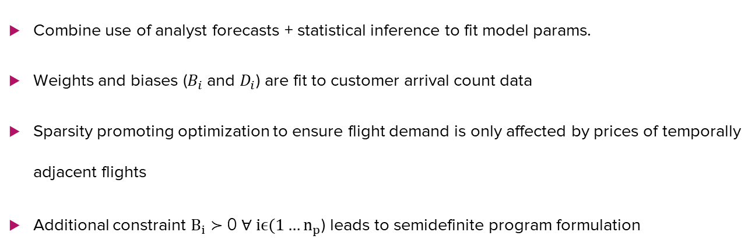
On Parameter Estimation
Combine use of analyst forecasts + statistical inference to fit model params.
Weights and biases ($B_{i}$ and $D_{i}$) are fit to customer arrival count data
Sparsity promoting optimization to ensure flight demand is only affected by prices of temporally adjacent flights
Additional constraint $B_{i}$ ≻ 0 $∀ iϵ(1…n_{p}$) leads to semidefinite program formulation

Slide 11
Simulated inventory trajectory for pricing control
Figure simulates price/inventory trajectory of 60 flights (randomly initialized) over a 20-day period
3 flights depart each day and 3 new (with max inventory) are added
Repricing period - 1 day

Slide 12
Simulated inventory trajectory for pricing control
Figure simulates net revenue of an airline operating 60 flights over a 20-day rolling period
Revenue generated by 3 pricing strategies (long, medium and short horizon) with nP = 20, 10 and 5 respectively

Slide 13
Further Use Cases
Hotels +Flight aggregators (OYO,Airbnb etc.)
Dynamic pricing of hotel rooms in similar locations with high cross price Elasticity
Can be easily extended to generate optimal prices for multiple
period bookings

