Slide 1

ACCIDENT ALERT TEAM REPORT

Slide 2
PROBLEM STATEMENT
Develop an intelligent system for real-time detection and localization of injured or fallen construction workers within a construction site to ensure prompt medical assistance and minimize response time.

Slide 3
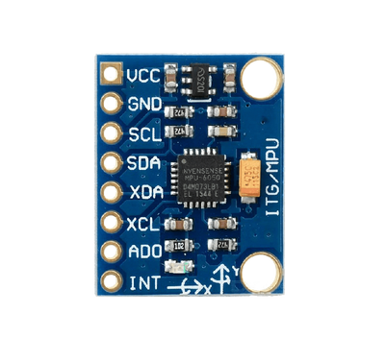
OUR SOLUTION
We use a gyroscope and use the readings of pitch, roll and yaw to get an angle.
Piezoelectric sensors are fitted on the helmet to detect impact.
We then use a microcontroller to implement a digital AND gate.
When a person crosses a certain angle and an impact is detected, the buzzers rings.
MPU 6050 (gyroscope)

Slide 4
CHALLENGES ADDRESSED
Digital AND gate ensures that stray vibrations on the construction site do not cause false alarms.
Calibrations were made to ensure deliberate body movements were not picked up as a fall

Slide 5
FUTURE SCOPE
The buzzer alarm system can be replaced with iot to send out alerts to emergency services.
Sensors can be added to monitor vitals.
NFC tags or RFID can be integrated so that in an event of collapse of construction sites, workers can be easily detected beneath rubble.

Slide 6
TEAM
Shreyans Jain
Dewansh Singh Chandel
Nimitt

