Slide 1

AN ANALYSIS ON THE HUMAN BIOPHYSICS USING MATHEMATICAL MODELS
(Introductory Presentation)
Project by: Shreyansh Sheth (20MBE0020)
Project Guide: Prof. Dr. R. Sivakumar

Slide 2
Contents
Introduction
Key Checkpoints
Understanding the Benford’s Law
Observation & Outcomes
Methodology
References

Slide 3
Introduction
This project will showcase the intriguing relationship between the incredible Mathematical theories and the Biophysics of the human beings. It will also underscore the ways these theories can help enhance the diagnosis in the Biomedical and Healthcare sectors.

Slide 4
Key Checkpoints
Studying the Newcomb-Benford’s Law/Benford’s Law
Understanding the fundamentals supporting this law
Identifying the possible application of this law on Biosignals (here ECG)
Selecting the biosignal datasets (here Normal and Abnormal ECGs)
Developing the MATLAB code
Derivation and conclusion

Slide 5

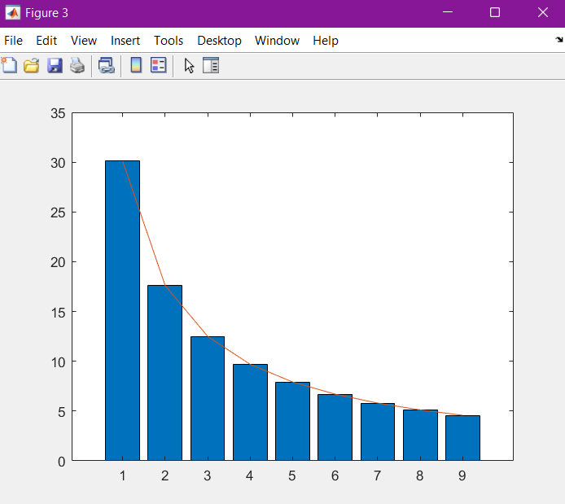
Understanding the Benford’s Law:
It is an observation that in many real-life sets of numerical data, the leading digit is likely to be small. In sets that obey the law, the number 1 appears as the leading significant digit about 30% of the time, while 9 appears as the leading significant digit less than 5% of the time. If the digits were distributed uniformly, they would each occur about 11.1% of the time. Benford's law also makes predictions about the distribution of second digits, third digits, digit combinations, and so on.

Slide 6
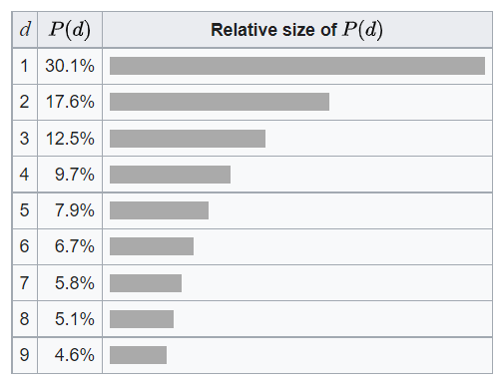
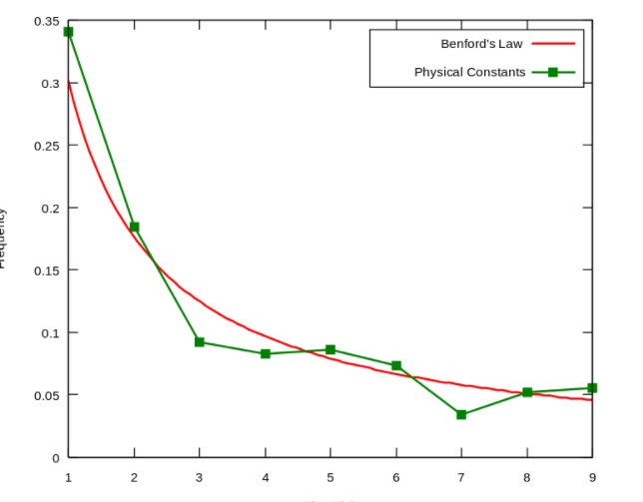
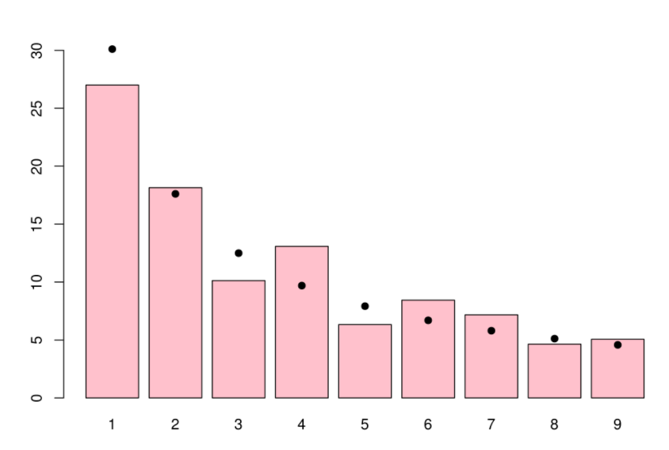
Observations & Outcomes
Benford’s Probability Distribution | Frequency of first significant digit of physical constants plotted against Benford's law | Distribution of first digits (in %, red bars) in the population of the 237 countries of the world as of July 2010. Black dots indicate the distribution predicted by Benford's law.

Slide 7
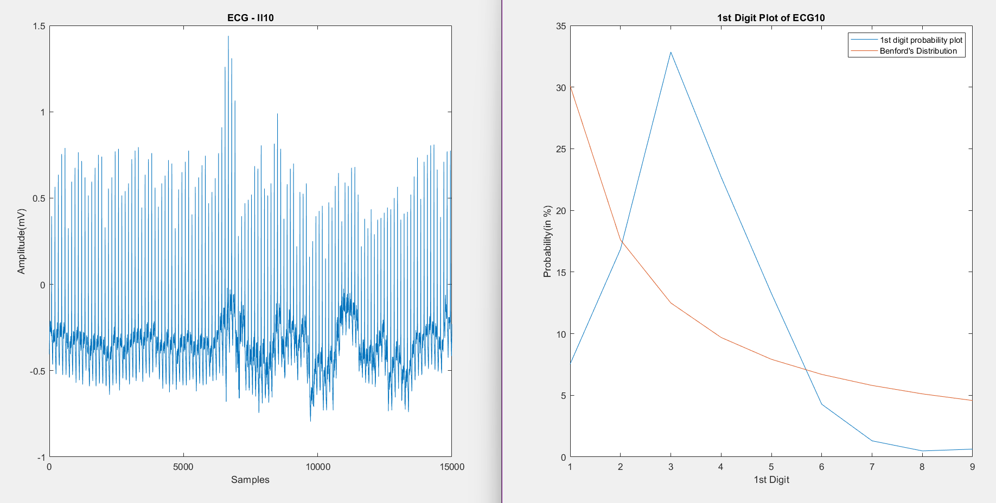
Observations & Outcomes
Abnormal ECG

Slide 8
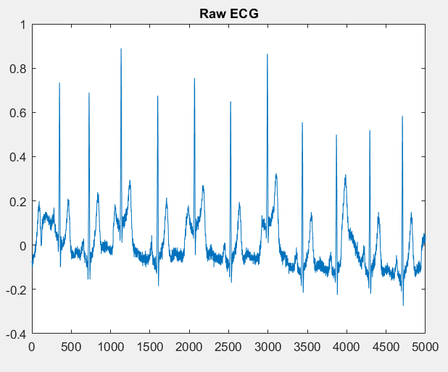
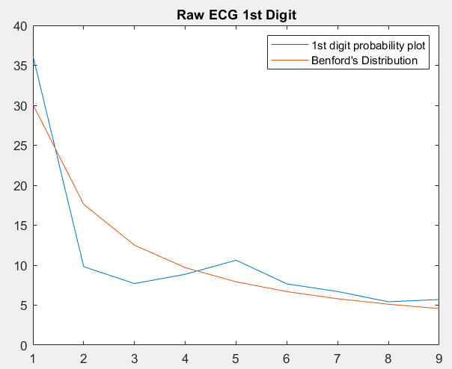
Observations & Outcomes
Normal ECG

Slide 9
Methodology
Listing out compatible laws
Studying the laws
Understanding the fundamentals of these laws
Identifying the possible application of the laws on Biosignals
Selecting the biosignals to apply the law on
Developing the codes for each laws
Getting the Biosignal Datasets
Applying the laws on the selected Biosignal datasets
Analysing whether the biosignal abides or violates the law
Final Conclusion

Slide 10
References
Kreuzer M, Jordan D, Antkowiak B, Drexler B, Kochs EF, Schneider G. Brain electrical activity obeys Benford's law. Anesth Analg. 2014 Jan;118(1):183-91. doi: 10.1213/ANE.0000000000000015. PMID: 24356167.
Newcomb, S. (1881). Note on the Frequency of Use of the Different Digits in Natural Numbers. American Journal of Mathematics, 4(1), 39–40. https://doi.org/10.2307/2369148
Benford, F. (1938). The Law of Anomalous Numbers. Proceedings of the American Philosophical Society, 78(4), 551–572. http://www.jstor.org/stable/984802

Slide 11

Thank You!

