Slide 1



SIPS 2026 · DIGITAL TRUST & INFRASTRUCTURE · PROBLEM STATEMENT
DPI Sentinel
“Downdetector tells you something's wrong. We give you the receipt.”
India's most-used digital rails have no independent witness
On 12 April 2025, UPI's transaction success rate fell to ~50% for nearly two hours, staying degraded for roughly five hours total — and no independent, real-time monitor exists to catch the next one.
22.35B
~5 hrs
~50%
UPI transactions in April 2026 alone
UPI degraded on 12 April 2025
success rate at the incident's worst point
No independent monitor
No help in the moment
No evidence afterward
NPCI's own uptime reporting updates monthly, not live.
Citizens can't tell if they were debited, or if it's safe to retry.
The burden of proof falls entirely on the citizen in any dispute.
DPI Sentinel · SIPS 2026 · Digital Trust & Infrastructure
1 / 7

Slide 2



TARGET USERS
Built for the people an outage actually hurts
Three groups feel a DPI incident in three different ways - each needs something different from an accountability layer.
Citizens
Banks, PSPs & Fintechs
Regulators, Journalists & Civic-Tech
Everyday UPI & DigiLocker users - especially elderly and high-frequency users most exposed to outage-window scam calls.
Institutions that absorb support-ticket floods and dispute costs every time a DPI rail degrades.
Researchers and policymakers with no independent, standing data source to hold DPI operators accountable.
Needs: real-time status, in-the-moment guidance, and proof for disputes.
Needs: an earlier, independently-verified incident signal than their own dashboards give them.
Needs: transparent, auditable incident history - not self-reported uptime.
DPI Sentinel · SIPS 2026 · Digital Trust & Infrastructure
2 / 7

Slide 3



PROPOSED SOLUTION
Observe. Guide. Prove.
Public accountability tools for DPI today are either operated by the entity being monitored, or crowd-sourced and unverifiable. Nobody has built the third option.
Observe
Guide
Prove
An independent witness network of probe nodes continuously monitors UPI and DigiLocker's public-facing surfaces - real availability and latency, on a fixed interval.
When an incident is active, Outage Copilot gives in-the-moment guidance: don't retry yet, check if you were debited, and watch for outage-season scam calls.
A citizen can request a cryptographically signed Incident Correlation Certificate - verifiable evidence for a bank dispute or RBI ombudsman complaint.
The gap between “informational” and “evidentiary” is the whole product. DPI Sentinel is the first independently operated, cryptographically auditable layer for India's DPI.
DPI Sentinel · SIPS 2026 · Digital Trust & Infrastructure
3 / 7

Slide 4
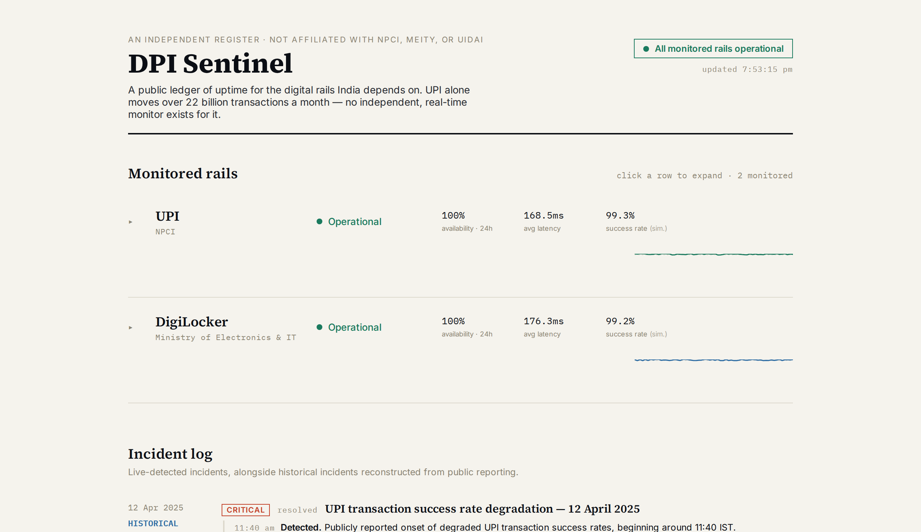
PROTOTYPE OVERVIEW
Already working - not a mockup
What's built:
Real HTTP/TLS synthetic probing, on a fixed interval, against real public targets
Automatic incident detection with full timeline (Detected → Identified → Monitoring → Resolved)
The real 12 April 2025 UPI incident, sourced from public reporting
Live “inject outage” demo control - probe → detect → incident → resolve, in real time
Next: multi-witness quorum network, hash-chained transparency log, and Evidence Certificate generation - detailed next.
Live status ledger - real synthetic probes, real incident detection, live demo controls
DPI Sentinel · SIPS 2026 · Digital Trust & Infrastructure
4 / 7

Slide 5
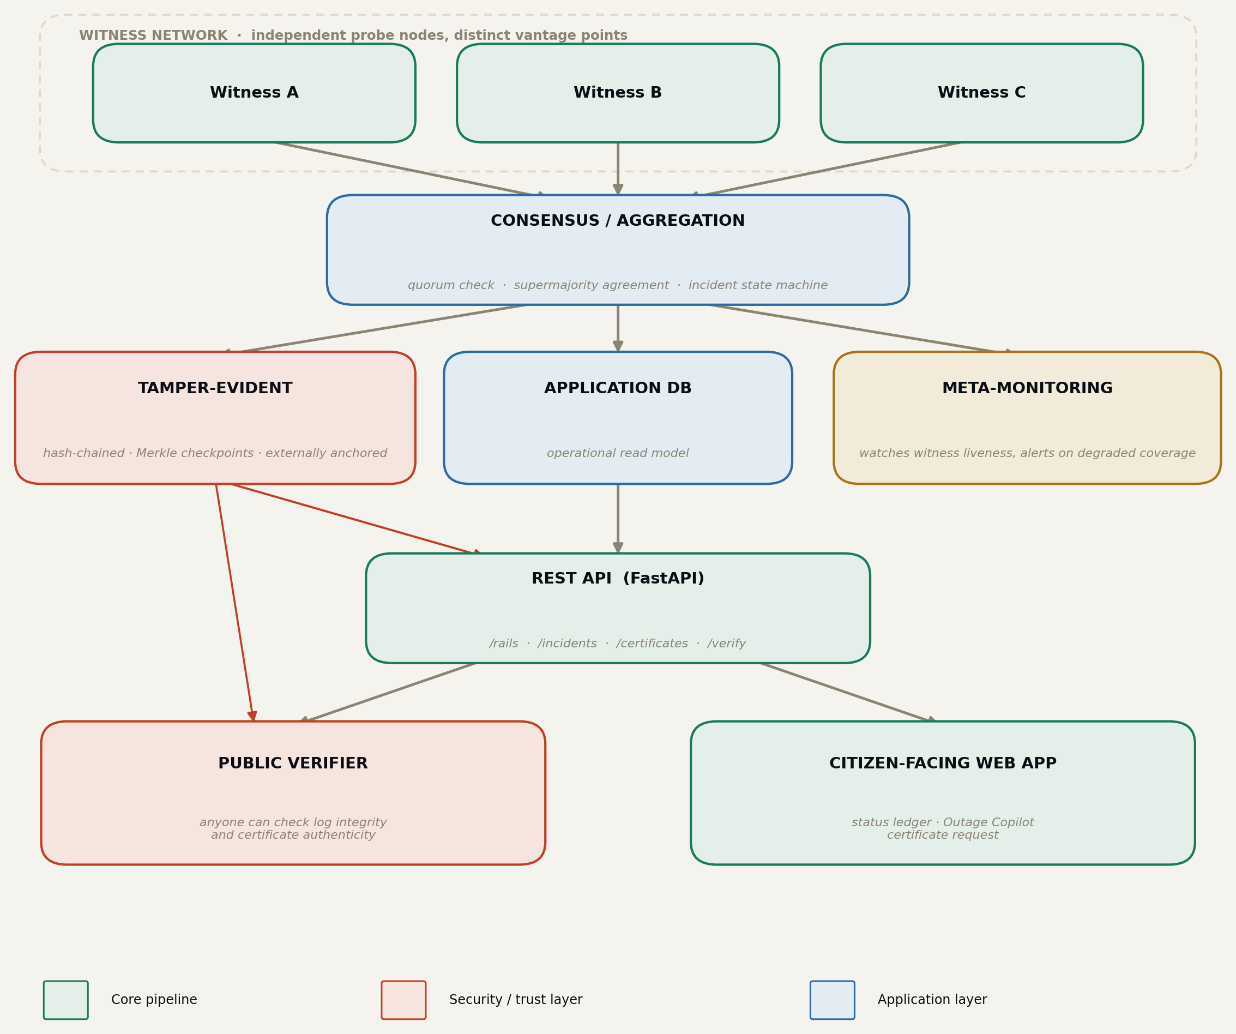
TECHNICAL ARCHITECTURE
Built so no single party - including us - can fake it
Quorum consensus, not one server
No single node — including one the project operator controls — can unilaterally declare an incident. An incident requires a quorum of independent witnesses to agree.
A tamper-evident log
Every observation is appended to a hash-chained, Merkle-structured log with signed checkpoints published externally - the same pattern that secures Certificate Transparency for the web's entire TLS ecosystem.
To fake an incident, an attacker would need to compromise a quorum of independently operated, geographically distinct nodes simultaneously - not one server.
DPI Sentinel · SIPS 2026 · Digital Trust & Infrastructure
5 / 7

Slide 6
EXPECTED IMPACT
Free for citizens. Paid by the institutions that benefit most.
Every monitored rail carries billions of transactions a month - independent accountability at this scale has never existed before.
Citizens - free, forever
Banks, PSPs & fintechs - paid API
Who: every citizen using UPI or DigiLocker.
What: public status ledger, Outage Copilot guidance, and a free tier of Evidence Certificates.
Why free: the whole trust thesis depends on independence. A paywalled accountability layer isn't one.
Who pays: banks, PSPs, and fintech apps that absorb support and dispute costs during DPI outages.
How: usage-based API for earlier, independently-verified incident signals + dispute evidence.
Why now: ₹22,495 crore lost to digital fraud in 2025, and rising RBI scrutiny on redress timelines.
Mirrors how Setu, Decentro, and Cashfree monetize: usage-based B2B APIs sitting on top of public infrastructure.
DPI Sentinel · SIPS 2026 · Digital Trust & Infrastructure
6 / 7

Slide 7
TEAM DETAILS
Kernel Panic
Theme: Digital Trust & Infrastructure · SIPS 2026, CSITM - IIM Bangalore
Name
Role
College
Contact
Shreyansh Kanojia
[Role, e.g. Full-stack / Systems]
[College, Branch, Year]
[email / phone]
DPI Sentinel is an independently operated, cryptographically verifiable accountability layer for India's digital public infrastructure - the first system that doesn't just tell citizens something broke, but gives them proof.
https://github.com/Shreyansh-Kanojiaa/dpi-sentinel · shreyanshkanojia104@gmail.com
DPI Sentinel · SIPS 2026 · Digital Trust & Infrastructure
7 / 7

