Slide 1

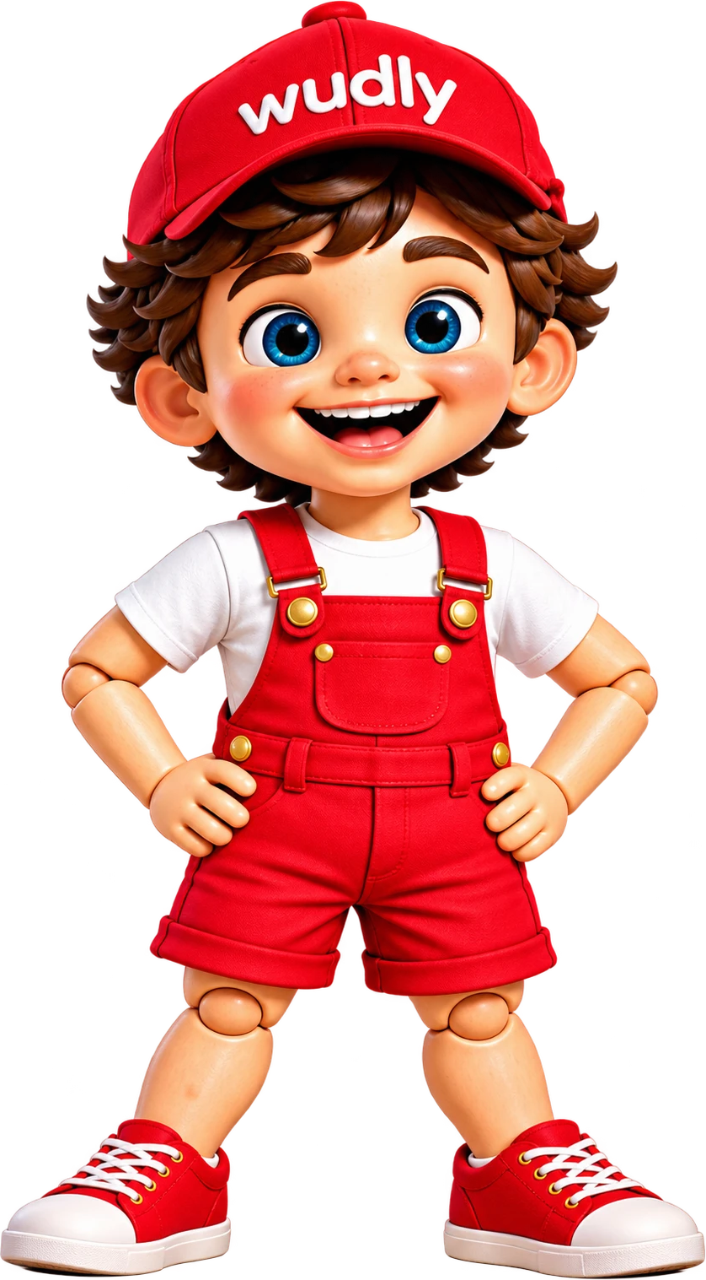
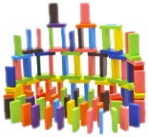
GOOD TO KNOW
Why wooden
toys?
5 reasons parents love them
Swipe →
@wudly_toys · wudlytoys.com
1 / 8

Slide 2
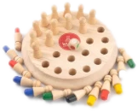
REASON 1 OF 5
Made to last
Sturdy wood takes years of drops, stacking and play, so toys can be passed on to siblings.
✓ Handles everyday play
✓ Can be passed down
✓ Fewer replacements
Parent tip
Rotate a few wooden toys each week so they always feel new.
@wudly_toys · wudlytoys.com
2 / 8

Slide 3
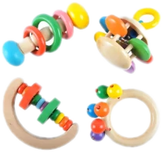
REASON 2 OF 5
A natural feel
Wood has real weight, texture and warmth that little hands can feel and explore.
✓ Real weight to hold
✓ Smooth, warm texture
✓ Natural tapping sounds
Parent tip
Notice the texture and sounds of wood together: tap, roll, stack.
@wudly_toys · wudlytoys.com
3 / 8

Slide 4
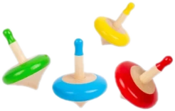
REASON 3 OF 5
Open-ended play
A block can be a phone, a car or a tower. Simple toys let children invent the game.
✓ One toy, many games
✓ Builds imagination
✓ Grows with your child
Parent tip
Ask "What else could this be?" and let your child decide.
@wudly_toys · wudlytoys.com
4 / 8

Slide 5
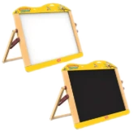
REASON 4 OF 5
Calm, screen-free
No batteries, lights or sounds. The child makes the play happen, at their own pace.
✓ No flashing lights
✓ Longer focus
✓ Child leads the play
Parent tip
Keep one screen-free play hour every day.
@wudly_toys · wudlytoys.com
5 / 8

Slide 6
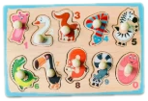
REASON 5 OF 5
Easy to care for
Wipe with a slightly damp cloth and let it air dry. No charging, no batteries.
✓ Wipe, don't soak
✓ Air dry
✓ No batteries
Parent tip
Avoid soaking wooden toys in water.
@wudly_toys · wudlytoys.com
6 / 8

Slide 7
QUICK COMPARE
Wooden vs plastic
 | Wooden | Plastic*
Feel in the hand | Warm, weighty | Light
Batteries & sounds | None | Often
Play style | Child-led | Toy-led
How long it lasts | Years | Varies
Care | Wipe clean | Wipe clean
*many plastic toys. A general guide, so check each product.
@wudly_toys · wudlytoys.com
7 / 8

Slide 8
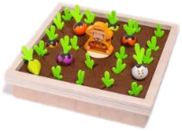
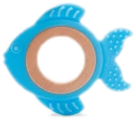
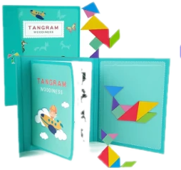
BEFORE YOU GO
Save this for
your next toy
Shop at wudlytoys.com
Shop by age · Free shipping over Rs.999
@wudly_toys · wudlytoys.com
8 / 8

