Slide 1


Unit – 2.1 Recurrence Relation
BTech & BSc (H)-CS $→$ 3rd Semester
Discrete Mathematics (2301HS301)
Prof. Vasudev Barjadiya
Department of Humanities & Science
vasudev.barjadiya@darshan.ac.in
901 64 27 400

Slide 2

Looping
Topics of Unit 2.1
Solution of Linear Recurrence Relation using Undetermined Coefficient Method

Slide 3

Looping
Outline of Unit 1.2
Recurrence Relation
Solution of Linear Recurrence Relation using Undetermined Coefficient Method

Slide 4
Method 1
Recurrence Relation

Slide 5








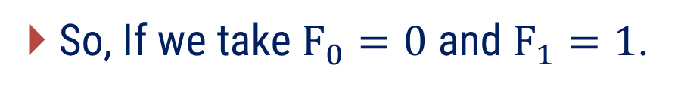
















Fibonacci Sequence
The Fibonacci sequence, also known as Fibonacci numbers, is defined as the sequence of numbers in which each number in the sequence is equal to the sum of two numbers before it. The Fibonacci Sequence is given as:
$$0,$$
$$1,$$
$$1,$$
$$2,$$
$$3,$$
$$5,$$
$$8,$$
$$13,$$
$$21,$$
$$…$$
$$+$$
$$+$$
$$+$$
$$+$$
$$+$$
So, If we take $F_{0}=0$ and $F_{1}=1$.
$$F_{2}$$
$$=F_{0}+F_{1}$$
$$=1$$
$$F_{3}$$
$$=F_{1}+F_{2}$$
$$=2$$
$$F_{4}$$
$$=F_{2}+F_{3}$$
$$=3$$

Slide 6


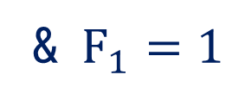
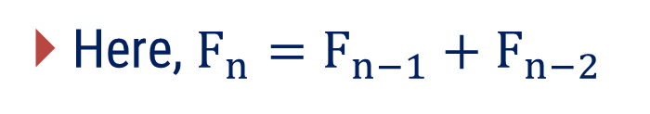

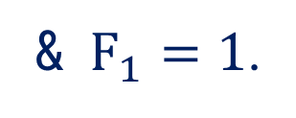

Fibonacci Sequence
In general, Fibonacci sequence can be defined as
$$F_{n}=F_{n−1}+F_{n−2},$$
$$n≥2$$
provided
$$F_{0}=0$$
& $F_{1}=1$.
Here, $F_{n}=F_{n−1}+F_{n−2}$
is known as recurrence relation and
$$F_{0}=0$$
& $F_{1}=1$
are known as initial conditions of recurrence relation.

Slide 7

Recurrence Relation
A recurrence relation for the sequence is a formula that expresses $\left\{ a_{n} \right\}$ in terms of one or more of the previous terms of the sequence, namely, $a_{0}, a_{1}, …, a_{n−1}$.

Slide 8
Method 2
Solution of Linear Recurrence Relation using Undetermined Coefficient Method

Slide 9
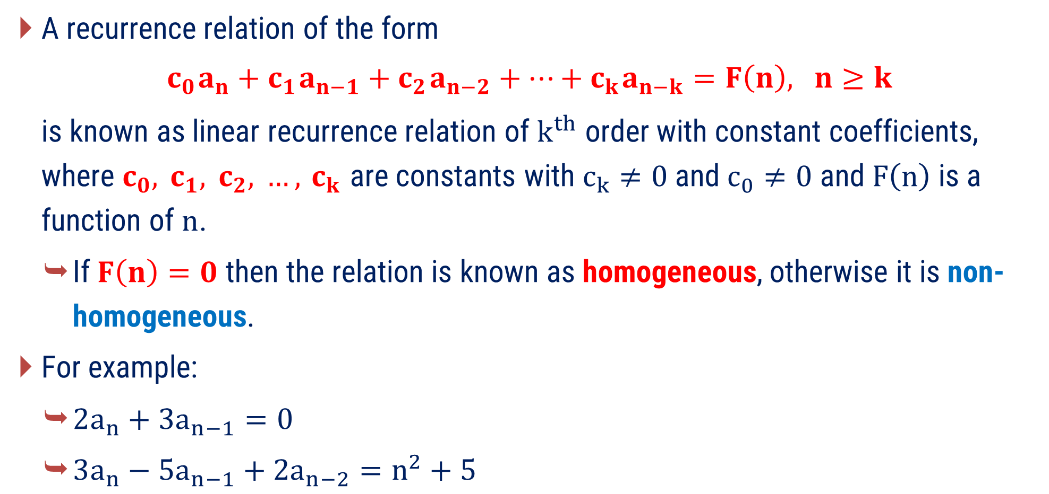

Linear Recurrence Relation
A recurrence relation of the form
$$c_{0} a_{n}+c_{1} a_{n−1}+c_{2} a_{n−2}+…+c_{k} a_{n−k}=F\left(n\right), n≥k$$
is known as linear recurrence relation of $k^{th}$ order with constant coefficients, where $c_{0}, c_{1}, c_{2}, …, c_{k}$ are constants with $c_{k}≠0$ and $c_{0}≠0$ and $F\left(n\right)$ is a function of $n$.
If $F\left(n\right)=0$ then the relation is known as homogeneous, otherwise it is non-homogeneous.
For example:
$2a_{n}+3a_{n−1}=0$
$3a_{n}−5a_{n−1}+2a_{n−2}=n^{2}+5$
$$…\left(1\right)$$
Homogeneous
Non-homogeneous

Slide 10
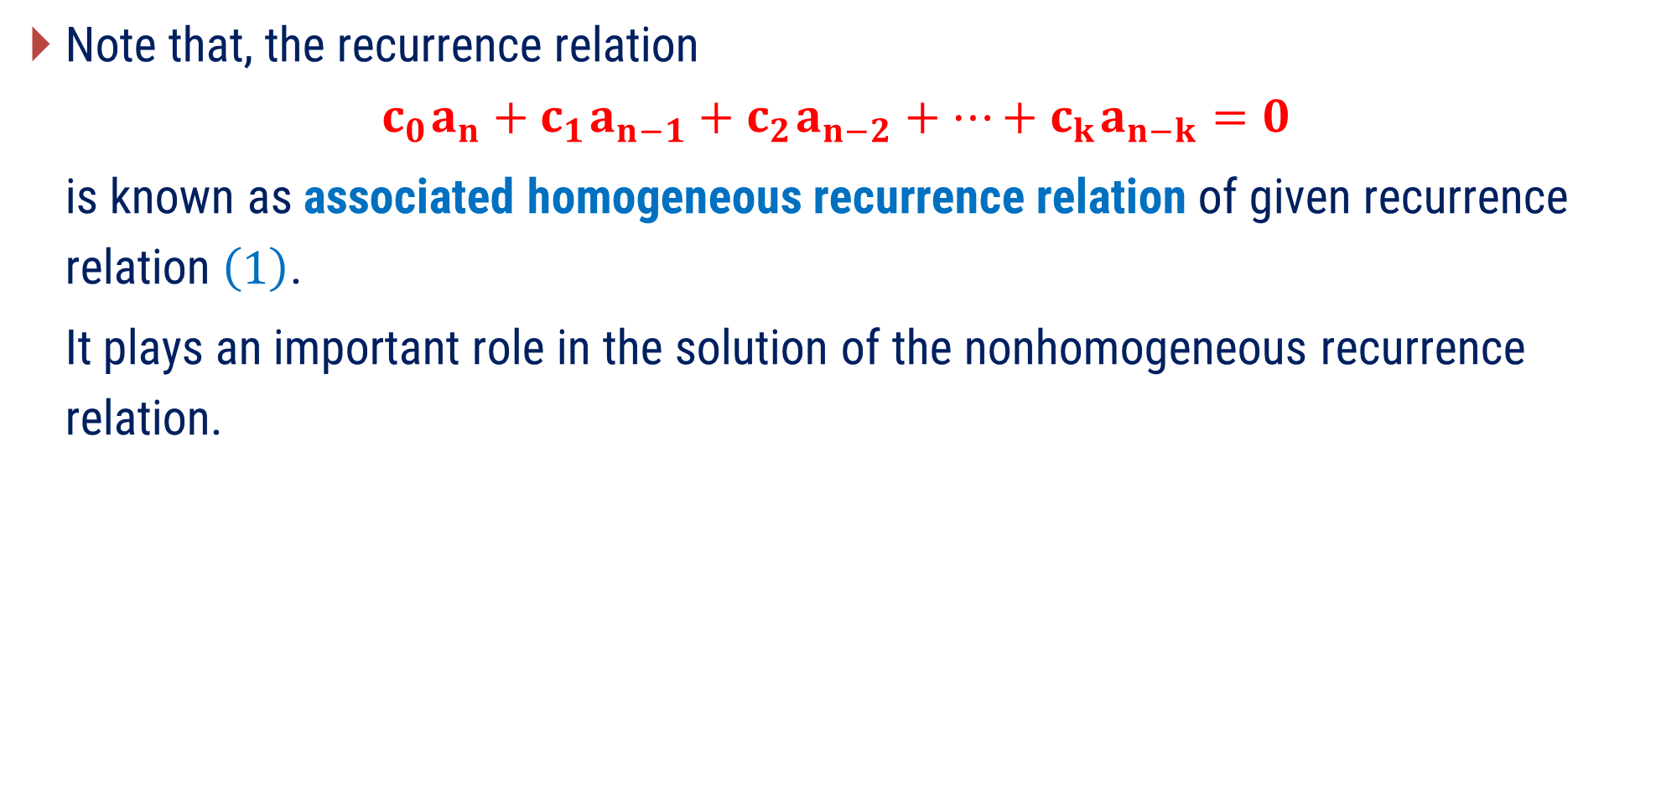
Linear Recurrence Relation
Note that, the recurrence relation
$$c_{0} a_{n}+c_{1} a_{n−1}+c_{2} a_{n−2}+…+c_{k} a_{n−k}=0$$
is known as associated homogeneous recurrence relation of given recurrence relation $\left(1\right)$.
It plays an important role in the solution of the nonhomogeneous recurrence relation.

Slide 11
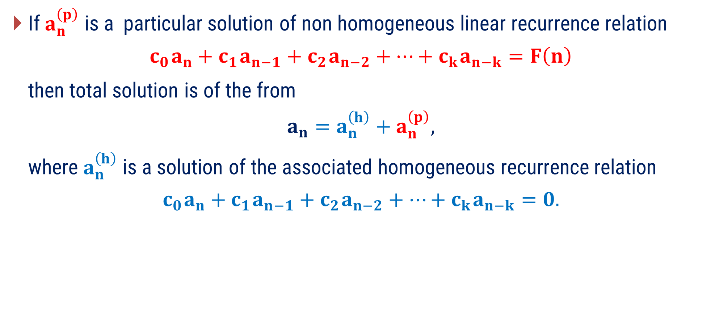
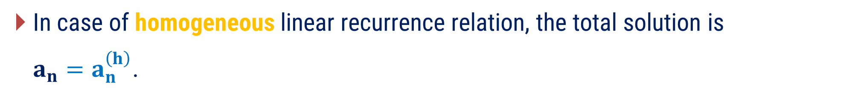
Solving Linear Recurrence Relation
Undetermined Coefficient Method
If $a_{n}^{\left(p\right)}$ is a particular solution of non homogeneous linear recurrence relation
$$c_{0} a_{n}+c_{1} a_{n−1}+c_{2} a_{n−2}+…+c_{k} a_{n−k}=F\left(n\right)$$
then total solution is of the from
$$a_{n}=a_{n}^{\left(h\right)}+a_{n}^{\left(p\right)},$$
where $a_{n}^{\left(h\right)}$ is a solution of the associated homogeneous recurrence relation
$$c_{0} a_{n}+c_{1} a_{n−1}+c_{2} a_{n−2}+…+c_{k} a_{n−k}=0.$$
In case of homogeneous linear recurrence relation, the total solution is
$a_{n}=a_{n}^{\left(h\right)}$.

Slide 12
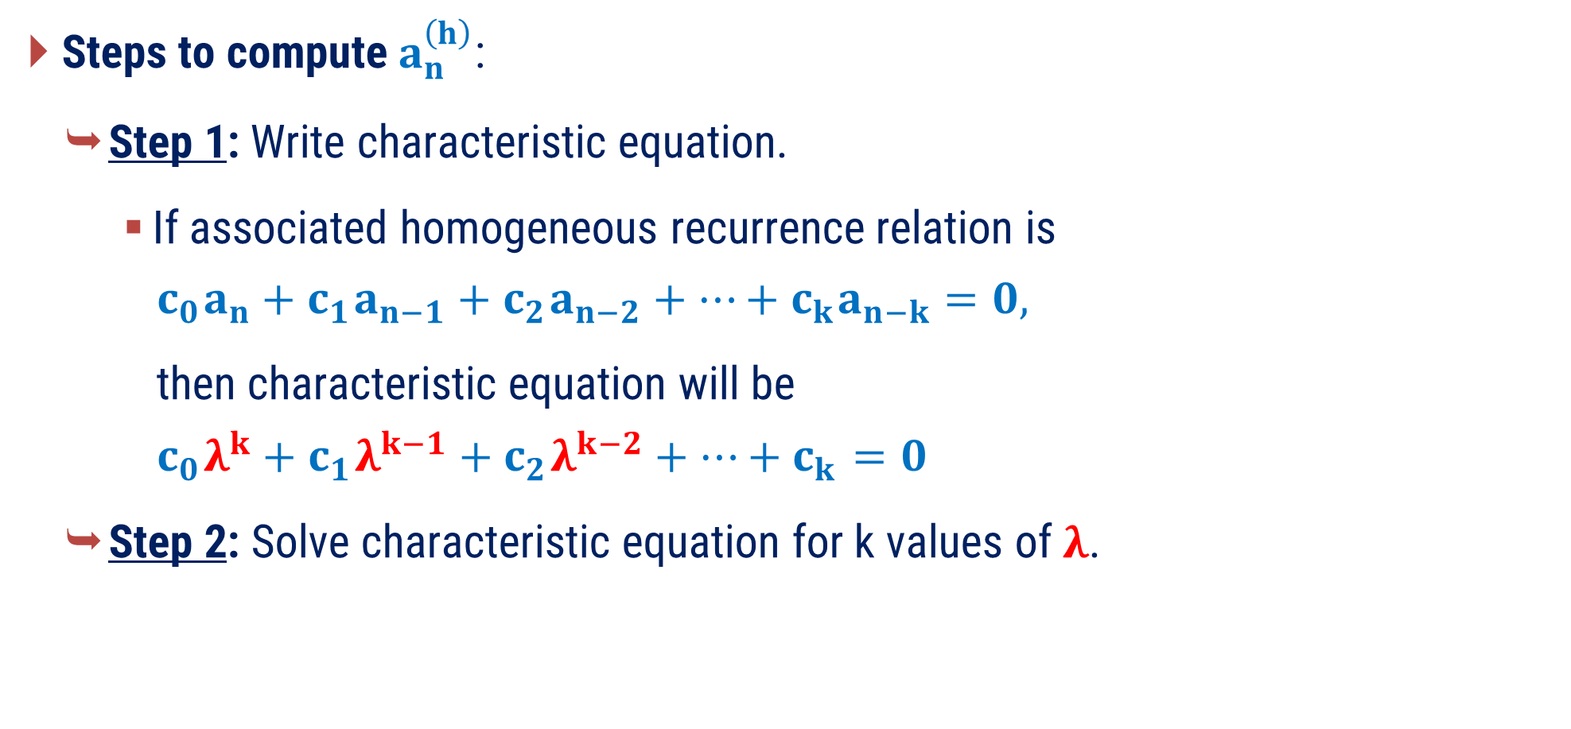
Solving Linear Recurrence Relation
Undetermined Coefficient Method
Steps to compute $a_{n}^{\left(h\right)}$:
Step 1: Write characteristic equation.
If associated homogeneous recurrence relation is
$$c_{0} a_{n}+c_{1} a_{n−1}+c_{2} a_{n−2}+…+c_{k} a_{n−k}=0,$$
then characteristic equation will be
$$c_{0} λ^{k}+c_{1} λ^{k−1}+c_{2} λ^{k−2}+…+c_{k} =0$$
Step 2: Solve characteristic equation for k values of $λ$.

Slide 13


Solving Linear Recurrence Relation
Undetermined Coefficient Method
Steps to compute $a_{n}^{\left(h\right)}$:
Step 3: Write $a_{n}^{\left(h\right)}$ according to $λ$.
$a_{n}^{\left(h\right)}$ according to $λ$
$$λ$$ | $$a_{n}^{\left(h\right)}$$
$$λ_{1}≠λ_{2}$$ | $$C_{1}{\left(λ_{1}\right)}^{n}+C_{2}{\left(λ_{2}\right)}^{n}$$
$$λ_{1}=λ_{2}=λ_{3}$$ | $$\left(C_{1}+C_{2}n+C_{3}n^{2}\right){\left(λ_{1}\right)}^{n}$$
$$λ_{1}=λ_{2}≠λ_{3}$$ | $$\left(C_{1}+C_{2}n\right){\left(λ_{1}\right)}^{n}+C_{3}{\left(λ_{3}\right)}^{n}$$

Slide 14


Solving Linear Recurrence Relation
Undetermined Coefficient Method
Steps to compute $a_{n}^{\left(p\right)}$:
Step 1: Write $a_{n}^{\left(p\right)}$ according to $F\left(n\right)$.
$a_{n}^{\left(P\right)}$ according to $F\left(n\right)$
$$F\left(n\right)$$ | $$a_{n}^{\left(P\right)}$$
Constant | $$P_{0}$$
$$a+bn+{cn}^{2}+{dn}^{3}+…$$ | $$P_{0}+P_{1}n+P_{2}n^{2}+P_{3}n^{3}+…$$
$$ab^{n} \left(b≠λ\right)$$ | $$P_{0}b^{n}$$
$ab^{n}$ $\left(b=λ \text{with} \text{multiplicity} m\right)$ | $$P_{0}n^{m}b^{n}$$

Slide 15
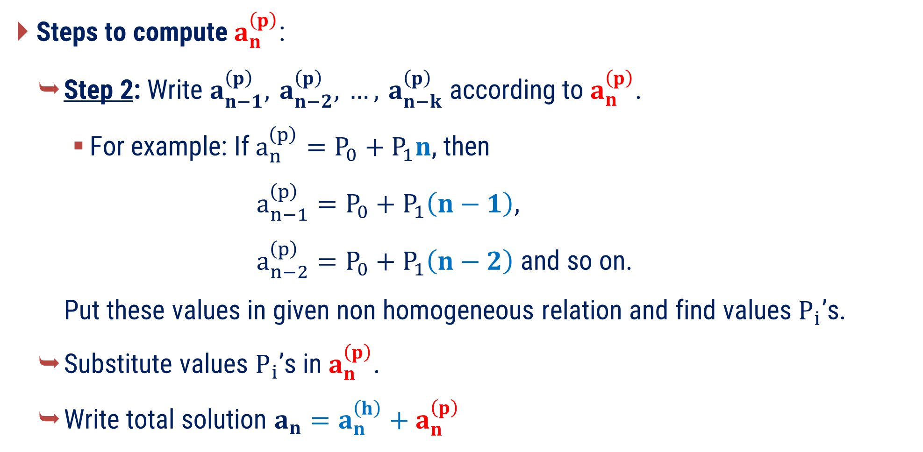
Solving Linear Recurrence Relation
Undetermined Coefficient Method
Steps to compute $a_{n}^{\left(p\right)}$:
Step 2: Write $a_{n−1}^{\left(p\right)}, a_{n−2}^{\left(p\right)}, …, a_{n−k}^{\left(p\right)}$ according to $a_{n}^{\left(p\right)}$.
For example: If $a_{n}^{\left(p\right)}=P_{0}+P_{1}n$, then
$a_{n−1}^{\left(p\right)}=P_{0}+P_{1}\left(n−1\right)$,
$a_{n−2}^{\left(p\right)}=P_{0}+P_{1}\left(n−2\right)$ and so on.
Put these values in given non homogeneous relation and find values $P_{ i}$’s.
Substitute values $P_{ i}$’s in $a_{n}^{\left(p\right)}$.
Write total solution $a_{n}=a_{n}^{\left(h\right)}+a_{n}^{\left(p\right)}$

Slide 16

Solving Linear Recurrence Relation
Undetermined Coefficient Method
Find constants using initial condition(s) if given.
Step 1: Find $C_{i}$’s using initial condition(s) if given.
Step 2: Substitute values of $C_{i}$’s in $a_{n}$.

Slide 17
Examples of Method 2
Solution of Linear Recurrence Relation using Undetermined Coefficient Method

Slide 18

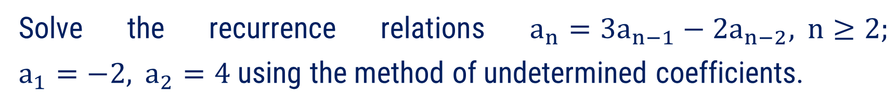



Method 2 ⇝ Example 1
Question:
Solve the recurrence relations $a_{n}=3a_{n−1}−2a_{n−2}, n≥2;$ $a_{1}=−2, a_{2}=4$ using the method of undetermined coefficients.
Solution:
Given recurrence relation is
$$a_{n}=3a_{n−1}−2a_{n−2}$$
$$⇒$$
$$a_{n}−3a_{n−1}+2a_{n−2}=0$$
Here, total solution is given by
$$a_{n}=a_{n}^{\left(h\right)}$$

Slide 19

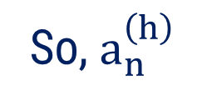
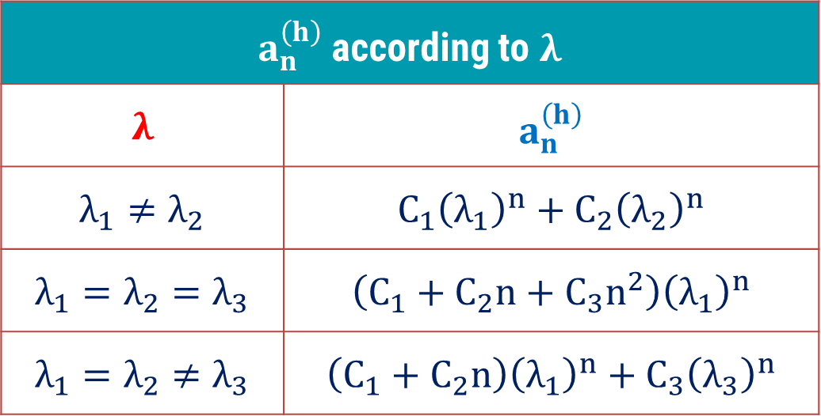












Method 2 ⇝ Example 1 (Continue)
Computing $a_{n}^{\left(h\right)}$
$$a_{n}−3a_{n−1}+2a_{n−2}=0$$
The characteristic equation is
$a_{n}^{\left(h\right)}$ according to $λ$
$$λ$$ | $$a_{n}^{\left(h\right)}$$
$$λ_{1}≠λ_{2}$$ | $$C_{1}{\left(λ_{1}\right)}^{n}+C_{2}{\left(λ_{2}\right)}^{n}$$
$$λ_{1}=λ_{2}=λ_{3}$$ | $$\left(C_{1}+C_{2}n+C_{3}n^{2}\right){\left(λ_{1}\right)}^{n}$$
$$λ_{1}=λ_{2}≠λ_{3}$$ | $$\left(C_{1}+C_{2}n\right){\left(λ_{1}\right)}^{n}+C_{3}{\left(λ_{3}\right)}^{n}$$
$$λ^{2}−3λ+2=0$$
$$⇒$$
$$(λ−1)$$
$$(λ−2)$$
$$=0$$
$$⇒$$
$$λ$$
$$=1,$$
$$2$$
So, $a_{n}^{\left(h\right)}$
$$=C_{1}{\left(1\right)}^{n}$$
$$+ C_{2}{\left(2\right)}^{n}$$

Slide 20









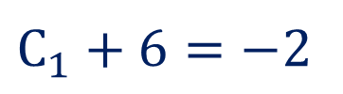









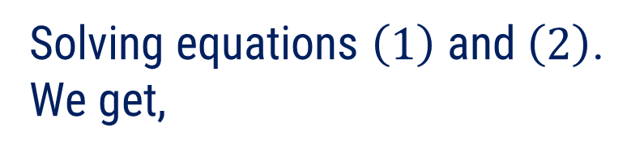










Method 2 ⇝ Example 1 (Continue)
Now, ${a_{n}=a}_{n}^{\left(h\right)}$
Solving equations $\left(1\right)$ and $\left(2\right)$.
We get,
$$a_{n}=$$
$$C_{1}{\left(1\right)}^{n}$$
$$+ C_{2}{\left(2\right)}^{n}$$
Given that,
$$C_{1}+2C_{2}=−2$$
$$a_{1}=−2$$
$$C_{1}+4C_{2}=4$$
$$n=1$$
$$a_{1}=C_{1}{\left(1\right)}^{1}+C_{2}{\left(2\right)}^{1}$$
$$−2C_{2}$$
$$=$$
$$−6$$
$$⇒$$
$$C_{2}=3$$
$$⇒$$
$$−2=C_{1}+2C_{2}$$
$$…\left(1\right)$$
From equation $\left(1\right)$
$$a_{2}=4$$
$$⇒$$
$$C_{1}+6=−2$$
$$n=2$$
$$a_{2}=C_{1}{\left(1\right)}^{2}+C_{2}{\left(2\right)}^{2}$$
$$⇒$$
$$C_{1}=−8$$
$$⇒$$
$$4=C_{1}+4C_{2}$$
$$…\left(2\right)$$
Hence, required solution is
$$a_{n}=\left(−8\right){\left(1\right)}^{n}+3{\left(2\right)}^{n}.$$

Slide 21

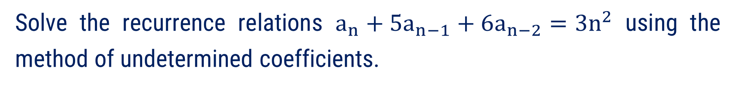

Method 2 ⇝ Example 2
Question:
Solve the recurrence relations $a_{n}+5a_{n−1}+6a_{n−2}=3n^{2}$ using the method of undetermined coefficients.
Solution:
Given recurrence relation is
$$a_{n}+5a_{n−1}+6a_{n−2}=3n^{2}$$
Here, total solution is given by
$$a_{n}=a_{n}^{\left(h\right)}+a_{n}^{\left(p\right)}$$

Slide 22










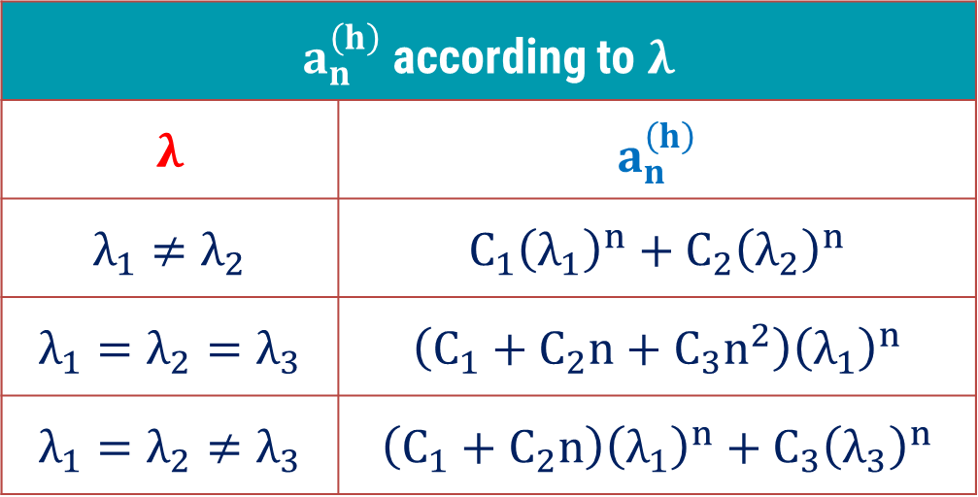



Method 2 ⇝ Example 2 (Continue)
Computing $a_{n}^{\left(h\right)}$
$$a_{n}+5a_{n−1}+6a_{n−2}=3n^{2}$$
The characteristic equation is
$a_{n}^{\left(h\right)}$ according to $λ$
$$λ$$ | $$a_{n}^{\left(h\right)}$$
$$λ_{1}≠λ_{2}$$ | $$C_{1}{\left(λ_{1}\right)}^{n}+C_{2}{\left(λ_{2}\right)}^{n}$$
$$λ_{1}=λ_{2}=λ_{3}$$ | $$\left(C_{1}+C_{2}n+C_{3}n^{2}\right){\left(λ_{1}\right)}^{n}$$
$$λ_{1}=λ_{2}≠λ_{3}$$ | $$\left(C_{1}+C_{2}n\right){\left(λ_{1}\right)}^{n}+C_{3}{\left(λ_{3}\right)}^{n}$$
$$λ^{2}+5λ+6=0$$
$$⇒$$
$$(λ+2)$$
$$(λ+3)$$
$$=0$$
$$⇒$$
$$λ$$
$$=−2,$$
$$−3$$
So, $a_{n}^{\left(h\right)}$
$$=C_{1}{\left(−2\right)}^{n}$$
$$+ C_{2}{\left(−3\right)}^{n}$$

Slide 23
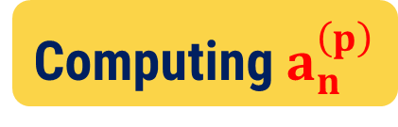
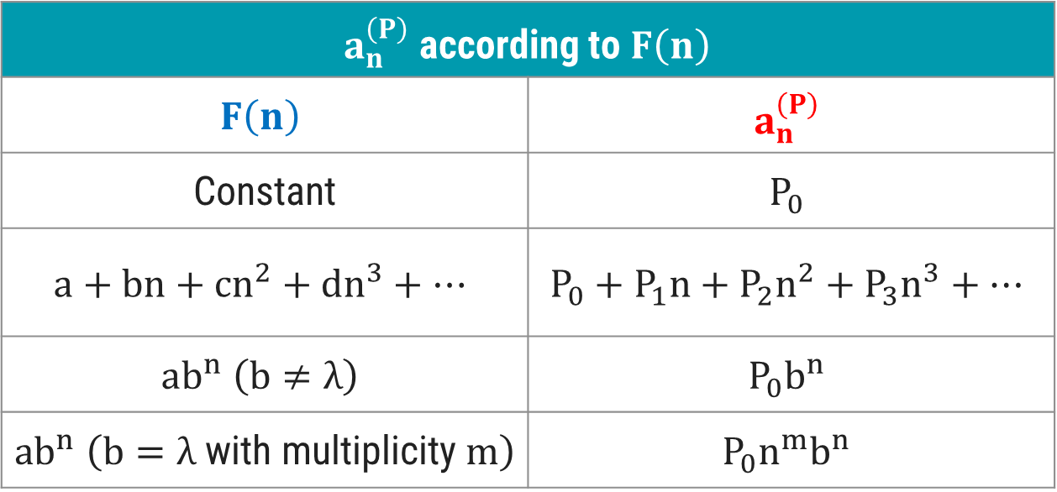

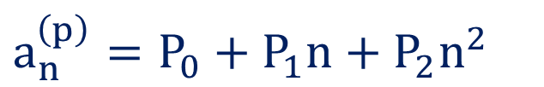

Method 2 ⇝ Example 2 (Continue)
Computing $a_{n}^{\left(p\right)}$
$$a_{n}+5a_{n−1}+6a_{n−2}=3n^{2}$$
Here,
$$F\left(n\right)=3n^{2}$$
Let,
$$a_{n}^{\left(p\right)}=P_{0}+P_{1}n+P_{2}n^{2}$$
$a_{n}^{\left(P\right)}$ according to $F\left(n\right)$
$$F\left(n\right)$$ | $$a_{n}^{\left(P\right)}$$
Constant | $$P_{0}$$
$$a+bn+{cn}^{2}+{dn}^{3}+…$$ | $$P_{0}+P_{1}n+P_{2}n^{2}+P_{3}n^{3}+…$$
$$ab^{n} \left(b≠λ\right)$$ | $$P_{0}b^{n}$$
$ab^{n}$ $\left(b=λ \text{with} \text{multiplicity} m\right)$ | $$P_{0}n^{m}b^{n}$$

Slide 24

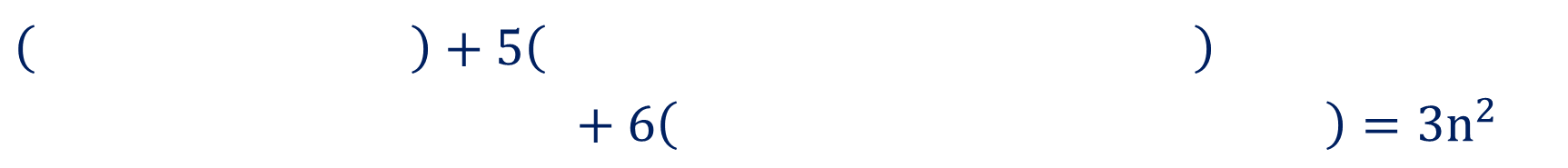
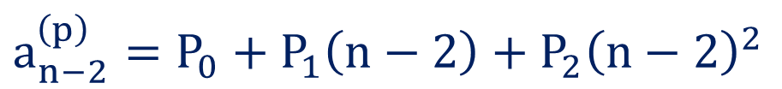
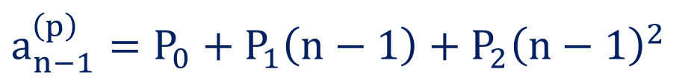


Method 2 ⇝ Example 2 (Continue)
Computing $a_{n}^{\left(p\right)}$
$$a_{n}+5a_{n−1}+6a_{n−2}=3n^{2}$$
Here,
$$F\left(n\right)=3n^{2}$$
Let,
$$a_{n}^{\left(p\right)}=P_{0}+P_{1}n+P_{2}n^{2}$$
$$a_{n−1}^{\left(p\right)}=P_{0}+P_{1}\left(n−1\right)+P_{2}{\left(n−1\right)}^{2}$$
$$a_{n−2}^{\left(p\right)}=P_{0}+P_{1}\left(n−2\right)+P_{2}{\left(n−2\right)}^{2}$$
Substituting these values in given recurrence relation. We get,
$$\left( P_{0}+P_{1}n+P_{2}n^{2} \right)+5\left( P_{0}+P_{1}\left(n−1\right)+P_{2}{\left(n−1\right)}^{2} \right)$$
$$+ 6\left( P_{0}+P_{1}\left(n−2\right)+P_{2}{\left(n−2\right)}^{2} \right)=3n^{2}$$
$$P_{0}+P_{1}n+P_{2}n^{2}$$
$$P_{0}+P_{1}\left(n−1\right)+P_{2}{\left(n−1\right)}^{2}$$
$$P_{0}+P_{1}\left(n−2\right)+P_{2}{\left(n−2\right)}^{2}$$

Slide 25

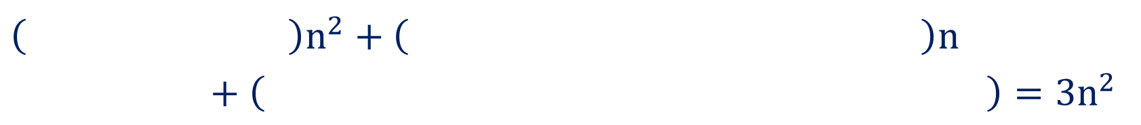








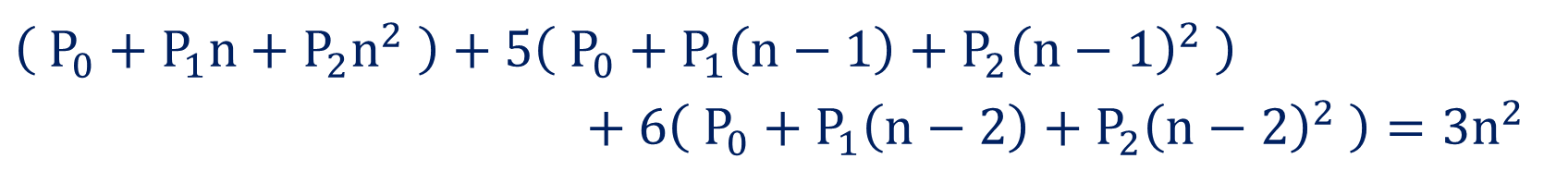

Method 2 ⇝ Example 2 (Continue)
$$\left( P_{0}+P_{1}n+P_{2}n^{2} \right)+5\left( P_{0}+P_{1}\left(n−1\right)+P_{2}{\left(n−1\right)}^{2} \right)$$
$$+ 6\left( P_{0}+P_{1}\left(n−2\right)+P_{2}{\left(n−2\right)}^{2} \right)=3n^{2}$$
$$⇒$$
$$\left( P_{0}+P_{1}n+P_{2}n^{2} \right)$$
$$+ 5\left( P_{0}+P_{1}n−P_{1}+P_{2}n^{2}−2P_{2}n+P_{2} \right)$$
$$+ 6\left( P_{0}+P_{1}n−2P_{1}+P_{2}n^{2}−4P_{2}n+4P_{2} \right)$$
$$=3n^{2}$$
$$⇒$$
$$P_{0}+P_{1}n+P_{2}n^{2}$$
$$+ 5P_{0}+5P_{1}n−5P_{1}+5P_{2}n^{2}−10P_{2}n+5P_{2}$$
$$+ 6P_{0}+6P_{1}n−12P_{1}+6P_{2}n^{2}−24P_{2}n+24P_{2}$$
$$=3n^{2}$$
$$⇒$$
$$\left( P_{2}+5P_{2}+6P_{2} \right)n^{2}+\left( P_{1}+5P_{1}−10P_{2}+6P_{1}−24P_{2} \right)n$$
$$+ \left( P_{0}+5P_{0}−5P_{1}+5P_{2}+6P_{0}−12P_{1}+24P_{2} \right)=3n^{2}$$
$$P_{2}+5P_{2}+6P_{2}$$
$$P_{1}+5P_{1}−10P_{2}+6P_{1}−24P_{2}$$
$$P_{0}+5P_{0}−5P_{1}+5P_{2}+6P_{0}−12P_{1}+24P_{2}$$
$$⇒$$
$$\left(12P_{2}\right)n^{2}+\left({12P}_{1}−34P_{2}\right)n+\left(12P_{0}−17P_{1}+29P_{2}\right)=3 n^{2}$$

Slide 26
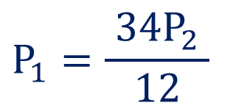
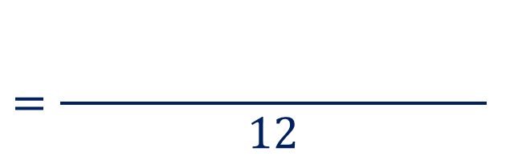



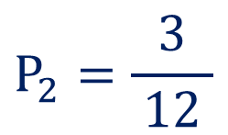
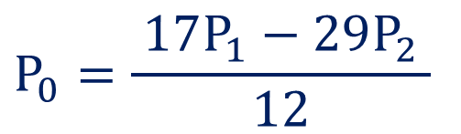
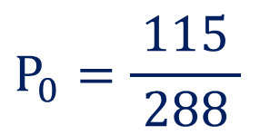
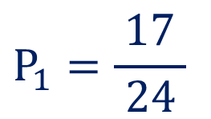





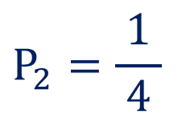



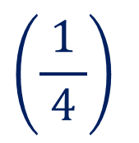
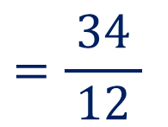



Method 2 ⇝ Example 2 (Continue)
$$\left(12P_{2}\right)n^{2}+\left({12P}_{1}−34P_{2}\right)n+\left(12P_{0}−17P_{1}+29P_{2}\right)=3 n^{2}$$
$$+ 0n+0$$
Comparing coefficients on both sides. We get,
$$12P_{2}=3$$
$${12P}_{1}−34P_{2}=0$$
$$12P_{0}−17P_{1}+29P_{2}=0$$
$$P_{2}=\frac{3}{ 12 }$$
$$P_{1}=\frac{ 34P_{2} }{ 12 }$$
$$P_{0}=\frac{ 17P_{1}−29P_{2} }{ 12 }$$
$$⇒$$
$$⇒$$
$$⇒$$
$$P_{2}=\frac{1}{ 4 }$$
$$=\frac{ 34 }{ 12 }$$
$$\left(\frac{1}{ 4 }\right)$$
$$\left(\frac{17}{ 24 }\right)$$
$$\left(\frac{1}{ 4 }\right)$$
$$\frac{17}{ 24 }$$
$$\frac{1}{ 4 }$$
$$−$$
$$=\frac{ 17\left(\frac{17}{ 24 }\right)− 29\left(\frac{1}{ 4 }\right)}{ 12 }$$
$$17$$
$$29$$
$$P_{1}=\frac{17}{ 24 }$$
$$P_{0}=\frac{115}{ 288 }$$

Slide 27
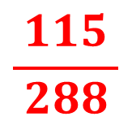

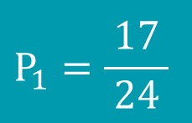
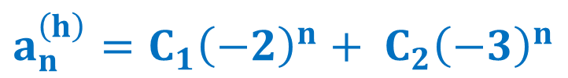
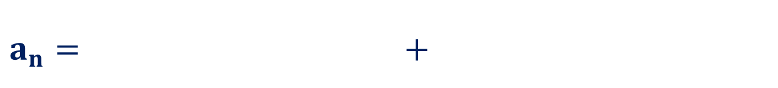
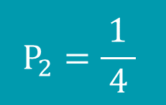
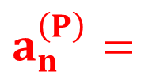
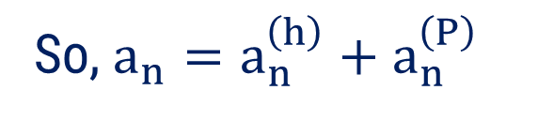
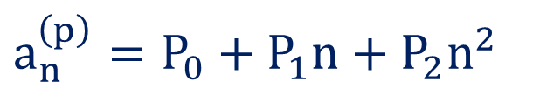
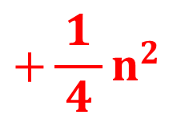
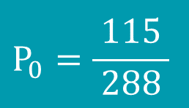
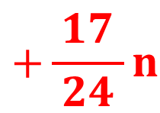

Method 2 ⇝ Example 2 (Continue)
Now,
$$P_{0}=\frac{115}{ 288 }$$
$$P_{1}=\frac{17}{ 24 }$$
$$P_{2}=\frac{1}{ 4 }$$
$$a_{n}^{\left(p\right)}=P_{0}+P_{1}n+P_{2}n^{2}$$
$$\frac{115}{ 288 }$$
$$+\frac{17}{ 24 }n$$
$$+\frac{1}{ 4 }n^{2}$$
$$a_{n}^{\left(h\right)}=C_{1}{\left(−2\right)}^{n}+ C_{2}{\left(−3\right)}^{n}$$
$$a_{n}^{\left(P\right)}=$$
So, ${a_{n}=a}_{n}^{\left(h\right)}+a_{n}^{\left(P\right)}$
$$\frac{115}{ 288 }+\frac{17}{ 24 }n+\frac{1}{ 4 }n^{2}$$
$$a_{n}=C_{1}{\left(−2\right)}^{n}+ C_{2}{\left(−3\right)}^{n}+\frac{115}{ 288 }+\frac{17}{ 24 }n+\frac{1}{ 4 }n^{2}$$
$$C_{1}{\left(−2\right)}^{n}+ C_{2}{\left(−3\right)}^{n}$$
Since there are no initial conditions given, this is our required solution.

Slide 28


Method 2 ⇝ Example 3
Question:
Solve the recurrence relations using the method of undetermined coefficients:
$$a_{n}+6a_{n−1}+12a_{n−2}+8a_{n−3}=2^{n}, n≥3; a_{0}=a_{1}=0, a_{2}=2$$
Solution:
Given recurrence relation is
$$a_{n}+6a_{n−1}+12a_{n−2}+8a_{n−3}=2^{n}$$
Here, total solution is given by
$$a_{n}=a_{n}^{\left(h\right)}+a_{n}^{\left(p\right)}$$

Slide 29














Method 2 ⇝ Example 3 (Continue)
Computing $a_{n}^{\left(h\right)}$
$$a_{n}+6a_{n−1}+12a_{n−2}+8a_{n−3}=2^{n}$$
The characteristic equation is
$a_{n}^{\left(h\right)}$ according to $λ$
$$λ$$ | $$a_{n}^{\left(h\right)}$$
$$λ_{1}≠λ_{2}$$ | $$C_{1}{\left(λ_{1}\right)}^{n}+C_{2}{\left(λ_{2}\right)}^{n}$$
$$λ_{1}=λ_{2}=λ_{3}$$ | $$\left(C_{1}+C_{2}n+C_{3}n^{2}\right){\left(λ_{1}\right)}^{n}$$
$$λ_{1}=λ_{2}≠λ_{3}$$ | $$\left(C_{1}+C_{2}n\right){\left(λ_{1}\right)}^{n}+C_{3}{\left(λ_{3}\right)}^{n}$$
$$λ^{3}+6λ^{2}+12λ+8=0$$
$$⇒$$
$${\left(λ+2\right)}^{3}$$
$$=0$$
$$⇒$$
$$λ$$
$$=−2,$$
$$−2,$$
$$−2$$
So, $a_{n}^{\left(h\right)}$
$$=\left(C_{1}+C_{2}n+C_{3}n^{2}\right)$$
$${\left(−2\right)}^{n}$$

Slide 30












Method 2 ⇝ Example 3 (Continue)
Computing $a_{n}^{\left(p\right)}$
$$a_{n}+6a_{n−1}+12a_{n−2}+8a_{n−3}=2^{n}$$
Here,
$$F\left(n\right)=2^{n}$$
$$λ=−2, −2, −2$$
$a_{n}^{\left(P\right)}$ according to $F\left(n\right)$
$$F\left(n\right)$$ | $$a_{n}^{\left(P\right)}$$
Constant | $$P_{0}$$
$$a+bn+{cn}^{2}+{dn}^{3}+…$$ | $$P_{0}+P_{1}n+P_{2}n^{2}+P_{3}n^{3}+…$$
$$ab^{n} \left(b≠λ\right)$$ | $$P_{0}b^{n}$$
$ab^{n}$ $\left(b=λ \text{with} \text{multiplicity} m\right)$ | $$P_{0}n^{m}b^{n}$$
Let,
$$a_{n}^{\left(p\right)}=P_{0} 2^{n}$$
$$a_{n−1}^{\left(p\right)}=P_{0} 2^{n−1}$$
$$a_{n−2}^{\left(p\right)}=P_{0} 2^{n−2}$$
$$a_{n−3}^{\left(p\right)}=P_{0} 2^{n−3}$$
Substituting these values in given recurrence relation. We get,
$$\left( P_{0} 2^{n} \right)+6\left( P_{0} 2^{n−1} \right)+12\left( P_{0} 2^{n−2} \right)+8\left( P_{0} 2^{n−3} \right)=2^{n}$$
$$P_{0} 2^{n}$$
$$P_{0} 2^{n−1}$$
$$P_{0} 2^{n−2}$$
$$P_{0} 2^{n−3}$$

Slide 31





























Method 2 ⇝ Example 3 (Continue)
$$\left( P_{0} 2^{n} \right)+6\left( P_{0} 2^{n−1} \right)+12\left( P_{0} 2^{n−2} \right)+8\left( P_{0} 2^{n−3} \right)=2^{n}$$
$$\left(\frac{1}{ 2 }\right)$$
$$\left(\frac{1}{ 2^{2} }\right)$$
$$\left(\frac{1}{ 2^{3} }\right)$$
$$⇒$$
$$P_{0} 2^{n}$$
$$+ 6P_{0} 2^{n}$$
$$+ 12P_{0} 2^{n}$$
$$+ 8P_{0} 2^{n}$$
$$=2^{n}$$
$$+ \frac{6}{ 2 }P_{0} 2^{n}$$
$$+ \frac{12}{4}P_{0} 2^{n}$$
$$+ \frac{8}{ 8 }P_{0} 2^{n}$$
$$⇒$$
$$P_{0} 2^{n}$$
$$=2^{n}$$
$$⇒$$
$$\left( P_{0}+3P_{0}+3P_{0}+P_{0} \right)$$
$$P_{0}+3P_{0}+3P_{0}+P_{0}$$
$$2^{n}$$
$$=2^{n}$$
$$⇒$$
$$\left(8P_{0}\right)$$
$$2^{n}$$
$$=$$
$$1⋅$$
$$2^{n}$$
$$P_{0}=\frac{1}{ 8 }$$
Comparing coefficients on both sides. We get,
$${8P}_{0}=1$$
$$⇒$$

Slide 32










Method 2 ⇝ Example 3 (Continue)
Now,
$$P_{0}=\frac{1}{ 8 }$$
$$a_{n}^{\left(p\right)}=P_{0} 2^{n}$$
$$\frac{1}{ 8 }2^{n}$$
$$=\frac{1}{ 2^{3} }2^{n}$$
$$a_{n}^{\left(P\right)}=$$
$$=2^{n−3}$$
$$a_{n}^{\left(h\right)}=\left(C_{1}+C_{2}n+C_{3}n^{2}\right){\left(−2\right)}^{n}$$
So, ${a_{n}=a}_{n}^{\left(h\right)}+a_{n}^{\left(P\right)}$
$$a_{n}=\left(C_{1}+C_{2}n+C_{3}n^{2}\right){\left(−2\right)}^{n}+2^{n−3}$$
$$\left(C_{1}+C_{2}n+C_{3}n^{2}\right){\left(−2\right)}^{n}$$
$$2^{n−3}$$

Slide 33







Method 2 ⇝ Example 3 (Continue)
Given that,
$$a_{n}=\left(C_{1}+C_{2}n+C_{3}n^{2}\right){\left(−2\right)}^{n}+2^{n−3}$$
$$a_{0}=0$$
$$n=0$$
$$a_{0}=\left(C_{1}+C_{2}\left(0\right)+C_{3}{\left(0\right)}^{2}\right){\left(−2\right)}^{0}+2^{0−3}$$
$$0=C_{1}+\frac{1}{ 8 }$$
$$⇒$$
$$C_{1}=−\frac{1}{ 8 }$$
$$⇒$$

Slide 34



















Method 2 ⇝ Example 3 (Continue)
$$a_{n}=\left(C_{1}+C_{2}n+C_{3}n^{2}\right){\left(−2\right)}^{n}+2^{n−3}$$
$$a_{1}=0$$
$$n=1$$
$$a_{1}=\left(C_{1}+C_{2}\left(1\right)+C_{3}{\left(1\right)}^{2}\right){\left(−2\right)}^{1}+2^{1−3}$$
$$+\frac{1}{ 4 }$$
$$⇒$$
$$0=\left(C_{1}+C_{2}+C_{3}\right)\left(−2\right)$$
$$=−\frac{1}{ 4\left(−2\right) }$$
$$=\frac{1}{ 8 }$$
$$⇒$$
$$C_{1}+C_{2}+C_{3}$$
$$−\frac{1}{ 8 }+C_{2}+C_{3}$$
$$=\frac{1}{ 8 }$$
$$⇒$$
$$C_{2}+C_{3}$$
$$=\frac{1}{ 8 }$$
$$+\frac{1}{ 8 }$$
$$C_{2}+C_{3}$$
$$=\frac{1}{ 4 }$$
$$⇒$$
$$⇒$$
$$…\left(1\right)$$

Slide 35























Method 2 ⇝ Example 3 (Continue)
$$a_{n}=\left(C_{1}+C_{2}n+C_{3}n^{2}\right){\left(−2\right)}^{n}+2^{n−3}$$
$$a_{2}=2$$
$$n=2$$
$$a_{2}=\left(C_{1}+C_{2}\left(2\right)+C_{3}{\left(2\right)}^{2}\right){\left(−2\right)}^{2}+2^{2−3}$$
$$+\frac{1}{ 2 }$$
$$⇒$$
$$2=\left(C_{1}+2C_{2}+4C_{3}\right)\left(4\right)$$
$$=2−\frac{1}{ 2 }$$
$$=\frac{3}{ 2 }$$
$$⇒$$
$$\left(C_{1}+2C_{2}+4C_{3}\right)\left(4\right)$$
$$−\frac{1}{ 8 }+2C_{2}+4C_{3}$$
$$=\frac{3}{ 8 }$$
$$=\frac{1}{ 2 }$$
$$⇒$$
$$⇒$$
$$2C_{2}+4C_{3}$$
$$=\frac{3}{ 8 }$$
$$+ \frac{1}{ 8 }$$
$$=\frac{1}{ 4 }$$
$$⇒$$
$$2C_{2}+4C_{3}$$
$$⇒$$
$$C_{2}+2C_{3}$$
$$…\left(2\right)$$

Slide 36


















Method 2 ⇝ Example 3 (Continue)
Solving equations $\left(1\right)$ and $\left(2\right)$. We get,
$$C_{2}+C_{3}=\frac{1}{ 4 } …\left(1\right)$$
$$C_{2}+C_{3} =\frac{1}{ 4 }$$
From equation $\left(1\right)$
$$C_{2}+2C_{3}=\frac{1}{ 4 } …\left(2\right)$$
$$C_{2}+0=\frac{1}{ 4 }$$
$$C_{2}+2C_{3}=\frac{1}{ 4 }$$
$$⇒$$
$$C_{2}=\frac{1}{ 4 }$$
$$⇒$$
$$− C_{3}$$
$$=$$
$$0$$
$$⇒$$
$$C_{3}=0$$
$$a_{n}=\left(C_{1}+C_{2}n+C_{3}n^{2}\right){\left(−2\right)}^{n}+2^{n−3}$$
Hence, required solution is
$$a_{n}=\left(−\frac{1}{ 8 }+\frac{1}{ 4 }n\right){\left(−2\right)}^{n}+{\left(2\right)}^{\left(n−3\right)}$$
$$C_{1}=−\frac{1}{ 8 }$$

Slide 37


Method 2 ⇝ Example 4
Question:
Solve the recurrence relation $a_{n}−5a_{n−1}+6a_{n−2}=n+2^{n};$ $n≥2, a_{0}=1, a_{1}=1$ using the method of undetermined coefficients.
Solution:
Given recurrence relation is
$$a_{n}−5a_{n−1}+6a_{n−2}=n+2^{n}$$
Here, total solution is given by
$$a_{n}=a_{n}^{\left(h\right)}+a_{n}^{\left(p\right)}$$

Slide 38















Method 2 ⇝ Example 4 (Continue)
Computing $a_{n}^{\left(h\right)}$
$$a_{n}−5a_{n−1}+6a_{n−2}=n+2^{n}$$
The characteristic equation is
$$λ^{2}−5λ+6=0$$
$a_{n}^{\left(h\right)}$ according to $λ$
$$λ$$ | $$a_{n}^{\left(h\right)}$$
$$λ_{1}≠λ_{2}$$ | $$C_{1}{\left(λ_{1}\right)}^{n}+C_{2}{\left(λ_{2}\right)}^{n}$$
$$λ_{1}=λ_{2}=λ_{3}$$ | $$\left(C_{1}+C_{2}n+C_{3}n^{2}\right){\left(λ_{1}\right)}^{n}$$
$$λ_{1}=λ_{2}≠λ_{3}$$ | $$\left(C_{1}+C_{2}n\right){\left(λ_{1}\right)}^{n}+C_{3}{\left(λ_{3}\right)}^{n}$$
$$⇒$$
$$(λ−2)$$
$$(λ−3)$$
$$=0$$
$$⇒$$
$$λ$$
$$=2,$$
$$3$$
So, $a_{n}^{\left(h\right)}$
$$=C_{1}{\left(2\right)}^{n}$$
$$+ C_{2}{\left(3\right)}^{n}$$

Slide 39






Method 2 ⇝ Example 4 (Continue)
Computing $a_{n}^{\left(p\right)}$
$$a_{n}−5a_{n−1}+6a_{n−2}=n+2^{n}$$
Here,
$$F\left(n\right)=n+2^{n}$$
$$λ=2, 3$$
Let,
$$a_{n}^{\left(p\right)}$$
$$=P_{0} +P_{1}n$$
$$+ P_{0} n 2^{n}$$
$a_{n}^{\left(P\right)}$ according to $F\left(n\right)$
$$F\left(n\right)$$ | $$a_{n}^{\left(P\right)}$$
Constant | $$P_{0}$$
$$a+bn+{cn}^{2}+{dn}^{3}+…$$ | $$P_{0}+P_{1}n+P_{2}n^{2}+P_{3}n^{3}+…$$
$$ab^{n} \left(b≠λ\right)$$ | $$P_{0}b^{n}$$
$ab^{n}$ $\left(b=λ \text{with} \text{multiplicity} m\right)$ | $$P_{0}n^{m}b^{n}$$

Slide 40





Method 2 ⇝ Example 4 (Continue)
Computing $a_{n}^{\left(p\right)}$
$$a_{n}−5a_{n−1}+6a_{n−2}=n+2^{n}$$
Here,
$$F\left(n\right)=n+2^{n}$$
Let,
$$a_{n}^{\left(p\right)}$$
$$=P_{0} +P_{1}n$$
$$+ P_{0} n 2^{n}$$
$$a_{n−1}^{\left(p\right)}=P_{0} +P_{1}\left(n−1\right)+ P_{0} \left(n−1\right) 2^{n−1}$$
$$a_{n−2}^{\left(p\right)}=P_{0} +P_{1}\left(n−2\right)+ P_{0} \left(n−2\right) 2^{n−2}$$
Substituting these values in given recurrence relation. We get,
$$\left( P_{0} +P_{1}n+ P_{0} n 2^{n} \right)−5\left( P_{0} +P_{1}\left(n−1\right)+ P_{0} \left(n−1\right) 2^{n−1} \right)$$
$$+6\left( P_{0} +P_{1}\left(n−2\right)+ P_{0} \left(n−2\right) 2^{n−2} \right)=n+2^{n}$$
$$P_{0} +P_{1}n+ P_{0} n 2^{n}$$
$$P_{0} +P_{1}\left(n−1\right)+ P_{0} \left(n−1\right) 2^{n−1}$$
$$P_{0} +P_{1}\left(n−2\right)+ P_{0} \left(n−2\right) 2^{n−2}$$

Slide 41




















Method 2 ⇝ Example 4 (Continue)
$$\left( P_{0} +P_{1}n+ P_{0} n 2^{n} \right)−5\left( P_{0} +P_{1}\left(n−1\right)+ P_{0} \left(n−1\right) 2^{n−1} \right)$$
$$+6\left( P_{0} +P_{1}\left(n−2\right)+ P_{0} \left(n−2\right) 2^{n−2} \right)=n+2^{n}$$
$$⇒$$
$$\left( P_{0}+P_{1}n+P_{2}n 2^{n} \right)$$
$$− 5\left( P_{0}+P_{1}n−P_{1}+P_{2}\left(n−1\right)2^{n−1} \right)$$
$$+ 6\left( P_{0}+P_{1}n−2P_{1}+P_{2}\left(n−2\right)2^{n−2} \right)$$
$$=n+2^{n}$$
$$⇒$$
$$P_{0}+P_{1}n+P_{2}n 2^{n}$$
$$−5P_{0}−5P_{1}n+5P_{1}−5P_{2}\left(n−1\right)2^{n−1}$$
$$+6P_{0}+6P_{1}n−12P_{1}+6P_{2}\left(n−2\right)2^{n−2}$$
$$=n+2^{n}$$
$$\left( P_{1}−5P_{1}+6P_{1} \right)n+\left( P_{0}−5P_{0}+5P_{1}+6P_{0}−12P_{1} \right)$$
$$+P_{2}n 2^{n}+\left( −5P_{2}n+5P_{2} \right)2^{n−1}+\left( 6P_{2}n−12P_{2} \right)2^{n−2}=n+2^{n}$$
$$⇒$$
$$\left( P_{1}−5P_{1}+6P_{1} \right)n+\left( P_{0}−5P_{0}+5P_{1}+6P_{0}−12P_{1} \right)$$
$$+P_{2}n 2^{n}+\left( −5P_{2}n+5P_{2} \right)2^{n−1}+\left( 6P_{2}n−12P_{2} \right)2^{n−2}=n+2^{n}$$
$$P_{1}−5P_{1}+6P_{1}$$
$$P_{0}−5P_{0}+5P_{1}+6P_{0}−12P_{1}$$
$$+P_{2}n 2^{n}$$
$$+ \left( −5P_{2}n+5P_{2} \right)$$
$$2^{n−1}$$
$$+ \left( 6P_{2}n−12P_{2} \right)$$
$$2^{n−2}$$
$$=n+2^{n}$$

Slide 42













Method 2 ⇝ Example 4 (Continue)
$$\left( P_{1}−5P_{1}+6P_{1} \right)n+\left( P_{0}−5P_{0}+5P_{1}+6P_{0}−12P_{1} \right)$$
$$+P_{2}n 2^{n}+\left( −5P_{2}n+5P_{2} \right)2^{n−1}+\left( 6P_{2}n−12P_{2} \right)2^{n−2}=n+2^{n}$$
$$+\frac{1}{ 2 }\left( −5P_{2}n+5P_{2} \right) 2^{n}$$
$$⇒$$
$$\left( 2P_{1} \right) n$$
$$+\left( 2P_{0}−7P_{1} \right)$$
$$+{ P}_{2}n 2^{n}$$
$$+\frac{1}{ 4 }\left( 6P_{2}n−12P_{2} \right) 2^{n}$$
$$=n+2^{n}$$
$$⇒$$
$$\left( 2P_{1} \right) n+\left( 2P_{0}−7P_{1} \right)$$
$$+\left( P_{2}n−\frac{5}{ 2 }P_{2}n+\frac{5}{ 2 }P_{2}+\frac{3}{ 2 }P_{2}n−3P_{2} \right)2^{n}=n+2^{n}$$
$$− \frac{5}{ 2 }P_{2}n+\frac{5}{ 2 }P_{2}$$
$$+ \frac{3}{ 2 }P_{2}n−3P_{2}$$
$$P_{2}n$$

Slide 43












Method 2 ⇝ Example 4 (Continue)
$$\left( 2P_{1} \right) n+\left( 2P_{0}−7P_{1} \right)$$
$$+\left( P_{2}n−\frac{5}{ 2 }P_{2}n+\frac{5}{ 2 }P_{2}+\frac{3}{ 2 }P_{2}n−3P_{2} \right)2^{n}=n+2^{n}$$
$$\left( 2P_{1} \right) n+\left( 2P_{0}−7P_{1} \right)+\left( \frac{5}{ 2 }P_{2}n−\frac{5}{ 2 }P_{2}n−\frac{1}{ 2 }P_{2} \right) 2^{n}=n+2^{n}$$
$$\frac{5}{ 2 }P_{2}n$$
$$−\frac{5}{ 2 }P_{2}n$$
$$−\frac{1}{ 2 }P_{2}$$
$$⇒$$
$$\left( 2P_{1} \right) n+\left( 2P_{0}−7P_{1} \right)−\frac{1}{ 2 }P_{2} 2^{n}$$
$$⇒$$
$$=n+0+2^{n}$$
Comparing coefficients on both sides. We get,
$$−\frac{1}{ 2 }P_{2}=1$$
$$2P_{1}=1$$
$$2P_{0}−7P_{1}=0$$

Slide 44












Method 2 ⇝ Example 4 (Continue)
$$−\frac{1}{ 2 }P_{2}=1$$
$$2P_{1}=1$$
$$2P_{0}−7P_{1}=0$$
$$P_{1}=\frac{1}{ 2 }$$
$$P_{0}=\frac{7}{ 2 }P_{1}$$
$$P_{2}=−2$$
$$⇒$$
$$⇒$$
$$⇒$$
$$P_{0}=\frac{7}{ 2 }$$
$$\left(\frac{1}{ 2 }\right)$$
$$P_{0}=\frac{7}{ 4 }$$

Slide 45













Method 2 ⇝ Example 4 (Continue)
Now,
$$P_{0}=\frac{7}{ 4 }$$
$$P_{1}=\frac{1}{ 2 }$$
$$P_{2}=−2$$
$$a_{n}^{\left(p\right)}=P_{0} +P_{1}n+ P_{0} n 2^{n}$$
$$a_{n}^{\left(p\right)}$$
$$=\frac{7}{ 4 }$$
$$+ \frac{1}{ 2 }n$$
$a_{n}^{\left(h\right)}=C_{1}{\left(2\right)}^{n}+ C_{2}{\left(3\right)}^{n}$
$$−2n 2^{n}$$
So, ${a_{n}=a}_{n}^{\left(h\right)}+a_{n}^{\left(P\right)}$
$$a_{n}=C_{1}{\left(2\right)}^{n}+ C_{2}{\left(3\right)}^{n}+\frac{7}{ 4 }+ \frac{1}{ 2 }n−2n 2^{n}$$
$$\frac{7}{ 4 }+ \frac{1}{ 2 }n−2n 2^{n}$$
$$C_{1}{\left(2\right)}^{n}+ C_{2}{\left(3\right)}^{n}$$

Slide 46











Method 2 ⇝ Example 4 (Continue)
$$a_{n}=C_{1}{\left(2\right)}^{n}+ C_{2}{\left(3\right)}^{n}+\frac{7}{ 4 }+ \frac{1}{ 2 }n−2n 2^{n}$$
Given that,
$$a_{0}=1$$
$$a_{0}=C_{1}{\left(2\right)}^{0}+ C_{2}{\left(3\right)}^{0}+\frac{7}{ 4 }+ \frac{1}{ 2 }\left(0\right)−2\left(0\right) 2^{0}$$
$$n=0$$
$$1=C_{1}+ C_{2}+\frac{7}{ 4 }$$
$$⇒$$
$$C_{1}+ C_{2}=1−\frac{7}{ 4 }$$
$$⇒$$
$$C_{1}+ C_{2}=−\frac{3}{ 4 }$$
$$⇒$$
$$…\left(1\right)$$

Slide 47











Method 2 ⇝ Example 4 (Continue)
$$a_{n}=C_{1}{\left(2\right)}^{n}+ C_{2}{\left(3\right)}^{n}+\frac{7}{ 4 }+ \frac{1}{ 2 }n−2n 2^{n}$$
Given that,
$$a_{1}=1$$
$$a_{1}=C_{1}{\left(2\right)}^{1}+ C_{2}{\left(3\right)}^{1}+\frac{7}{ 4 }+ \frac{1}{ 2 }\left(1\right)−2\left(1\right) 2^{1}$$
$$n=1$$
$$1={2C}_{1}+ {3C}_{2}+\frac{7}{ 4 }+\frac{1}{ 2 }−4$$
$$⇒$$
$$2C_{1}+3C_{2}=1+4−\frac{7}{ 4 }−\frac{1}{ 2 }$$
$$=5−\frac{9}{ 4 }$$
$$=\frac{ 11 }{ 4 }$$
$$⇒$$
$$2C_{1}+3C_{2}=\frac{ 11 }{ 4 }$$
$$⇒$$
$$…\left(2\right)$$

Slide 48


















Method 2 ⇝ Example 4 (Continue)
Solving equations $\left(1\right)$ and $\left(2\right)$. We get,
$$C_{1}+C_{2}=−\frac{3}{ 4 } …\left(1\right)$$
$$2×$$
$$2C_{1}+2C_{2}=−\frac{6}{ 4 }$$
From equation $\left(1\right)$
$$2C_{1}+3C_{2}=\frac{ 11 }{ 4 } …\left(2\right)$$
$$2C_{1}+3C_{2}=\frac{ 11 }{ 4 }$$
$$C_{1}+\frac{ 17 }{4}=−\frac{3}{ 4 }$$
$$⇒$$
$$C_{1}=−\frac{20}{ 4 }$$
$$⇒$$
$$−\frac{ 17 }{4}$$
$$− C_{2}$$
$$=$$
$$⇒$$
$$C_{1}=−5$$
$$C_{2}=\frac{ 17 }{4}$$
$$⇒$$

Slide 49




Method 2 ⇝ Example 4 (Continue)
Now,
$$C_{1}=−5$$
$$a_{n}=C_{1}{\left(2\right)}^{n}+ C_{2}{\left(3\right)}^{n}+\frac{7}{ 4 }+ \frac{1}{ 2 }n−2n 2^{n}$$
$$C_{2}=\frac{ 17 }{4}$$
Hence, required solution is
$$a_{n}=−5{\left(2\right)}^{n}+\frac{ 17 }{4}{\left(3\right)}^{n}+\frac{7}{ 4 }+ \frac{1}{ 2 }n−2n 2^{n}$$

Slide 50
THANK YOU
Prof. Vasudev Barjadiya
Department of Humanities & Science
vasudev.barjadiya@darshan.ac.in
901 64 27 200

