Slide 1


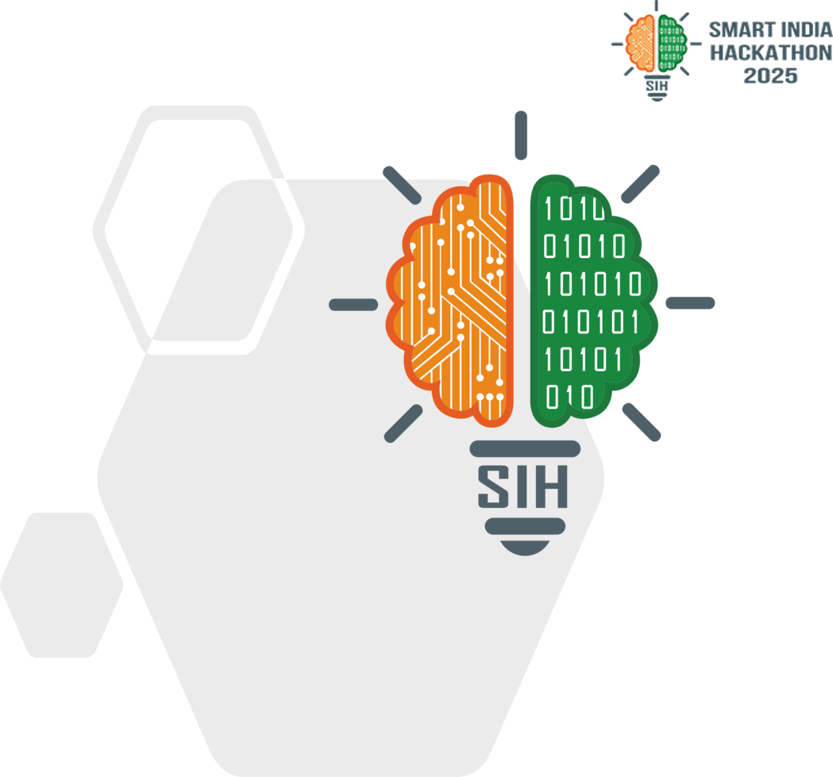
SMART INDIA HACKATHON 2026
Problem Statement ID: SIH26076
Problem Statement Title: Development of personalized homepage for 'Mausam' mobile application
Nodal Ministry / Organization: Ministry of Earth Sciences (MoES) / IMD
Theme & Category: Smart Automation | Software
Team Name: Team Mausam
Package: com.teammausam.mausam_app
Github Repo Link: github.com/Shreyansh303/team_mausam_sih_2026
Demo: https://www.youtube.com/watch?v=dAnlxq_2jj8
Target OS: Android 7.0+ (minSdk 24), ios & Flutter Web

Slide 2
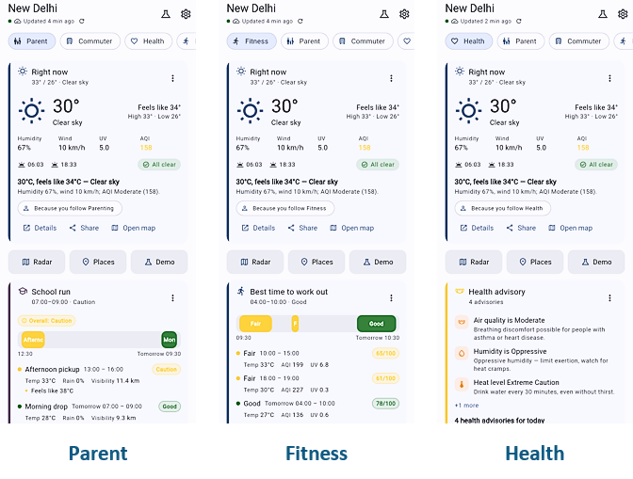

SOLUTION OVERVIEW
Team
Mausam
PROPOSED SOLUTION
PROTOTYPE
Users choose 1–3 personas, and the engine ranks 33 card types by persona affinity to build a personalized feed.
Urgency comes first, regardless of preference. A warning with urgency ≥ 0.8 stays pinned for all 8 personas, ensuring critical alerts reach everyone.
pytest -q → 386 passed · flutter test →125 passed
flutter analyze → clean · 10/10 demo steps PASS
63 screenshots · 115 commits
Flutter (Frontend): onboarding, ranked home, 15 renderer kinds across 33 card types, full-screen detail page each, radar map, saved places, settings, demo sheet, WebSocket client, offline cache, en/hi complete.
The feed is easy to understand and adapts over time. Each card shows up to 4 reasons for why it appears, while learning stays limited so important warnings are never buried.
Time, season, location, elevation, and active warnings shape what users see. For example, a parent sees School Run first in the morning, but not at night.
FastAPI (Backend): provider chain, 33 card builders, the engine, auth, saved places, events, admin console, /ws/alerts, Docker + Render config, GitHub Actions CI.
WHY WE STAND OUT
Server-driven
Change the homepage from the backend—no app update needed.
Honest data:
Estimated data is clearly marked, with no fake IMD data.
Smart ranking
Cards are ranked based on relevance, context, and urgency.
Live updates
New warnings can instantly change what users see.
Made for real phones Lightweight, works offline, and stays accessible.
Multilingual
Translates cards, advice, and actions—not just buttons.
Page 2
@SIH Idea submission

Slide 3





Team
Mausam
TECHNICAL APPROACH
ARCHITECTURE & RESILIENT DATA PIPELINE
THE SCORING FORMULA
Flutter App
FastAPI
External Data Sources
1
GATE
2
RELEVANCE
3
CONTEXT
4
URGENCY
5
ENGAGEMENT
GET /api/v1/home
Receives request and orchestrates the pipeline
Eligibility
User Fit
When it Matters
Data Driven
Learn From User
Remove hidden cards
Remove cards whose preconditions fail
rel = min(1, max(contribs) + 0.15 x (Σcontribs -max(contribs)))
ctx = clamp(time x season,
0.4, 1.6)
Derived directly from the current data:
eng = 0.25 x tanh((
taps + 2.expands +
3.pins - 3.dismisses)/8)
IMD
Open-Meteo
Estimated
Tide → Coastal location
Warnings → Active warning
Packing → Saved place
Heat → feels_like ≥ 35°C
Contribution =
Persona Weight x Card affinity
Time-of-day multiplier
seasonal multiplier
Red heatwave : 1.0
AQI Very poor : 0.75
Dense fog : 0.8
Calm sea : 0
Taps → positive
Expands → stronger positive
Pins → strongest positive
Dismisses → negative
Snapshot Assembly
Derived Metrices
Engine
Explain
POST
/events
Flutter
App
forecast, air quality, marine, radar
AQI, heat index, wind chill rain, waves, commute, more
gate
relevance
multiplier
localized card
payloads
batched <=100
Ranked, ready to draw
Primary persona: 1.0
Secondary personas: 0.7
Base relevance: 1.0
score
learning
urgency
Keeps context impact between 0.4 - 1.6
Range: -0.25 to +0.25
Tech Stack
FINAL SCORE
Score = 0.5 x rel x ctx + 0.5 x urg + eng
MOBILE
Flutter 3.47 (Android/iOS/web) · Riverpod · go_router · Dio · flutter_map · fl_chart · ARB
DATA SOURCES
BACKEND
IMD current_wx_api · nowcastapi · warnings_district_api · aws_data_api
Open-Meteo forecast / air / marine / geocoding
FastAPI · Python 3.13 · Pydantic v2 · httpx · SQLAlchemy 2
ENGINE
Pure Python, no I/O — catalog · context · scoring · explain · learning · 33 builders
Status:
401 — needs IP whitelisting. Provider detects it, backs off 10 min, falls through
Status:
keyless 200
STORAGE
Used for:
current + hourly + 16-day, UV, visibility, soil moisture & temp, sunrise/sunset; PM2.5/PM10/O₃/NO₂/SO₂/CO → CPCB scale; waves, swell, SST
SQLite default → PostgreSQL via DATABASE_URL
Used for:
station obs, 3-h nowcast, district warnings
CACHE
In-process TTL → Redis via REDIS_URL
LIVE ALERTS
WebSocket /ws/alerts (FCM = production transport, designed)
BigDataCloud reverse geocode · RainViewer
Open-Meteo forecast / air / marine / geocoding
AUTH
Guest token + demo OTP, JWT HS256
DEPLOY
Docker · infra/render.yaml · APK via GitHub Actions artifact
Status:
keyless 200
Used for:
lat/lon → district/state; radar frames + tiles
Status:
optional free key
Used for:
station AQI / real traffic — estimated without them
Page 3
@SIH Idea submission

Slide 4
Team
Mausam
FEASIBILITY AND VIABILITY
RIGOR, METRICS & RISK MITIGATION
FEASIBILITIES
TECHNICAL
RISKS → MITIGATION
Already green in CI. The engine is I/O-free, so scaling /home only scales a cache; the warm path stays in-process at ~2 ms.
providers/imd.py handles 401s and retries after 10 min. Once approved, IMD goes live via whitelisting—no code changes.
IMD APIs need whitelisting, answer 401 from any un-approved host
→
OPERATIONAL
Zero-setup by design: no API key, Docker, or DB server. SQLite initializes on first boot, with Render deployment via blueprint. One script takes a fresh machine from clone to passing tests.
ECONOMIC
A judged demo depends on the network
→
Offline demo: cached home renders with freshness; if cleared, “Sample data” appears.
All default data sources are free and keyless. Paid sources fall back to labelled estimates, while the demo runs on free Render hosting.
INSTITUTIONAL
Server-driven cards turn homepage updates into backend deployments, not app-store releases. The IMD provider is ready and can be enabled by whitelisting—no code change needed.
→
"source": "estimated" + Estimated chip + tides disclaimer, enforced by the product principles in VISION.md and verified in QA step 4d.
Modelled values mistaken for observations
EVIDENCE
Card types · renderer kinds · personas
Payload
Scenario overlays
Warm /home
Release APK
Languages offered · complete
Cities · coastal points in the offline gazetteer
"Show less" taps to demote a card out of the feed
≤4 reasons/card; formula in docs/03; 9 tests cover determinism, warnings, coastal gating, and personas.
5 • 2
A ranker that cannot be explained cannot be operated
→
33 · 15 · 8
34.5 KB full → 13.5 KB lite
212 • 102
10 / 10
2 ms server-side · 4.6 ms median round trip · 3.6 ms under
Learning could bury a safety-critical card
→
Engagement stays within ±0.25; urgency ≥0.8 keeps red warnings pinned.
3 (rank 3 → 8, score 0.470 → 0.268)
62.5 MB, 3 ABIs, minSdk 24 / targetSdk 36
Page 4
@SIH Idea submission

Slide 5






Team
Mausam
IMPACT AND BENEFITS
ECONOMIC BENEFITS
ENVIRONMENTAL BENEFITS
SOCIAL BENIFITS
Protects farmer income by reducing fertilizer losses and improving efficiency, while mitigating weather-related economic risks for coastal communities.
Root-zone moisture, rainfall, AQI, Douglas Sea State, and harmonic tides help farmers, communities, and coastal users make safer environmental decisions.
CPCB AQI categories prompt mask and asthma advisories, helping vulnerable groups take timely precautions against harmful pollution.
SAFETY
TIME
TRUST
REACH
OPERABILITY FOR IMD
Orange+ pins warnings for every persona and pushes them to connected users in milliseconds.(17.7 ms measured)
The answer is on the first screen, not three taps down a menu of tables.
Every card shows its reasons, provider status stays visible, and modelled data is marked “Estimated.” Trust comes first.
Hindi support, low-bandwidth mode, offline cache, Android 7.0+, TalkBack, and AA contrast—built for all devices, not just flagships.
Server-driven cards enable backend homepage control without release dependencies. IMD provider activates via whitelisting.
A LIVE JOURNEY
IMD / admin issues an ORANGE THUNDERSTORM warning for Delhi
Backend merges it into the snapshot, urgency = 0.8 → PINNED for every persona
/ws/alerts pushes warning_issued{affects_you:true} to every connected client
Parent's phone: orange banner appears, warning card ANIMATES to the top, school-run verdict flips to "Avoid" /home served in 17.7 ms ✅
The parent did not have to be looking for it. That is the whole point.
ALIGNMENT
NATIONAL-SCALE IMPACT
A
THE INCUMBENT’S OWN STORE PAGE
B
THE HARM
C
THE MULLTIPLIER
D
OUR PROMISE
E
GROWTH
UN "Early Warnings for All" (2027): addresses the last-mile delivery challenge
Lightning
2,558
deaths(2023)
958M
Online India
Mausam
24 h notice
cuts damage
(UN SG/ GCA)
30%
0.30 X 18,406
≅5,500
lives/yr
(upper bound)
3.13/5
from 4.4k ratings
~ 990K
downloads
1.14B
smartphones in India
=
Fog road deaths
15,115
(2024)
1:9
benefit-cost
~95%
village 4G coverage
958M
Indian internet users
~ 0.1%
reach
Digital India/Bhashini: enables regional-language delivery of government services
4X
urban
Top reviews complain about(exactly what this prototype fixes):
No saved favourites
District-level only
Charts not understandable
Slow
Heat
733
(2024, independent count)
23,000 lives+
$162B/yr
Globally available from better warnings
(real world adoption, false alert. access, etc)
~50%
(conservation)
“Every 1% converted
in 55 lives a year.”
So distribution is not the constraint; product experience is, and that is this PS
Page 5
@SIH Idea submission

Slide 6








Team
Mausam
RESEARCH AND REFERENCES
STANDARDS & SCIENCE WE IMPLEMENT
OUR WORK
WHAT
STANDARD
WHERE USED
CODE/REF
Github repository
API Contract
Air quality index
CPCB
National AQI, 6 bands,sub index per pollutant
services/aqi_cpcb.py
github.com/Shreyansh303/team_mausam_sih_2026
REST + WebSocket
normative for both sides
Heat index
NWS Rothfusz
Regression + both adjustments
services/comfort.py
docs/04_api_contract.md
Dew point
Magnus
formula
services/comfort.py
QA Evidence
Personalization engine spec
Sea State
Douglas
scale
services/marine.py
10/10 demo steps
Formulae, tests, explainibility
docs/QA_report.md
docs/03_personalization_engine.md
Wind
Beaufort
scale
services/marine.py
Card Catalog
Push Design
UV Bands
WHO
Global Solar UV Index
builders/uv_index.py
All 33 cards, affinities, gates, urgency rules
FCM as production alert transport
Warning colours
IMD
yellow / orange / red conventions
AppTheme.warningSeverityColor
docs/02_card_catalog.md
docs/09_push_notifications.md
Rainfall intensity
IMD
classification
builders/rain_alert.py
Agro-Zones
7 Indian Zones x 12 months
data/planting_calendar.json
DATA SOURCES
COMPETITIVE LANDSCAPE
MARKET / ADOPTION CONTEXT
SOURCES
ROLE
ENDPOINT/NOTES
PRODUCT
WHAT IT DOES
WHAT IT DOES NOT DO
METRIC
VALUE/ INSIGHT
SOURCE
IMD
Primary, whitelisting pending — station obs, nowcast, district warnings
mausam.imd.gov.in/api
Authoritative Indian data, official warnings
Weather-app market size / CAGR
~$7.8B (2024)
~12.8% CAGR (2024-2030)
Grand View Research/ MarketsandMarkets
Mausam (IMD, today)
One screen for everyone; no persona, no ranking, no explanation
Open-Meteo
Fallback, keyless — the prototype runs on this today
api.open-meteo.com
AccuWeather/ Weather.com
Polished global apps, some personalization
Not IMD-authoritative for India; no CPCB AQI; no agro/tide layer for Indian users; closed ranking
India smartphone
~1.2B (2024)
TRAI(subscription data)
RainViewer
Radar frames and tiles
api.rainviewer.com
api.bigdatacloud.com
Windy/ Ventusky
Excellent maps for enthusiasts
Expert-facing, not a citizen homepage; no warnings-first ranking
Rural internet users
~52%(2024)
TRAI(subscription data)
BigDataCloud
Reverse geocoding
Optional, keyed — station AQI, real traffic flow
Damini (lightning), Meghdoot (agri)
IMD's own targeted apps — right idea, right audience
Separate apps per audience. Our approach is the inverse: one app that becomes the right app.
CPCB · TomTom
api.bigdatacloud.com
Government digital-services adoption
~67%(2024)
Digital India / MeitY dashboards
INCOIS / Survey of India
Named in the tides disclaimer as the authoritative source we are not using
Team Mausam
Persona x context x urgency ranking, explainable, server-driven, offline, bilingual
-
Page 6
@SIH Idea submission

