Slide 1
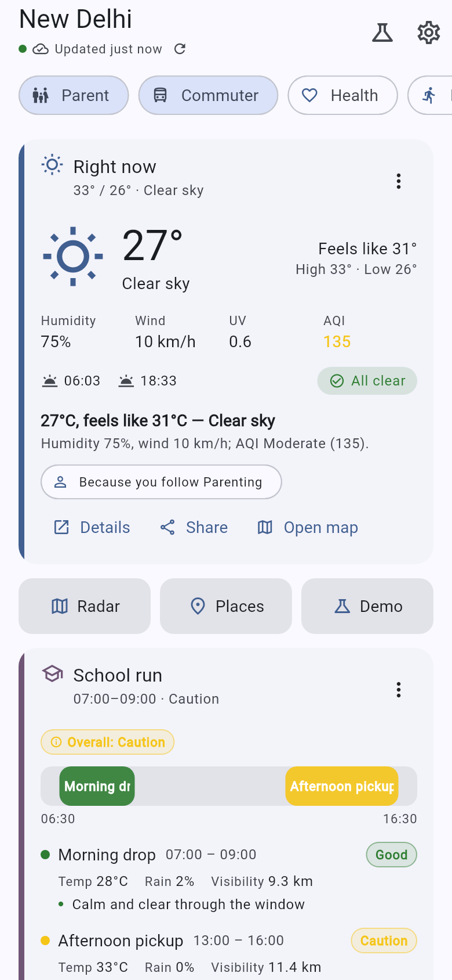
SMART INDIA HACKATHON 2026 · PS 26076 · MoES / INDIA METEOROLOGICAL DEPARTMENT
Mausam Personalized
A persona-aware, context-aware home screen for IMD's Mausam app
THE PROBLEM
Mausam shows every user the same screen, in the same order. The eight groups named in PS 26076 do not need more data — they need the two or three things that matter to them, first, with the “so what” attached. And relevance is not a property of the user alone: it moves with the hour, the place, the season, and above all with what the sky is doing right now.
Health-conscious
Outdoor fitness
Beachgoers & surfers
Travellers
Parents & families
Agriculture & gardeners
Commuters
Event planners
Eight personas. Users pick 1–3; everyone also gets the base set.
Team Mausam prototype for SIH 2026 — not an IMD product, and not affiliated with or endorsed by IMD or MoES. IMD's public warning colour conventions are used; no IMD logos or branding.
07:30, New Delhi · parent + commuter — the school run ranks first, with its reasons
Notes:
PS 26076 asks for a personalized homepage for Mausam. The eight bullets are eight user groups, each with three or four signals they care about. The point to land: personalization here is a ranking problem over live data, not a settings screen — relevance moves with the hour, the place and the weather itself. This is a Team Mausam prototype, not an IMD product.

Slide 2
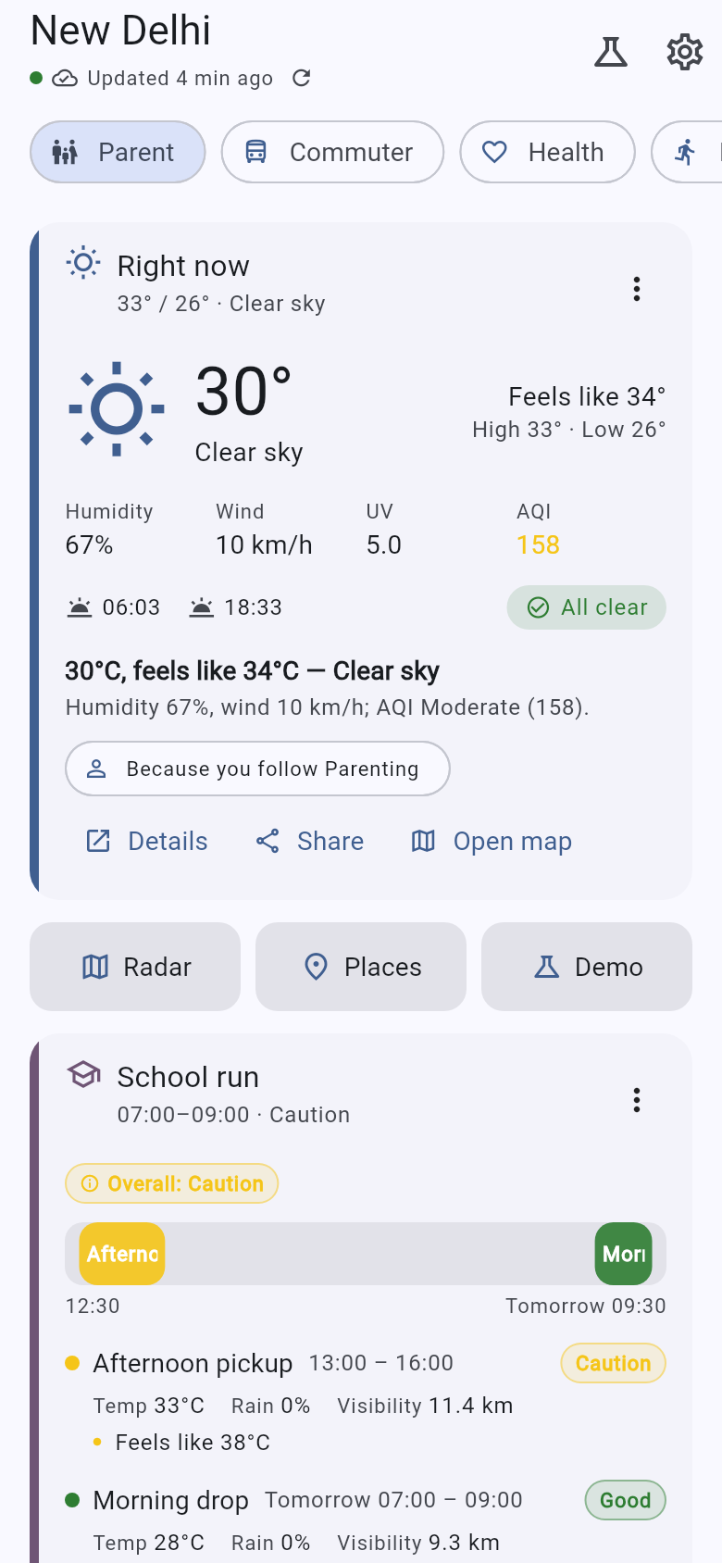
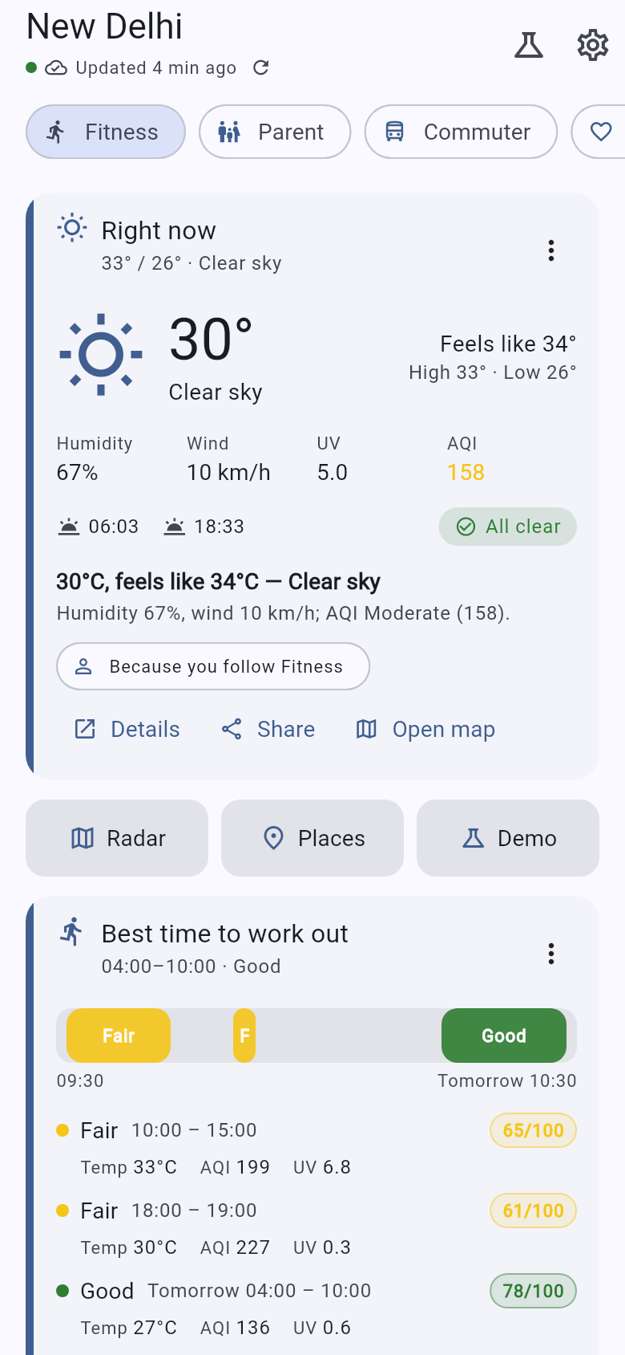
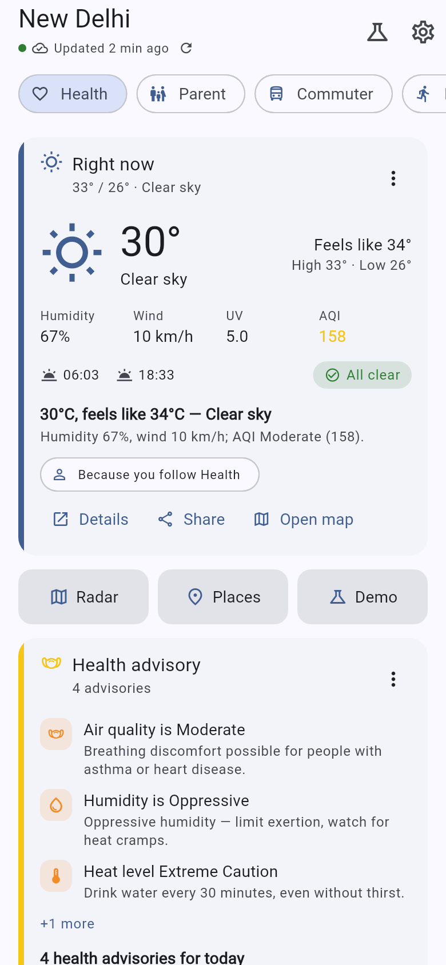
Proposed solution
One ranked feed per user — computed on the server, explained on the card.
A FastAPI backend assembles a weather / air-quality / marine snapshot for the user's coordinates, derives the insights the problem statement actually asks for — best running hours, a school-run verdict, a tide window, frost risk, a packing list — and runs a deterministic engine over 33 card types. The app draws the order it is given.
Same backend. Same location. Same minute.
1
Gate, then score
Drop what the user cannot use (no tides inland, no heat alert below 35 °C), then score: 0.5·relevance·context + 0.5·urgency + learning.
2
Urgency outranks preference
Anything reaching urgency 0.8 pins above every preference — a red warning reaches all eight personas. Asserted by a test on every run.
3
Explain every card
Up to four reasons per card from seven families, localized server-side. Long-press → “Why am I seeing this?” shows them, plus the score.
Parent
Fitness
Health
4
Learn, bounded and reversible
Three completely different feeds from one payload each. Nothing in the app hardcodes a card order, so IMD could add, reorder or retire a card without an app release.
Taps, pins and dismissals move the score by at most ±0.25, so learning can never bury a warning. Reset restores the feed exactly.
Notes:
The engine is ~460 lines of pure, I/O-free Python over a declarative catalog of 33 cards, with the formula written in docs/03 before it was written in code. The three phones are the one-line demo of personalization: same backend, same location, same minute, three different screens.

Slide 3
Technical approach
Flutter · FastAPI · a pure-Python ranking engine — and no API key to run any of it.
Flutter app
FastAPI backend
Providers
Android · iOS · web
Python 3.13 · Pydantic v2
a chain, with the source recorded
· Riverpod · go_router · Dio · flutter_map
· 15 renderers, a detail page each
· JSON file cache → works offline
· WebSocket client → live re-rank
· ARB i18n: en + hi complete
· Draws the order it is given
REST /api/v1
· snapshot assembly, TTL-cached
· derived metrics: CPCB AQI, comfort, workout, school run, commute, frost, packing, planting, tides*, pollen*
· engine → explain → 33 builders → i18n
· SQLite / Postgres · JWT · admin console
snapshot
· IMD — whitelist-aware, 401 today
· Open-Meteo forecast / air / marine
· BigDataCloud reverse geocoding
· RainViewer radar frames + tiles
· IMD → Open-Meteo → estimated
· * estimated values say so on screen
WS /ws/alerts
cached upstream
The score, in full — deterministic, unit-tested, and normative in docs/03
rel = min(1, max(contribs) + 0.15·(sum(contribs) - max)) contribs = persona weight x card affinity
ctx = clamp(time_mult x season_mult, 0.4, 1.6) urg = f(data): AQI Very Poor .75, red heatwave 1.0
eng = 0.25·tanh((taps + 2·expands + 3·pins - 3·dismisses)/8) bounded to +/- 0.25
score = 0.5·rel·ctx + 0.5·urg + eng pinned if urg >= 0.8 order: pinned, hero, top 8, more_cards
Flutter 3.47
FastAPI · Py 3.13
SQLite / Postgres
TTL cache / Redis
WebSocket alerts
Docker · Render
GitHub Actions CI
No API key needed
Notes:
Provider chain per field is IMD, then Open-Meteo, then estimated, and every value records its source. The engine does no I/O, which is why it is fully unit-tested: nine engine tests cover determinism, warning-pinning, coastal gating, persona switching, time-of-day and the dismiss/pin effect.

Slide 4
Feasibility and viability
Not a mock-up. Every step of the judge demo script was walked in the real app against a live backend — verdict PASS (docs/QA_REPORT.md).
348
103
10 / 10
2 ms
33 / 8
40
backend tests,
fully offline
app tests ·
analyze clean
demo steps
PASS
warm /home,
server-side
card types /
personas
QA screenshots
of the walk
Risks, and what already handles them
What we do not claim
IMD APIs answer 401 until a host is whitelisted
· The APK has never been installed on a handset. Everything was verified in the web build — which shares 100 % of the Dart code — plus a static APK check.
· The release APK is debug-signed. It installs and runs; a Play-store build needs a real keystore.
· Five languages are offered, two are complete. Marathi, Tamil and Bengali fall back to English per key.
· Tides, pollen and traffic are modelled, never observed — and the screen says so.
· Pins and hides survive a session but not a reinstall — the app does not read card preferences at start-up.
providers/imd.py detects it, backs off 10 min and falls through to Open-Meteo. Whitelisting flips it on with no code change.
A live demo depends on the network
The offline path is on the demo script: cache first, then a bundled payload that labels itself “Sample data”.
Modelled values could look like observations
“source”: “estimated”, an Estimated chip, and an INCOIS / Survey of India disclaimer on tides.
Learning could bury a safety-critical card
The engagement term is bounded at ±0.25 and urgency ≥ 0.8 pins regardless. You cannot dismiss your way out of a red warning.
Notes:
The QA report is a 378-line evidence file: each demo step quoted, driven in the real build against a live backend, read back out of the app's accessibility tree. Nine defects were found by looking at the demo and all nine are fixed with regression tests. Backend tests run fully offline through respx, so CI needs no network and no key.

Slide 5
Impact and benefits
Every signal the problem statement names has a card — and the mapping is machine-checked on every test run.
Health-conscious
Outdoor fitness
Beachgoers & surfers
Travellers
“Air quality is Severe (463) — move your workout indoors”
“Best run 06:00–07:30”, with the AQI and heat index attached
“Sea is Very Rough — 4.5 m waves”, next tide window, water temp
“London · Raincoat / umbrella · rain chance up to 53 % in 3 days”
aqi · pollen · uv_index · humidity · health_advisory
best_workout_window · sun_times · wind · heat_alert
sea_conditions · tides (Estimated) · water_temp
saved_places · travel_alerts · packing_suggestions
Parents & families
Agriculture & gardeners
Commuters
Event planners
“School run 07:00–09:00 · Caution”, with reasons, before 07:30
Soil moisture, rainfall outlook, tonight's frost risk, what to sow
“Severe impact on your commute (+22 min)”, visibility 0.3 km
14-day outlook, rain probability for the date, comfort index
school_commute · rain_alert · warnings
soil_moisture · rainfall_outlook · frost_alert · planting_guidance
commute_conditions · visibility · storm_fog_alert
extended_forecast · rain_probability · comfort_index
Safety
Time
Trust
Reach
Operability
Orange and above pins for every persona; /home served 17.7 ms on the request right after a live push.
The answer is on the first screen, not three taps into a table of numbers.
Reasons on every card, provider status on /health, “Estimated” wherever a value is modelled.
Hindi complete · 13.5 KB in low-bandwidth mode · offline cache · Android 7.0 · AA contrast.
Server-driven cards: changing the homepage is a backend deploy, not an app-store release.
Notes:
PERSONA_COVERAGE in backend/app/engine/catalog.py is the machine-checked mapping from each persona to the cards that cover its bullets in the problem statement, and docs/03 Tests 7 asserts it. All eight personas were photographed in the QA walk.

Slide 6
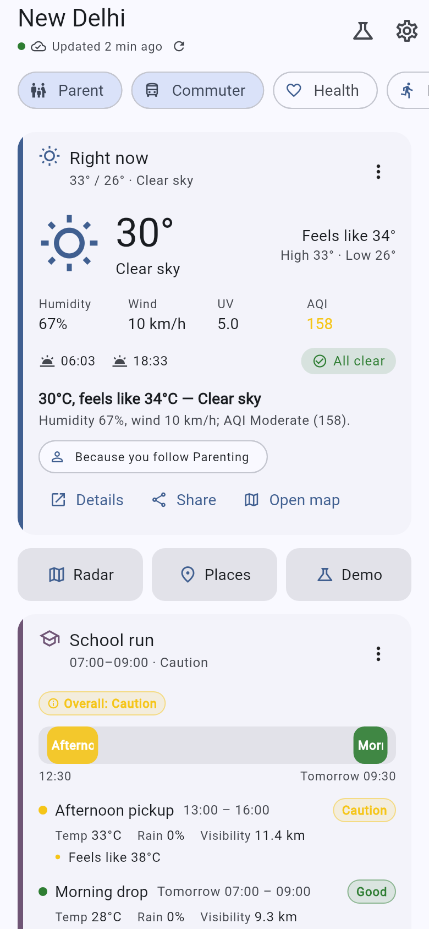
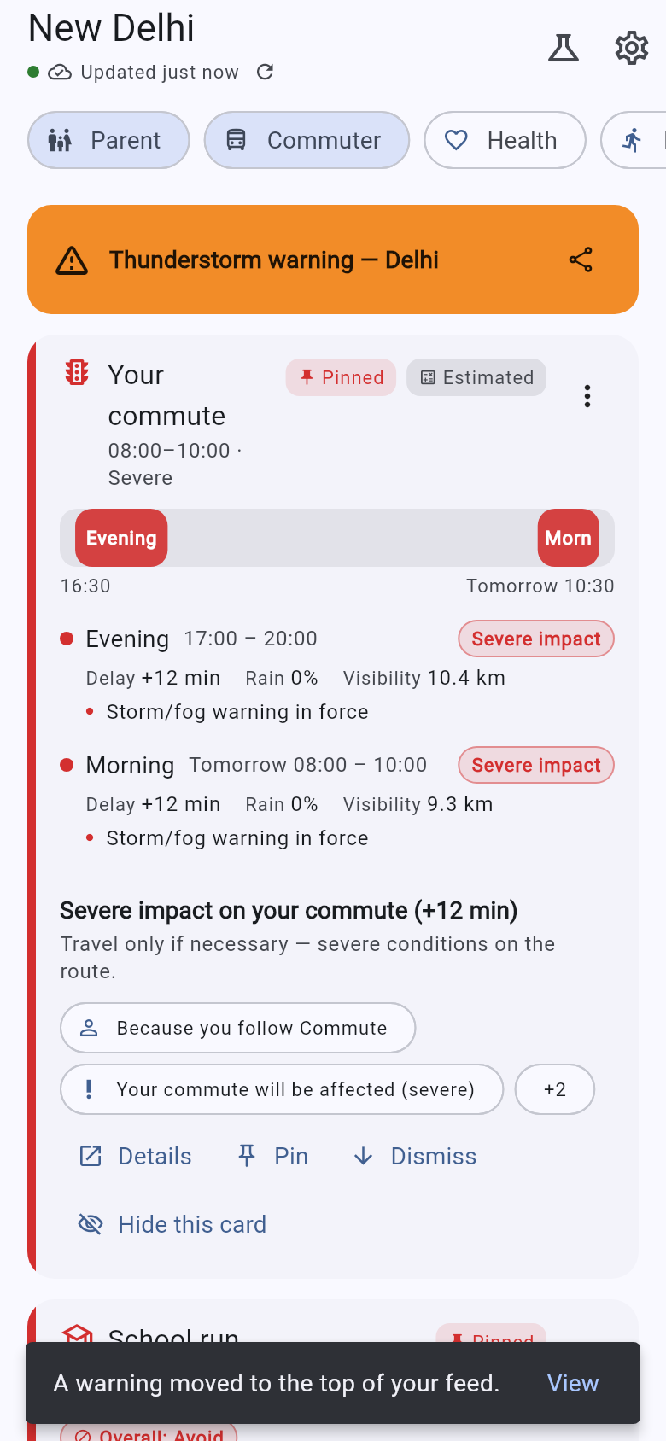
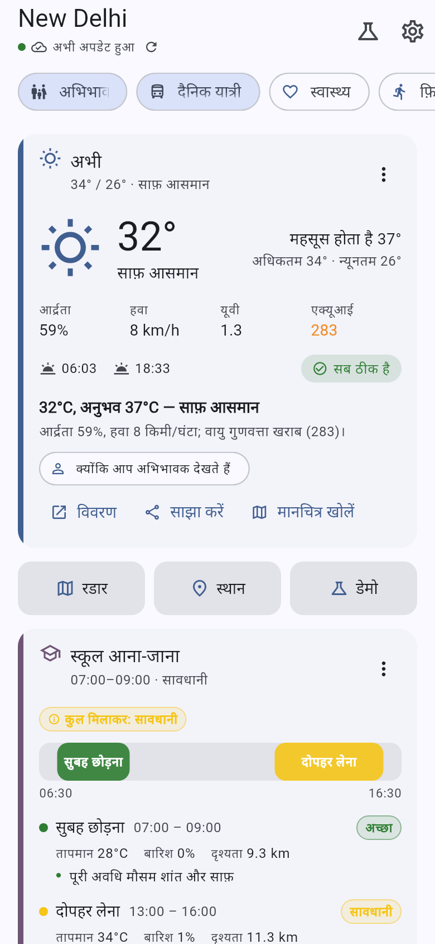
The demo, and what comes next
Five minutes, one laptop, one phone or a Chrome tab. Every step below was walked and photographed.
1
Onboard — language, then Parent + Commuter, then Delhi.
2
Demo clock to 07:30 — School run and Commute conditions rank 1 and 2, each with its reasons.
3
Tap Fitness, then Health — the whole feed changes; same backend, same minute.
4
Move to Panaji — sea conditions, tides (Estimated) and water temperature appear, gated on the coast.
5
Push an orange thunderstorm from the admin console — banner, re-rank, warning to the top of the feed.
6
“Show less” ×3 demotes a card · kill the network and it still renders · switch to हिन्दी.
Before the push
…seconds later
हिन्दी
WHAT COMES NEXT
S3 FCM push
S1 ML ranker v2
S4 More languages
S2 Home-screen widget
The WebSocket proves the re-rank path but only reaches an open app. FCM delivers the same payload to a closed one — a transport swap at one broadcast point.
Logistic regression over the events already logged, blended as score += 0.2·(p_tap − 0.5) behind a flag. v1 stays the floor, so the bound still holds.
mr / ta / bn are started with per-key fallback; the pipeline and the parity test already exist. Translation work, not engineering.
The highest-visibility surface for a weather app — and the payload it needs is what /home already returns under lite=1.
Team Mausam · SIH 2026 · PS 26076 (MoES / IMD) · Software · Smart Automation | github.com/Shreyansh303/team_mausam_sih_2026 | Evidence: docs/QA_REPORT.md · Pitch: docs/07_PITCH.md
Notes:
Rehearsal notes: start the backend first and point the app at 127.0.0.1:8000, never localhost. Wait for the green dot on the freshness chip — that is the alerts socket, and it is what makes step 5 work. Delete any pushed warning before moving on, because a live warning changes every later screen. Step 6 takes three “Show less” taps, not two. The traveller story needs two saved places added first. Team members are listed in the README.

