Slide 1
Towards a Compute-Efficient Physics-Informed Neural Network
Analytical reference: mid-span displacement of the damped fixed–fixed beam (Mode 1)
From Beam-Vibration Benchmark to Railway Physics
[Presenter name]
[Programme / institution]
t from 0 to 1 s
Physics-informed neural networks · Euler–Bernoulli beam vibration · Railway engineering (target application)
20.58 Hz · 20.58 cycles in 1 s · decay 3.54 s⁻¹
Progress report · completed experiments through B2-E03 · PINN-RP commit cdd87b5
Notes:
Title. Presenter name and institution are placeholders: the repository metadata does not identify the presenter, so they were not guessed. The curve is the closed-form analytical reference solution (exact root of the clamped-beam eigenproblem), not a network prediction. Scope: only completed experiments through B2-E03 (commit cdd87b5) are reported.

Slide 2


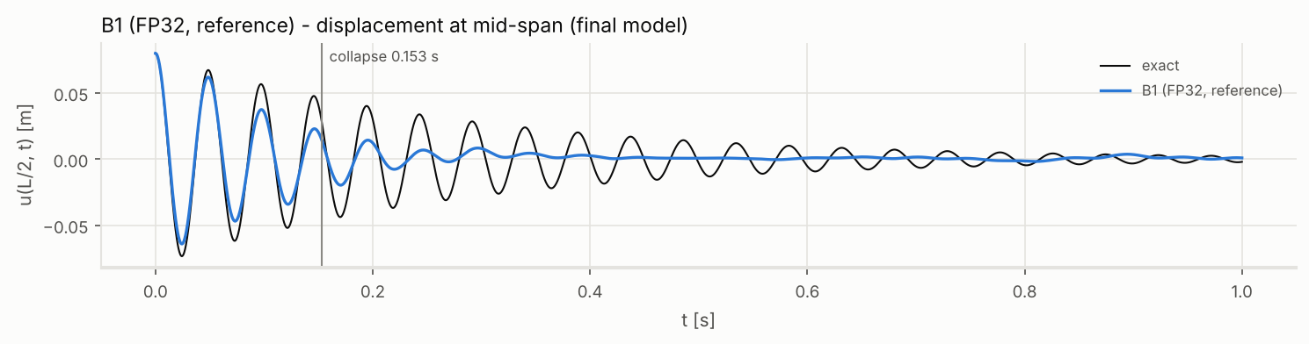




The problem: accurate dynamics at low compute
Objective
PDE
c²u_xxxx + u_tt + γu_t = 0
PINN
network u_θ(x, t)
Prediction
vibration u(x, t)
Lower physical error
+
Better dynamic fidelity
+
Lower computational cost
Observed failure mode
Correct early oscillation
Artificial damping
Collapse
Tracked on every run
PDE residual
Frequency error
Damping / decay rate
Persistence (cycles)
Peak memory
Wall-clock time
B1 (seed 1234): decay 8.98 s⁻¹ vs exact 3.54 s⁻¹; collapse at 0.153 s (3.15 of 20.58 cycles)
A low scalar loss is not enough: u ≡ 0 also satisfies the homogeneous beam equation, so a collapsed late-time field can carry a small residual. Dynamics are therefore measured directly.
Source: analytical reference (src/beampinn/physics); B2-E01 B1 seed 1234 (results_batch2/tables/B2-E01_RESULTS.csv, figures/B2-E01_displacement_trace.png) · commit cdd87b5
Notes:
The goal is not a lower training loss but correct physics per unit compute. Every run reports PDE residual, frequency and decay error, persistence (cycles before the local amplitude falls below 50 % of exact), memory and wall-clock. The trace is the real B1 control (seed 1234): the first cycles are right, then the response is over-damped and collapses.

Slide 3
Starting point: the published benchmark
BENCHMARK
Cem Söyleyici & Hakkı Özgür Ünver
“A Physics-Informed Deep Neural Network based beam vibration framework for simulation and parameter identification”
Engineering Applications of Artificial Intelligence, 141 (2025) 109804 · DOI 10.1016/j.engappai.2024.109804
Our controlled re-implementation of the paper method (C0)
3.26
relative L2 · static (non-oscillating) field · NTK weights grew to ~10¹⁴–10¹⁵
640,000 PDE evaluations = 2.2 % of the paper's 28,800,000 (45,000 epochs × 640)
Method | Spatio-temporal Fourier feature mapping + NTK adaptive loss weighting
Network | 6 × 200 tanh · Adam lr 1e-4 · 45,000 epochs
Benchmark FE-D-M1 | Fixed–fixed damped beam · L = 2.75 m · Mode 1 · 20.58 Hz · 20.58 cycles in 1 s
Published accuracy | Relative L2 = 4.64e-4 (paper's reported value)
This is our incumbent, not our novelty.
Research question: can we reproduce it, diagnose why it loses dynamic fidelity, and improve physical accuracy per unit compute?
Source: Söyleyici & Ünver, EAAI 141 (2025) 109804; references/batch1/ (paper_benchmark_registry.csv, optimization_leaderboard.csv, PHASE_A1_CHECKPOINT.md) · commit cdd87b5
Notes:
The paper reports relative L2 = 4.64e-4 with Fourier features + NTK weighting. In our controlled implementation at our budget (2.2 % of the paper's evaluation count), the paper-faithful configuration C0 settled on a static field (L2 3.26) while the NTK weights grew to ~1e14–1e15. This is an observation under our budget, not a claim that the paper is wrong.

Slide 4










Research infrastructure achieved
ACHIEVED
Frozen ROOT provenance
Independent PINN-RP
Experiment registry
Benchmark + exact reference
Fixed evaluation
Batch-1 repo frozen at d31864a; byte-identical after every phase
All new work in a separate repository; ROOT never written
42 Batch-2 runs, each with config hash, git SHA, seed
Closed-form damped Mode-1 solution; paper-faithful and exact-root references
201 × 2001 grid; frozen persistence metric; 51 × 501 residual grid
Compute accounting
Pre-registration
Seed replication
Checkpoints + safety
Automated tests
PDE evaluations, forward/backward passes, peak RAM, wall-clock
Hypotheses and decision thresholds committed before any training
Seeds 1234–1236 for every Batch-2 arm; bit-exact control re-runs
Snapshots every 128k evaluations; runtime guard blocks writes to ROOT
168 tests passing at B2-E03 completion
Source: configs/root_provenance.json; results_batch2/EXPERIMENT_REGISTRY.csv; tests/ (pytest at cdd87b5); docs/hypotheses/B2-E0{1,2,3}.md · commit cdd87b5
Notes:
Infrastructure is a result in itself: every number in this deck is reproducible from a registered run, a frozen evaluator and a committed pre-registration. ROOT (the Batch-1 repository) is frozen at d31864a and was verified byte-identical after every phase. 168 tests passed at the B2-E03 completion commit (re-verified from a clean export of cdd87b5).

Slide 5
What we tested
68
completed training runs
26 Batch 1 + 42 Batch 2
Representation / formulation
Optimization / training
Sampling
Numerical precision
Fourier feature embedding (paper method)
NTK adaptive loss weighting (paper method)
Fourier convention / input scaling / bias init
Hard IC/BC constraints
tanh²(ω₁t) temporal conditioning
Mixed formulation v = u_xx
Modal reduction (diagnostic)
Exponential LR decay
Larger mini-batch (32 → 128)
Training budget (5k → 20k steps)
Adam → L-BFGS
Full-batch Adam
Causal temporal weighting
RAD adaptive sampling
Collocation resampling / larger pool (L-BFGS)
FP64 (vs FP32)
35
distinct configurations
25 Batch 1 + 10 new in Batch 2
16
intervention families
in 4 classes
3
seeds per Batch-2 arm
1234, 1235, 1236
Source: results_batch2/EXPERIMENT_REGISTRY.csv (42 runs); references/batch1/optimization_leaderboard.csv (26 runs); counting rules in speaker notes · commit cdd87b5
Notes:
Counting rules (from the registry and the Batch-1 leaderboard, not estimated): a run = one completed training run. Distinct configurations count seed replicates once (Batch 1: Z2 = Y1 at seed 1235) and bit-exact control re-runs once (B2-E02 M0 = B2-E01 modal; B2-E02T B1 and B2-E03 B1 = B2-E01 B1). Batch-2 B1 is the Batch-1 Z4 configuration, so Batch 2 adds 10 new configurations. The 35 configurations include the vanilla baseline and three supervised representation checks, which are controls and are not counted as intervention families. The superseded legacy notebook study is not counted. Batch-1 runs are single-seed (1234; one run at 1235).

Slide 6
Batch 1: reproduction and first optimizations
FAILED ON THIS BENCHMARK
Paper method (Fourier + NTK)
Static field under the tested budget (C0 L2 3.26)
ACHIEVED
Hard IC/BC constraints + tanh²(ω₁t)
IC/BC exact by construction (4.8e-6 / 1.4e-5); required network output O(1) instead of ≈ −8,369
ACHIEVED
LR decay · mini-batch 128 · budget
Persistence 1.17 → 3.15 → 8.09 cycles
ACHIEVED
Supervised capacity check
Network recovers ω = 129.25 / 129.37 rad/s (exact 129.32): capacity is not the bottleneck
Persistence (cycles of 20.58): Y1 1.17 → Z4 3.15 → Z4-20K 8.09 · C0, E4, X2: no sustained oscillation
FAILED ON THIS BENCHMARK
RAD adaptive sampling
Budgets differ (labels): E4/X2/Y1 at 160k, C0/Z4 at 640k, Z4-20K at 2.56M evaluations. Z4 = the frozen B1 reference used in Batch 2.
Did not solve this benchmark failure under the tested budget
Source: references/batch1/optimization_leaderboard.csv; tables/phaseZ4_20K_checkpoints.csv, phaseY1_20K_checkpoints.csv, phaseX_oscillation.csv; reports/PHASE_E_SCREEN.md · commit cdd87b5
Notes:
Batch 1 (single seed) moved the full-field PINN from a static field to sustained early oscillation. Hard constraints make IC/BC exact; tanh²(ω₁t) removes an ill-conditioned target (required N* ≈ −ω²/2 = −8,369 with (t/T)² vs −1.9 to −0.16 with tanh²). LR decay, mini-batch 128 and more budget progressively extend persistence. Supervised controls show the network can represent the 20.6 Hz solution. Unsuccessful interventions are reported as 'did not solve this benchmark failure under the tested budget', not as generally ineffective. Best Batch-1 run (Z4-20K): L2 0.263, 8.09 of 20.58 cycles at 2.56M evaluations, still over-damped and collapsing at 0.393 s.

Slide 7
B2-E01: one change at a time, matched compute
Metric | B1 | B1 FP64 | Mixed v = u_xx | Modal q(t)
Persistence [cycles] | 3.15 | 3.15 | 1.67 | 7.62
L2 (exact) | 0.526 | 0.526 | 0.675 | 0.270
Frequency error | −0.96 % | −0.96 % | −2.0 % | −0.04 %
Decay rate [s⁻¹] (exact 3.54) | 8.98 | 8.98 | 13.24 | 5.40
u PDE residual | 0.110 | 0.110 | 2.57 | 0.074
Training time [s] | 822 | 1,404 | 374 | 190
Peak RAM [MB] | 934 | 1,178 | 730 | 704
FAILED ON THIS BENCHMARK
FP64 precision
No accuracy change; 1.71× wall-clock, +26 % RAM
FAILED ON THIS BENCHMARK
Mixed formulation
0.46× wall-clock, but worse physics: u-residual 2.57 vs 0.110
DIAGNOSTIC
Modal reduction
7.62 cycles, L2 0.270 — exact spatial mode supplied
Seed 1234 · every arm 640,000 PDE evaluations · 4 arms run concurrently on 4 vCPU
Removing the spatial learning burden substantially improves temporal learning.
Source: results_batch2/tables/B2-E01_RESULTS.csv (seed 1234, 640,000 PDE evaluations per arm); reports/B2-E01_REPORT.md · commit cdd87b5
Notes:
FP64 and mixed are labelled 'failed on this benchmark': they did not improve the physical solution here. FP64 is identical to FP32 to the reported digits at 1.71× the wall-clock. Mixed halves the cost per step but its displacement violates the beam equation (u-residual 2.57). Modal supplies the exact spatial mode shape and learns only q(t): it is a diagnostic, not a competitor.

Slide 8
Three-seed replication: what is robust
FAILED ON THIS BENCHMARK
FP64 ≡ FP32 in 3/3 seeds
max relative L2 difference 5.4e-6; 1.62–1.71× wall-clock
FAILED ON THIS BENCHMARK
Mixed: cheaper, never more accurate
0.46–0.47× wall-clock; L2 0.623–0.675 vs B1 0.402–0.549
DIAGNOSTIC
Modal: longer persistence in 3/3 seeds
×2.42, ×2.13, ×1.19 vs B1; collapses at 0.296–0.370 s, not 1 s
DIAGNOSTIC
Modal improves, then degrades
peaks at 8.16–8.62 cycles (384k–512k), then retreats by 640k
BENCHMARK
B1 seed variability
3.11–5.10 cycles; L2 0.402–0.549
Source: results_batch2/tables/B2-E01S_SEED_RESULTS.csv, B2-E01S_SEED_SNAPSHOTS.csv; reports/B2-E01_SEED_REPLICATION.md · commit cdd87b5
Notes:
Robust across seeds: FP64 is not material; mixed is cheaper but never more accurate; modal has longer persistence than B1 in every seed, but the magnitude varies (seed 1236 gain is within the pre-registered comparability band, because B1 itself persisted longest there). The modal front reaches its best state at 384k–512k evaluations and then retreats: a reproducible late-training degradation. Not presented as a universal result: one benchmark, three seeds.

Slide 9
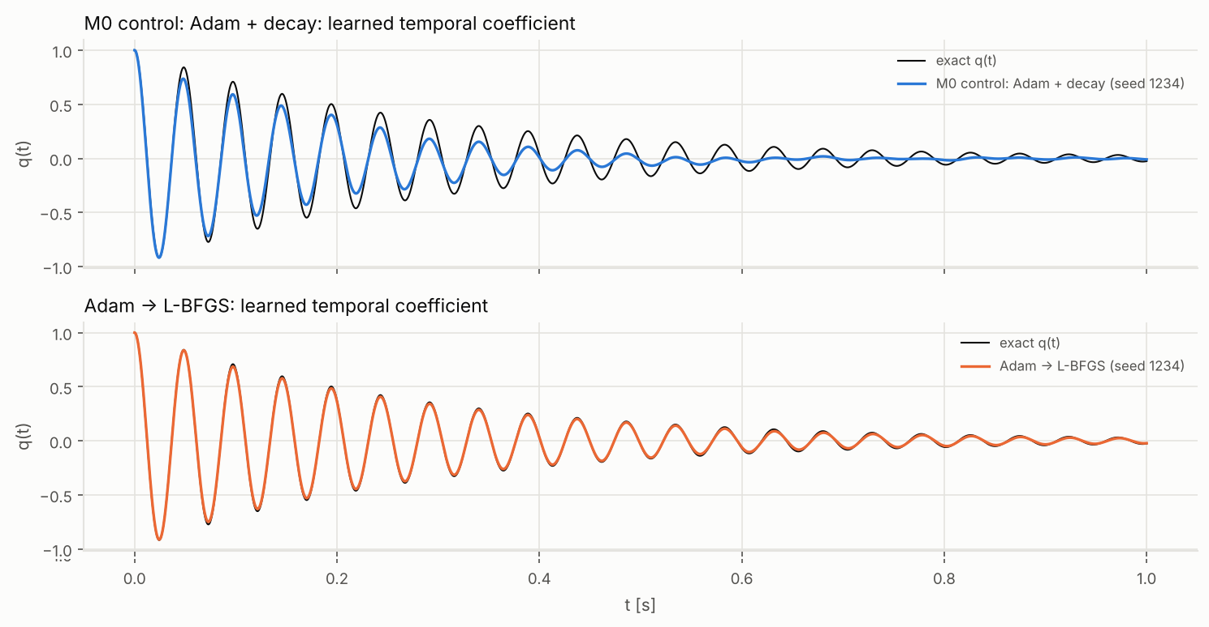
B2-E02: the optimizer test (modal diagnostic)
DIAGNOSTIC
Arm (3 seeds) | Persistence [cycles] | L2 | Decay [s⁻¹] | Rel. wall-clock
M0 Adam + decay | 6.1–7.6 | 0.27–0.33 | 5.4–6.1 | 1.00
Adam → L-BFGS | 20.58 | 0.038–0.093 | 3.62–4.10 | 0.91–0.93
Causal weighting | 2.1–4.6 | 0.56–1.56 | fit not meaningful | 1.00–1.01
20.58
cycles = full 1-s window, 3/3 seeds
0.27–0.33 → 0.038–0.093
relative L2: Adam control → Adam → L-BFGS
Diagnostic only — not yet a valid full-field solution.
Exact spatial mode supplied · 623,360 vs 640,000 PDE evaluations · +29–30 % peak RAM
Source: results_batch2/B2-E02_RESULTS.csv; figures/B2-E02_q_of_t.png (seed 1234); reports/B2-E02_REPORT.md · commit cdd87b5
Notes:
Pre-registered modal screen, three seeds, same initialisation and budget. Adam for 320k evaluations, then full-batch L-BFGS on a fixed 640-point set: full-window persistence in all seeds, L2 down 3.5–7×, decay close to exact (3.54). Causal weighting was worse in every seed. Wall-clock ratios are within-batch. This result uses the exact spatial mode shape: it shows the temporal sub-problem is solvable by better optimization, not that the full-field PINN is solved.

Slide 10
Transfer to the full field: the key negative result
FAILED ON THIS BENCHMARK
Seed | Persistence change [cycles] | L2 vs B1 | PDE residual vs B1
1234 | −1.6 | ×1.28 | ×1.55
1235 | −2.4 | ×1.54 | ×2.38
1236 | −2.6 | ×1.44 | ×1.22
Cheaper in time (0.87–0.89× wall-clock) but 1.61–1.63× peak RAM, and worse on every accuracy metric in 3/3 seeds.
The optimizer that solves the isolated temporal problem does not automatically solve the coupled space–time problem.
end = 640,000 (B1) / 623,360 (Adam → L-BFGS) evaluations; identical up to 256k
Source: results_batch2/B2-E02T_RESULTS.csv, B2-E02T_SNAPSHOTS.csv, B2-E02T_CLASSIFICATION.json; reports/B2-E02_REPORT.md §4 · commit cdd87b5
Notes:
Same Adam → L-BFGS controller, same accounting, applied to the frozen full-field B1 configuration (pre-registered transfer test). It fails the transfer criteria in every seed: persistence −1.6 to −2.6 cycles, L2 ×1.28–1.54, u-residual ×1.22–2.38 relative to B1. After the switch the L-BFGS front stops advancing while B1 keeps advancing. Decision E: the improvement exists only in the modal diagnostic.

Slide 11
B2-E03: sparse collocation alone is not the root cause
Residual gap G: L-BFGS fixed 640 35–76× · Adam fixed 640 4–6× · L-BFGS resampled 1.8–2.8× · L-BFGS 2,560 pool 1.2–1.4× · B1 1.1×
L-BFGS 2,560 pool, seed 1234: diverged at 576,640 evaluations (no bar; excluded by pre-registered Amendment 1).
More collocation coverage removed the train/dense residual gap without restoring dynamic propagation. Sparse collocation alone is not the root cause — no stage-2 variant beat B1 (pre-registered CASE D).
Source: results_batch2/B2-E03_RESULTS.csv, B2-E03_CLASSIFICATION.json (CASE D); reports/B2-E03_REPORT.md · commit cdd87b5
Notes:
Four single-change arms from the identical 320k state: L-BFGS on the fixed set, L-BFGS with fresh points every 50 closures, L-BFGS on a 4× larger pool, and full-batch Adam on the fixed set. The gap between dense-grid and training residual is a coverage × optimizer interaction (35–76× only with fixed points AND L-BFGS). Yet the 2,560-point pool has almost no gap and still stalls or diverges, and Adam on the fixed set also stalls. Resampled L-BFGS advanced in 2/3 seeds and matched B1 in only one. Value: it stopped us from optimizing collocation density, which would have been the wrong direction.

Slide 12
Where we are: no optimized full-field PINN yet
1
Benchmark established
Full-field reference (B1, 640k evaluations)
ACHIEVED
L2 0.526
3.15 cycles
seed 1234; across 3 seeds L2 0.402–0.549, 3.11–5.10 of 20.58 cycles
2
Reproducibility established
ACHIEVED
3
Failure mechanisms narrowed (refinement ongoing)
ACHIEVED
4
Candidate optimization mechanisms identified
PARTIAL
Best modal diagnostic (Adam → L-BFGS)
5
Reproducible full-field improvement
L2 0.038–0.093
20.58 cycles
3/3 seeds · exact spatial mode supplied — not the optimized PINN
NOT YET DONE
6
Compute-efficient optimized PINN
NOT YET DONE
7
Railway validation
NOT YET DONE
Closing this gap on the coupled full field is the central open problem.
Batch-1 best full-field run: L2 0.263, 8.09 cycles at 4× compute (2.56M evaluations, 1 seed), still collapsing at 0.393 s.
Source: B2-E01 seed replication (B2-E01S_SEED_RESULTS.csv); B2-E02_RESULTS.csv; references/batch1/tables/phaseZ4_20K_checkpoints.csv · commit cdd87b5
Notes:
No completion percentage is given because there is no defensible way to compute one. The validated full-field reference is still B1 at matched compute. The modal diagnostic shows what correct temporal learning looks like when the spatial mode is supplied; achieving comparable dynamics while learning the spatial field, without extra compute, is the open problem.

Slide 13

Path to the railway application
FUTURE WORK
Beam-vibration benchmark
current work (in progress)
Why start from a beam benchmark
Full-field optimized PINN
not yet achieved
Exact solution available, so dynamic fidelity (frequency, damping, persistence) is measurable
Euler–Bernoulli beam models are standard building blocks of track and bridge dynamics in the PINN literature (e.g. beams on Winkler foundations, moving loads)
A method must first preserve dynamics on controlled physics before it is trusted on noisy railway measurements
Railway vibration / structural dynamics
future
Wheelset / axle / bearing vibration
future
Physics-informed condition monitoring
future
No railway experiment, dataset or deployment has been performed yet. Railway work starts only after a validated full-field method exists.
Source: planned validation path (not executed); literature context: docs/LITERATURE_MATRIX.md (H2, H3: Kapoor et al., beams on Winkler foundation, moving loads) · commit cdd87b5
Notes:
Railway is the intended first vertical application. The beam benchmark is the controlled step: exact physics, measurable fidelity. Moving to wheelset/axle/bearing vibration and condition monitoring requires (1) a validated full-field method, (2) real railway data and (3) more complex dynamics. None of these steps has been executed.

Slide 14
Takeaways
1
We have not found the final optimized PINN yet.
2
We have ruled out several obvious explanations — precision, derivative order alone, collocation density, the L-BFGS switch alone — and identified a strong gap between temporal-only and coupled space–time learning.
3
The next breakthrough must improve the full-field solution, not merely the diagnostic modal problem.
Research objective
Lower error
+
Longer physical fidelity
+
Less compute
+
Transfer to railway physics
Source: B2-E01–B2-E03 reports and CSVs; frozen baseline commit cdd87b5 · ROOT d31864a unchanged
Notes:
Central message: we progressed from reproducing a difficult PINN benchmark to systematically identifying why it fails; tested multiple formulation and optimization strategies; demonstrated substantial gains in an isolated diagnostic problem; and narrowed the remaining problem to achieving those gains on the coupled full-field physics without increasing compute.

