Slide 1
PINN optimisation for damped structural vibration: findings and path to railway predictive maintenance
Shreyansh · supervisor progress review

Slide 2
OBJECTIVE
One objective, three papers: understand PINN failure on a controlled beam, then transfer to railways
Paper | Scope | Status
P1 PINN optimisation (beam) | Why long-window damped-vibration PINNs fail; window law + reference-free rule | Diagnostics done (E01–E04); window sweep paused
P2 Railway transfer + Physics Reference Layer | Verification-labelled physics references for railway models | Not started
P3 Railway application | Predictive maintenance use case (axle / bearing / wheel) | Not started
No railway claim is made yet: all evidence so far is on the beam benchmark.

Slide 3
BENCHMARK FE-D-M1
Benchmark: a damped fixed-fixed Euler–Bernoulli beam with an exact analytical solution
Quantity | Value
Boundary conditions | fixed-fixed, mode 1
Damped frequency ω_d | 129.32 rad/s (20.58 Hz)
Window | 1 s = 20.58 cycles
Exact decay rate ζ | 3.54 1/s
Reference | analytical modal solution (exact)
Success = | full-window persistence (20.58 cycles) + correct decay + low L2
Notes:
Sources: B2-E01_RESULTS.csv (omega_d 129.32 rad/s, full_window_cycles 20.58); B2-E05.md (zeta = gamma/2 = 3.54).

Slide 4
BATCH 1 SUMMARY
Batch 1's best configuration (B1) reproduces the frequency but over-damps and collapses at 8.1 of 20.6 cycles
B1 = hard IC/BC + tanh²(ω₁t) + D4 Fourier + exp-decay LR + mini-batch 128 (Z4-20K) | Value
Training | 20,000 steps, 2.56M PDE evaluations, 2,290 s
L2 (exact) | 0.263
Fitted frequency | 129.2 rad/s
Collapse | 0.393 s = 8.1 of 20.6 cycles
Decay | 5.40 vs 3.54 1/s (over-damped)
Verdict | FAIL: no validated optimised PINN
Notes:
Source: configs/frozen/batch1_hard_tanh2.yaml batch1_result. The number of Batch-1 runs is not stated in the listed sources and is left out.

Slide 5
HYPOTHESES ELIMINATED
Five candidate explanations were tested at matched compute and eliminated
Hypothesis | Test | Key number | Verdict
Floating-point precision | FP64 control (E01) | identical L2 0.526 / 0.549 / 0.402 in 3 seeds | not material
4th-order operator | mixed form, order 2 (E01) | persistence 1.67–2.13 vs B1 3.11–5.10 cycles | cheaper, not better
Collocation coverage | resampling / 4× reservoir (E03) | H1 supported in 1/3 seeds only; 4X leaves front stalled | insufficient (CASE D)
Optimiser: full-batch Adam | ADAM-FULL (E03) | H2 falsified 0/3 | eliminated
L-BFGS on the full field | Adam→L-BFGS transfer (E02) | worse than B1 in 3/3; L2 ×1.28–1.54 | eliminated
Notes:
Sources: B2-E01_SEED_REPLICATION.md, B2-E02_REPORT.md, B2-E03_REPORT.md, B2-E03_RESULTS.csv. Network capacity: no Batch-2 test in the listed sources, so it is not listed.

Slide 6
OPTIMISER REVERSAL
The same optimiser solves the modal problem but fails on the full field
Seed | Modal Adam→L-BFGS: cycles / L2 | Full-field B1: cycles / L2 | Full-field Adam→L-BFGS: cycles / L2
1234 | 20.58 / 0.038 | 3.15 / 0.526 | 1.60 / 0.671
1235 | 20.58 / 0.071 | 3.11 / 0.549 | 0.72 / 0.843
1236 | 20.58 / 0.093 | 5.10 / 0.402 | 2.53 / 0.578
• Modal: full window (20.58 cycles) in 3/3 seeds — but the exact mode shape is supplied (diagnostic, not a method).
• Full field: worse than B1 in 3/3 seeds (persistence −1.6 to −2.6 cycles).
• Decision E: the improvement exists only in the modal diagnostic.
Notes:
Sources: B2-E02_RESULTS.csv, B2-E02T_RESULTS.csv, B2-E02_REPORT.md.

Slide 7
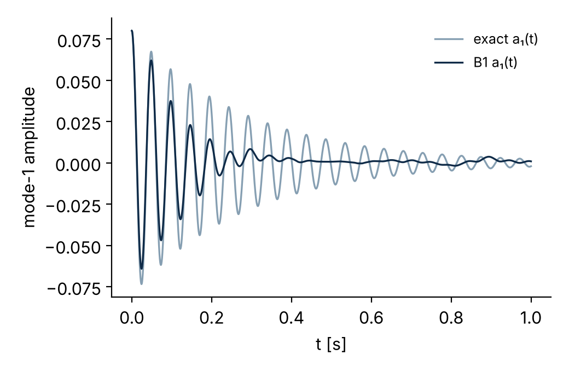
B2-E04 DIAGNOSTICS
Collapse is a loss of first-mode amplitude; no candidate diagnostic leads it (CASE F)
• Residual energy outside mode 1: 1.1·10⁻⁶ (B1, 640k, seed 1234); higher modes ≤ 5·10⁻⁵ of exact energy in all runs.
• Collapse = a₁(t) → 0, not growth of higher modes.
• Spatial/temporal gradient ratio: 1.6–3.4·10⁴ at init, 0.87–2.0 after training (no late imbalance).
• Verdict: CASE F — no clear mechanism among A–D (B partial, not discriminating).
Notes:
Sources: B2-E04_REPORT.md; B2-E04/units/FF_b1-640k_s1234.json (rho_nonfund 1.14e-6) and .npz (A_t, A_a, A_a1ex).

Slide 8
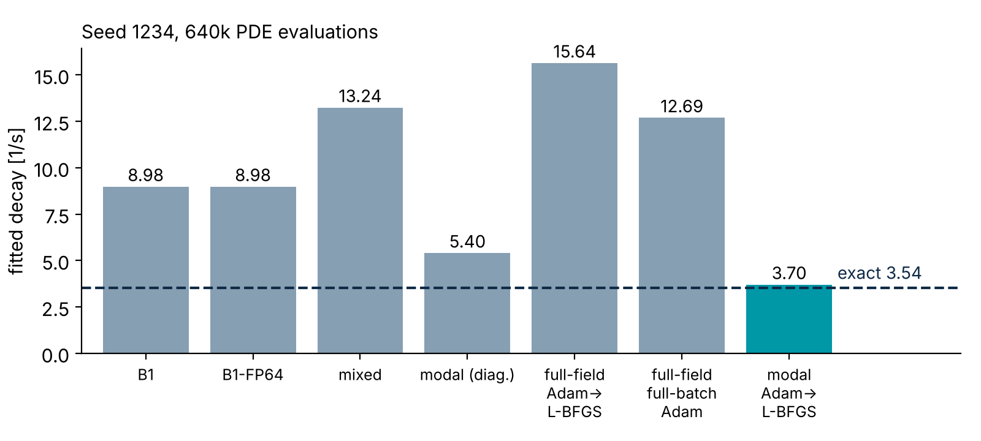
MECHANISM
Every failing arm decays too fast: artificial damping is the common symptom
Proposed damping-bias law (long windows):
λ* = √(ζ² + (R / 2ω)²)
R = unresolved residual per unit amplitude [s⁻²], measurable without the reference.
Only the modal L-BFGS arm (3.70) is near the exact 3.54.
Status: hypothesis under test (B2-E05).
Notes:
Sources: B2-E01S_SEED_RESULTS / B2-E01_SEED_REPLICATION.md, B2-E02_RESULTS.csv, B2-E03_RESULTS.csv (fit_decay, seed 1234). Law: sprint/SPRINT_24H_v2_CLAUDE_CODE.md section 0 (proposed, not validated).

Slide 9
EXPLORATORY
EXPLORATORY — SEED 1234 ONLY
Reweighting the loss moves the damping in both directions, but none beat B1
Variant | L2_exact | Fitted decay (exact 3.54) | Behaviour
B1 (logged) | 0.526 | 8.98 | over-damped
normalised loss (degree 0) | 5.48 @2500 steps | growing | amplitude ratio 1.8 / 9.3 / 61 at t = 0.05 / 0.4 / 1.0 s
fixed exponent p = 0.5 | 0.818 | 10.20 | late spurious growth
energy-rate loss μ = 10 | 4.49 @2500 steps | — | collapsed to a static field
feedback controller on p | 0.604 | 11.19 | sensor latched onto growth; p driven to 0
Takeaway: the loss's amplitude homogeneity sets the sign of the bias; the remaining lever with a quantitative prediction is window length.
Notes:
Sources: sprint/SPRINT_24H_v2_CLAUDE_CODE.md section 1; sprint/exploratory_runs_2026-10-09.csv. Scratch runs, not results of record.

Slide 10
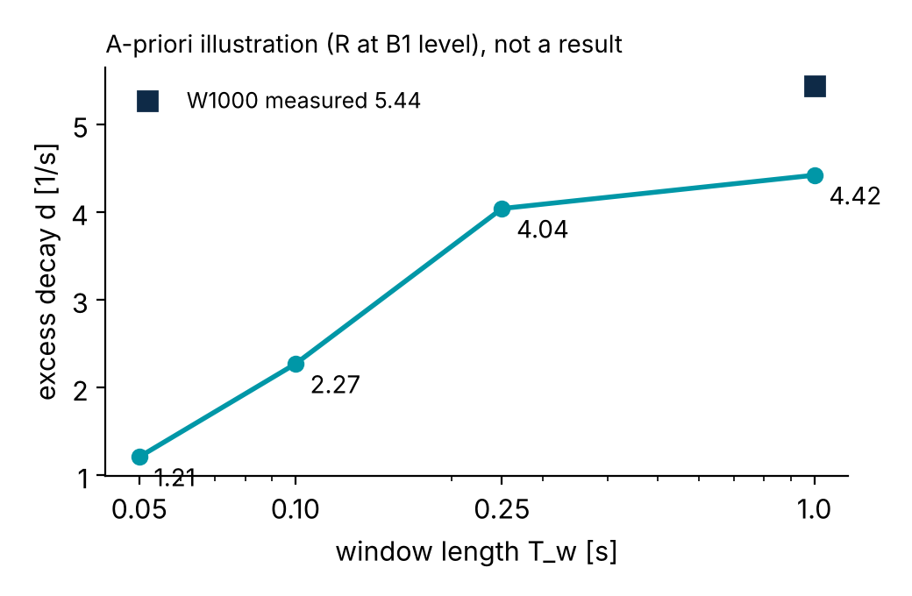
WINDOW LAW AND PRIOR ART
Window law: shorter windows should cut excess decay; first run W1000 reproduces B1 bit-for-bit
W1000 (1 window, seed 1234): bit-identical to logged B1, L2 0.52639.
Measured excess decay 5.44 1/s vs predicted 6.29 from its measured R (2374 s⁻²).
Prior art: AT-PINN (2024) and AT-PINN-HC (2025) do time-marching with hard constraints on EB beams, but give no relation between segment length and damping error.
Novelty claimed only for the law + reference-free window rule, if validated.
Notes:
Sources: docs/hypotheses/B2-E05.md section 1 (a-priori table); results_batch2/runs/B2-E05-W1000-s1234/results_row.csv; sprint/STATUS.md (W1000 predicted 6.29).

Slide 11
HONEST STATUS
Status: diagnostics are validated; the window law is untested beyond one window
Validated (pre-registered, 3 seeds) | Exploratory (seed 1234) | Pending
B1 reproduced bit-exactly in PINN-RP | loss-homogeneity runs (6 variants) | W050 / W100 / W250 sweep: not yet run (W050 interrupted at 11/20 windows)
FP64, mixed, coverage, L-BFGS transfer eliminated | W1000 vs prediction (1 run) | Block-3 gate: prediction vs measurement
Collapse = mode-1 amplitude loss (E04, CASE F) |  | Seeds 1235/1236; sweep currently PAUSED awaiting PI
No optimised PINN is claimed.

Slide 12
TIMELINE
Timeline: P1 manuscript by 20 Oct, P2 and P3 by 20 Nov, each behind a gate
Milestone | Date | Gate
Window sweep (W050/W100/W250) + Block-3 analysis | on resume | PASS / PARTIAL / FAIL pre-registered in B2-E05.md
P1 manuscript (beam) | 20 Oct | PASS → law + rule; FAIL → diagnostic manuscript
P2 railway transfer + Physics Reference Layer | by 20 Nov | supervisor decisions (next slide) + data access
P3 railway application | by 20 Nov | validated transfer model

Slide 13
PLACEHOLDER
Railway transfer model: axle, bearing and wheel dynamics
to be added

Slide 14
NEXT STEPS
Decisions needed from the supervisor
• Target vehicle
• Sensor scenario: on-board or wayside
• Bearing type and drawing
• Validation data source
• Does a “submitted” paper count for graduation?

