Slide 1
Reproducibility and Optimization of Physics-Informed Neural Networks for High-Frequency Beam Vibration
Fixed–fixed Euler–Bernoulli beam, first mode
Controlled investigation of Fourier features, NTK weighting, hard constraints, optimization, sampling and computational budget
[Author name]
[Institution]
October 2026
Analytical reference: mid-span displacement of the fixed–fixed beam, Mode 1 (20.6 Hz), t = 0–1 s
Notes:
WHAT THIS SLIDE SHOWS: Title. This talk reports a controlled reproducibility and optimization investigation of a published Fourier-feature / NTK-weighted PINN for damped beam vibration.
WHY IT MATTERS: High-frequency, long-window transient vibration is a known hard case for PINNs; a reproducibility audit tells us what is and is not established.
KEY RESULT: We identified conditioning and optimization bottlenecks and quantified budget effects; a fully validated optimized PINN was NOT established within the tested budget.
The orange trace is the analytical reference solution (Eq. 28, exact root), not a network output. Author and institution fields are placeholders to be filled in.

Slide 2
A damped, high-frequency beam transient
PROBLEM AND TARGET PAPER
The physical problem
PUBLISHED BASELINE
Söyleyici & Ünver, Eng. Appl. Artif. Intell. 141 (2025) 109804
6 × 200 tanh network
Spatio-temporal multiscale Fourier features (σ_x = 1; σ_t = 10, 1)
NTK-trace loss weighting
Adam, lr 1e-4, 45 000 epochs
L = 2.75 m, both ends clamped (u = u_x = 0); initial shape = Mode 1, A₀ = 0.08 m
c²·u_xxxx + u_tt + γ·u_t = 0
Euler–Bernoulli beam with viscous damping (paper Eq. 49): c² = 43.73², γ = 7.08
20.6 Hz
20.6
3.54 s⁻¹
4.64 × 10⁻⁴
Mode 1, ω_d = 129.32 rad/s
cycles in the 1 s window
physical decay rate
Relative L2 error reported by the paper for this case (FE-D-M1, Mode 1). Published value — not a result of this study.
Fourier + NTK is the paper's method, not our contribution. Our work audits and stress-tests it.
Notes:
WHAT THIS SLIDE SHOWS: The benchmark — a fixed–fixed Euler–Bernoulli beam released from its first mode shape, with viscous damping, over a 1 s window — and the published method we audited.
WHY IT MATTERS: At 20.6 Hz the window contains about 20.6 damped cycles. A PINN must propagate the correct oscillation from the initial condition through the whole window, which is the hard part.
KEY RESULT: The paper reports a relative L2 error of 4.64e-4 with Fourier features + NTK weighting. That number is the paper's, shown here as the published baseline. Fourier + NTK is not our contribution.
Sources: paper Eq. 49 and Table 3; ω_d and decay rate from our analytical reference (src/beampinn/physics/benchmarks.py).

Slide 3
A controlled, one-change-at-a-time workflow
REPRODUCIBILITY AUDIT
1
2
3
4
5
6
7
8
Published method
Implementation audit
Paper-faithful baseline
Diagnostic variants
Conditioning experiment
Optimizer experiment
Sampling / batch experiment
Compute-budget study
Each step changed one factor relative to its parent run; every run used one CPU thread, seed 1234, float32 and an identical evaluation grid (201 × 2001).
Verified audit findings
1
Fourier convention
Legacy code omitted the 2π factor of paper Eq. 38–39.
4
Reference-code differences
Public code uses standardised inputs, no 2π, N(0,1) biases and a decaying LR.
2
Frequency metric
Legacy metric used f = mode² and 1 Hz FFT bins; replaced by a damped-cosine fit.
5
Two references
Printed root (4.7300) vs exact root: they differ by 4.386e-4 relative L2, 94.5 % of the 4.64e-4 target.
3
Sparse evaluation
An 81 × 81 grid under-resolves 20.6 cycles; replaced by 201 × 2001.
Notes:
WHAT THIS SLIDE SHOWS: The order of the investigation, from the published method to the compute-budget study, and the five audit findings that had to be fixed before any comparison was meaningful.
WHY IT MATTERS: Without a faithful baseline and a correct metric, a negative (or positive) result cannot be attributed. The dual reference matters most: the printed eigenvalue root alone accounts for 4.386e-4 relative L2, i.e. 94.5% of the published 4.64e-4, so we score against both a paper-faithful and an exact-physics reference.
KEY RESULT: Five verified implementation/evaluation issues (Stage 0 audit and Stage 0.1 corrections). The damped-cosine frequency fit has a 95th-percentile error of about 1.4e-5 at the target error level.
Sources: results_optimization/reports/STAGE0_AUDIT.md, STAGE01_CORRECTIONS.md, CONVENTIONS.md; tables/stage01_reference_comparison.csv, stage01_frequency_extractor_uncertainty.csv.

Slide 4
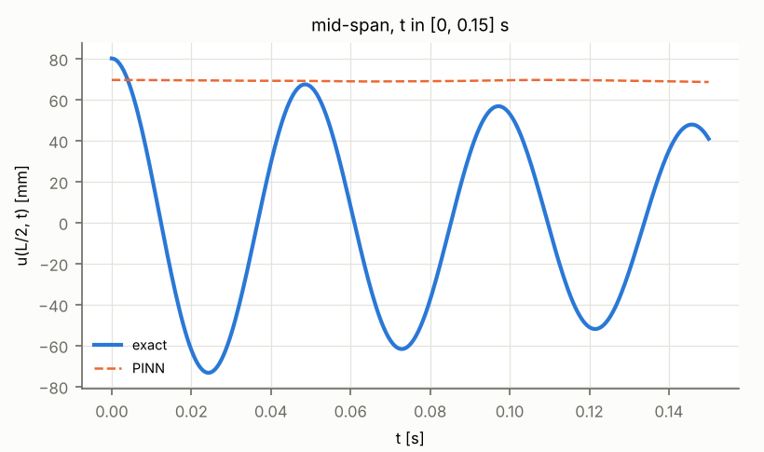
The faithful baseline settles on a near-static field
FIRST FAILURE: PAPER-FAITHFUL FOURIER + NTK (C0)
C0 at 20 000 steps: mid-span displacement, first 0.15 s (blue: exact; dashed: PINN)
3.26
0.06
~10¹⁴–10¹⁵
0 cycles
relative L2 at 20 000 steps
amplitude ratio, PINN / exact
final λ_ut 8.5e14, λ_ux 9.9e14
static / low-frequency attractor
Observed optimization failure in our implementation. The weight growth coincides with the static solution; it does not prove that NTK weighting causes the collapse.
Notes:
WHAT THIS SLIDE SHOWS: The paper-faithful Fourier+NTK implementation (run C0, 20 000 steps, 6.4e5 PDE evaluations). Left: the network stays near 70 mm while the exact beam oscillates. Right: the NTK weights for the IC/BC terms rise to 1e14–1e15 relative to the PDE term.
WHY IT MATTERS: The published method did not reproduce the target dynamics in our controlled implementation. Bias/normalisation repairs (D1–D4), Fourier alone, the reference-code convention and an LR schedule on C0 (Y4) also gave static or non-oscillating fields.
KEY RESULT: L2 = 3.26, amplitude ratio 0.06, fitted frequency ≈ 0, PDE residual 21.7. We describe this as an observed optimization failure (a static/low-frequency attractor). The large NTK weights coincide with it; we do not claim they cause it — no fixed-λ ablation was run.
Sources: reports/PHASE_A1_CHECKPOINT.md; tables/phaseA_summary.csv; logs/C0_paper__s1234__c41ccb1cdf/history.csv (λ values); figure crop of figures/phaseA_A1_C0_paper_diagnostics.png.

Slide 5
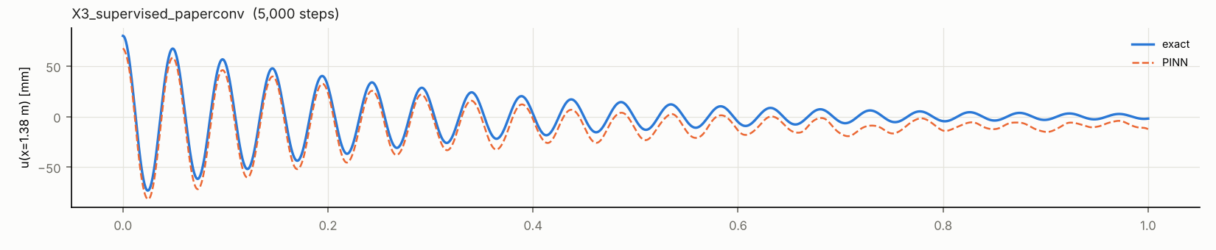
The bottleneck is optimization, not capacity
CONDITIONING AND REPRESENTATION
Hard-constraint ansatz: u = u₀(x) + g(t)·Φ(x)·A₀·N(x, t)
Representation check: supervised fit of the exact solution
g(t) = (t/T)²
original time factor
≈ −8 400
required network output N near t → 0 (range −8 369 to −1.0)
Diagnostic (5 000 steps) | Rel. L2 | ω [rad/s]
X3 supervised (paper convention) | 0.463 | 129.25
X4 supervised (reference-code conv.) | 0.316 | 129.37
Exact solution | — | 129.32
g(t) = tanh²(ω₁t)
ω₁ = 129.37 rad/s from PDE coefficient + clamped-beam eigenproblem
O(1)
required N in −1.9 to −0.16
“The network has sufficient representational capacity; the principal difficulty is physics-constrained optimization/conditioning rather than inability to represent the target frequency.”
Both factors enforce the IC and BCs exactly (IC error 4.8e-6, BC error 1.4e-5).
PDE-loss gradient norm, early (t < 0.02 s) vs late (t > 0.5 s): 7.2e3 vs 1.5e8 for (t/T)² (E4); 8.4e5 vs 9.8e4 for tanh² (X2).
Notes:
WHAT THIS SLIDE SHOWS: Left: the hard-constraint ansatz satisfies the initial and boundary conditions exactly (IC error 4.8e-6, BC error 1.4e-5). With g(t) = (t/T)² the network must output about −8 400 near t → 0 to produce the initial velocity behaviour; with g(t) = tanh²(ω₁t) it needs only O(1) values. ω₁ is computed from the PDE coefficient and the clamped-beam eigenproblem — a declared problem-specific prior, not fitted to the solution. Right: the same network architecture, trained on data from the exact solution instead of the PDE, reproduces the 20.6 Hz oscillation.
WHY IT MATTERS: It separates two explanations for the failure: inability to represent the solution vs difficulty of optimizing the physics loss. The supervised fits rule out the first.
KEY RESULT: Supervised X3/X4 recover ω = 129.25 / 129.37 rad/s (exact 129.32). The PDE-trained tanh² run X2 reached L2 0.909 and oscillated, but at 112.2 rad/s and over-damped. Conclusion: the network has sufficient representational capacity; the principal difficulty is physics-constrained optimization/conditioning.
Sources: reports/PHASE_E_SCREEN.md, PHASE_X_DIAGNOSTIC.md; profiles/phaseE_ansatz_conditioning.txt; tables/phaseX_conditioning.csv, phaseX_oscillation.csv; figure crop of figures/phaseX_midspan_traces.png.

Slide 6
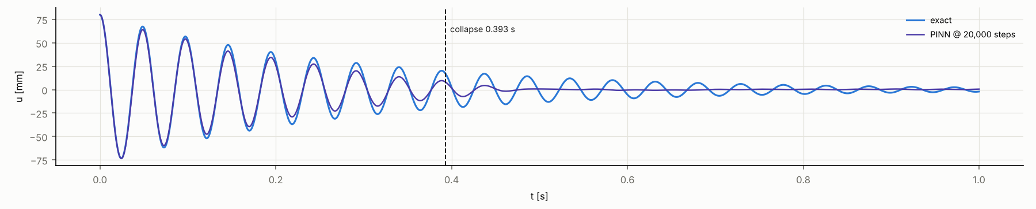
Later collapse, but never the full window
OPTIMIZATION RESULTS: PHASES E → X → Y → Z
Phase · run | Single change vs parent | Rel. L2 | Persistence
E · E4 | hard constraints, g = (t/T)² | 2.83 | no oscillation
X · X2 | g = tanh²(ω₁t), ref.-code convention | 0.909 | ω 112.2, over-damped
Y · Y1 | + LR schedule 1e-3·0.9^(k/1000) | 0.774 | 1.2 cycles
Z · Z1 | Y1 + RAD sampling | 0.718 | 1.6 cycles
Z · Z4 | Y1 with mini-batch 128 | 0.526 | 3.2 cycles
Z4-20K | Z4 with 20 000 steps | 0.263 | 8.1 cycles
Z4-20K at 20 000 steps
129.2 rad/s
frequency (exact 129.32)
5.40 s⁻¹
fitted decay (exact 3.54): over-damped
8.1 / 20.6
cycles before collapse
5 000 steps unless noted. Persistence: cycles until local amplitude < 50 % of exact (full window 20.6).
Mid-span displacement, exact (blue) vs Z4-20K (purple); dashed line: collapse at 0.393 s. Full-window reproduction not achieved.
Notes:
WHAT THIS SLIDE SHOWS: The sequence of single-factor changes after the conditioning fix, with the relative L2 error and the measured persistence (cycles before the local amplitude drops below half the exact amplitude), and one representative trace of the most persistent candidate.
WHY IT MATTERS: Frequency is now correct and the first cycles are reproduced, but the solution decays too fast and then collapses toward a low-amplitude trajectory. That is the remaining failure mode.
KEY RESULT: Y1 L2 0.774 (1.2 cycles) → Z4 0.526 (3.2 cycles) → Z4-20K 0.263 (8.1 cycles of 20.6). Frequency 129.2 rad/s (exact 129.32); decay 5.40 1/s vs 3.54 — still over-damped. RAD (Z1) gave 0.718 / 1.6 cycles and did not resolve the collapse; a second seed (Z2) showed the same failure mode. Z4-20K's L2 of 0.263 is roughly 570× the published 4.64e-4; full-window reproduction was not achieved.
Sources: reports/PHASE_E_SCREEN.md, PHASE_X_DIAGNOSTIC.md, PHASE_Y_OPTIMIZER_DIAGNOSTIC.md, PHASE_Z_DIAGNOSTIC.md, PHASE_Y1_20K_BUDGET_DIAGNOSTIC.md, PHASE_Z4_20K_BUDGET_DIAGNOSTIC.md; tables/phaseY1_20K_checkpoints.csv, phaseZ4_20K_checkpoints.csv; figure crop of figures/phaseZ4_20K_disp_traces.png.

Slide 7
More physics computation, longer persistence
COMPUTE BUDGET AND DYNAMIC PERSISTENCE
Checkpoint | PDE evals | Collapse | Cycles
Y1 5k | 160k | 0.057 s | 1.2
Y1 20k | 640k | 0.151 s | 3.1
Z4 5k | 640k | 0.153 s | 3.2
Z4 20k | 2.56M | 0.393 s | 8.1
Within the tested range, increased physics computation produced progressively longer dynamic persistence and lower error, but did not yield full-window reproduction.
Batch size cannot be attributed independently. At equal 6.4e5 evaluations, mini-batch 128 (Z4 5k) and 32 (Y1 20k) reach 3.2 vs 3.1 cycles and L2 0.526 vs 0.550. The measured difference is wall-clock (611 s vs 1 078 s); there is no matched small-batch run at 2.56M. The last 6.4e5 block advanced the collapse by +0.047 s vs +0.096 s before; no extrapolation is claimed.
Notes:
WHAT THIS SLIDE SHOWS: The collapse time (first time the local amplitude ratio falls below 0.5) at every 5 000-step checkpoint of the two 20 000-step runs, plotted against cumulative PDE-residual evaluations (steps × mini-batch).
WHY IT MATTERS: It tests whether the collapse is a fixed attractor or budget-limited. Within the tested range the collapse front moves monotonically later with physics computation.
KEY RESULT: Y1-20K: 6.4e5 evaluations, 0.151 s, 3.1 cycles, L2 0.550. Z4-20K: 2.56e6 evaluations, 0.393 s, 8.1 cycles, L2 0.263. Within the tested range, increased physics computation produced progressively longer dynamic persistence and lower error, but did not yield full-window reproduction. Batch size cannot be isolated: at equal evaluations the two recipes reach the same state; the larger batch only reached it in 0.57× the wall-clock time on this CPU. The last block's advance was about half of the previous ones, so we do not extrapolate.
Sources: tables/phaseY1_20K_checkpoints.csv, phaseZ4_20K_checkpoints.csv; reports/PHASE_Y1_20K_BUDGET_DIAGNOSTIC.md, PHASE_Z4_20K_BUDGET_DIAGNOSTIC.md (also figures/budget_collapse_vs_pde_evals.png).

Slide 8
What is established — and what is not
CONCLUSION
ESTABLISHED
NOT ESTABLISHED
NEXT
The published Fourier + NTK baseline did not reproduce the target dynamics in our controlled implementation
The original hard-constraint time factor (t/T)² was poorly conditioned
The network can represent the 20.6 Hz solution
LR, batch size and physics-computation budget materially affect optimization
RAD did not resolve the observed failure
No validated optimized PINN
No claim of superiority over the paper
No full-window Mode-1 reproduction
No Mode-2 generalization result
Independent confirmation once a genuinely successful Mode-1 candidate is found
Higher-frequency / Mode-2 validation
Extension to railway vibration / SHM physics — future work only
FUTURE WORK (not part of this study)
Beam PINN
Railway structural / component dynamics
Sensor-informed PINN
Axle / bearing vibration or AE
Physics-constrained fault estimation
Notes:
WHAT THIS SLIDE SHOWS: The final scientific position of the study, separated into what is established, what is not, and what comes next.
CENTRAL CONCLUSION: We performed a controlled reproducibility and optimization investigation of a Fourier/NTK PINN for damped beam vibration, identified conditioning and optimization bottlenecks, verified that the network can represent the target dynamics, and quantified how training strategy and physics-computation budget affect late-time dynamic persistence. A fully validated optimized PINN was not established within the tested budget.
WHY IT MATTERS: The negative and diagnostic results are informative: they locate the difficulty in physics-constrained optimization rather than representation, and they show the published result is not reproduced by a faithful implementation at the tested budgets.
KEY RESULT: Best measured candidate (Z4-20K) reaches 8.1 of 20.6 cycles, L2 0.263 — not a validated method. Mode 2 was not run, because no Mode-1 candidate passed the gate. The railway / SHM pathway on the bottom row is future work only; no railway result exists or is claimed.

