Slide 1

CineStream
Movie Ticket Booking System
OOPS Capstone Project
Presented by: Shreyansh Singhal (590011979) , Soumil Dubey (590016651) | BT-CSE-IV-SPZ-CSF-B8

Slide 2




Introduction
What is CineStream?
About the Project
User Login
Swing GUI
CineStream is a desktop-based Movie Ticket Booking System built entirely in Java using the Swing GUI framework.
It simulates a real-world cinema booking experience — from user login and mall selection to seat picking and payment checkout.
The system uses an in-memory database and object-oriented design to manage users, malls, movies, and seat states.
Register & authenticate
Rich desktop interface
In-Memory DB
OOP Concepts
HashMap / ArrayList
Encapsulation, Abstraction,
Inheritance

Slide 3
Requirements
Functional & Non-Functional
⚙ Functional Requirements
🛡 Non-Functional Requirements
User registration and login with credential validation
Browse malls and view currently showing movies
Select cinema halls / screens per movie
Interactive seat selection
Booking summary with GST tax calculation (18%)
Confirm payment and persist seat state in memory
Usability: Intuitive dark-theme GUI
Performance: Instant in-memory lookups via HashMap
Reliability: Seat state persists for session duration
Scalability: Add malls/movies by updating initDatabase()
Portability: Pure Java — runs on any JVM (Windows/Linux/Mac)
Maintainability: OOP models isolate domain concerns

Slide 4
High-Level Design
System Architecture & Flow
User Journey Flow
Login /
Register
Dashboard
(Mall Select)
Movie
Select
Seat
Select
Checkout
& Payment
Architecture Layers
Presentation Layer (Java Swing — JFrame, CardLayout, JToggleButton, JPanel)
Business Logic Layer (Booking flow, seat management, GST computation)
Data Layer (In-memory HashMap<String,User>, ArrayList<Mall>, boolean[][] seats)

Slide 5
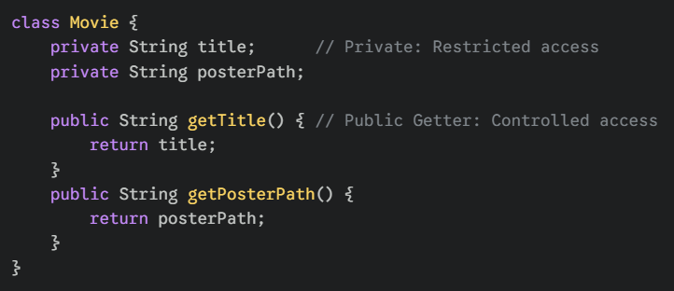
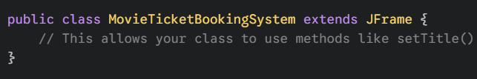
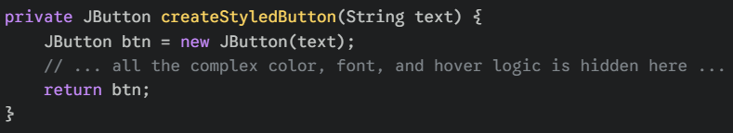
Low-Level Design
OOP Concepts Snippets from our code
Encapsulation
Inheritance
Abstraction

Slide 6
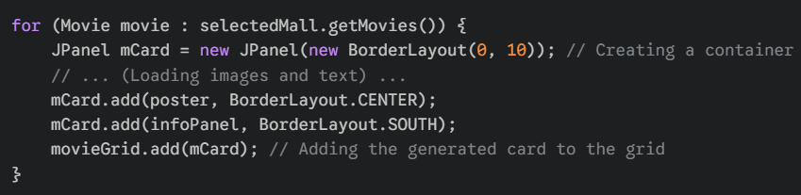
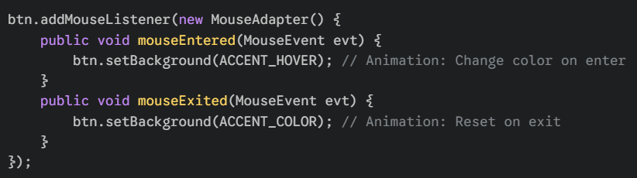
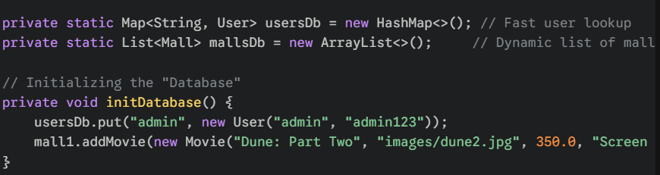
Swing GUI (Frontend)
HashMap & ArrayList (Backend)

Slide 7
Thank You!

