Slide 1
The Effects of Economic Growth on Health
Does Wealth cause Health or vice versa?
Julian Bara-Mason | Saranya Vadrevu | Rui Chong | Shreyansh Parihar

Slide 2
Table of Contents
Introduction
Stability of GDP per capita and health indicator relationships between countries over time
Comparison of cross-sectional and longitudinal relationships over time
Variation of the relationship across different countries and possible correlation with historical events
Assessing causality: Does wealth cause health or vice versa?

Slide 3





Introduction
Health and wealth are closely connected. This case study investigates the relationship between economic growth and health outcomes
Life Expectancy
Infant Mortality
Maternal Mortality
Health Expenditure per Capita
GDP per Capita

Slide 4
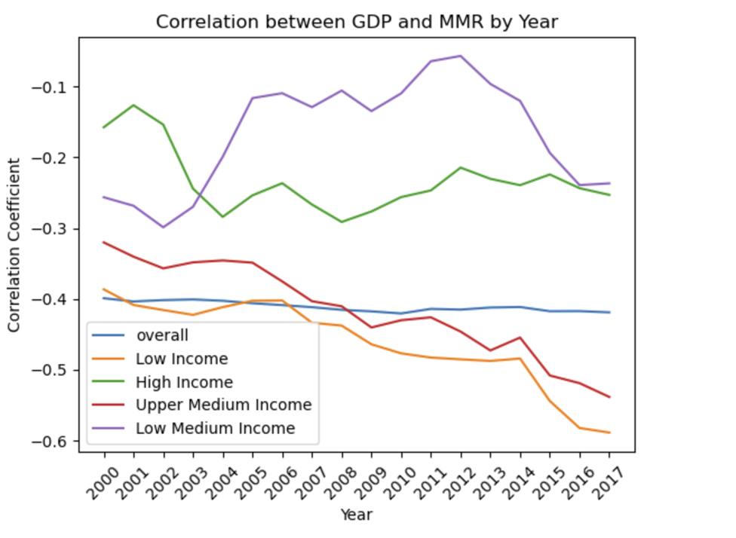
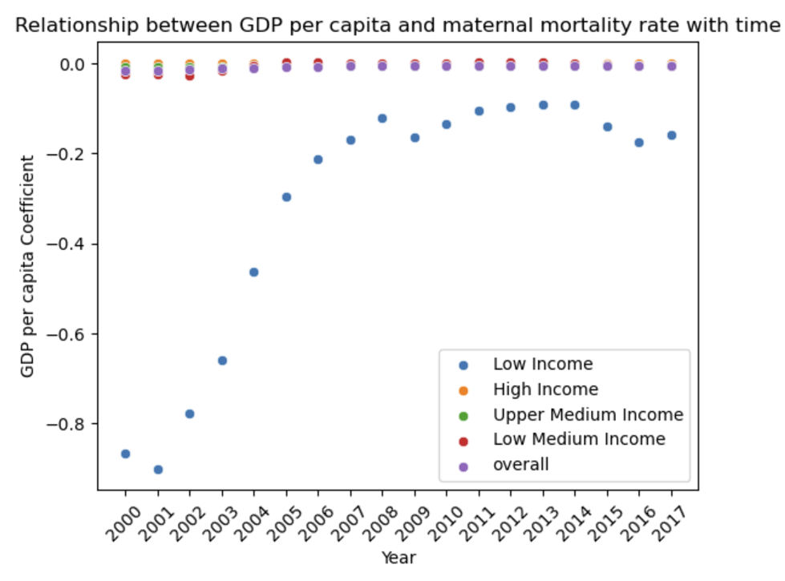
Q1

Slide 5
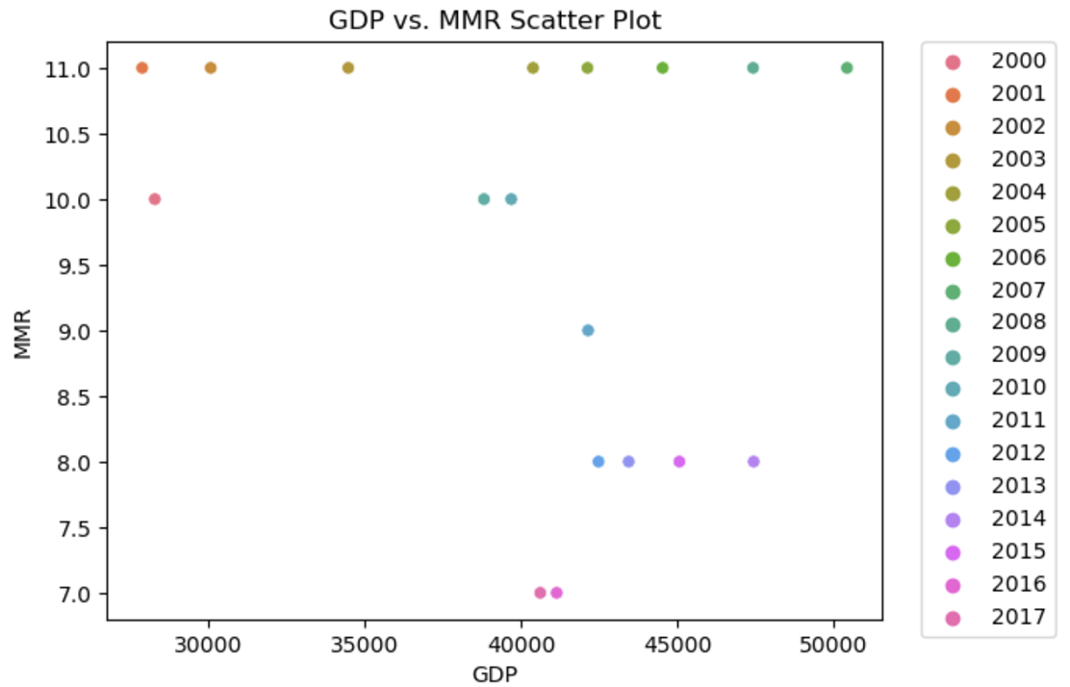
Q2

Slide 6
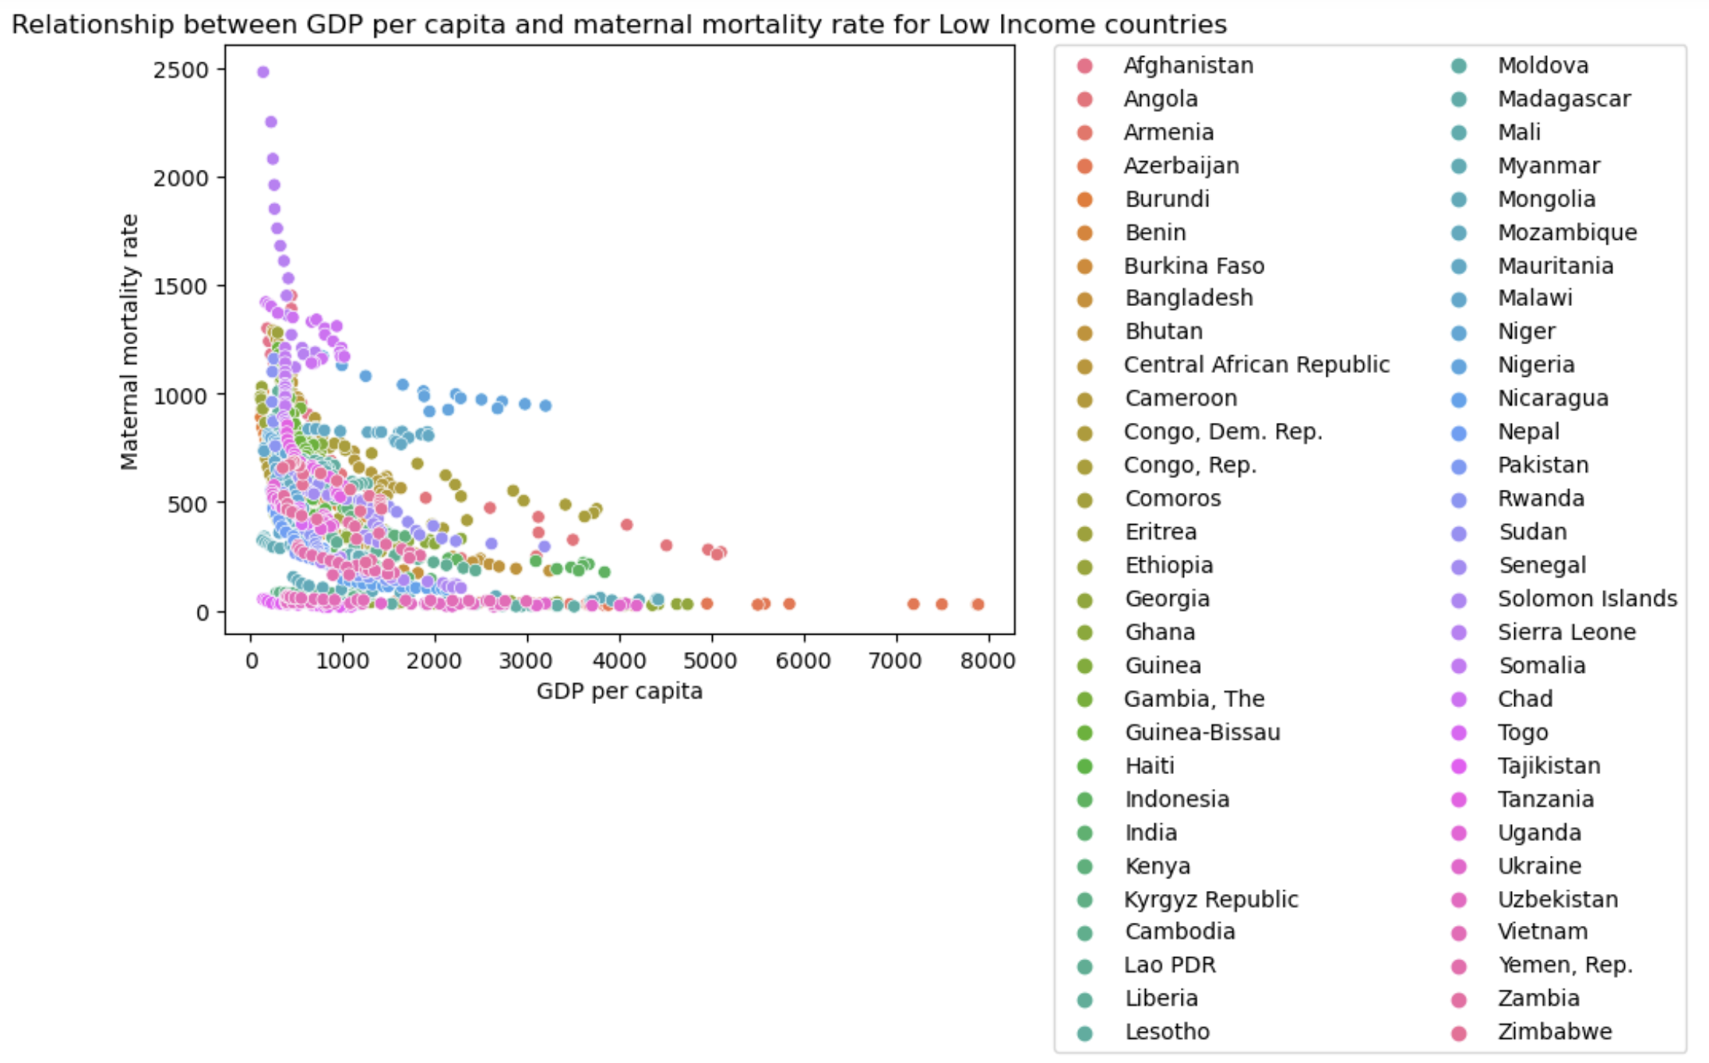
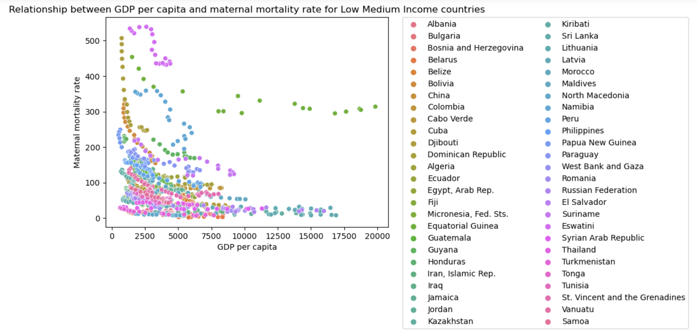
Q3
Anamaloies from low income countries:
Angola: Ebola Outbreak, Droughts, Decrease in oil prices during 2014 – 2016 impacted the economy adversely
Nigeria: Boka Haram insurgency (2009) and Drop in oil prices (2014)
Eswatini
Equitorial Guinea

Slide 7
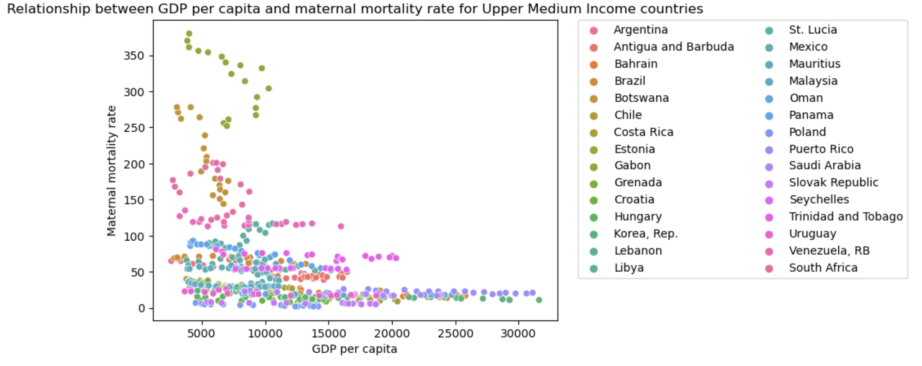
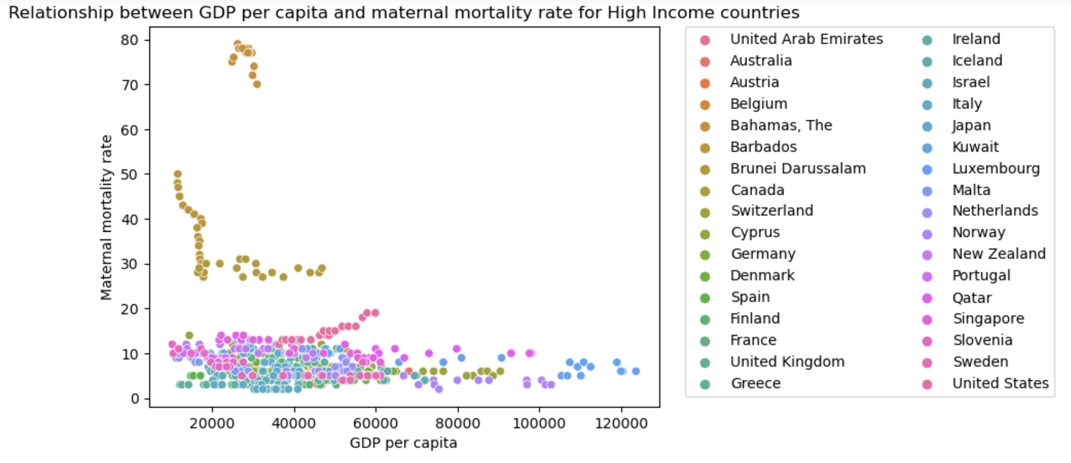
Q3
Bahamas
Barbados
Brunei Darusaalam
Gabon
Bostwana

Slide 8
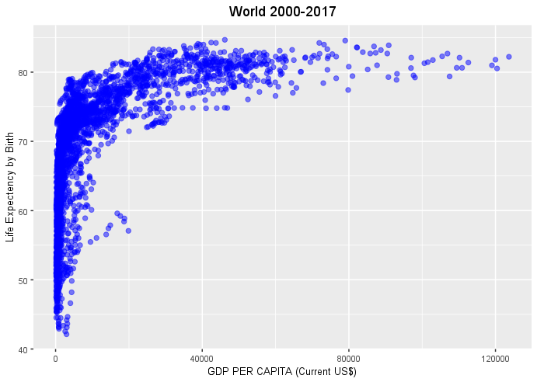
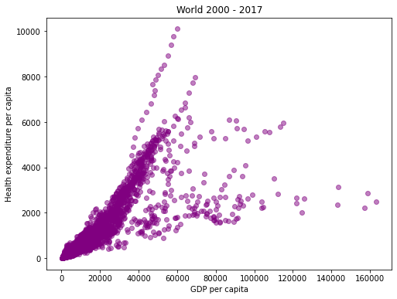
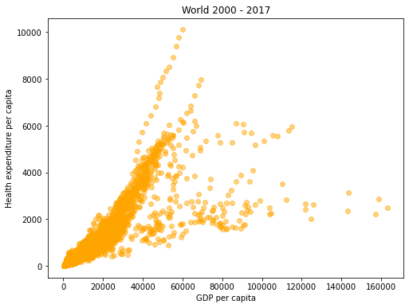
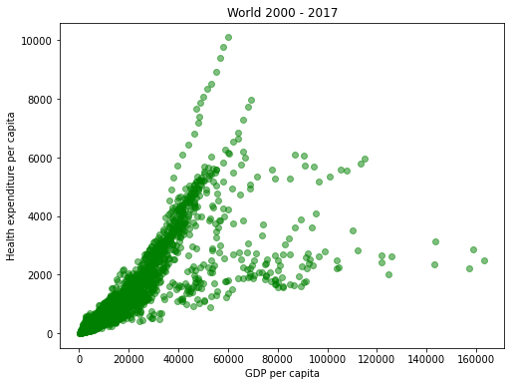
Stability of GDP per capita and health indicator relationships between countries over time (2000 – 2017)
Life Expectancy
Infant Mortality
Maternal Mortality
Health Expenditure per Capita

Slide 9
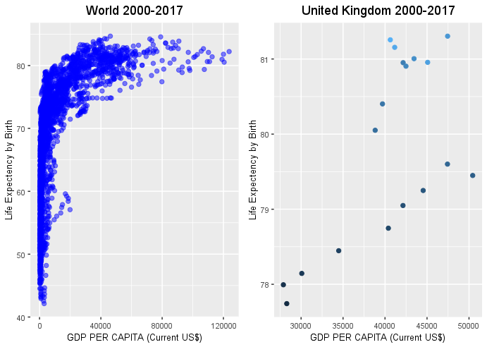
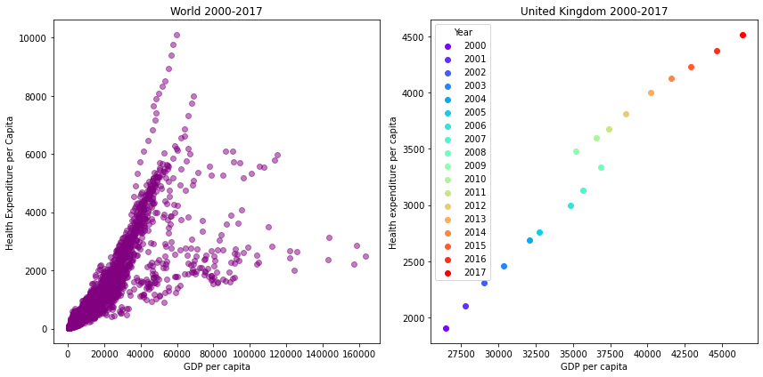
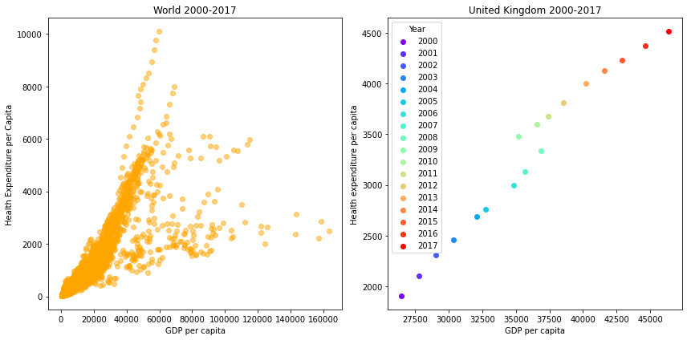
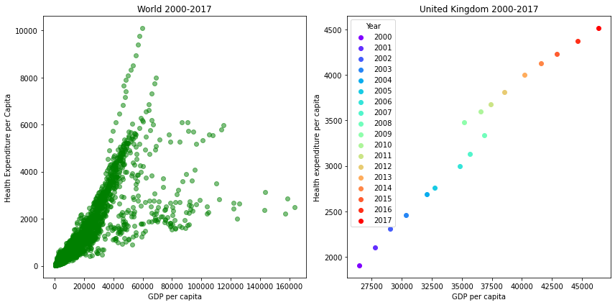
Comparison of cross-sectional and longitudinal relationships over time (2000 – 2017)
Life Expectancy
Infant Mortality
Maternal Mortality
Health Expenditure per Capita

Slide 10
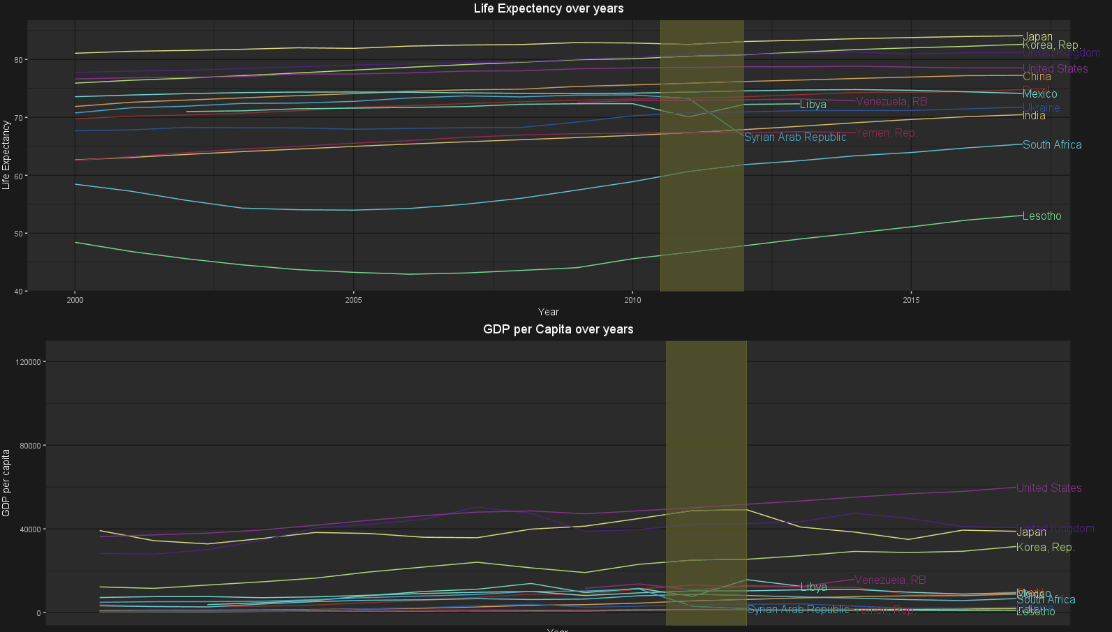
Variation of the relationship across different countries and possible correlation with historical events (2000 – 2017)
Life Expectancy
We can see breakdown of life expectancy in period 2011-2012 for Syria and Libya
This is likely due to Civil war in Libya and Syria.
The impact on life expectancy is on larger scale in Syria as there was high death toll which may result in drastic decrease in Life expectancy since the war was still going on till the recent ceasefire agreement in 2021.
And that maybe the reason we can there is no data from Syria after 2012.

Slide 11
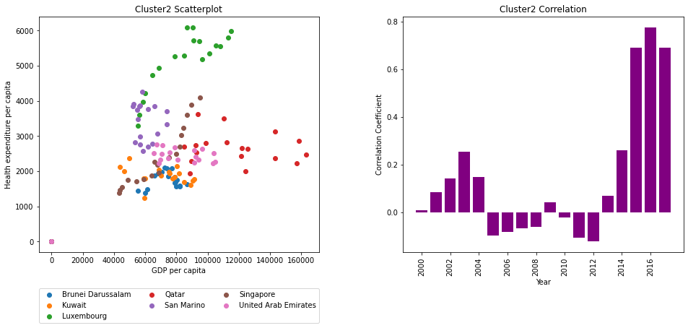
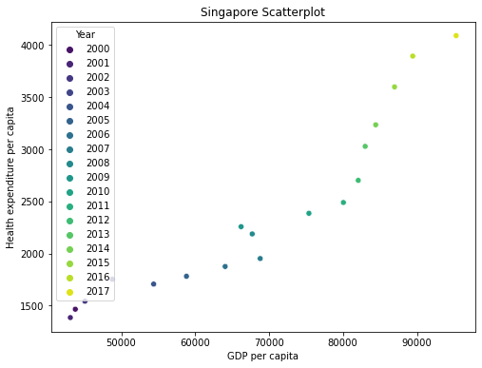
Variation of the relationship across different countries and possible correlation with historical events (2000 – 2017)
Infant Mortality
Breakdown in 2007 and 2008 for Singapore. Health Expenditure per Capita decreased as GDP per capita increased.
Could be attributed to the 2007-2008 global financial crash

Slide 12
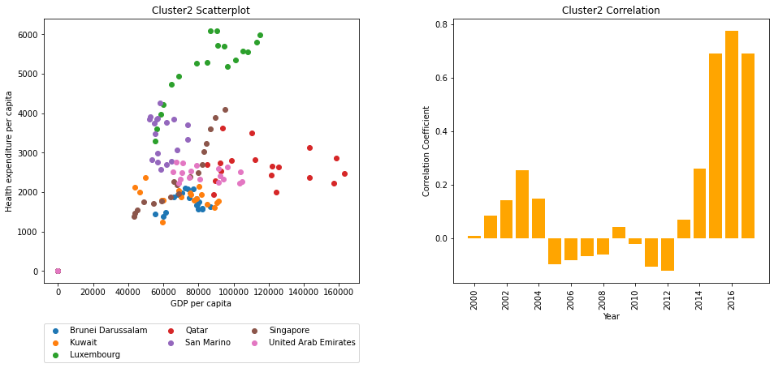
Variation of the relationship across different countries and possible correlation with historical events (2000 – 2017)
Maternal Mortality
Breakdown in 2007 and 2008 for Singapore. Health Expenditure per Capita decreased as GDP per capita increased.
Could be attributed to the 2007-2008 global financial crash

Slide 13
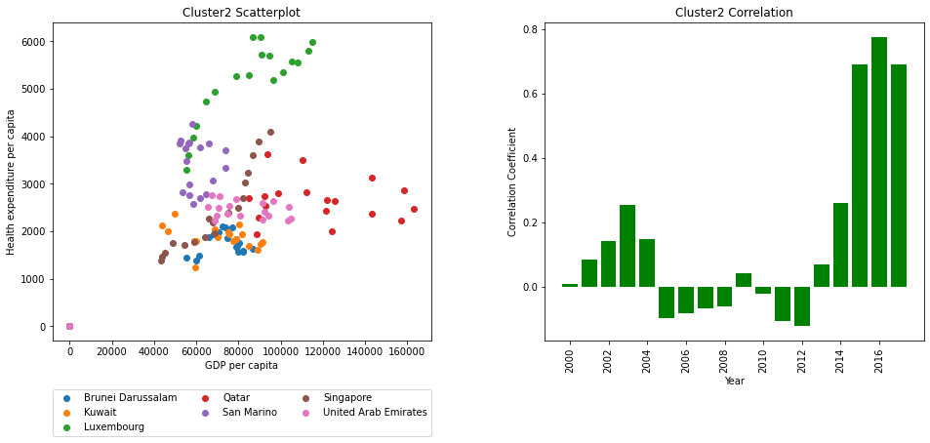
Variation of the relationship across different countries and possible correlation with historical events (2000 – 2017)
Health Expenditure per Capita
Breakdown in 2007 and 2008 for Singapore. Health Expenditure per Capita decreased as GDP per capita increased.
Could be attributed to the 2007-2008 global financial crash

Slide 14
Assessing causality: Does wealth cause health or vice versa?
Health cause Wealth?
Health cause Wealth?
insertModelFormula
insertModelFormula
Model Summary
Model Summary
CONCLUSION?

