Slide 1

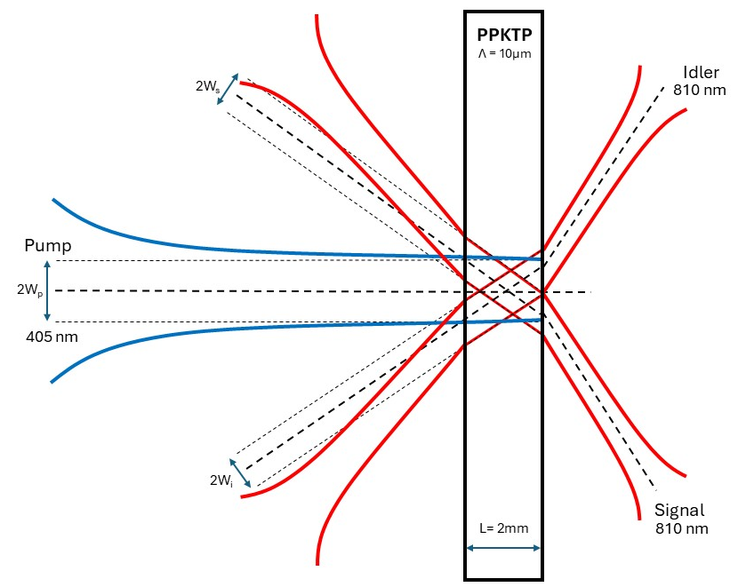
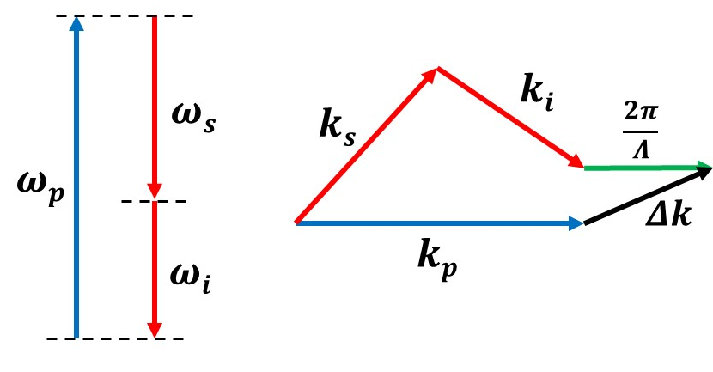
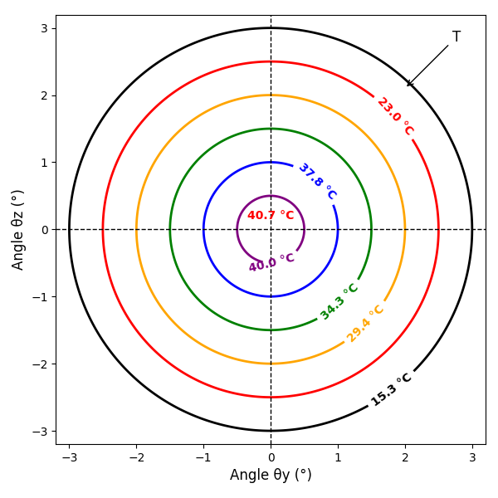
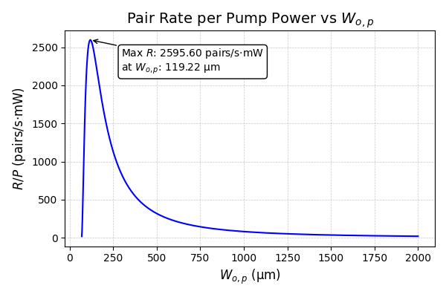
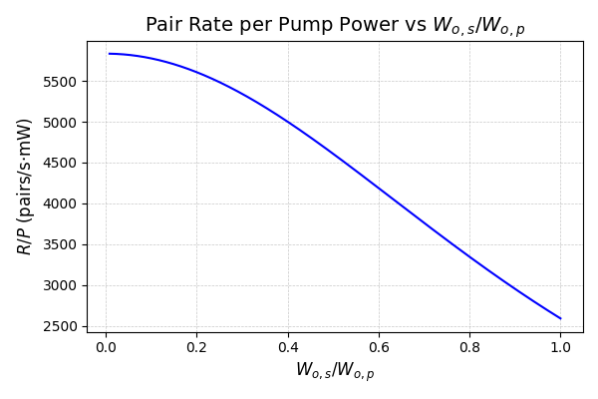
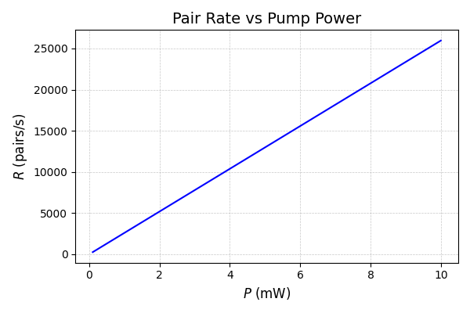
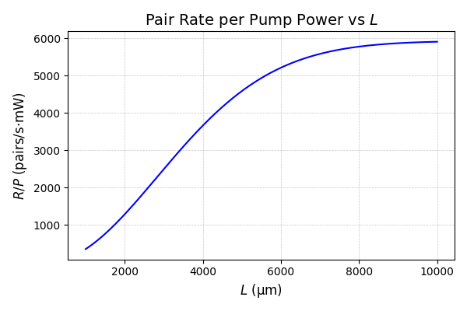



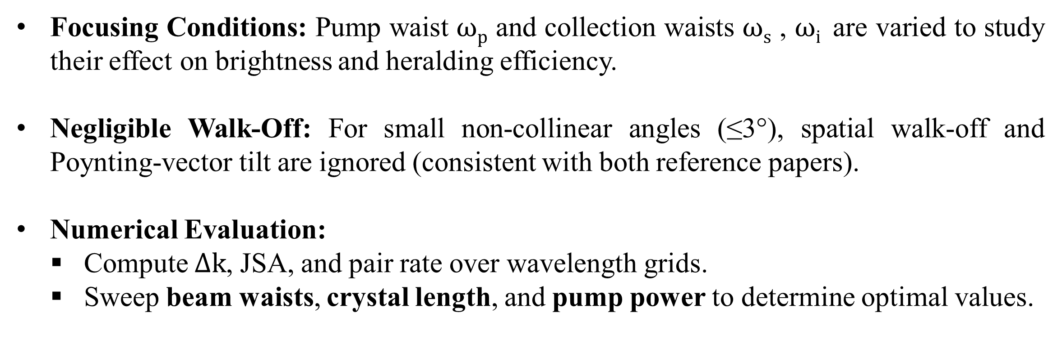

Spontaneous Parametric Down Conversion (SPDC): Maximizing Photon Pair Rate for Type – II SPDC with
PPKTP Crystal
Shreyansh Agarwal,^{1,*} Tomis Prajapati,^{1,†} and V. Narayanan^{1,2}
^{1,}Department of Physics, Indian Institute of Technology Jodhpur 342030
²Quantum Information and Computation (IDRP), Indian Institute of Technology Jodhpur 342030
*b23ph1024@iitj.ac.in †tomis.1@iitj.ac.in
INTRODUCTION
Spontaneous Parametric Down-Conversion (SPDC) is a key method for generating entangled photon pairs for quantum communication, computation, and sensing.
Type-II SPDC: a pump photon splits into orthogonally polarized signal and idler photons inside a χ² nonlinear crystal.
The photon pair rate and heralding efficiency depend strongly on pump focusing, beam waists, crystal length, and phase-matching temperature.
PPKTP is preferred due to its high nonlinear coefficient, stability, and wide temperature-tuning range.
Precise modelling helps predict optimal focusing conditions for maximizing pair generation.
Understanding these dependencies is crucial for building high-brightness, low-loss quantum light sources.
METHODOLOGY
Type-II SPDC: The approach employed in this work relies on photon-pair generation in a PPKTP crystal via the standard χ² nonlinear interaction, subject to energy and momentum conservation,
$\text{(}\text{i}\text{) }\text{K}\text{p}\text{ = }\text{Ks} \text{cos}\text{(}\text{θs}\text{) + }\text{Ki} \text{cos}\text{(}\text{θi}\text{) + 2}\text{π}\text{/}\text{Λ}$ , (ii) ω_{p} = ω_{s} + ω_{i}.
Refractive Index Calculation: Temperature-dependent Sellmeier equations (Kato–Takaoka & Emanueli–Arie) are used to compute refractive indices.
Quasi-Phase Matching (QPM): The QPM temperature is obtained by solving
$ΔK\left(T\right)=\text{K}\text{p} \text{− }\text{K}\text{s} \text{cos}\text{(}\text{θs}\text{) }\text{−} \text{Ki} \text{cos}\text{(}\text{θi}\text{) }\text{−}\text{ 2}\text{π}\text{/}\text{Λ}\text{ = 0}$,
$$Kj= 2π nj(T)/λ .$$
Joint Spectral Amplitude (JSA): The biphoton state is modelled using
$Φ(ωs,ωi)=α(ωs+ωi) φ(ωs,ωi)$,
where α is the pump envelope and φ is the phase-matching function.
Pair-Production Rate:
$$R=\frac{η_{s}η_{i}Pd_{eff}^{2}ω_{s}ω_{i}}{\sqrt{2}π^{3/2}ϵ_{0}c^{3}n_{s}n_{i}n_{p}B_{p}}\int_{−∞}^{∞}{T_{s}\left(ω_{s}\right)\int_{−∞}^{∞}{T_{i}\left(ω_{p}−ω_{s}\right){\left|Φ\left(ω_{s},ω_{i}\right)\right|}^{2}dω_{s}dω_{p}}}.$$
Beam focusing parameters (pump, signal, idler waists) enter through the spatial-mode
overlap.
Focusing Conditions: Pump waist $ωp$ and collection waists $ωs$ , $ωi$​ are varied to study their effect on brightness and heralding efficiency.
Negligible Walk-Off: For small non-collinear angles (≤3°), spatial walk-off and Poynting-vector tilt are ignored (consistent with both reference papers).
Numerical Evaluation:
  Compute $Δk$, JSA, and pair rate over wavelength grids.
  Sweep beam waists, crystal length, and pump power to determine optimal values.
RESULTS AND DISCUSSION
Our approach predicts a QPM temperature of 40.66 °C for degenerate Type-II SPDC in PPKTP. The optimal pump waist of 119.22 µm yields a maximum brightness of 2595.60 pairs/s.mW, with beam-waist matching playing the most significant role in enhancing pair generation. Crystal length and pump power further increase the rate but with diminishing returns due to spatial-overlap limits.
CONCLUSION
REFERENCES
Our approach shows that optimizing beam-waist focusing is the most effective way to enhance Type-II SPDC brightness in PPKTP. The identified optimal pump waist and QPM temperature provide practical guidelines for designing high-efficiency entangled-photon sources. These results highlight how careful parameter tuning can significantly improve photon pair rates and overall heralding performance.
Lynden K. Shalm, Evan Meyer-Scott, Bradley G. Christensen, and et al. Strong loophole-free test of local realism. Phys. Rev. Lett., 115:250402, Dec 2015.
B. Hensen and et al. Loophole-free bell inequality violation using electron spins separated by 1.3 kilometres. Nature, 526(7575):682–686, Oct 2015.
S. Emanueli and A. Arie, “Temperature-dependent dispersion equations for KTiOPO4 and TiOAsO4,” Applied Optics, vol. 42, no. 33, pp. 6661–6665, 2003.
K. Fradkin, A. Arie, A. Skliar, and G. Rosenman, “Tunable midinfrared source by difference frequency generation in bulk periodically poled KTiOPO4,” Applied Physics Letters, vol. 74, no. 7, pp. 914–916, 1999.
K. Kato and E. Takaoka, “Sellmeier and thermo-optic dispersion formulas for KTP,” Applied Optics, vol. 41, no. 24, pp. 5040–5044, 2002.
Andrew Rockovich, Daniel Gauthier, and Shu’an Wang, “Maximizing the Purity and Heralding Efficiency of Down-Converted Photons Using Beam Focal Parameters,” arXiv preprint arXiv:2312.06663, 2023.
ACKNOWLEDGEMENT
VN wants to acknowledge the DST grant no. DST/ICPS/QueST/Theme-1/2019/6 for the research funding. Tomis wants to acknowledge CSIR for the research support.

