Slide 1
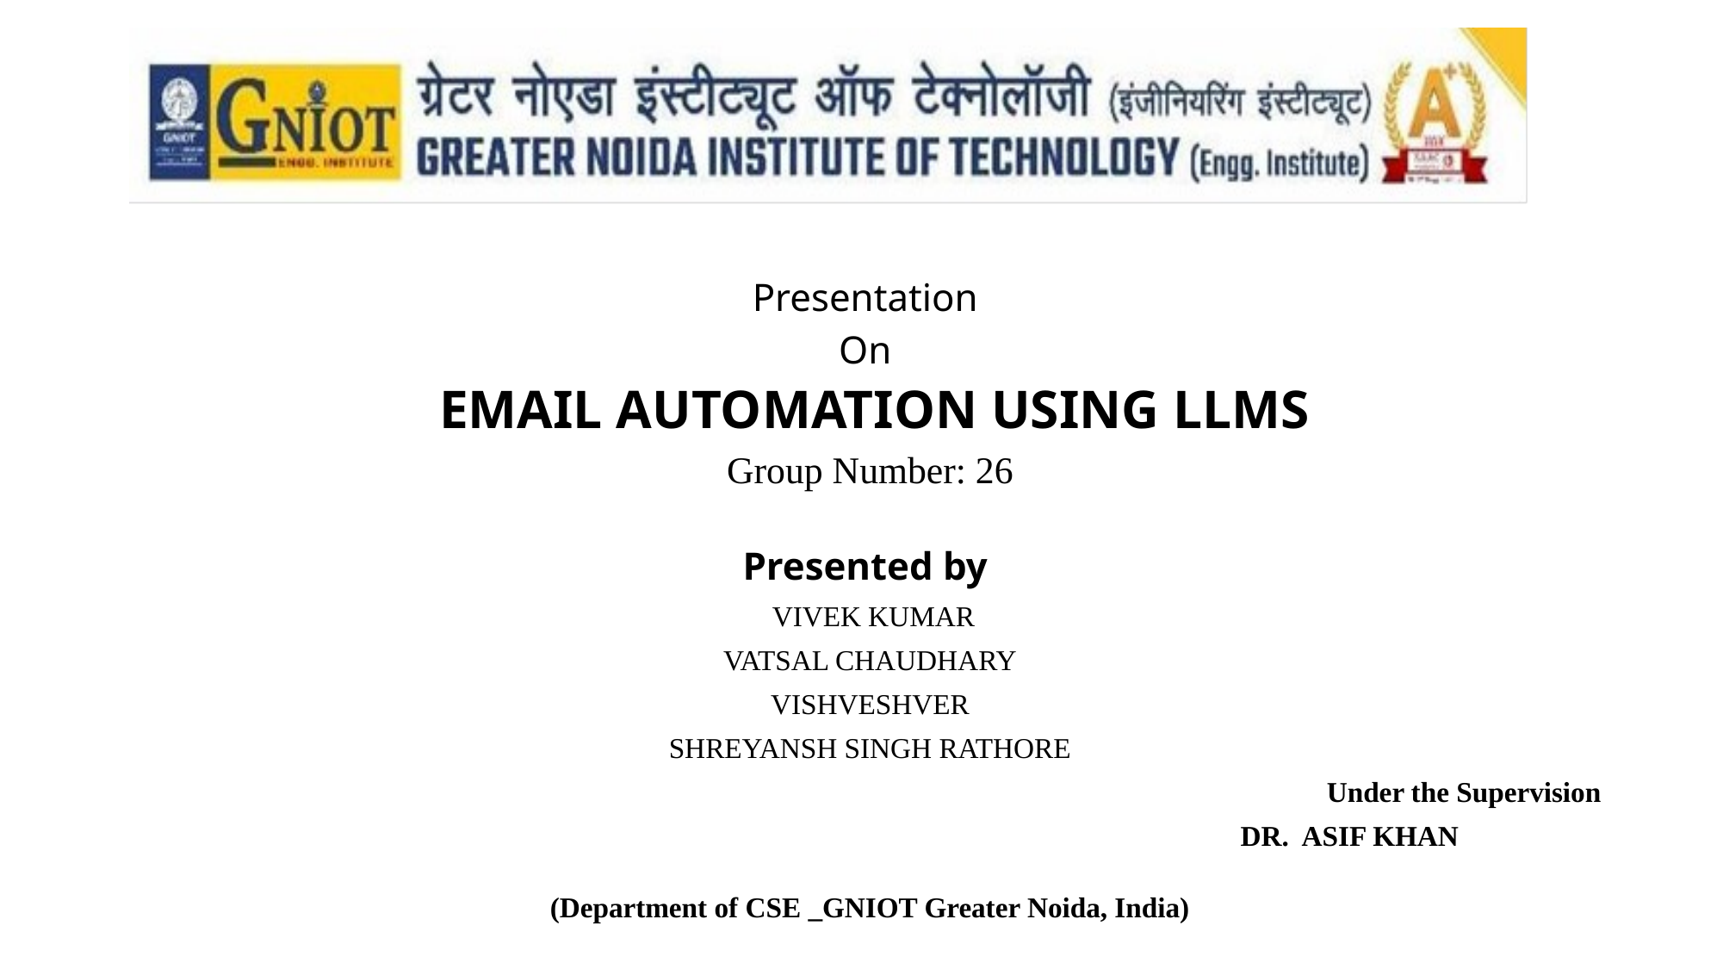

Slide 2

Table of Contents
1. Introduction
2. Research Objectives
3. Literature Survey
4. Proposed Model
5. Discussion About Methodology & Algorithm
6. Conclusion & Future Work
7. Research Paper Progress
8. References
Slide 2

Slide 3
1.Introduction
Email remains one of the most widely used communication channels globally, with over 300 billion emails sent daily across professional and personal domains.
Manual email drafting is time-consuming, repetitive, and often lacks personalization, leading to reduced productivity in enterprise environments.
Recent advances in Large Language Models (LLMs) offer a transformative approach to intelligent email automation, enabling context-aware generation, summarization, and personalized communication at scale.
This project proposes an AI-powered email automation platform that leverages LLM capabilities to generate professional email drafts, summarize threads, rewrite content in different tones, classify emails, and detect priority levels.
Slide 3

Slide 4
2.Research Objectives
1. Develop an inbox-native interaction layer that captures active conversation context from webmail clients without interrupting the user workflow.
2. Design a context-preserving orchestration layer with token budgeting, preference caching, and task-aware routing.
3. Incorporate memory-aware personalization for tone control, signature reuse, and sender-specific response policy.
4. Introduce observability for latency, token consumption, estimated cost, and routing efficiency.
5. Ensure resilience through fallback inference, graceful degradation, and rate-limit-tolerant request handling under upstream service constraints.
Slide 4

Slide 5
3.Literature Survey
Existing Approach
Strength
Limitation
Why Our System Is Different
Smart compose systems
Fast completion
No full-thread reasoning
Handles complete conversation context
Manual LLM use
Flexible prompting
Workflow breaks on context transfer
Embedded in inbox workflow
Enterprise copilots
Strong integration
Opaque routing/cost
Explicit telemetry and routing
Template-based systems
Deterministic
Weak tone adaptation
Context-aware generation
Research gap: A browser-native, context-preserving, cost-aware, and provider-flexible email orchestration system with explicit telemetry and evaluation.
Slide 5

Slide 6
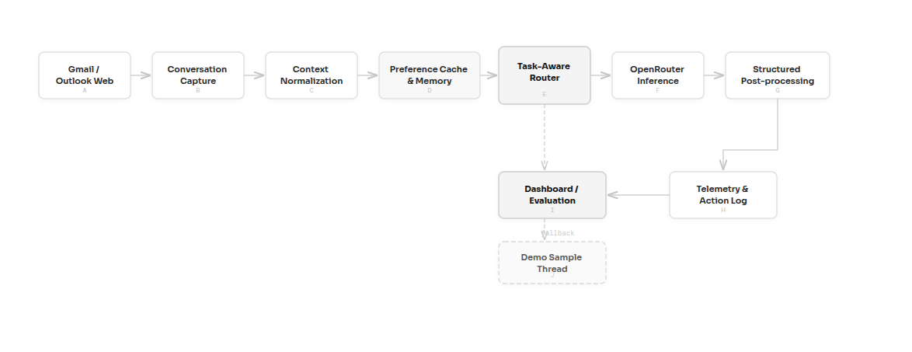
4.Proposed Model
Slide 6

Slide 7
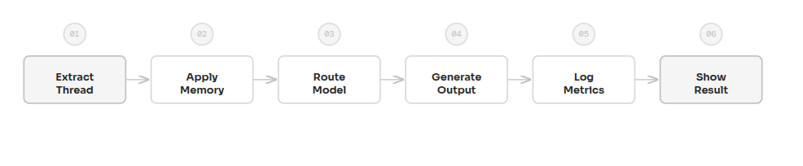
5.Discussion About Methodology & Algorithm
1. Extract the active thread and assemble a bounded conversation context.
2. Normalize the thread by removing UI noise and unnecessary fragments.
3. Resolve user memory, tone, signature, and default profile.
4. Route the task to the appropriate OpenRouter-backed profile.
5. Generate the output with task-specific prompts and context constraints.
6. Parse structured metadata such as confidence, priority, and action items.
7. Record telemetry including route reason, latency, token usage, and estimated cost.
8. Render the result in the interface and persist the action history.
Slide 7

Slide 8
6.Conclusion & Future Work
Conclusion
Future Work
The project shows that email automation becomes substantially more effective when generation is combined with thread context, model routing, and preference memory.
Stronger Outlook parsing and layout stabilization
The system shifts email handling from manual drafting to an intelligent orchestration workflow with visible cost and latency trade-offs.
Attachment-aware summarization
The architecture also improves explainability through route reason, structured metadata, and telemetry.
Multilingual support
Persistent long-term memory storage
Controlled user studies and quality scoring
Slide 8

Slide 9
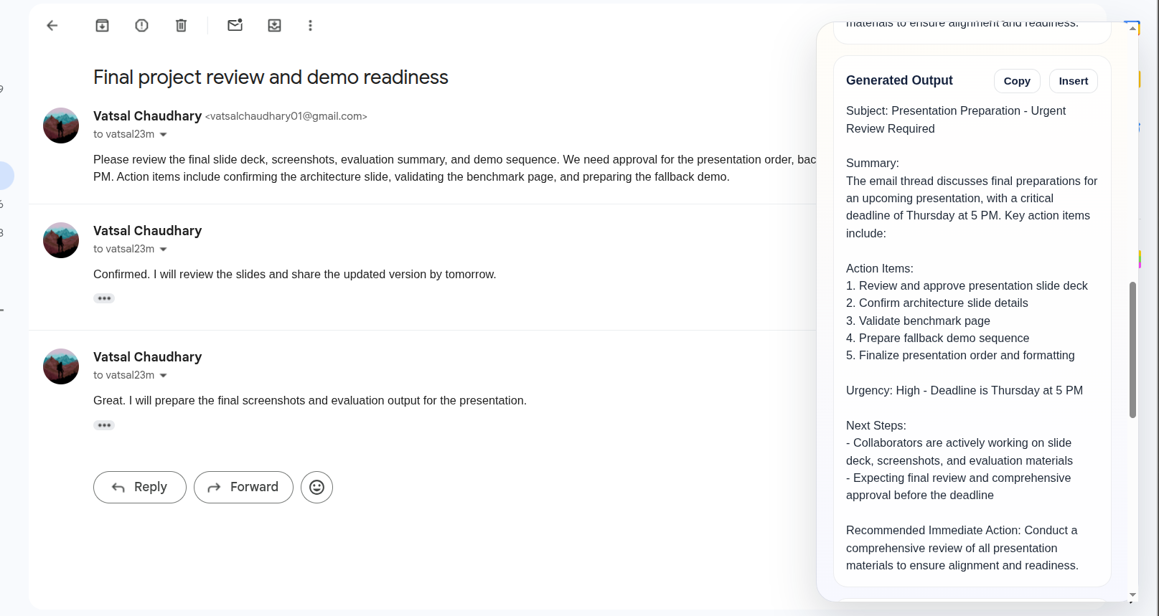
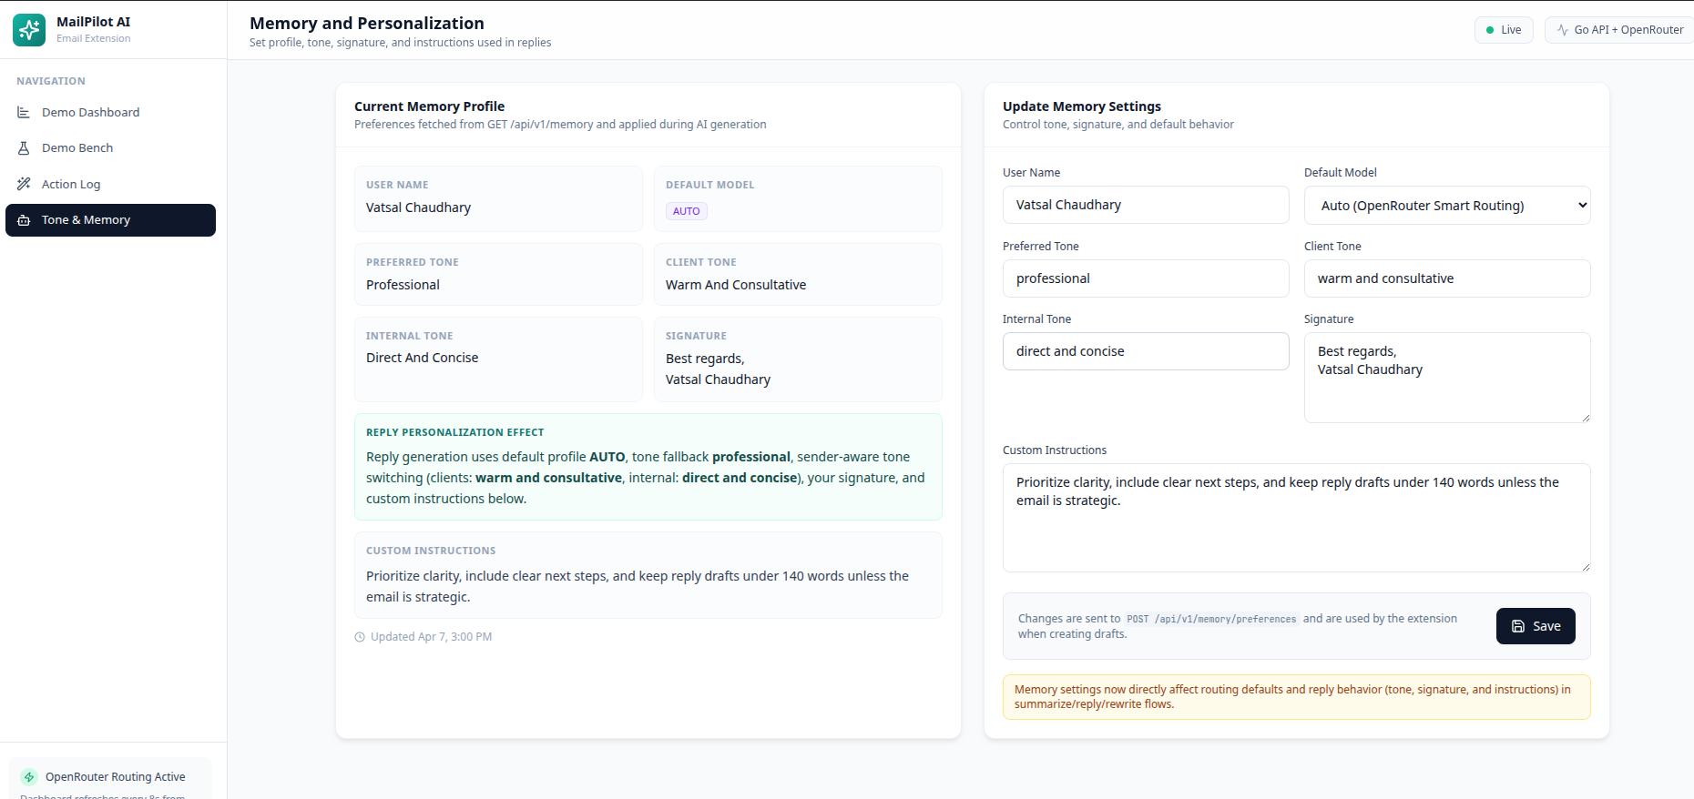
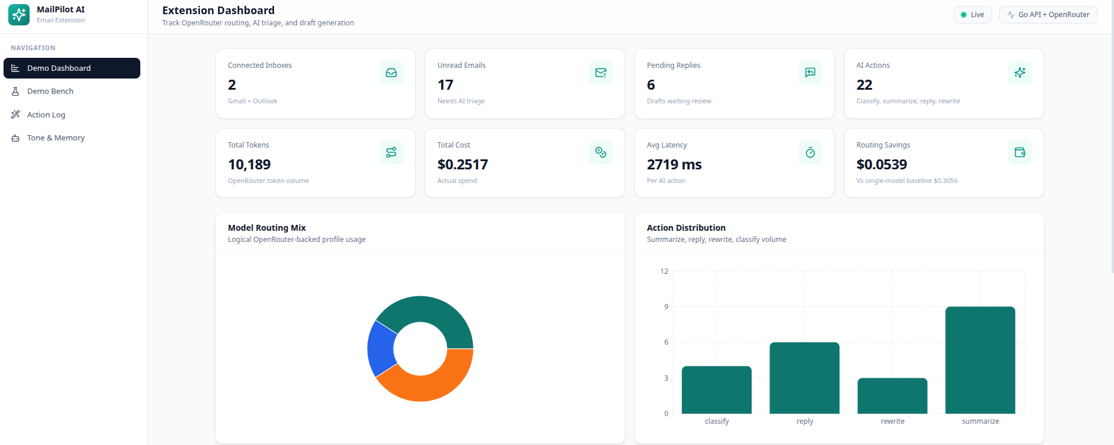
7.Demonstration and Evaluation
Problem definition
Literature survey
System implementation
Evaluation tuning
Final writing
Slide 9

Slide 10
8.References
[1] Vaswani, A. et al., "Attention Is All You Need," Advances in Neural Information Processing Systems (NeurIPS), 2017.
[2] Schulhoff, S. et al., "The Prompt Report: A Systematic Survey of Prompting Techniques," arXiv preprint, 2024.
[3] Google, "Gemini API Reference," Google AI for Developers, 2024. [Online]. Available: https://ai.google.dev/docs
[4] Al-Debagy, O. and Martinek, P., "A Comparative Review of Microservices and Monolithic Architectures," Budapest University of Technology and Economics, 2018.
[5] Dilip, K., "Review on SMTP Protocol for E-Mail Systems," Galgotias University, Department of Computer Science and Engineering, 2020.
[6] Chen, M. et al., "Leveraging Generative AI in Enterprise Applications," IEEE Conference on AI and Business Operations, 2023.

