Slide 1

s
Presentation
On
EMAIL AUTOMATION USING LLMS
Group Number: 26
Presented by
VIVEK KUMAR
VATSAL CHAUDHARY
VISHVESHVER
SHREYANSH SINGH RATHORE
Under the Supervision
DR. ASIF KHAN
(Department of CSE _GNIOT Greater Noida, India)

Slide 2
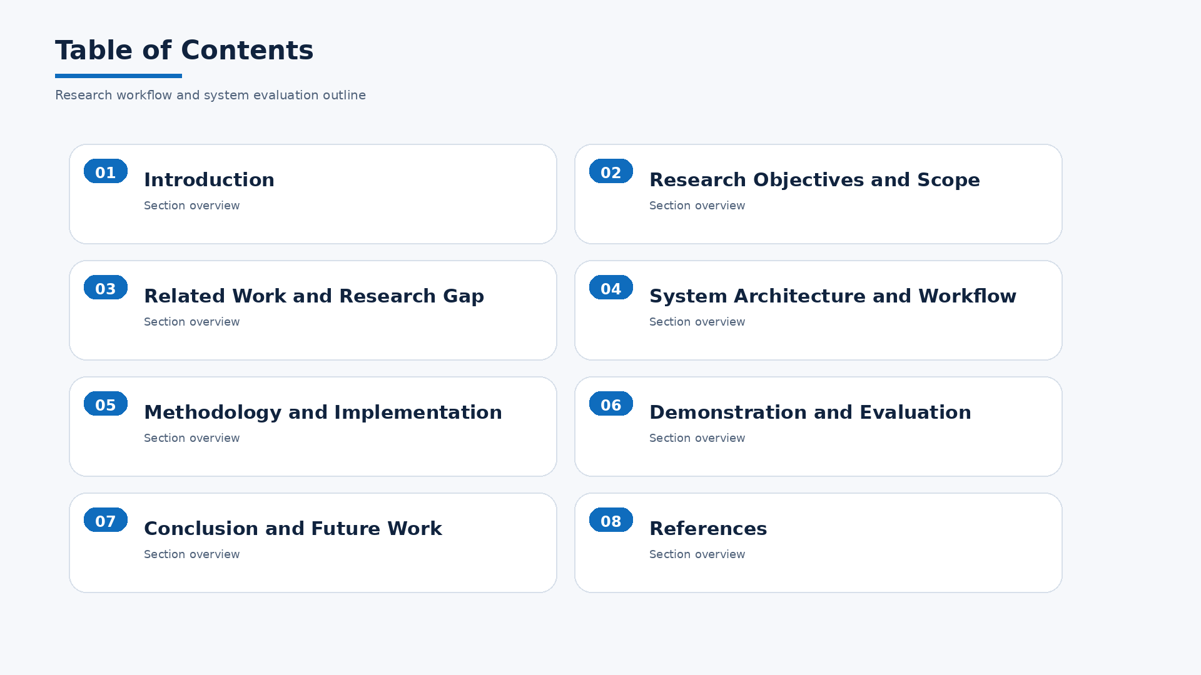

Slide 3
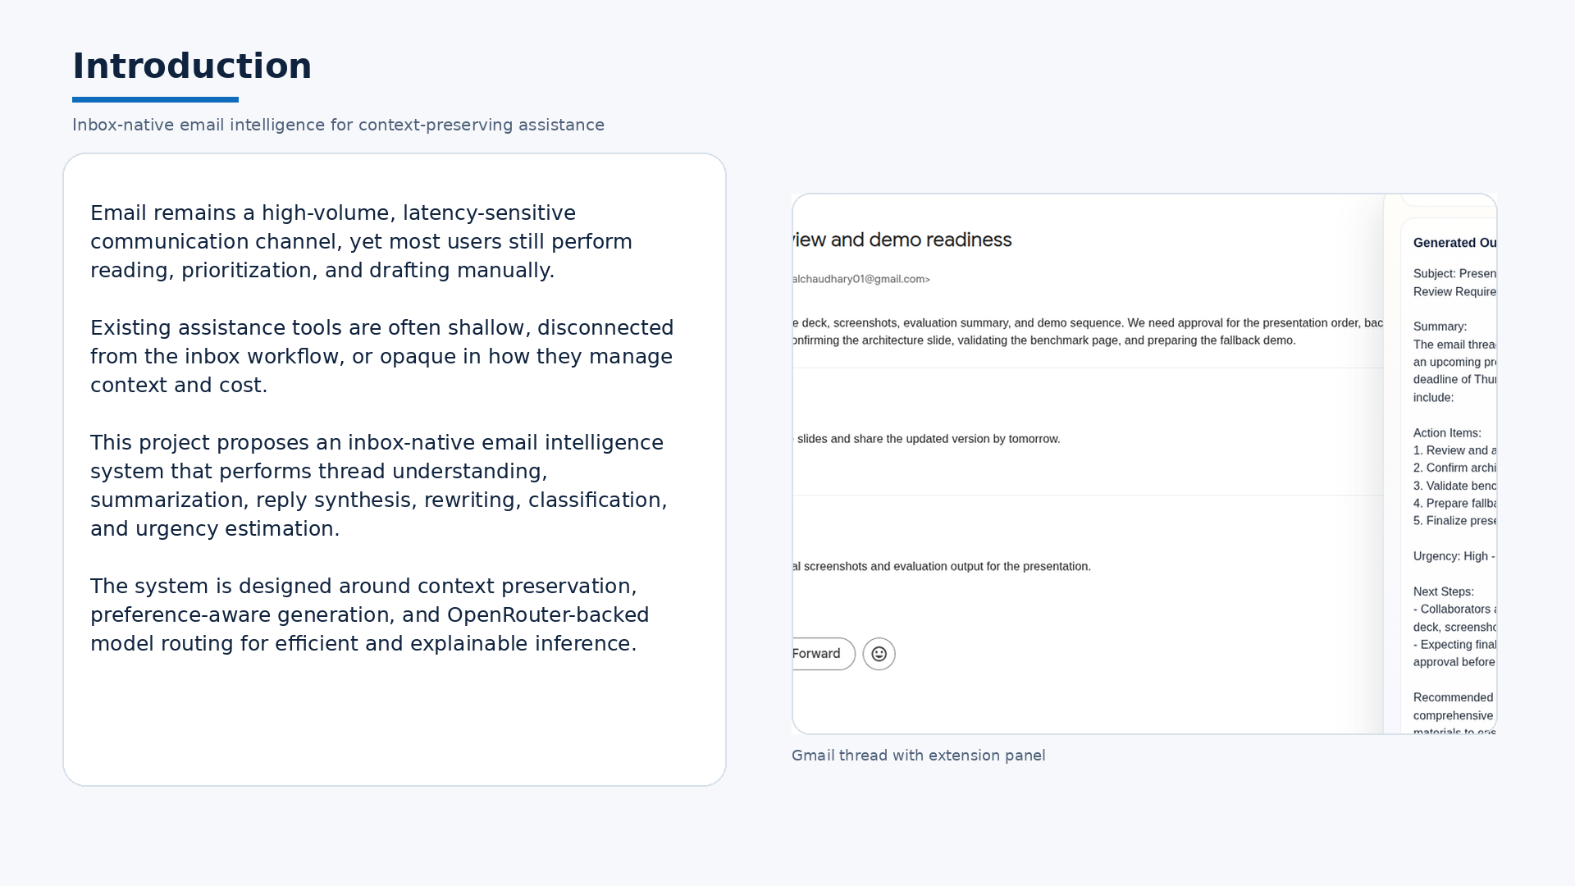

Slide 4
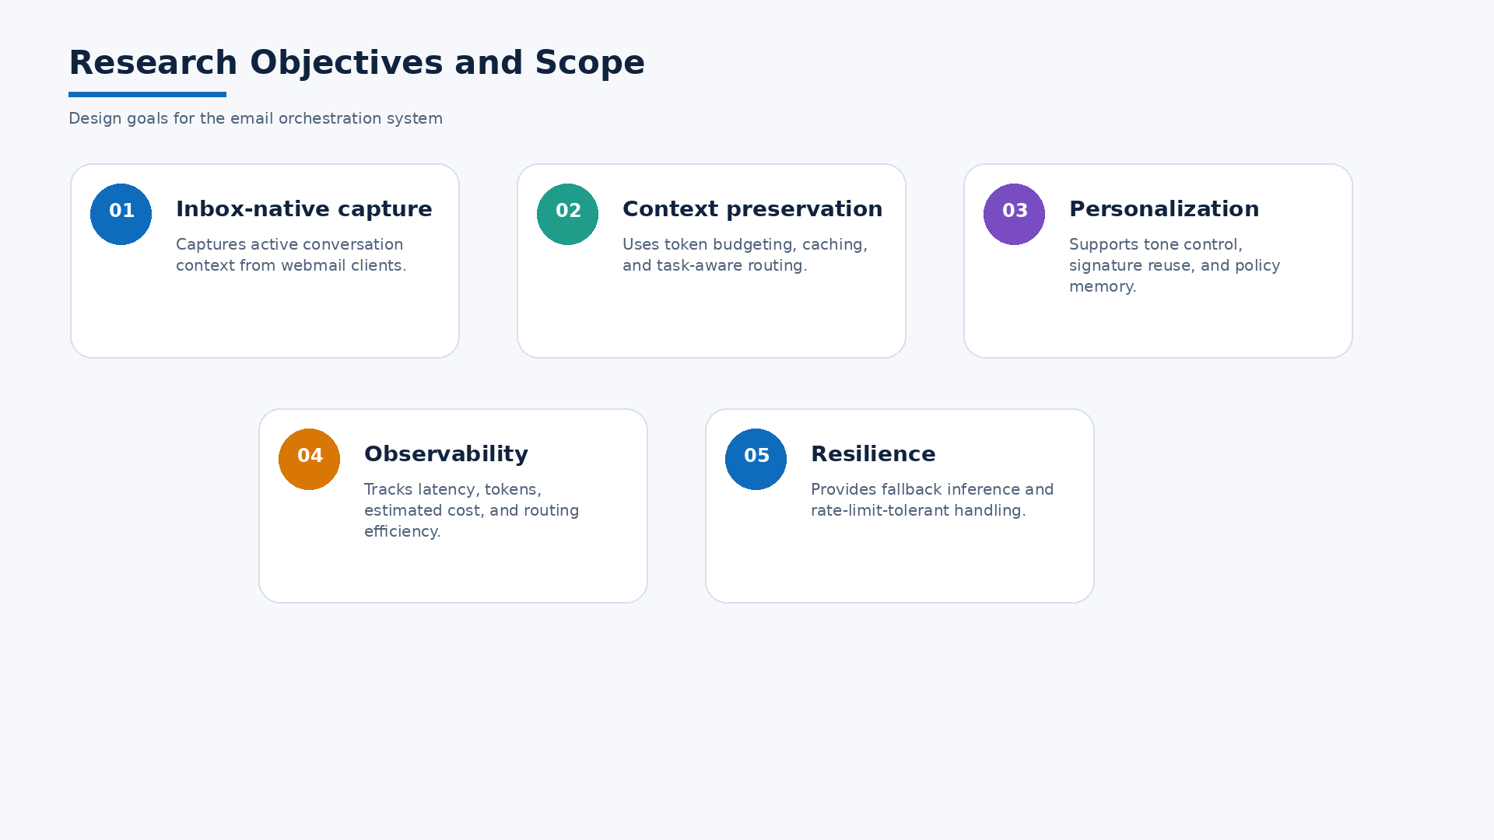

Slide 5
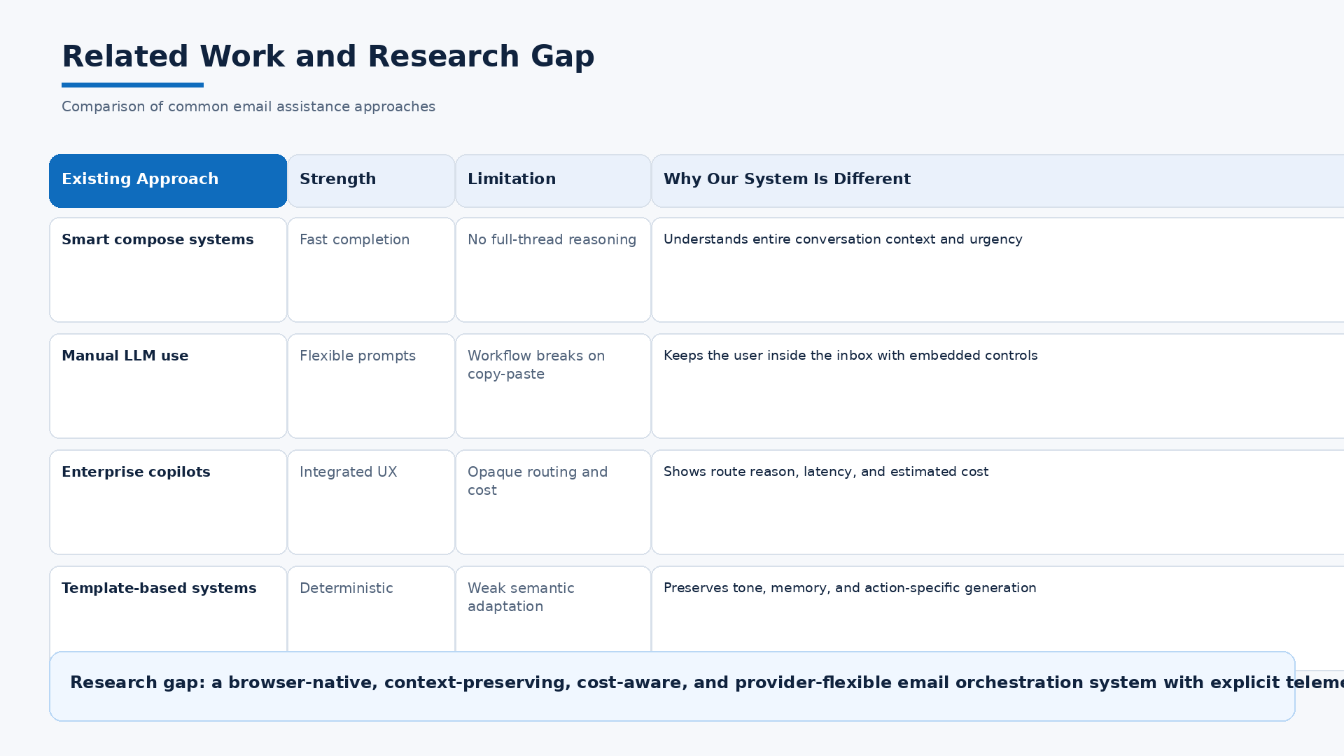

Slide 6
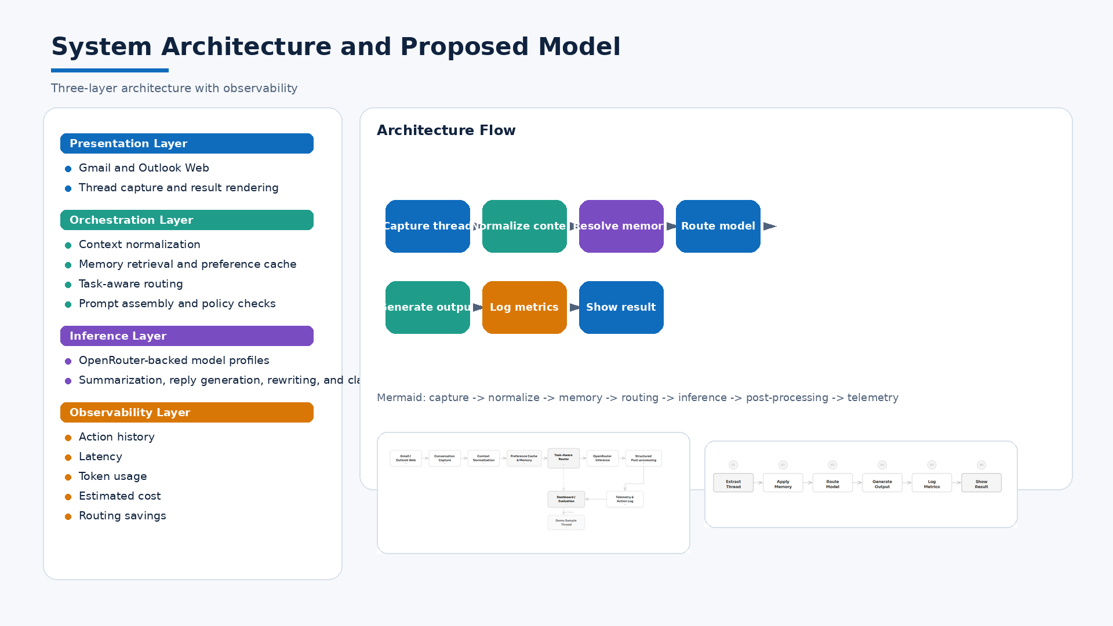

Slide 7
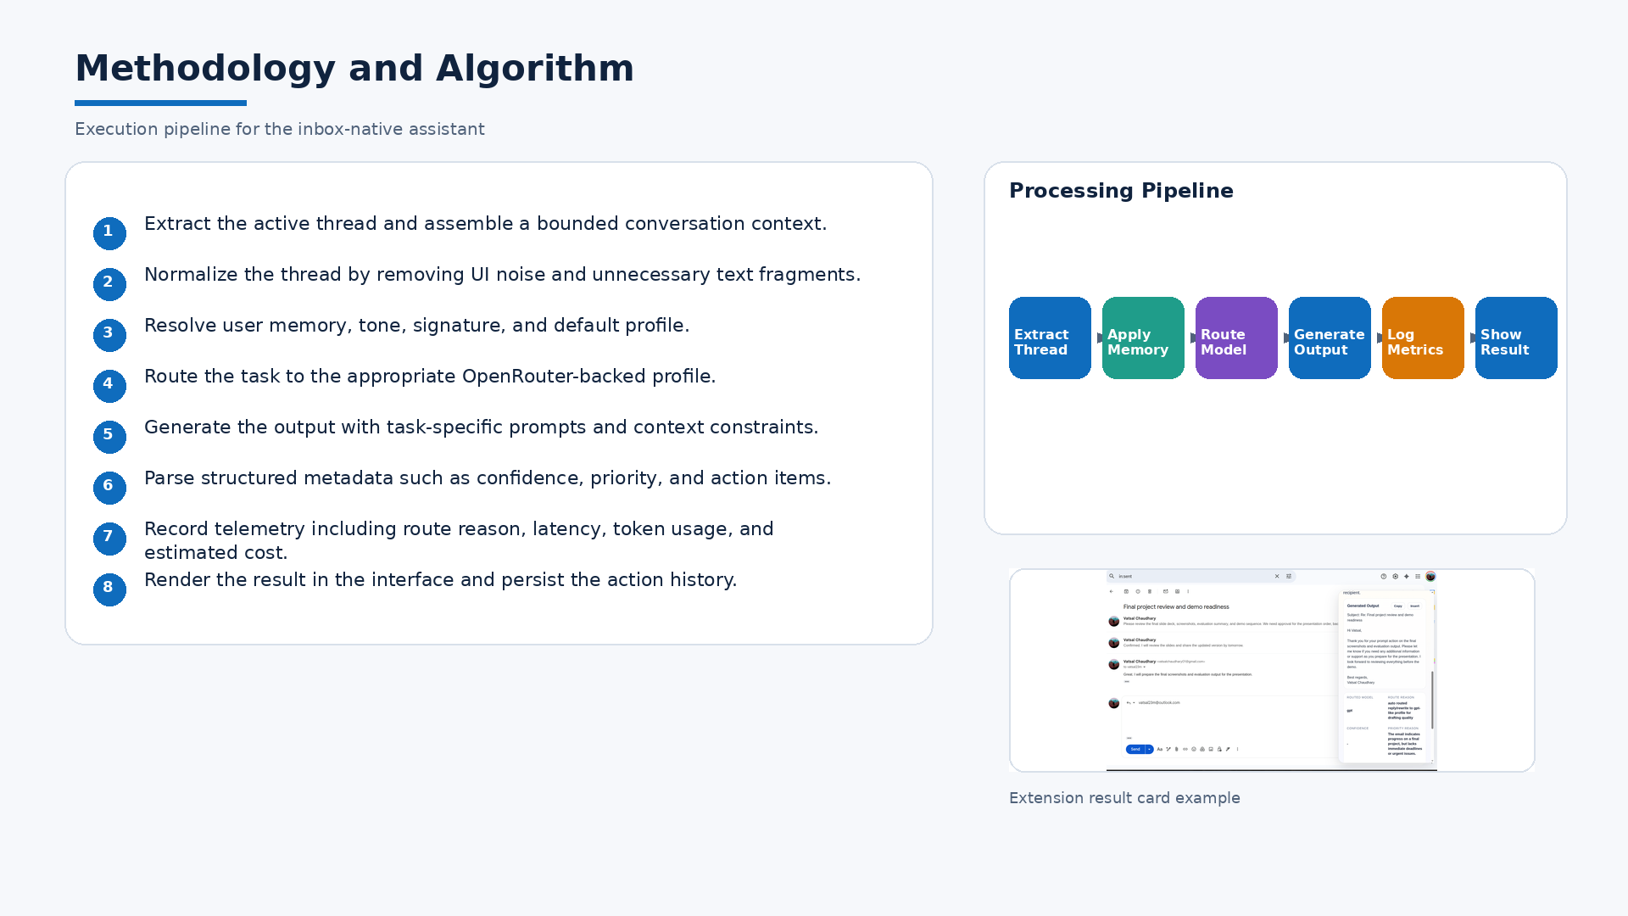

Slide 8
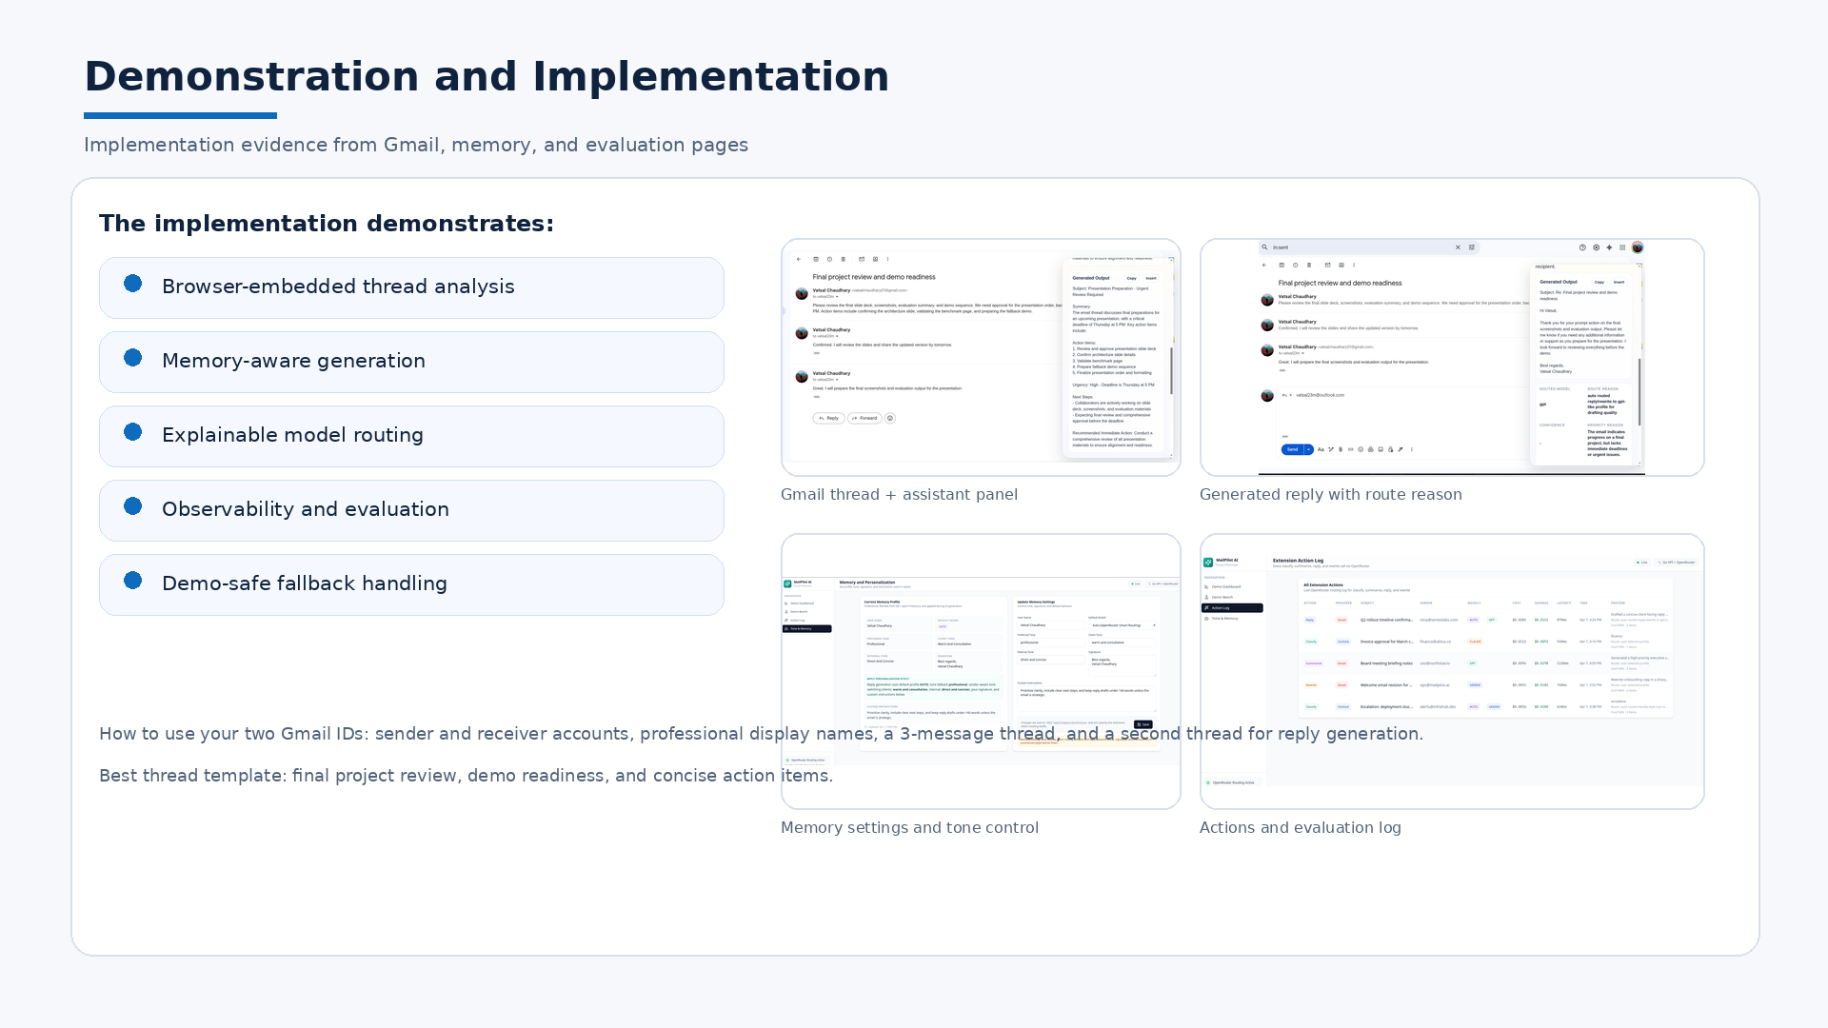

Slide 9
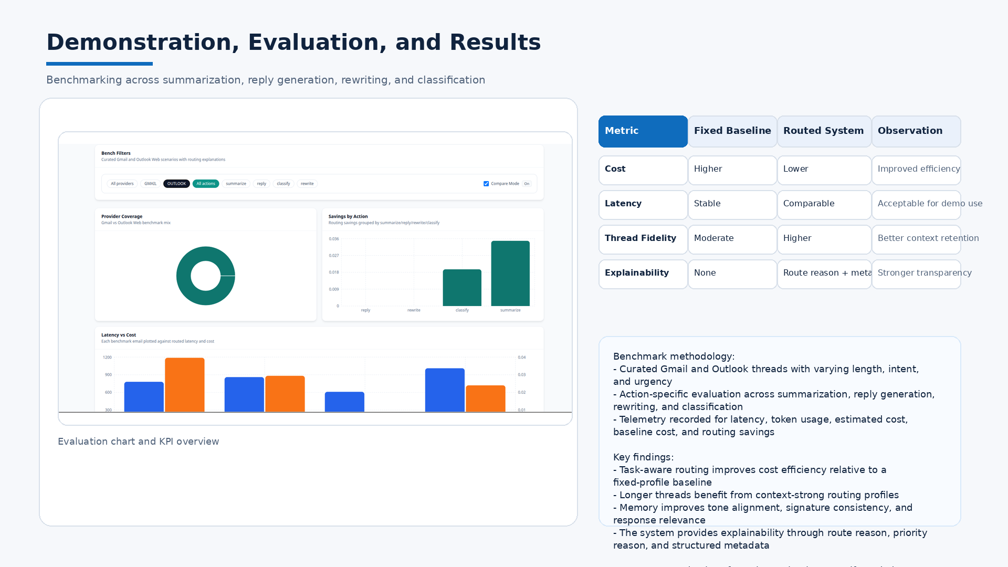

Slide 10
