Slide 1

s
Presentation
On
EMAIL AUTOMATION USING LLMS
Group Number: 26
Presented by
VIVEK KUMAR
VATSAL CHAUDHARY
VISHVESHVER
SHREYANSH SINGH RATHORE
Under the Supervision
DR. ASIF KHAN
(Department of CSE _GNIOT Greater Noida, India)

Slide 2
Table of Contents
1.Introduction
2.Research Objectives
3.Literature Survey
4.Proposed Model
5.Discussion About Methodology & Algorithm
6.Conclusion & Future Work
7. Research Paper Progress
8.References

Slide 3
1.Introduction
Email handling is a high-frequency workflow where users repeatedly read long threads, infer intent, and draft responses under time pressure.
The core issue is not only writing speed; it is decision quality: identifying urgency, selecting tone, and preserving thread context without missing commitments.
This project frames email automation as an algorithmic pipeline: thread extraction -> intent/priority inference -> response planning -> generation -> post-validation.
The system outputs structured assistance (summary, reply draft, rewrite, classification, priority, action items) so users can review quickly and send with confidence.

Slide 4
2.Research Objectives
Formalize a context-extraction methodology that converts noisy thread content into normalized input (subject, sender cues, semantic body blocks).
Design an adaptive decision layer that maps task intent (summarize/reply/rewrite/classify) to generation strategy while preserving output consistency.
Implement priority scoring and action-item extraction so outputs are decision-oriented, not only text-completion outputs.
Evaluate practical productivity gains using response relevance, tone alignment, summary compression quality, and drafting-time reduction.
Build an observability loop that records request volume, latency, token estimate, and per-action cost for continuous prompt and routing improvement.

Slide 5
3.Literature Survey
Transformer-based work established long-context sequence modeling, enabling summarization of multi-message email threads with dependency preservation.
Prompt-engineering studies show that explicit structure constraints improve reliability for professional communication tasks compared with free-form prompting.
Earlier email automation systems were largely template/rule-driven; they improved speed but failed on context transfer, personalization, and intent nuance.
Recent LLM assistants improve fluency, yet papers and product analyses report instability in tone control and actionability without post-processing stages.
Research gap: an end-to-end methodology that combines context extraction, adaptive generation, and decision-focused post-processing in one workflow.

Slide 6
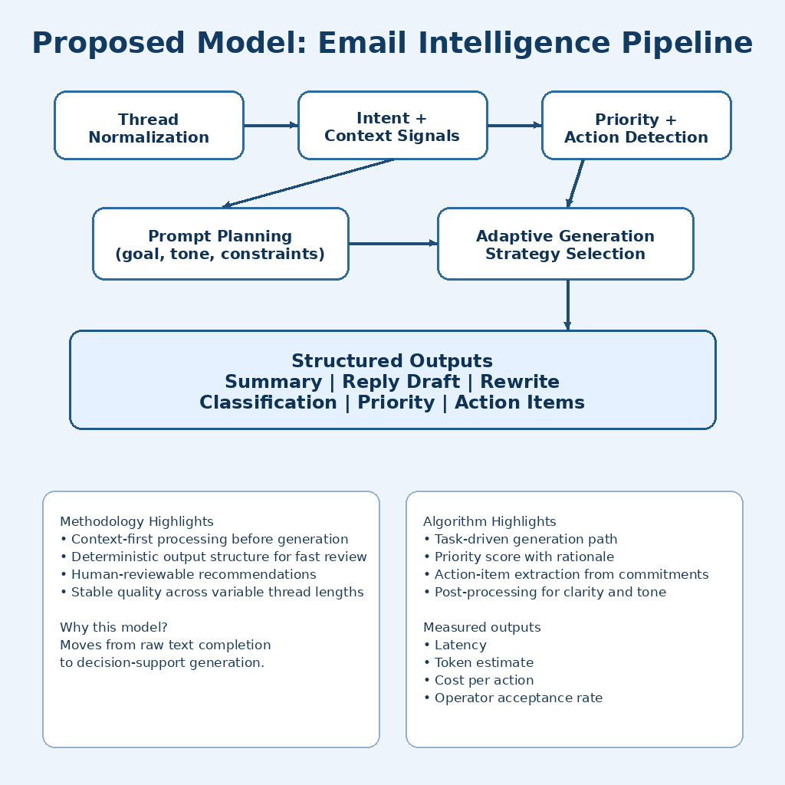
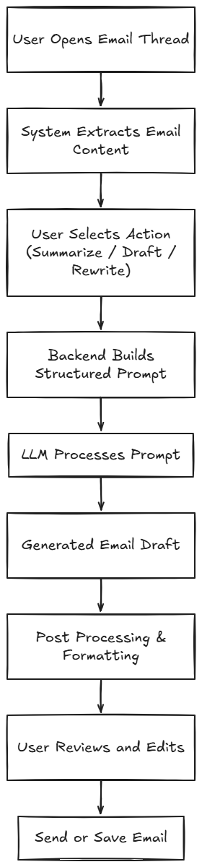
4.Proposed Model

Slide 7
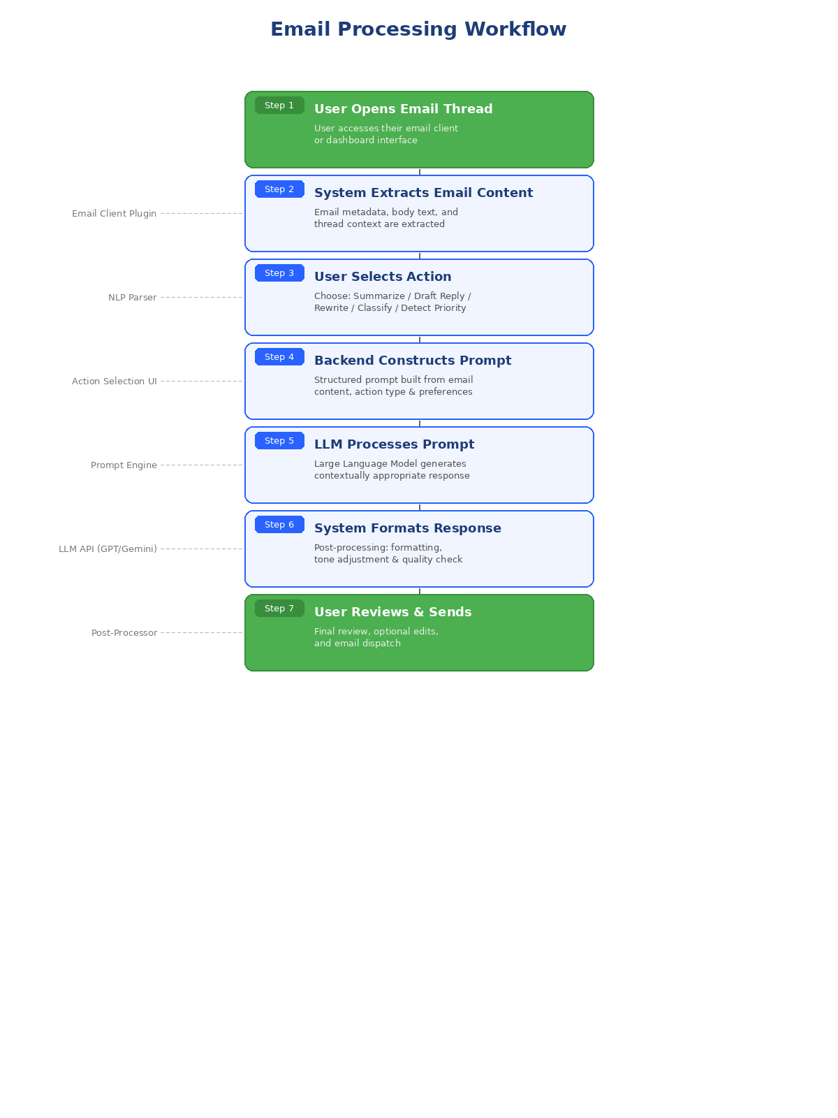
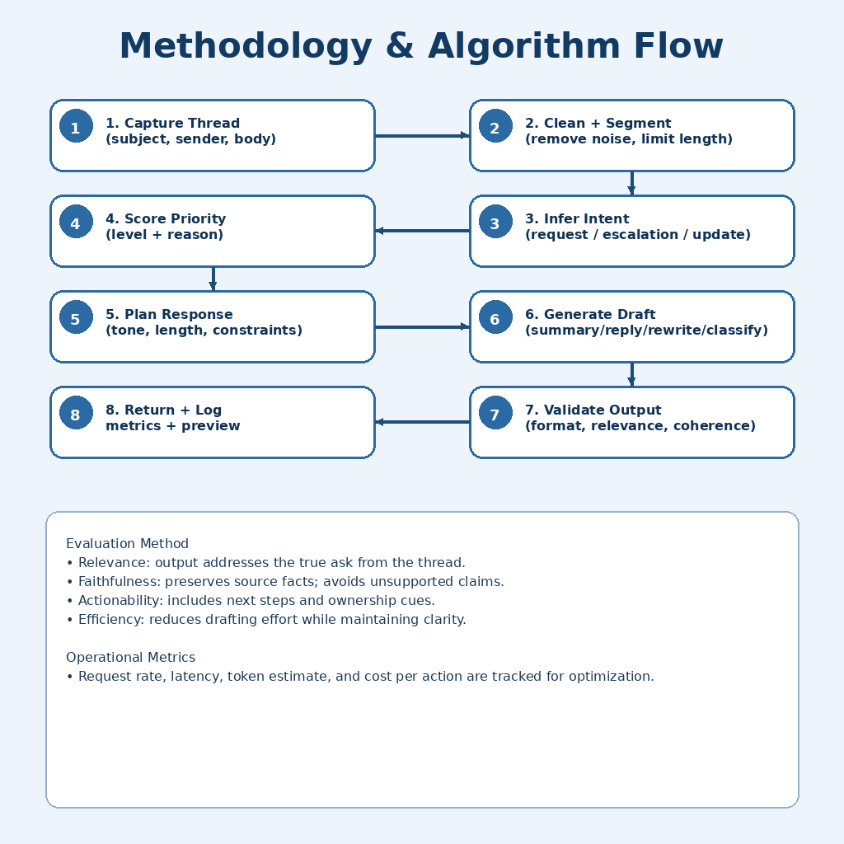
5.Discussion About Methodology & Algorithm

Slide 8
6.Conclusion & Future Work
Conclusion:
LLM-based email automation systems can significantly reduce the manual effort and time invested in professional email drafting and communication.
The proposed architecture demonstrates effective integration of prompt construction, LLM processing, and post-processing layers to generate contextually appropriate and personalized email content.
Future Work:
Multilingual email generation to support global enterprise communication.
Improved personalization through advanced user preference learning and behavioral analysis.
Enterprise system integration with CRM, ERP, and collaboration platforms.
Context-aware AI assistants capable of proactive email management and intelligent scheduling.

Slide 9
7. Research Paper Progress
Architecture Design: The system architecture comprising the user interface layer, backend processing layer, LLM processing layer, post-processing layer, and data intelligence layer has been finalized.
Literature Review Completion: A comprehensive review of transformer-based models, prompt engineering techniques, and prior email automation systems has been completed and documented.
Prototype System Development: An initial prototype demonstrating core email generation, summarization, and tone rewriting capabilities has been developed and tested.
Experimental Evaluation: Benchmarking and evaluation metrics for measuring productivity improvements, response quality, and user satisfaction are being defined for systematic assessment.

Slide 10
8.References
[1] Vaswani, A. et al., "Attention Is All You Need," Advances in Neural Information Processing Systems (NeurIPS), 2017.
[2] Schulhoff, S. et al., "The Prompt Report: A Systematic Survey of Prompting Techniques," arXiv preprint, 2024.
[3] Google, "Gemini API Reference," Google AI for Developers, 2024. [Online]. Available: https://ai.google.dev/docs
[4] Al-Debagy, O. and Martinek, P., "A Comparative Review of Microservices and Monolithic Architectures," Budapest University of Technology and Economics, 2018.
[5] Dilip, K., "Review on SMTP Protocol for E-Mail Systems," Galgotias University, Department of Computer Science and Engineering, 2020.
[6] Chen, M. et al., "Leveraging Generative AI in Enterprise Applications," IEEE Conference on AI and Business Operations, 2023.

