Slide 1
Project 8: Duplicate Question Retrieval
Semantic Duplicate Detection over the Quora Question Pairs Dataset
Short-Text Vector Indexing • TF-IDF • BM25 • Dense • Hybrid-RRF
Your Name / Team Name

Slide 2
Problem Statement
• Goal: given a new question, retrieve semantically duplicate questions already asked on Quora — reframed from pairwise duplicate classification into a retrieval task.
Dataset: Quora Question Pairs
• 404,290 raw question pairs; 149,263 labeled is_duplicate=1
• 537,929 unique questions in the deduplicated retrieval corpus
• 298,526 qrel (query_id, doc_id) pairs covering 149,650 unique query IDs
• 400 held-out evaluation queries (40 short ≤ 5 words / 360 long)

Slide 3
System Architecture
Preprocessing
Dual-Space
TF-IDF / BM25
Dense
(Sentence
Transformer)
Hybrid-RRF
Fusion
Evaluation
UI
• Preprocessing: lowercase, strip punctuation, NLTK tokenize, stopword removal + Porter stemming — skipped for short text (≤ 5 words) to avoid token collapse.
• TF-IDF and BM25 each fuse light (surface-form) and heavy (stemmed) corpus-wide spaces via RRF; TF-IDF adds a character n-gram space for short queries.
• Dense: all-MiniLM-L6-v2 embeddings, FAISS exact search. Hybrid-RRF fuses BM25 with Dense.

Slide 4
Methodology: 4 Ranking Models
TF-IDF
Dual-space (light + heavy + char n-gram) cosine similarity, fused with RRF
BM25
Dual-space (light + heavy) Okapi BM25, fused with RRF
Dense
Sentence-transformer embeddings (all-MiniLM-L6-v2) + FAISS inner-product search
Hybrid-RRF
Reciprocal Rank Fusion of BM25 + Dense ranked lists
Reciprocal Rank Fusion (RRF) formula:
RRF_Score(d) = Σ 1 / (k + rₘ(d)) over methods m ∈ M, k = 60

Slide 5
Engineering Story: The Short-Text Bug Arc
Caught and corrected by the project's own evaluation methodology
• Bug found: aggressive stopword removal + stemming collapsed short queries to 0–1 tokens (e.g. “What is the google?” → [googl]), causing degenerate 1.0 cosine-similarity ties across unrelated documents.
• Fix #1 (global light mode): removed stopword/stemming everywhere. Fixed the tie bug, but was applied uniformly — full held-out TF-IDF dropped to 0.1158 P@10 from a 0.1283 buggy baseline.
• Caught by segmentation: splitting eval queries into short (≤5 words) vs. long revealed the fix had over-corrected long queries, which were never part of the original bug.
• Fix #2 (per-text scoping in one vocabulary): restored long-query metrics, but fragmented vocabulary inside the shared vectorizer (e.g. query token “geographic” vs. indexed stem “geograph”), crashing short-query TF-IDF.
• Final fix (dual-space RRF fusion): independent corpus-wide light + heavy (+ char n-gram for short queries) spaces, fused with the same RRF formula as the top-level hybrid — recovered short-query TF-IDF to 0.1450 P@10 and long-query to 0.1294 P@10 simultaneously.

Slide 6
Results: Held-Out Performance (400 queries, k=10)
Method | P@10 | Recall@10 | MAP@10 | nDCG@10
TF-IDF | 0.1310 | 0.8341 | 0.6631 | 0.7314
BM25 | 0.1368 | 0.8582 | 0.7129 | 0.7755
Dense | 0.1738 | 0.9659 | 0.9087 | 0.9431
Hybrid-RRF | 0.1708 | 0.9535 | 0.8843 | 0.9251
• Dense leads on all 4 metrics (P@10, Recall@10, MAP@10, nDCG@10).
• Hybrid-RRF (BM25 + Dense) is second on all 4 metrics, ahead of both standalone lexical methods.
• BM25 outperforms TF-IDF on every metric within the lexical pair.

Slide 7
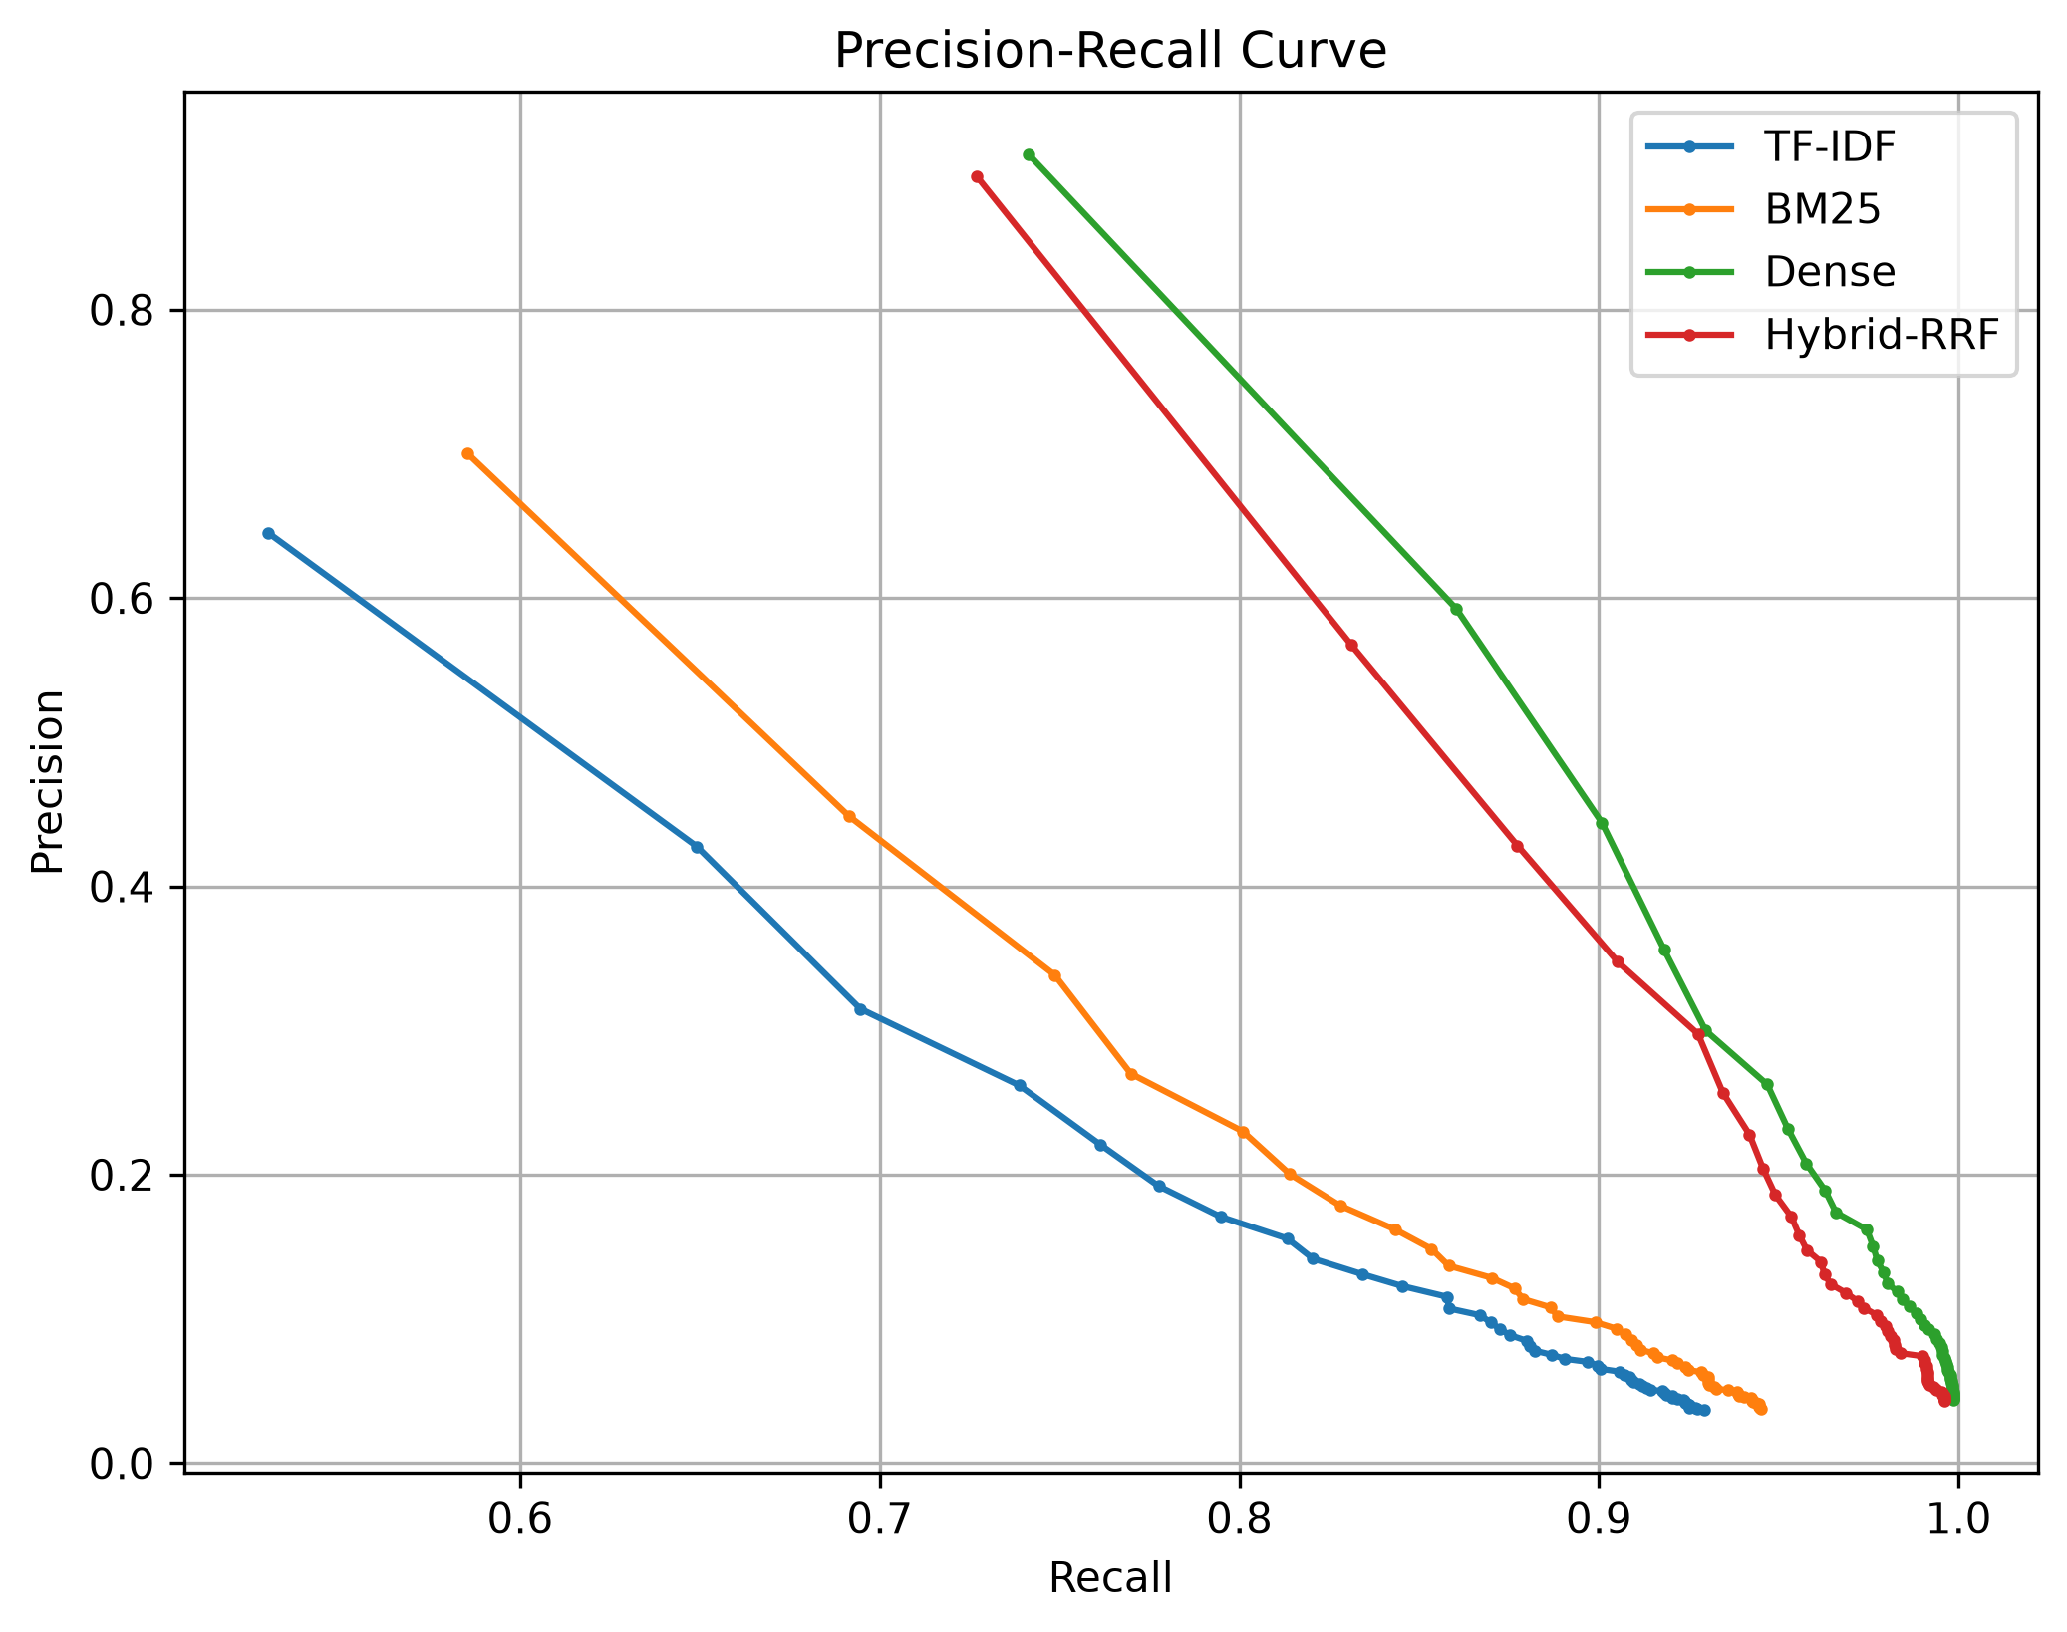
Precision-Recall Curve

Slide 8
Search Interface (Streamlit UI)
No screenshot found in reports/ — describing the UI instead (supply a screenshot to replace this slide):
• Search tab: free-text query box + method dropdown (TF-IDF / BM25 / Dense / Hybrid-RRF); returns top-10 ranked questions with scores.
• Performance Comparison tab: per-metric winner cards plus the full 4-method × 4-metric comparison table (reports/comparison_table.csv).
• Precision-Recall Curve tab: interactive Plotly PR curves for all 4 methods, k = 1..50, with k = 10 marked.

Slide 9
Conclusion
• Dense retrieval wins outright: P@10 0.1738, Recall@10 0.9659, MAP@10 0.9087, nDCG@10 0.9431 — best on every held-out metric.
• Hybrid-RRF (BM25 + Dense) is a close second on every metric (nDCG@10 0.9251 vs. Dense's 0.9431) while retaining an interpretable lexical signal — the practical production choice when exact-term matches still matter.
• The short-text bug arc shows the evaluation methodology itself (segmentation by query length) was what caught a real regression that the aggregate metric alone had hidden.

