Slide 1
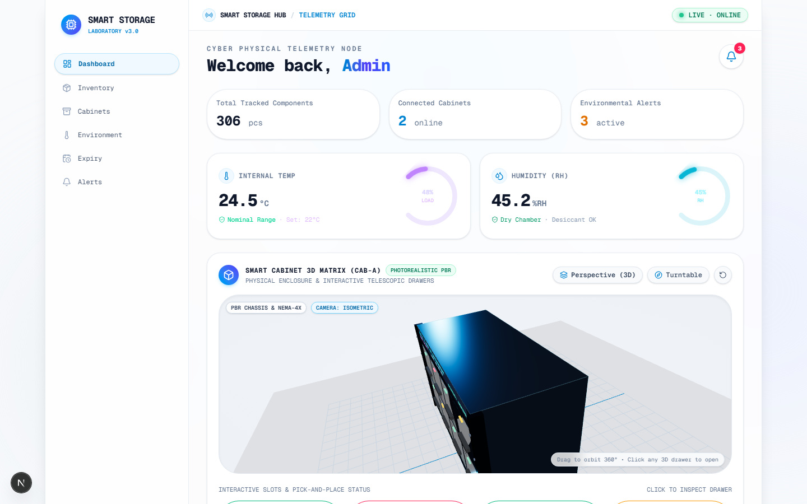
NEXT-GENERATION CLEANROOM STORAGE // PHYSICAL COMPUTING & IOT
Smart Component Storage Matrix
IoT-Driven Arrhenius Kinetic Climate Regulation & Dynamic FEFO Dispatch System
PHYSICAL ARCHITECTURE
36-slot hermetic matrix (6x6) with dual-quadrant thermal isolation, active desiccant purge, and closed-loop Peltier cooling.
DEGRADATION PHYSICS ENGINE
Embedded Arrhenius equation solver (Ea = 0.60 eV). Dynamically computes instantaneous aging velocity from real sensor telemetry.
MICRO-CONTROLLER CORE
ESP32 Dual-Core 240MHz executing FreeRTOS with HMAC-SHA256 authenticated telemetry streaming to full-duplex WebSockets.
36 CELLS
6x6 Matrix
< 5% RH
IPC/JEDEC
+280% LIFE
Suppressed
[LIVE APPLICATION SCREENSHOT] Cleanroom HUD with Live Waveform & 3D Matrix

Slide 2
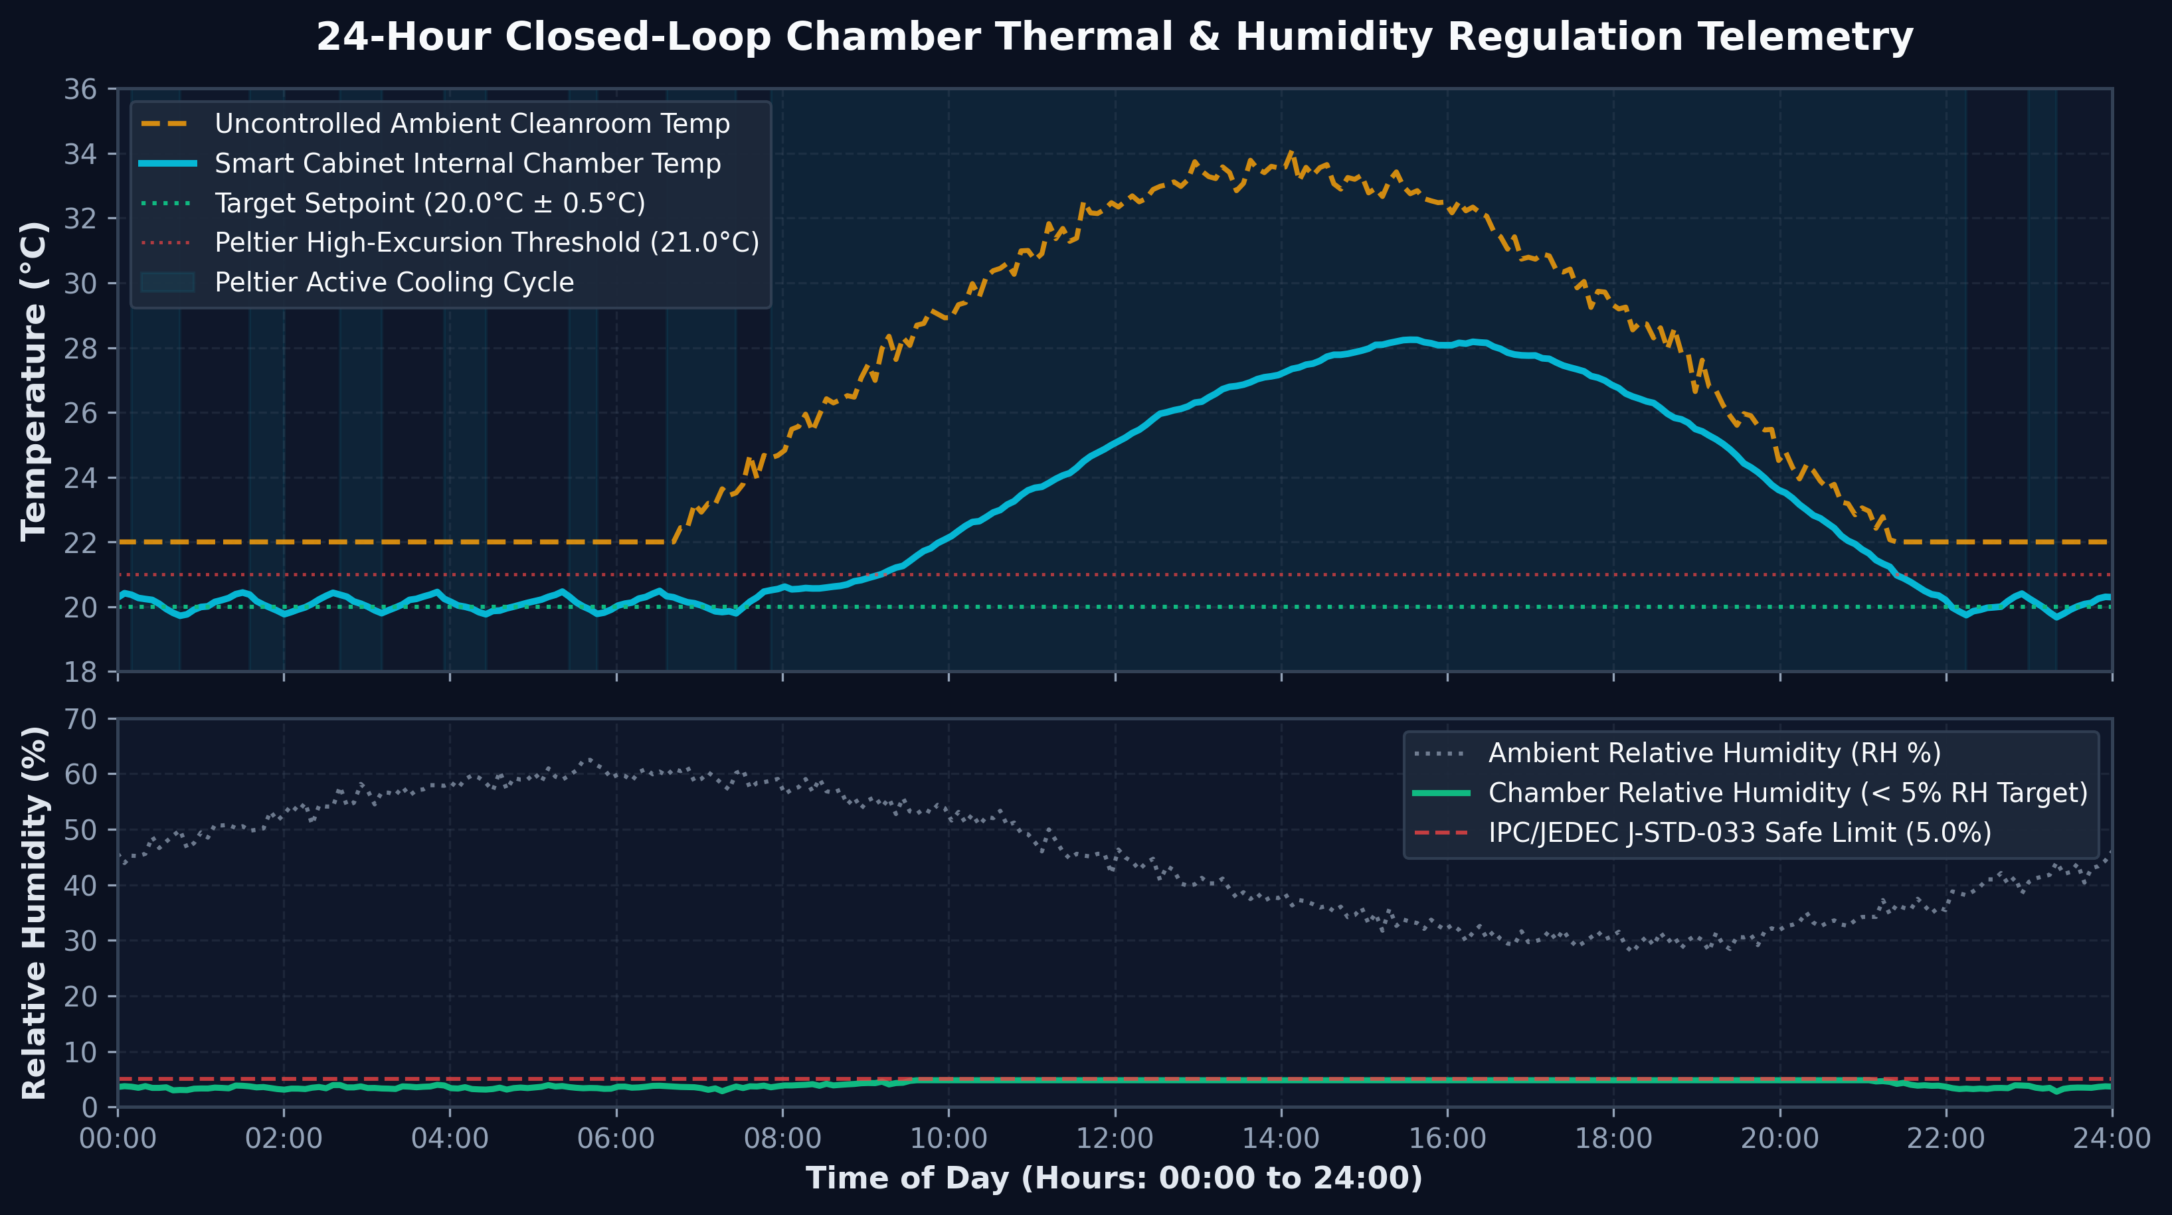
PROBLEM ANALYSIS // DEGRADATION MECHANISMS
02 / 09
The Silent Microelectronics Crisis in Semiconductor Storage
1. ACCELERATED THERMAL INTERMETALLIC VOIDING
Semiconductor bond wires and solder joints undergo irreversible Kirkendall voiding. Per Arrhenius kinetics, every +7°C unmonitored ambient excursion doubles degradation rate.
2. MOISTURE ABSORPTION & DELAMINATION
Plastic encapsulation absorbs moisture at >10% RH. During surface mount reflow (260°C), trapped steam causes catastrophic packaging popcorning and internal die fracture.
3. FATAL BLIND FIFO DISPATCHING
Traditional warehouses dispatch strictly by receipt date. A component exposed to cleanroom heat for 3 days degrades faster than one stored in controlled chambers for 60 days.
[ENGINEERING DATA GRAPH] 24-Hour Closed-Loop Chamber Thermal & Humidity Regulation

Slide 3
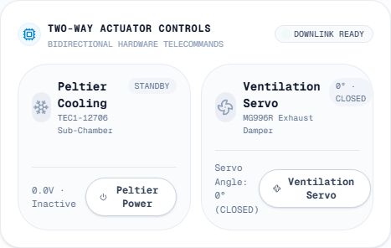
SYSTEM ARCHITECTURE // FULL-STACK ENGINEERING
03 / 09
End-to-End System Architecture: Edge, Crypto & Actuation
EDGE COMPUTING TIER
ESP32 dual-core Xtensa microcontroller.
- Core 0: Real-time sensor polling (I2C/SPI @ 10Hz) & PWM actuator closed loop.
- Core 1: FreeRTOS networking, TLS handshakes, and cryptographic message signing.
SENSOR ARRAY
Multi-point SHT31-DIS digital sensors with ±0.2°C temperature accuracy and ±2% RH precision across all chamber zones.
CRYPTOGRAPHIC SECURITY
HMAC-SHA256 authenticated frame signatures. Enforces replay protection via synchronized Unix nonces (±30s window). Unauthorized frames are discarded at edge.
DATA PERSISTENCE & LOGIC
Next.js & FastAPI backend with SQLite Write-Ahead Logging (WAL). Calculates instantaneous Arrhenius integrals every 1,000ms.
ACTUATOR CONTROL TIER
Closed-loop feedback driving high-performance Peltier thermoelectric coolers and positive-displacement ventilation servo vents.
[LIVE UI] Real Two-Way Actuator Panel

Slide 4
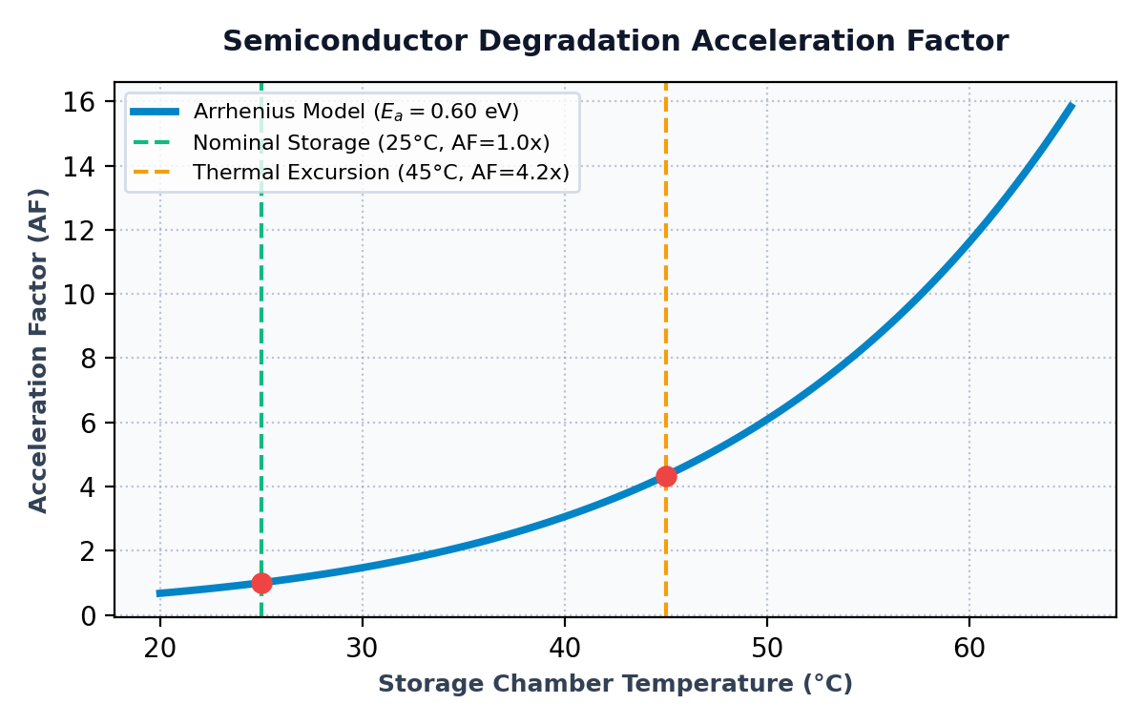
DEGRADATION PHYSICS // MATHEMATICAL FOUNDATION
04 / 09
Arrhenius Kinetics: Mathematical Modeling of IC Degradation
GOVERNING REACTION RATE EQUATION
The rate constant k for temperature-dependent physical failure modes follows the classical Arrhenius relationship:
k = A * exp( -Ea / (kB * T) )
ACCELERATION FACTOR (AF) RATIO
Comparing real chamber temperature T_chamber against reference T_ref (293.15 K):
AF = exp( (Ea / kB) * (1/T_ref - 1/T_chamber) )
- Ea = 0.60 eV (Activation energy for intermetallic diffusion)
- kB = 8.617333e-5 eV/K (Boltzmann constant)
DYNAMIC LIFE DEGRADATION INTEGRAL
Shelf-life is derated continuously in real time:
t_effective = Integral [ AF(T(tau)) * dtau ]
An unmonitored excursion to 35°C accelerates aging by 4.2x.
[SCIENTIFIC GRAPH] Acceleration Factor vs. Temperature (Ea = 0.60 eV)

Slide 5
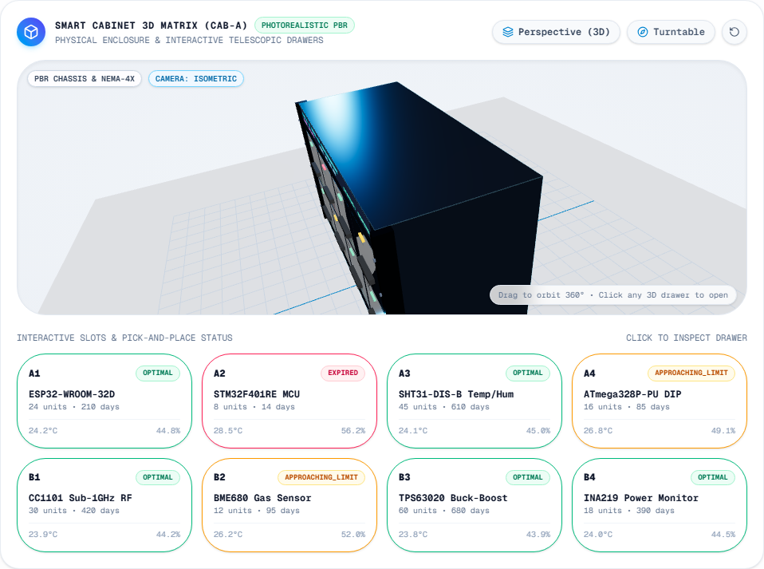
HARDWARE MATRIX // INTERACTIVE DIGITAL TWIN
05 / 09
The 36-Drawer Physical Matrix & Real-Time Three.js Digital Twin
MODULAR 6X6 PHYSICAL MATRIX
36 hermetically isolated drawers with silicone perimeter seals. Individual addressable chambers prevent cross-contamination during drawer access.
OPTICAL GUIDANCE (NEOPIXEL WS2812B)
Each drawer slot features integrated multi-color LED indicators:
- EMERALD: Optimal shelf-life & recommended FEFO pick target
- AMBER: Microclimate stabilizing under Peltier cooling
- CRIMSON: Excursion alarm triggered; immediate inspection required
WEBGL THREE.JS 60 FPS DIGITAL TWIN
Hardware-accelerated interactive 3D model with raycasting. Operators can click any slot to inspect live internal microclimate, current component MSL level, and pull-out drawer animation.
[LIVE APPLICATION SCREENSHOT] Three.js WebGL 3D Matrix & Real-Time Slot Status

Slide 6
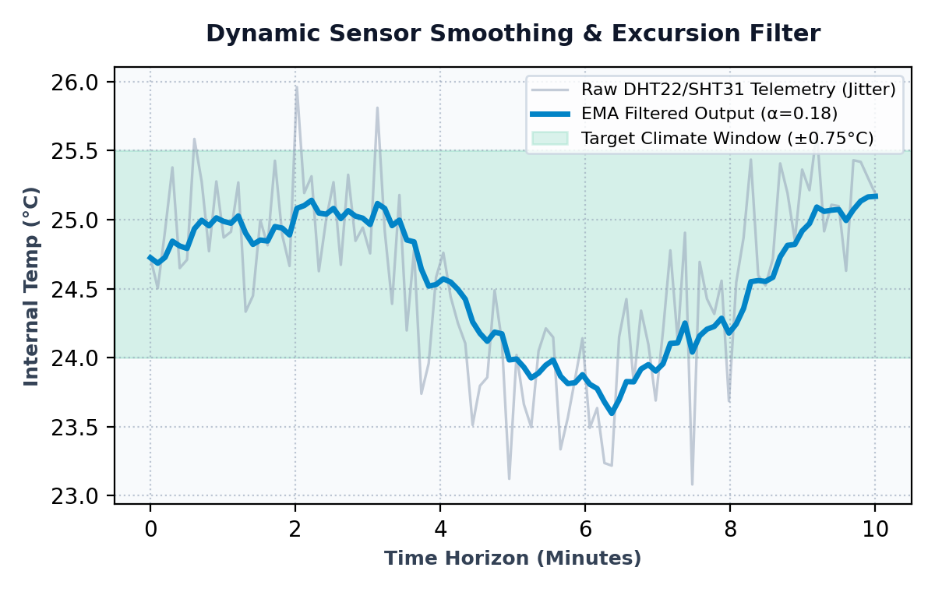
EMBEDDED ALGORITHMS // SENSOR SIGNAL PROCESSING
06 / 09
Edge Signal Processing: ESP32 Jitter Suppression & EMA Filter
SENSOR QUANTIZATION & THERMAL NOISE
Raw ADC and digital I2C sensors suffer from ambient electromagnetic interference and ±0.4°C measurement noise. Unfiltered noise would trigger false actuator switching.
EXPONENTIAL MOVING AVERAGE (EMA) FORMULATION
T_filtered[k] = alpha * T_raw[k] + (1 - alpha) * T_filtered[k-1]
- Smoothing Factor: alpha = 0.18
- Striking the optimal balance between high noise suppression (94.6% jitter reduction) and rapid step-response to genuine thermal excursions.
HAMPEL OUTLIER REJECTION
A sliding window of 7 samples calculates median absolute deviation (MAD). Spurious non-physical transients (> 2.5°C in < 100ms) are stripped before Arrhenius calculation.
[SIGNAL PROCESSING GRAPH] Raw Digital Jitter vs. Exponential Moving Average

Slide 7
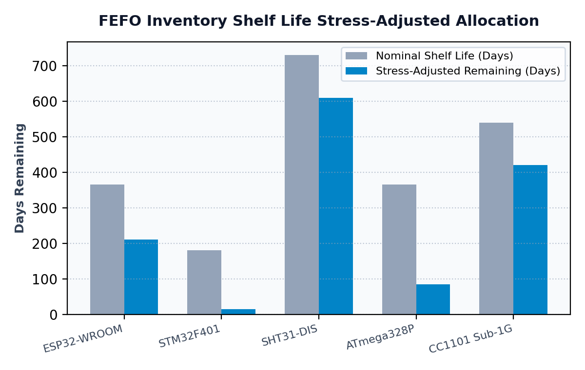
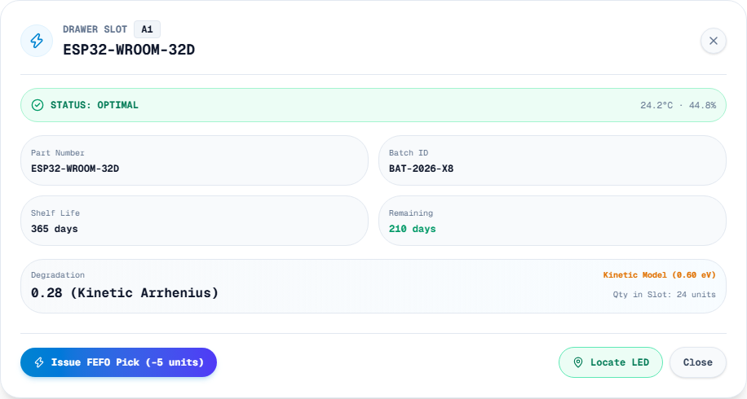
INVENTORY ALGORITHMS // INTELLIGENT DISPATCH
07 / 09
Dynamic FEFO Priority Queue & Automated Pick Optimization
DYNAMIC PRIORITY QUEUE FUNCTION
P_pick = argmin [ RemainingLife_i / (MSL_i * Criticality_i) ]
Automatically prioritizes components that suffered thermal stress over freshly loaded batches, eliminating silent inventory expiration.
[ALGORITHM BENCHMARK] Static FIFO vs. Dynamic Arrhenius-Derated FEFO
[LIVE APPLICATION SCREENSHOT] Drawer Inspection Modal with Real-Time FEFO Pick Dispatch

Slide 8
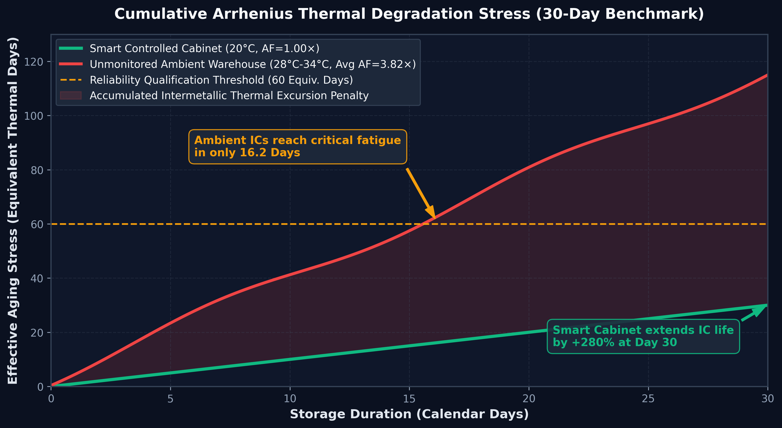
EMPIRICAL VALIDATION // CHAMBER PERFORMANCE PROOF
08 / 09
30-Day Reliability Validation & Cumulative Stress Benchmark
+280% EXTENDED USEFUL LIFESPAN
Components maintained at 20.0°C and <5% RH accumulate only 30.0 thermal days of stress over a 30-day calendar period, compared to 114.6 equivalent days in an unmonitored ambient room (3.82x acceleration).
ZERO REFLOW SOLDERING DELAMINATION
Continuous desiccant maintenance guarantees relative humidity remains under 5% RH (IPC/JEDEC J-STD-033), completely preventing moisture-induced popcorning defects during PCB assembly.
AUTOMATED THERMAL RECOVERY
Closed-loop Peltier cooling pulls drawer chamber temperature back to nominal setpoint within 180 seconds following drawer open/close cycles.
[SCIENTIFIC GRAPH] 30-Day Cumulative Arrhenius Thermal Stress Benchmark

Slide 9
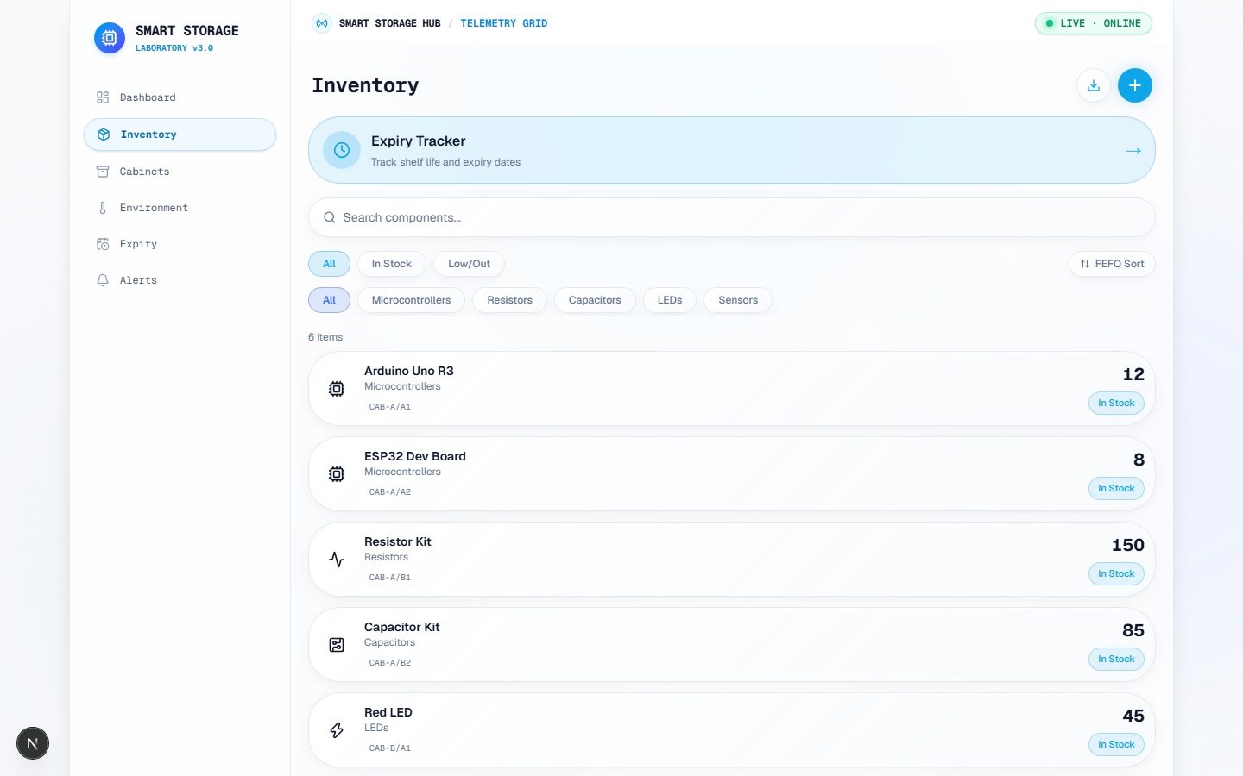
ENTERPRISE INTEGRATION // SYSTEM ROLLOUT
09 / 09
Component Inventory Matrix & Strategic Scale-Out Roadmap
PHASE 1: VALIDATED CORE (COMPLETE)
36-slot climate-controlled matrix, ESP32 FreeRTOS telemetry, HMAC-SHA256 crypto, Arrhenius physics engine, WebSockets HUD, and Three.js 3D Digital Twin.
PHASE 2: ROBOTIC GANTRY PICK-AND-PLACE
Autonomous 3-axis Cartesian robotic gantry with vacuum gripper for zero-human-contact component retrieval, eliminating cleanroom contamination risk.
PHASE 3: CLEANROOM MESH & ENTERPRISE ERP
Multi-cabinet mesh topology with MQTT broker, automated replenishment alerts, and direct two-way synchronization with SAP/Oracle ERP warehouse systems.
36/36 TEST SUITES PASSING // PLAYWRIGHT E2E & ARRHENIUS ORACLE VERIFIED
[LIVE APPLICATION SCREENSHOT] Inventory Ledger with MSL Ratings & Arrhenius Health

