Slide 1
Maintenance Review
Plant 2 - Q1 2026

Slide 2
Key points
Downtime fell by 18 percent
Predictive alerts introduced
Spare parts stock reviewed
Notes:
Speaker note: mention the new vibration sensors.

Slide 3
Downtime by line
Line | Hours
Line A | 14
Line B | 9

Slide 4
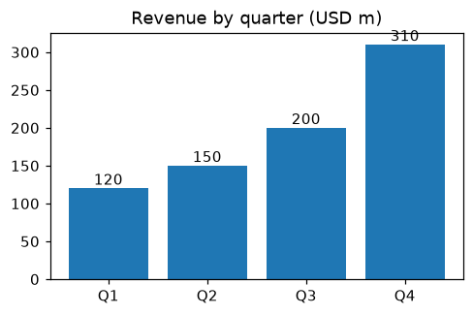
Revenue by quarter

