Slide 1


2026
Presented by
Acropolis Institute of Technology and Research
Dept. of CSIT & CSE(CY)
in collaboration with
IIT Ropar & ClayGrounds

Slide 2
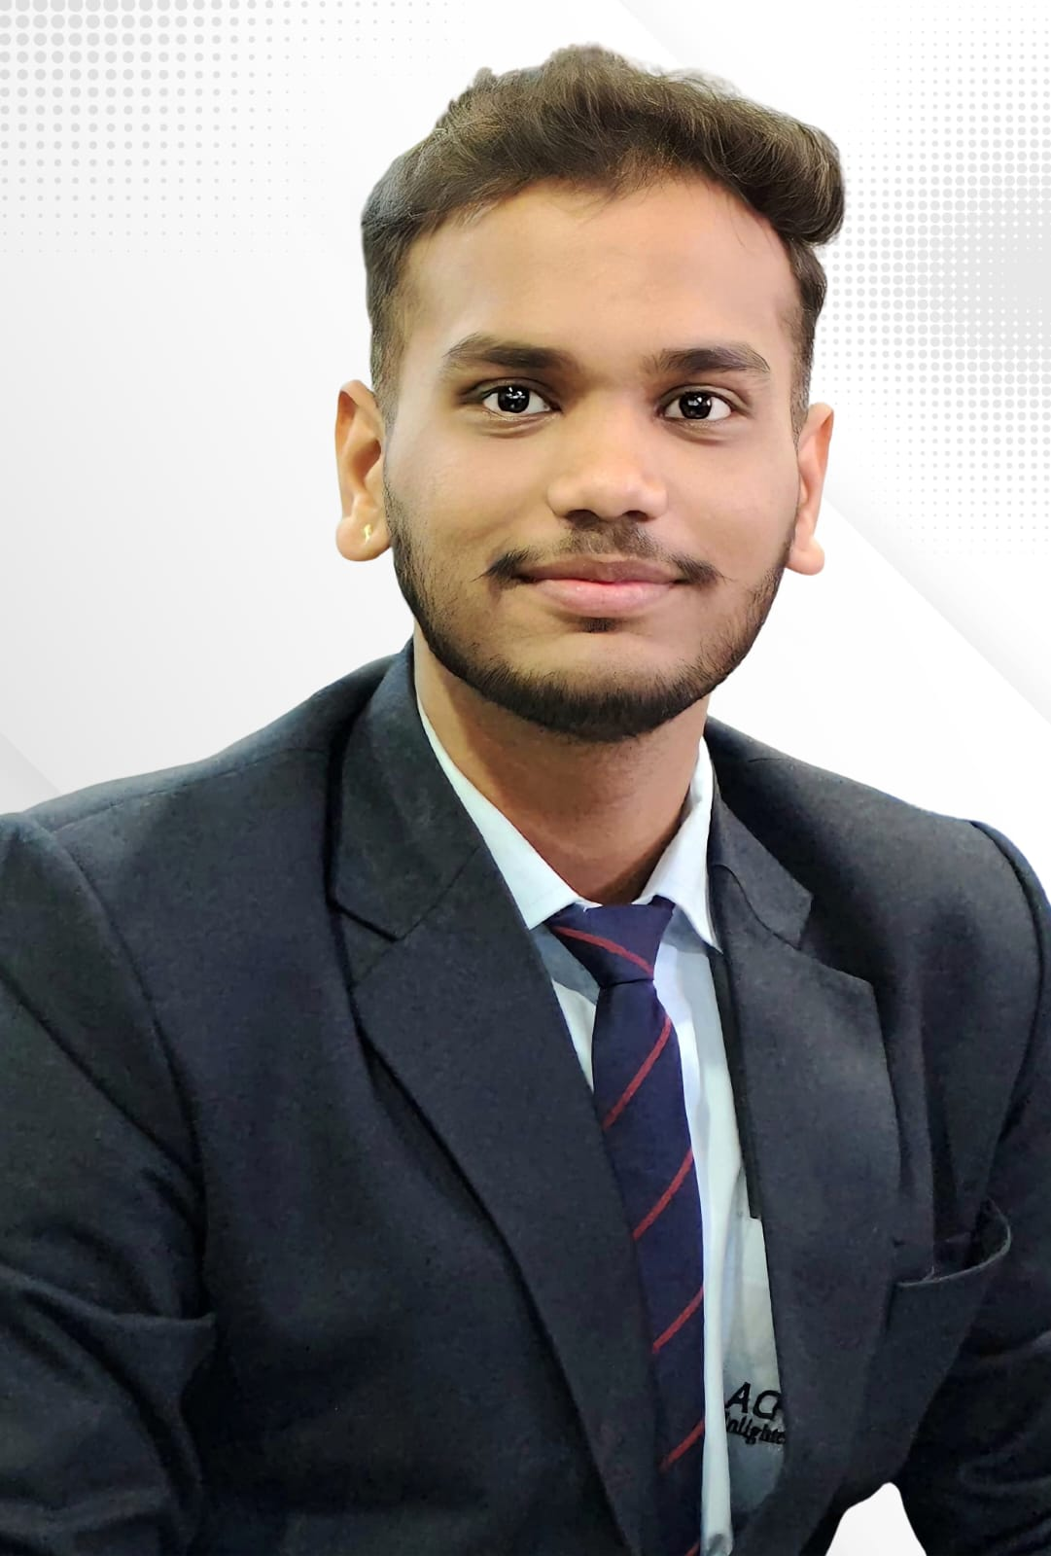
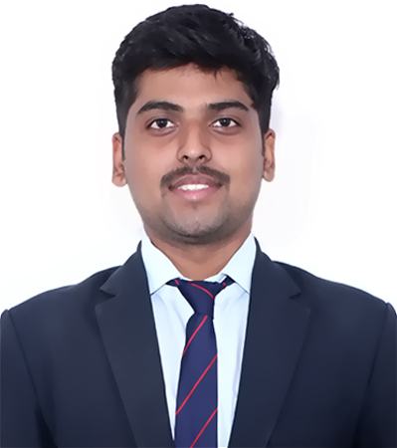
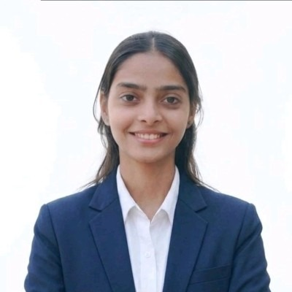
Team Profile
TRACK / PROBLEM STATEMENT
Sustainable Transportation
TEAM NAME
Shreyansh Tiwari
Kunal Sonare
KNS
TEAM LEADER'S NAME
Shreyansh Tiwari
EMAIL ADDRESS
tshreyansh029@gmail.com
Nandini Chourasiya
TEAM MEMBERS
Kunal Sonare , Nandini Chourasiya
IKIGAI 2026
2

Slide 3
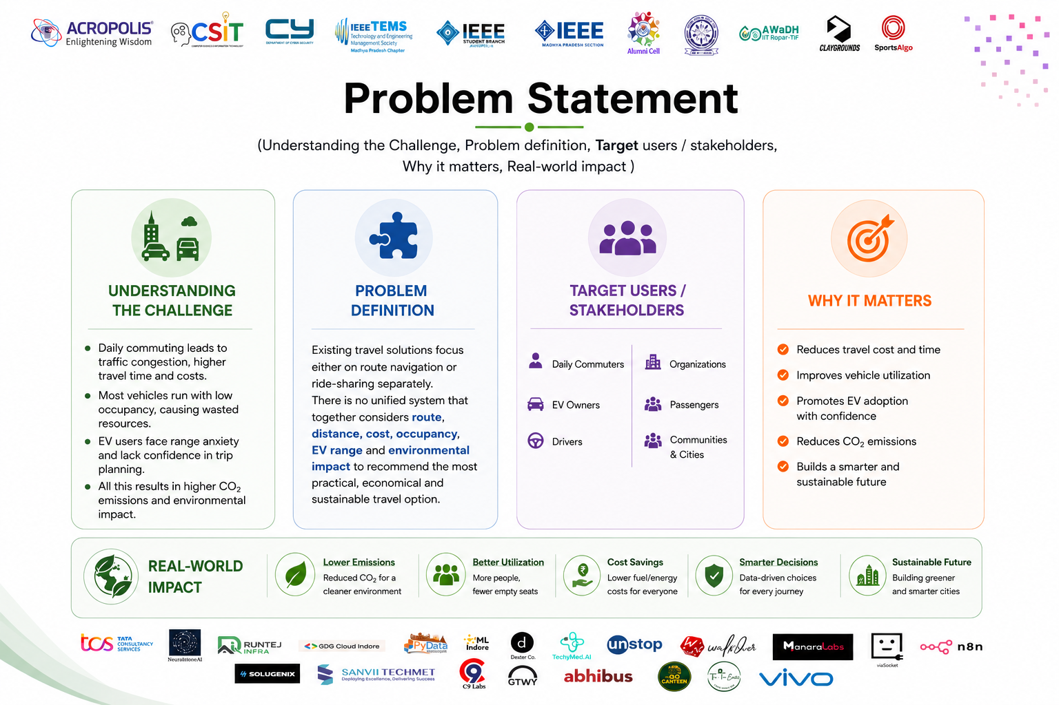

Slide 4
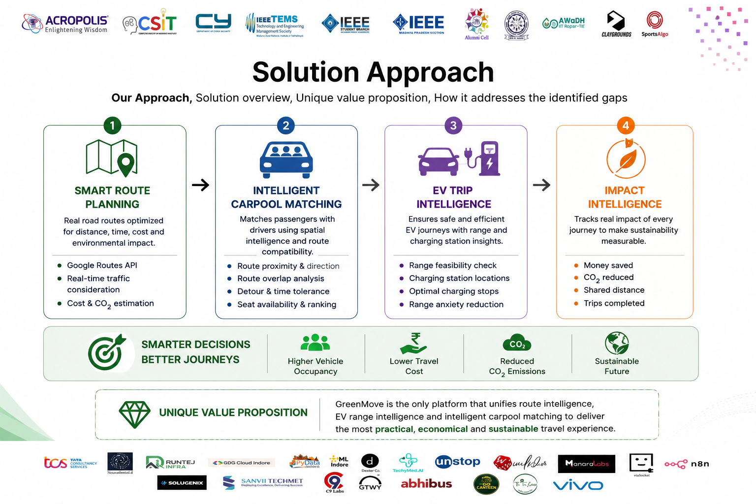

Slide 5
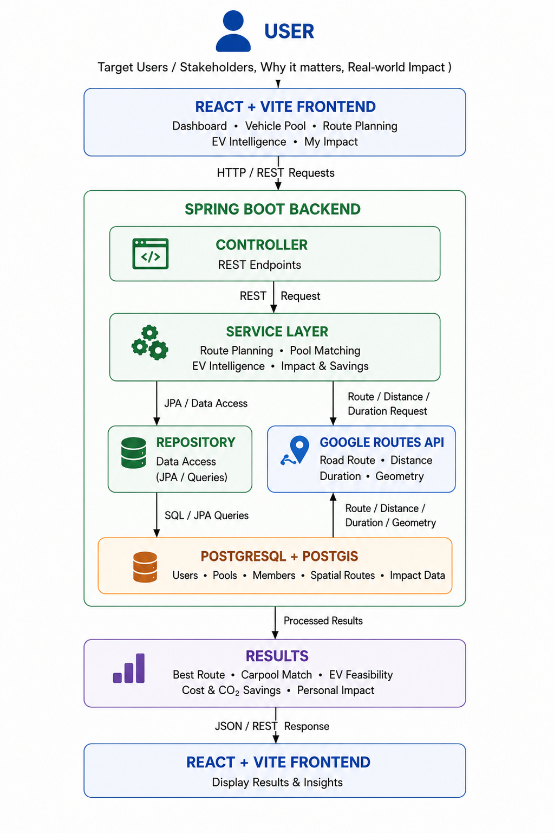
Workflow

Slide 6
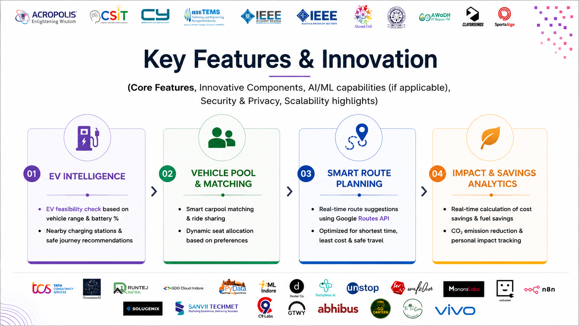

Slide 7
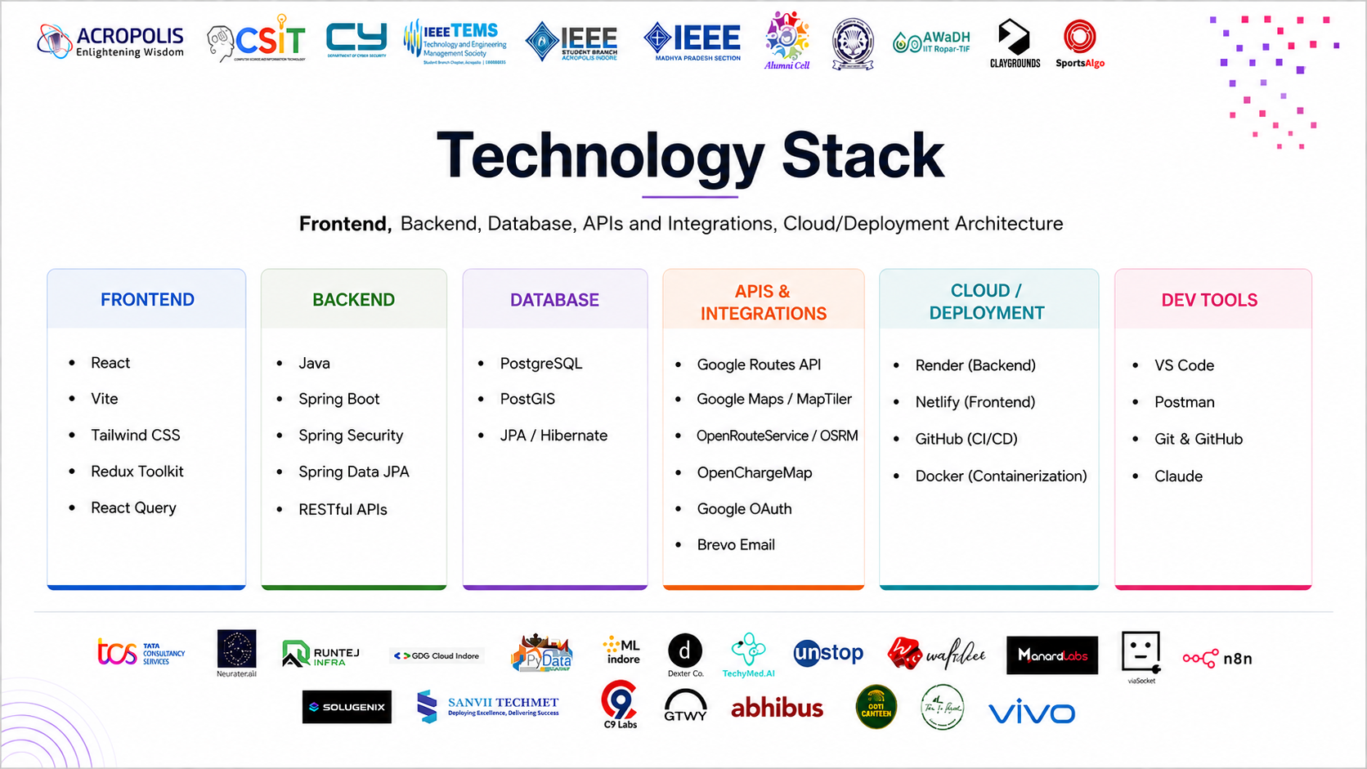

Slide 8
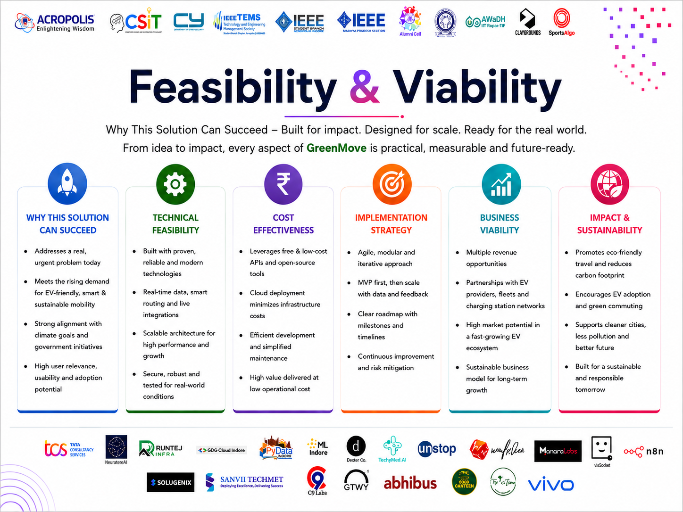

Slide 9
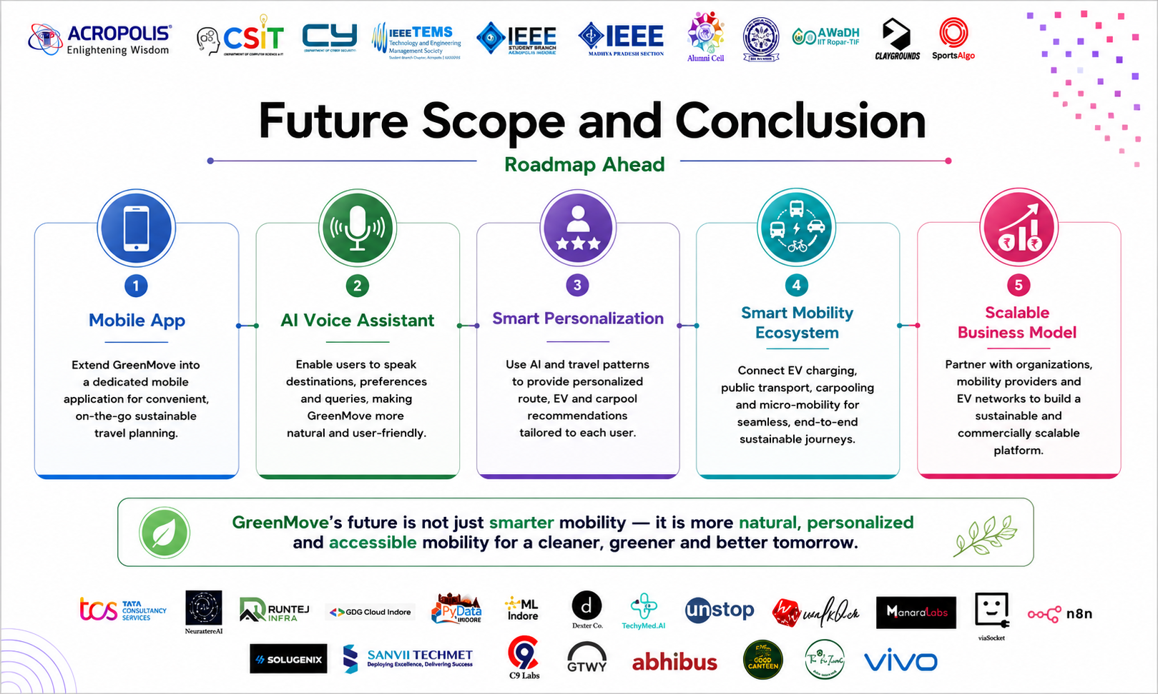

Slide 10
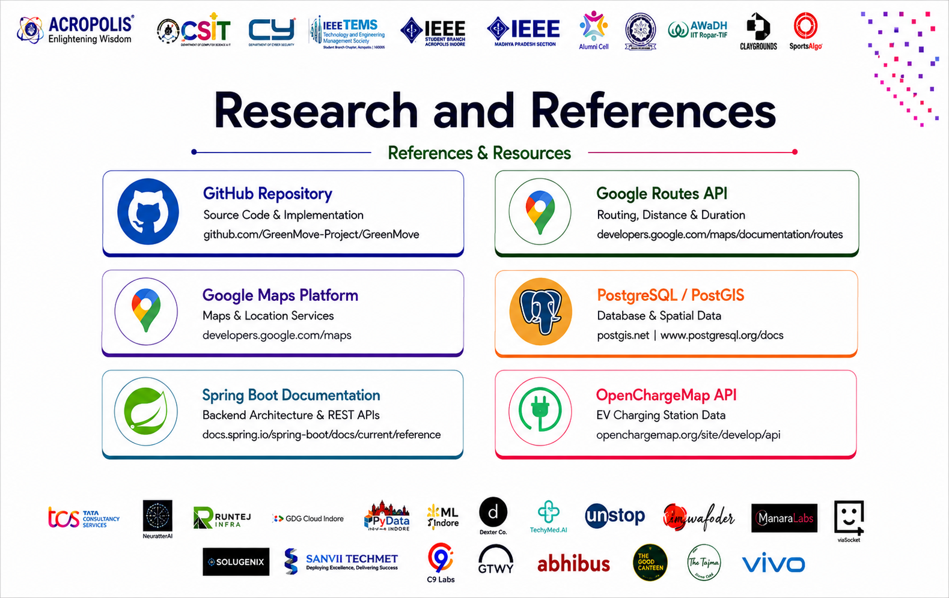

Slide 11
Thank you
CONTACT (TEAM LEADER)
E-mail
tshreyansh029@gmail.com
KNS
9826733860
Team Name
Phone
Address
1Indore , MP
acroikigai@acropolis.in

