Slide 1




SMART INDIA HACKATHON 2026
Problem Statement ID – SIH26155
Problem Statement Title- AI-Driven Multi-Vendor Network Security Compliance Auditor
Theme- Blockchain & Cybersecurity
PS Category- Software
Team ID-
Team Name: NetSentry
@SIH Idea submission
1

Slide 2

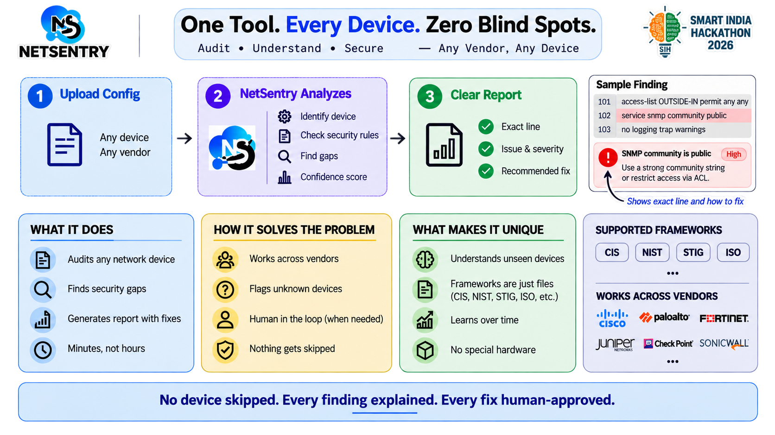
One Tool. Every Device. Zero Blind Spots.
Explainer Video
@SIH Idea submission
2
Notes:
2

Slide 3
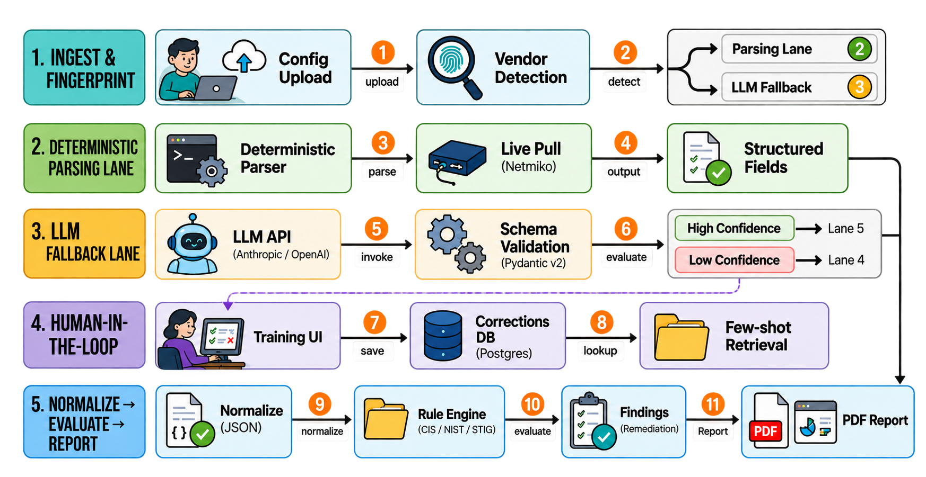
TECHNICAL APPROACH
3
@SIH Idea submission
3
@SIH Idea submission- Template
Notes:
3

Slide 4
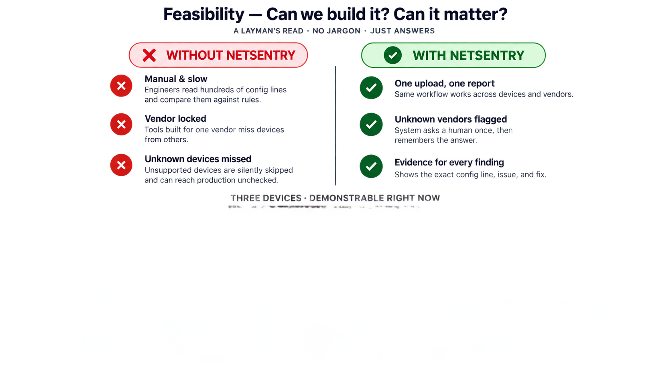
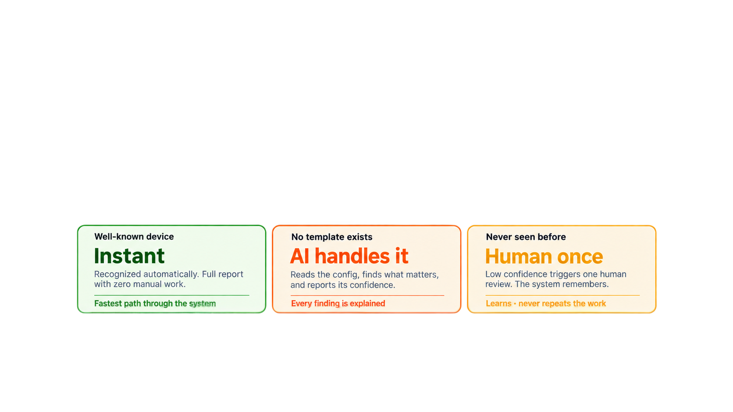
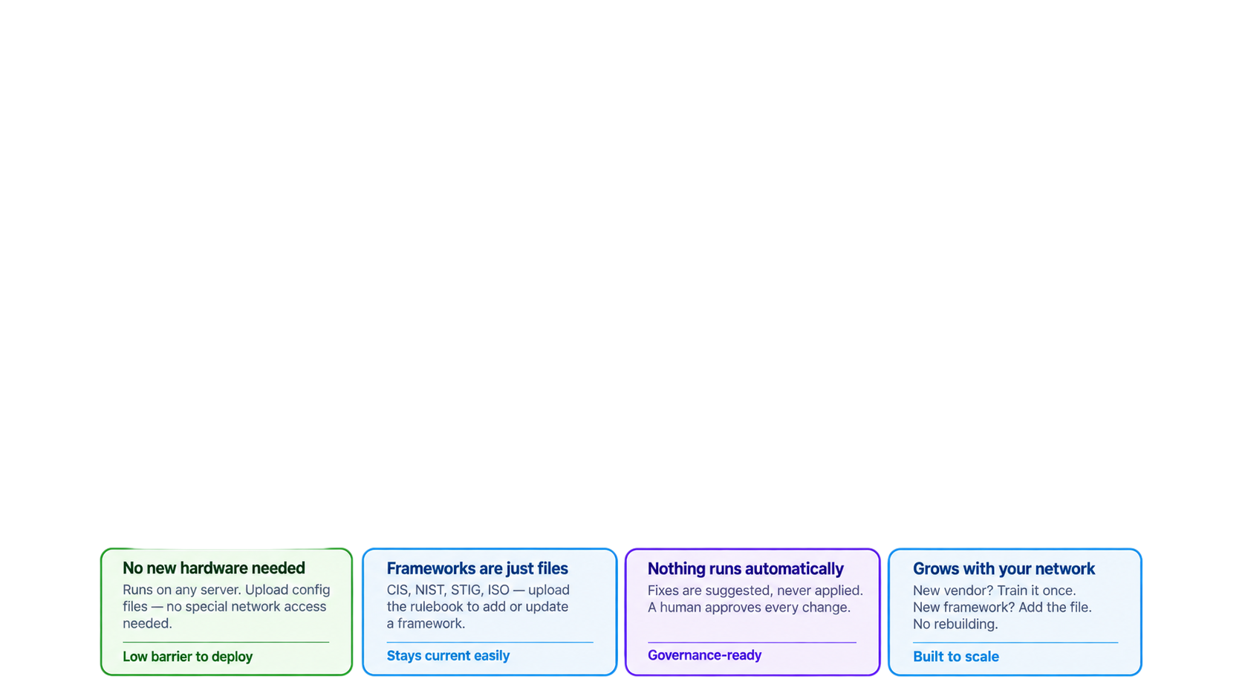
Feasibility- Can we build? Can it matter?
Three Device Demonstrables right now
@SIH Idea submission- Template
4
@SIH Idea submission
4
Notes:
4

Slide 5
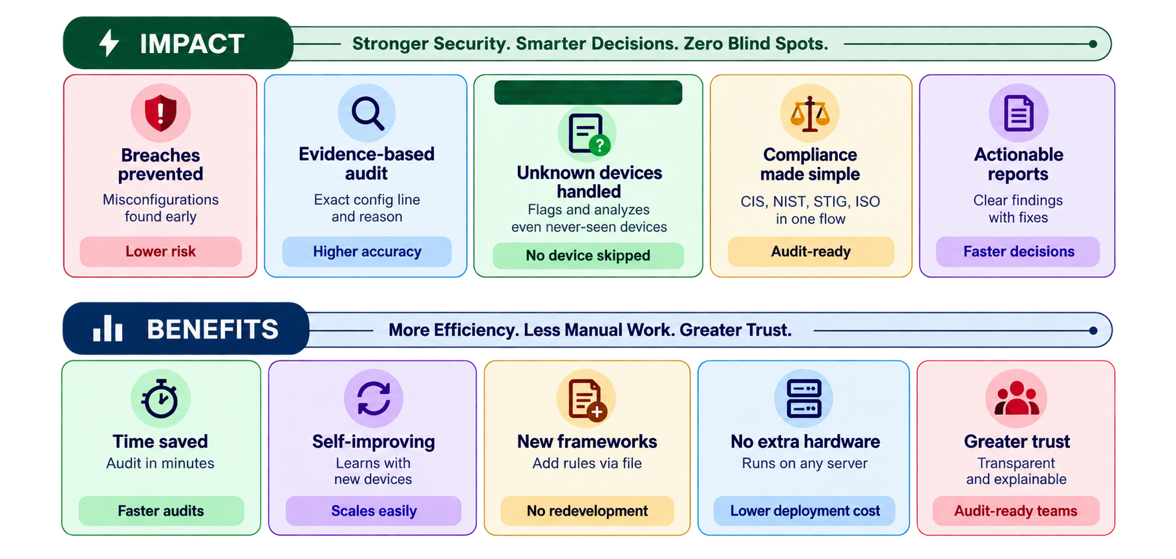
Why It Matters
(MVP)
@SIH Idea submission
5
Notes:
5

Slide 6








RESEARCH AND REFERENCES
Standards referenced
Market Validation
CIS Benchmarks, NIST SP 800-53, DISA STIGs, ISO/IEC 27001 — mapped into the rule engine and normalized schema
$2.2B to $3.6B market by 2032 (~6.8% CAGR); Gartner ties most cloud failures to customer misconfiguration
Click here
Click here
Competitors studied
Technical references
Tufin, AlgoSec, FireMon lead policy orchestration but struggle at multi-vendor scale; Cisco/Palo Alto tools stop at their own hardware
Netmiko, NAPALM for collection; NLP and LLM few-shot for unseen configs
Click here
Click here
@SIH Idea submission
6
Notes:
6

