Slide 1

Lending club case study
Contributed by
Shreyanth HG and Vignesh v

Slide 2
Problem statement
Risk analytics in banking and financial services and understand how data is used to minimise the risk of losing money while lending to customers.
Business Understanding
You work for a consumer finance company which specialises in lending various types of loans to urban customers. When the company receives a loan application, the company has to make a decision for loan approval based on the applicant’s profile.

Slide 3
Two types of risks are associated with the bank’s decision:
1. If the applicant is likely to repay the loan, then not approving the loan results in a loss of business to the company
2. If the applicant is not likely to repay the loan, i.e. he/she is likely to default, then approving the loan may lead to a financial loss for the company

Slide 4
UNIVARIATE ANALYSIS

Slide 5
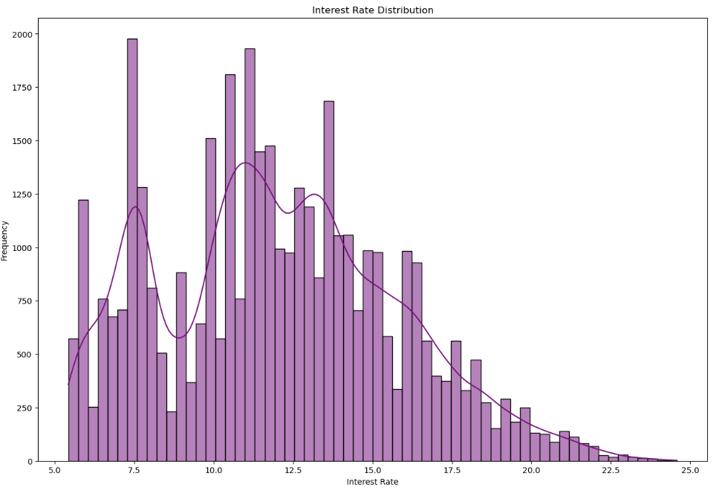
Interest Rate Distribution
In a sea of loans, interest rates ranged widely. Most clustered around 10-15%, but outliers reached for the sky. Stability, a distant dream.

Slide 6
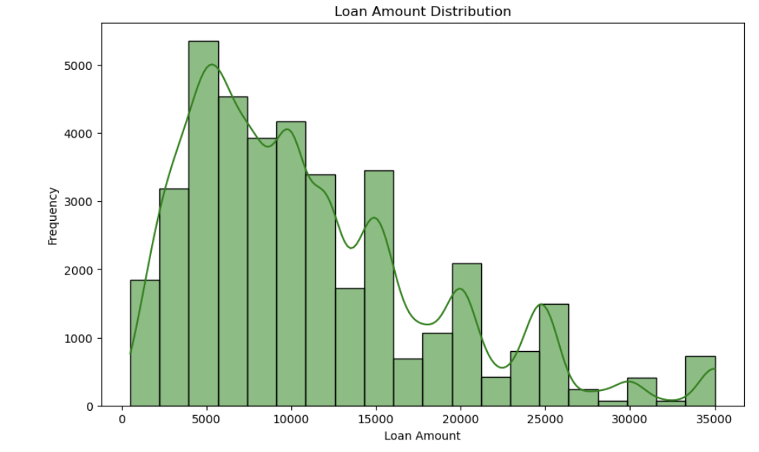
Loan Amount Distribution
Loan amounts varied, forming peaks and valleys. 10K, 20K, 30K Financial dreams and realities found their place in the histogram's dance.

Slide 7
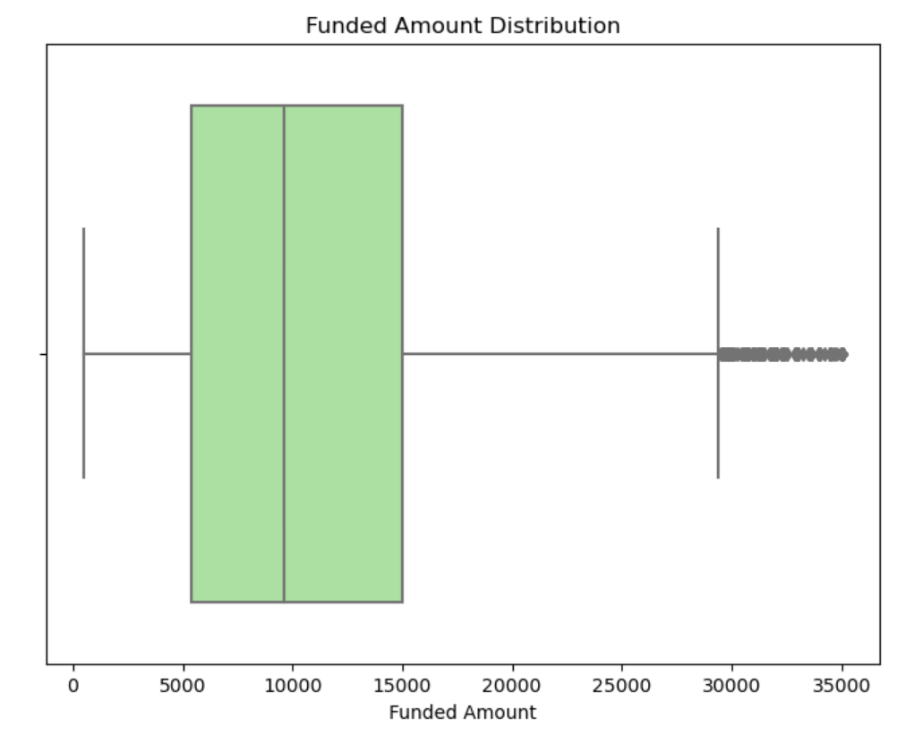
Box plot for funded_amnt
The funded amounts had their stories too. Some thrived while others struggled. The box plot whispered the secrets of financial support.

Slide 8
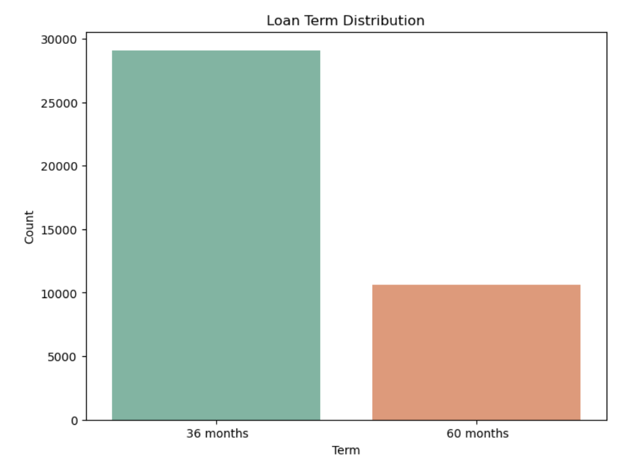
Bar chart for term
Terms danced in a bar chart waltz. Short or long, loans told their tales. The borrowers' choices revealed in vibrant bars.

Slide 9
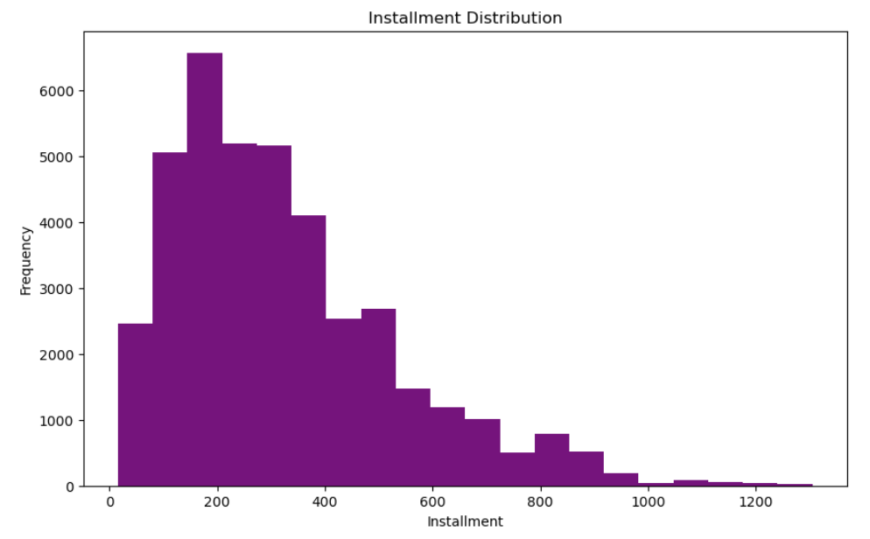
Histogram for installment
Story: Installment payments echoed in a purple histogram. Peaks and valleys of financial commitments formed a visual symphony.

Slide 10
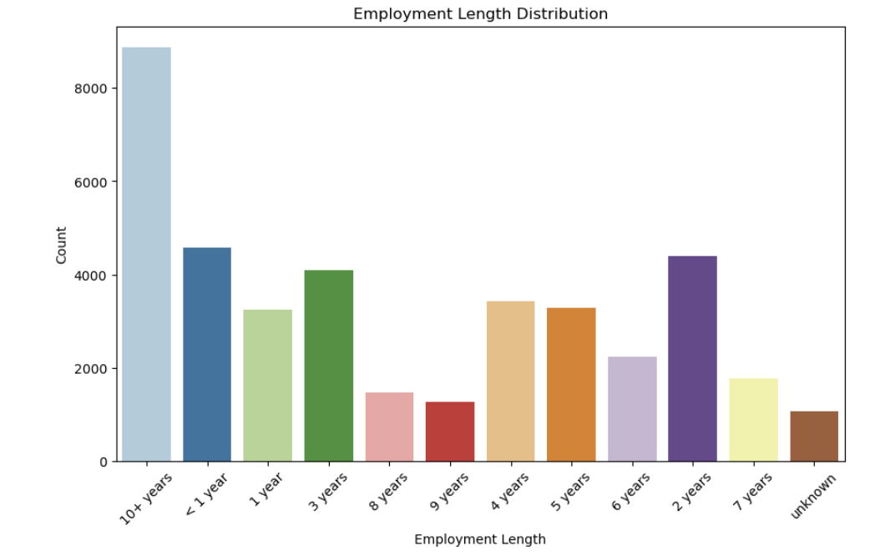
Bar chart for emp_length
Employment lengths came to life. Fresh beginnings to experienced hands, their counts painted a career mosaic in shades of blue

Slide 11
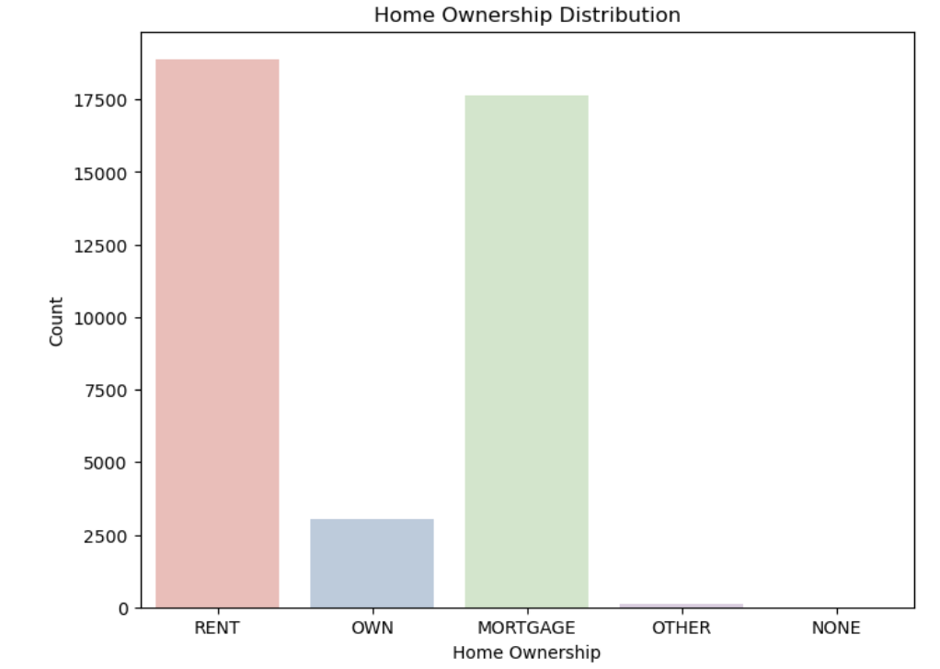
Bar chart for home_ownership
Homes owned, counted and displayed. From mortgages to rentals, the bar chart told tales of property and responsibility.

Slide 12
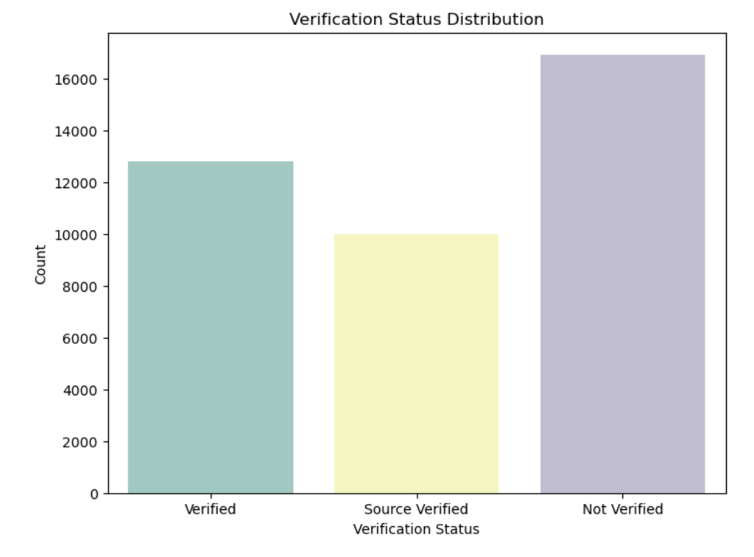
Bar chart for verification_status
Verification statuses paraded, colors of trust in a bar chart dance. From verified to not, their counts painted a picture of transparency.

Slide 13
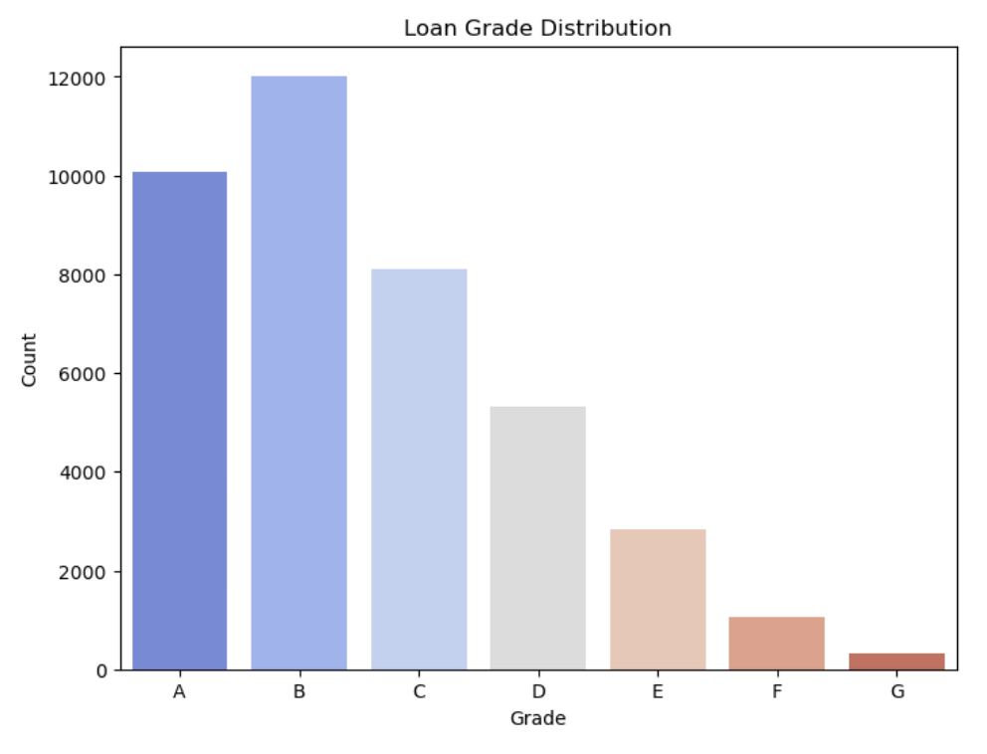
Loan Grade Distribution
Grades marked loans' journeys. A bar chart in cool shades revealed the diversity of borrowers' financial prowess.

Slide 14
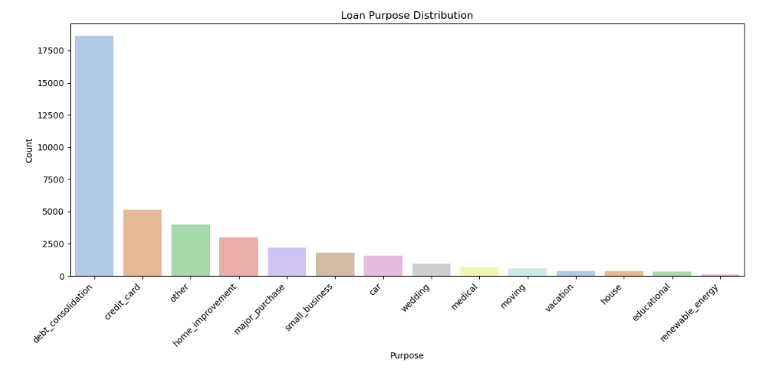
Loan Purpose Distribution
Loan purposes whispered in a bar chart melody. From debt consolidation to vacations, financial dreams varied in hues.

Slide 15
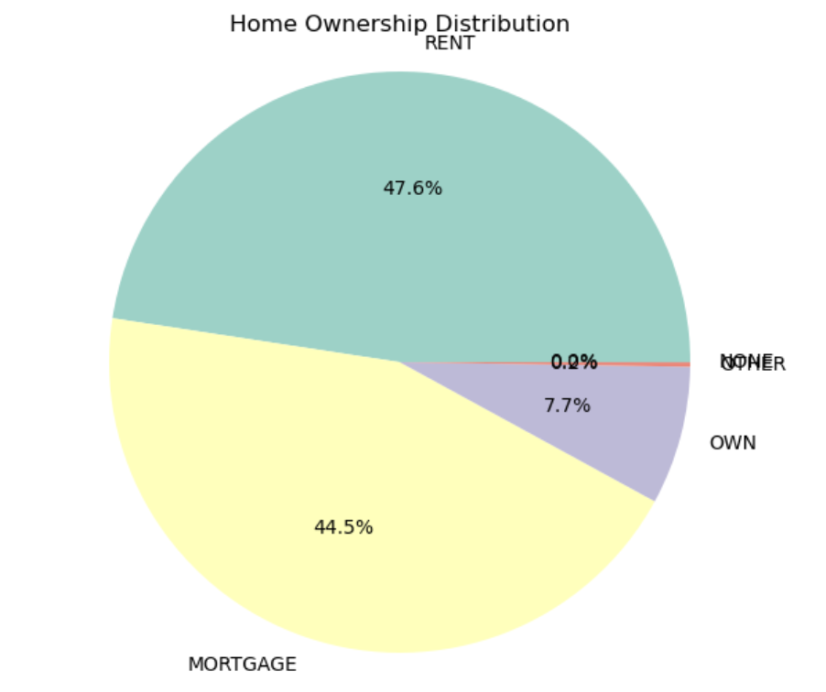
Home Ownership Distribution
Homeownership claimed its slice. A pie chart displayed the shares of roofs over heads in percentages.

Slide 16
BIVARIATE ANALYSIS

Slide 17
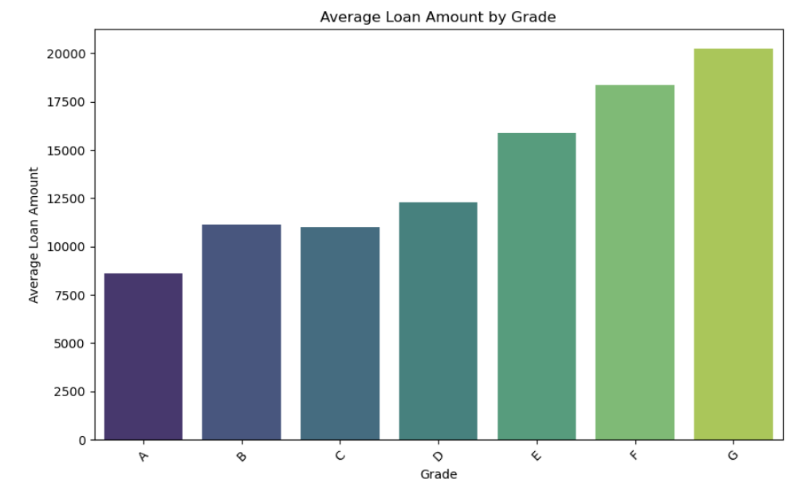
Grades
Grades told a story of financial hope. As grades climbed, so did average loan amounts. A colorful bar chart charted the path to financial dreams.

Slide 18
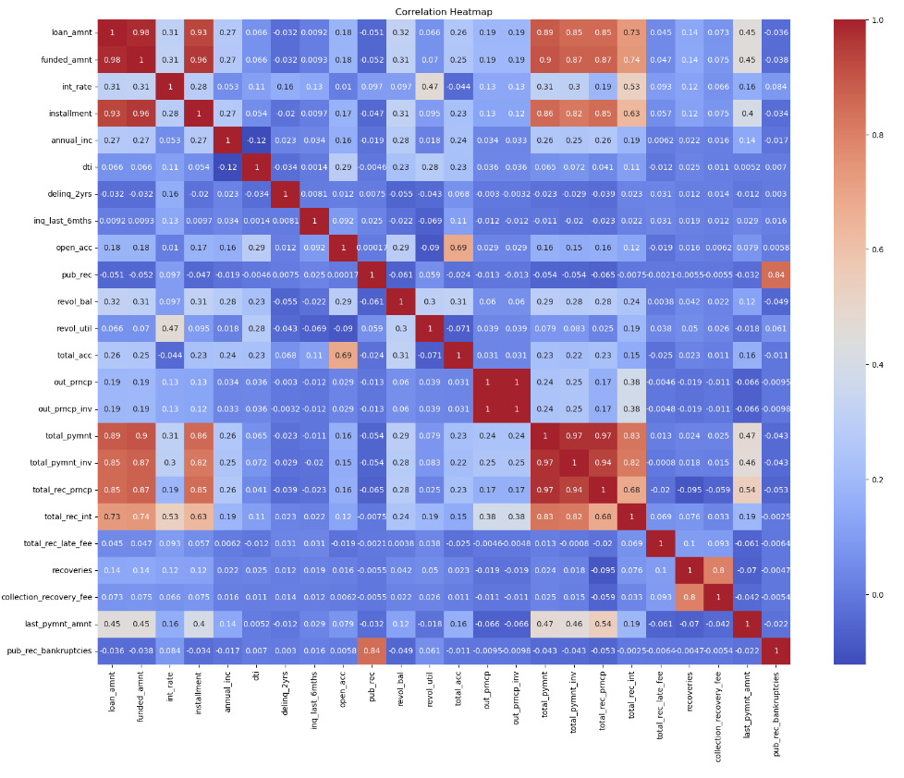
Heatmap of correlation matrix
A heatwave of correlations revealed secrets beneath the data's surface. Variables whispered in warm hues, their stories interwoven in the matrix's glow.

Slide 19
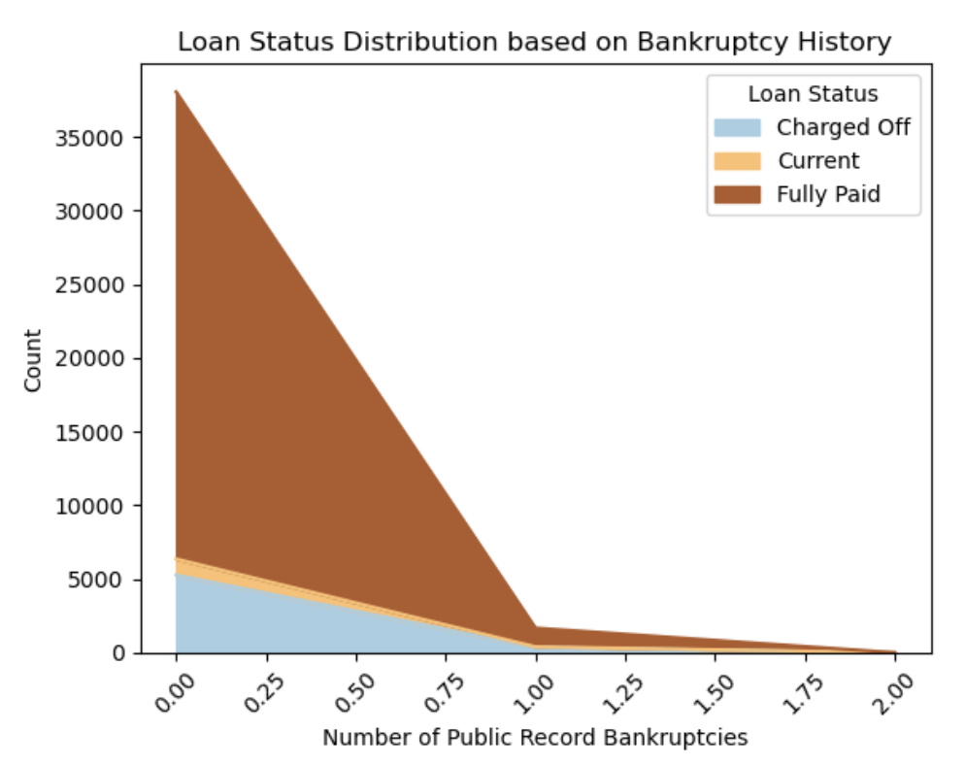
Stacked area plot for loan status distribution based on bankruptcy history
Public record bankruptcies, a chapter in the loan story. Stacked areas weaved a narrative of financial struggles, a dance of loans and credit histories.

Slide 20
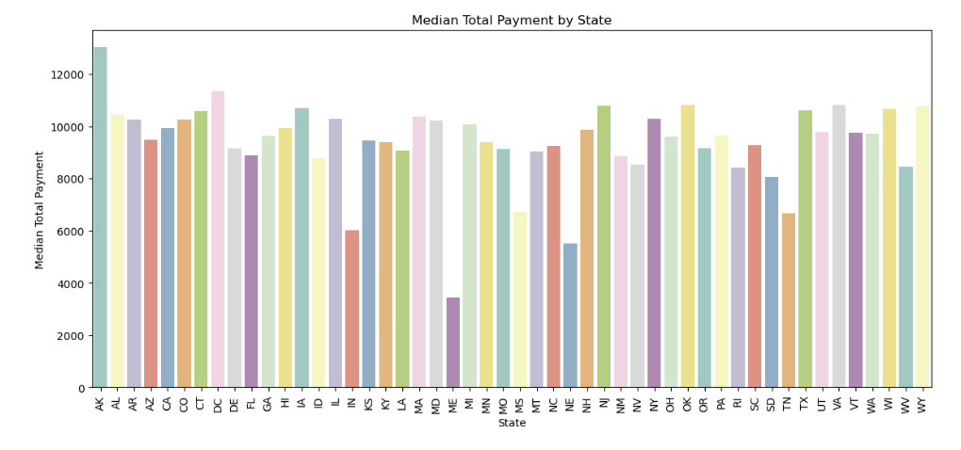
Bar plot for median total payment by state
States held their own in payments, a median tale. A bar plot painted a portrait of financial prosperity, with each state contributing its shade.

Slide 21
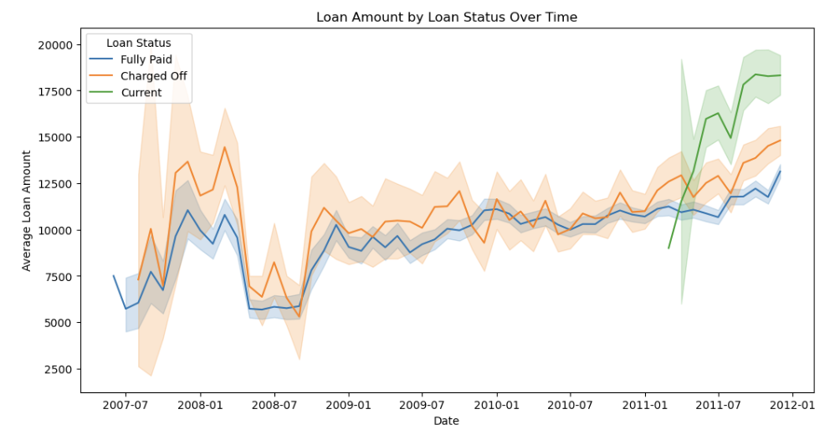
Loan Status Over Time
Loans live, evolve, and tell their tales over time. See the average loan amount's journey, split by loan status, in this time-traveling plot.

Slide 22
Valuable features for portfolio and risk assessment of the company.
funded_amnt: The initial loan amount funded by investors is a key factor. Higher loan amounts may pose higher default risk.
installment: Monthly loan payments are crucial. Higher installments relative to income can strain borrowers, increasing default risk.
total_pymnt: The total payment received indicates whether borrowers have met their obligations, impacting default assessment.
total_pymnt_inv: Similar to total payment, this metric considers investor contributions, revealing the overall repayment performance.

Slide 23
total_rec_prncp: The total principal received signifies how much of the loan amount has been repaid, influencing default predictions.
total_rec_int: Total interest received reflects a borrower's commitment to loan repayment, affecting default assessments.
last_pymnt_amnt: The latest payment amount indicates the borrower's current financial stability and potential for default.
revol_bal: A high revolving balance may indicate financial stress, affecting the ability to repay loans and increasing default risk.
int_rate: Interest rates impact affordability. Higher rates can strain borrowers, elevating the likelihood of default.
annual_inc: Borrower income plays a critical role. Lower income levels relative to loan amount can raise default risk.

Slide 24
THANK YOU

