Slide 1
Descriptive and inferential statistical methodologies has proven effective in creating a proactive ‘alarm’, identifying Horse Power (0.76), Volumetric Flow Meter 1 (0.05) and Pump Efficiency (0.34) emerging as key variables of interest that have high correlations associated with Pump Failure.

Slide 2
Descriptive Analysis has enabled us to clearly identify particular signature abnormalities showing clear signature changes in both Rolling Standard Deviation and Rolling Mean Datasets when observed over the respective failure period of interest.

Slide 3
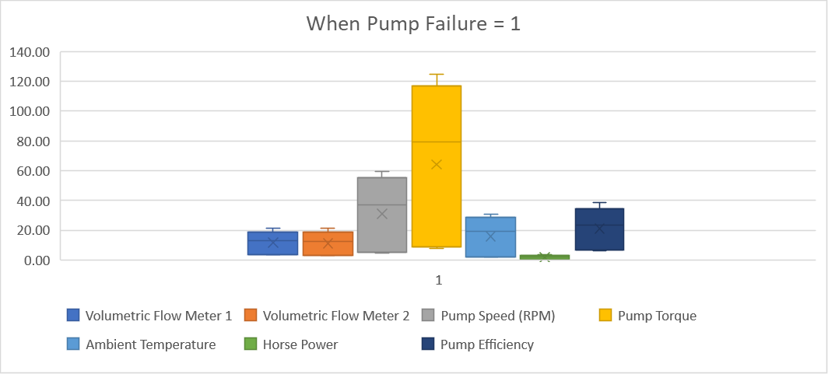
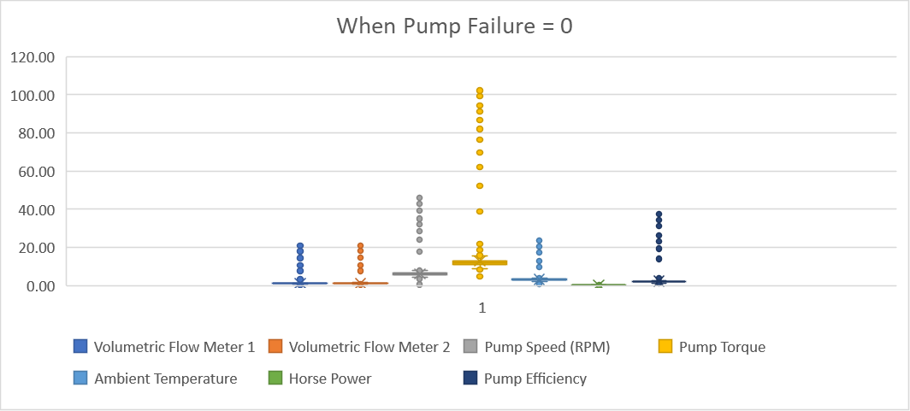
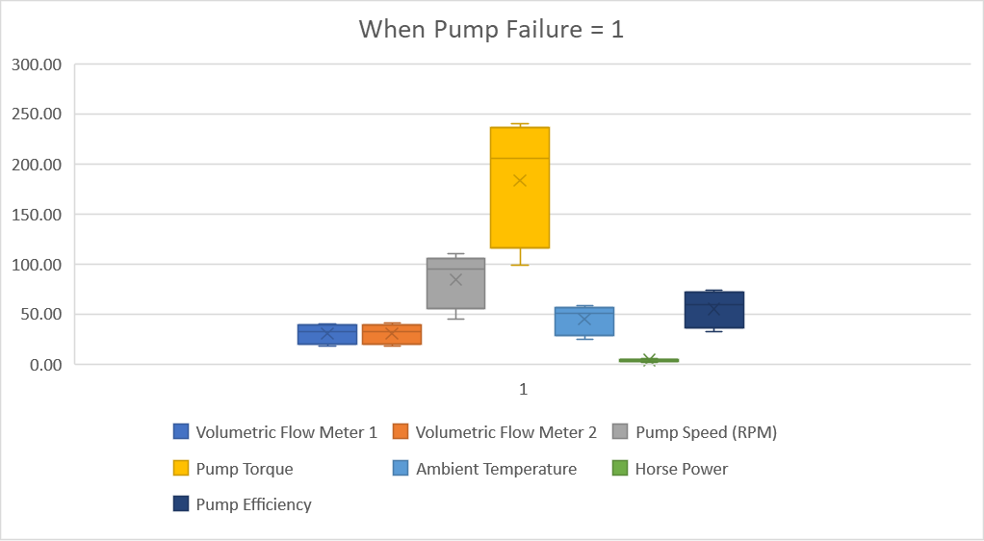
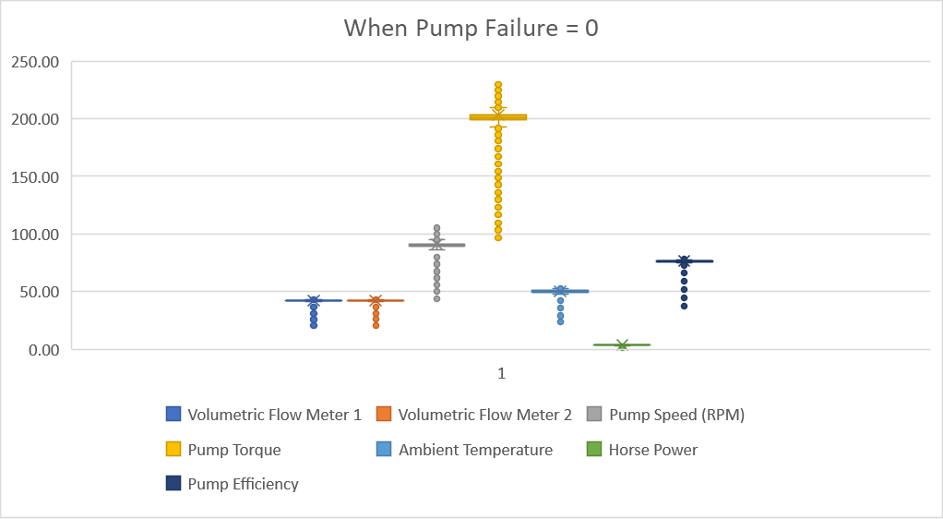
Further segmentation of the data via binary means (Pump Failure = 0 or 1) illustrated through Box Plot, show a clear signature difference between that of normal behaviour and that of Failure with Pump Torque, Pump Speed, Ambient Temperature showing the 3 largest variances.
Rolling Stdev and Rolling Mean

Slide 4
Correlation analyses across datasets yield interesting insights with Volumetric Flow(-0.69) and Pump Efficiency(-0.70) negatively correlated with Pump Failure in the Rolling Mean Data, whilst Horse Power(0.64) and Volumetric Flow Meter 1 (0.64) show a subsequently strong positive correlation in the Rolling Stdev Dataset.

Slide 5
Lastly, analysis of the model fit reveals that with a R Squared of horse power, a linear model is a good fit for the data with variables horse power, pump efficiency and volumetric meter 1 having the largest coefficients, indicative that these variables have the most immediate relationship with respect to Pump Failure behaviour.

