Slide 1


Infosys virtual internship 6.0
ARTIFICIAL
INTELLIGENCE
"Research Navigator: Semantic Paper Analyzer"

Slide 2

PROBLEM STATEMENT
The "Research Navigator: Semantic Paper Analyzer" project aims to address this challenge by developing an AI-powered system that semantically analyzes academic paper abstracts and full texts.

Slide 3
PROJECT OVERVIEW
:
This tool is a semantic research paper analyzer that allows users to upload PDF or DOCX documents and interactively ask questions about the content. It uses TF-IDF-based retrieval and cosine similarity, combined with web retrieval from Semantic Scholar and arXiv, to fetch relevant answers without using any pre-trained embedding models.

Slide 4
OBJECTIVES
Allow users to upload PDF/DOCX research papers.
Extract meaningful sentences from the uploaded document.
Identify keyphrases and LDA topics from the text.
Enable users to ask questions and retrieve answers from both local document and web sources.
Provide a ChatGPT-like interactive interface for question-answering.

Slide 5
FEATURES
Document Upload: PDF/DOCX support.
Text Extraction & Preprocessing: Cleans text by removing URLs, page numbers, and formatting.
Sentence Tokenization: Splits text into sentences for easier retrieval.
Keyphrase Extraction: TF-IDF-based top keywords.
Topic Modeling: LDA to identify document topics.
Web Retrieval: Fetches relevant papers from Semantic Scholar and arXiv.
Question Answering: Returns answers from local document and web sources using TF-IDF + cosine similarity.
Interactive Chat Interface: Maintains chat history for ongoing queries.

Slide 6

TECH STACK / TOOLS USED
Python
Streamlit for the user interface
NLTK for text tokenization
Scikit-learn for TF-IDF, LDA, and cosine similarity
PDFPlumber and python-docx for file parsing
Requests & Feedparser for web scraping Semantic Scholar & arXiv

Slide 7

HOW ITS WORK

Slide 8
PROCESS
Document Upload: User uploads PDF/DOCX.
Text Extraction & Cleaning: Extracts plain text and cleans it.
Sentence Tokenization: Filters sentences for length >5 words.
Keyphrase Extraction: Finds top 12 TF-IDF terms.
LDA Topics: Generates top topics for semantic understanding.
Web Retrieval (optional): Searches Semantic Scholar & arXiv for related papers.

Slide 9
PROCESS
TF-IDF Vectorization: Vectorizes both local sentences and external papers.
Question Answering:User asks a question.
Cosine similarity finds top matches.
Answers synthesized from top local and web sentences.
Interactive Interface: Maintains chat history with previous Q&A.

Slide 10
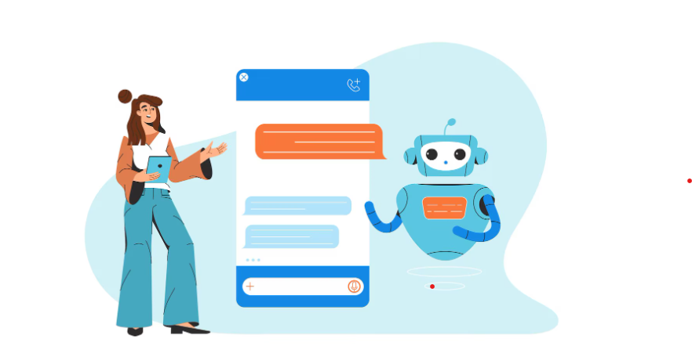
ADVANTAGES
No need for pre-trained models → lightweight and fast.
Uses real-time web retrieval for enhanced accuracy.
Can analyze large documents with interactive questioning.

Slide 11
FUTURE IMPROVEMENTS
Implement a ranking mechanism for better web-based answers.
Add summarization of retrieved answers.
Extend to multi-document analysis.
Add language translation for international papers.

Slide 12
SAMPLE WORKFLOW
Upload paper.pdf
Display top keyphrases and LDA topics.
Enable Chat: Ask “What are the applications of AI?”
Output answer with references to local and web papers.

Slide 13
THANK YOU!
Shreya Patidar

